Slide 1
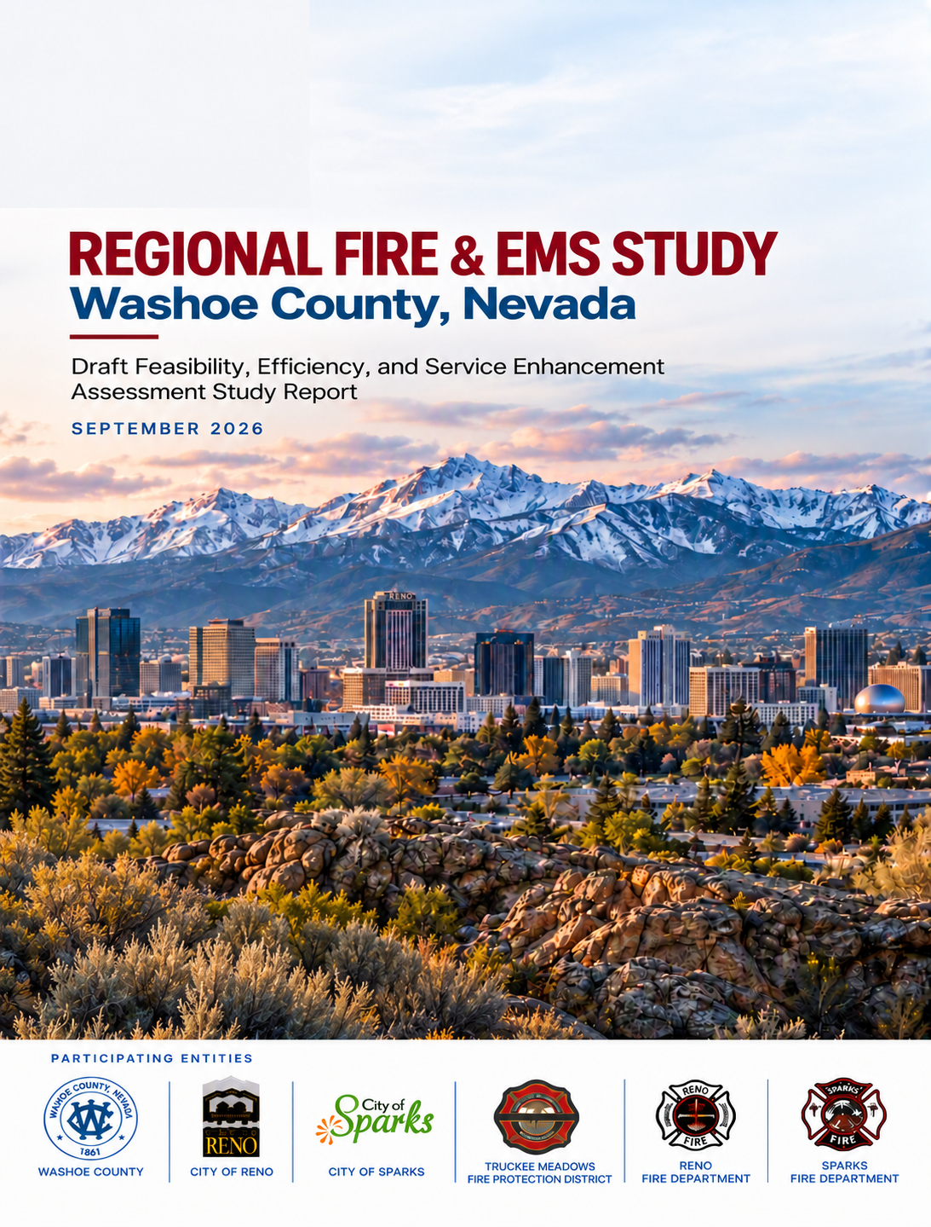
Regional Fire and EMS Study
WASHOE COUNTY, NEVADA
Feasibility, Efficiency, and Service Enhancement Assessment
Presentation to the Regional Fire Services Study Board and the Public
October 22, 2026
Washoe County | Truckee Meadows Fire Protection District | City of Reno | City of Sparks
1

Slide 2
Agenda
Six sections, followed by Board questions and discussion.
01
Study Background & Key Findings
02
Where We Are Today
03
Where Service Can Improve
04
How the Fire Service Could Be Organized
05
Fiscal Impacts
06
Recommendation and Next Steps
REGIONAL FIRE AND EMS STUDY
2

Slide 3
Study Background
& Key Findings
PART 1 OF 6 / STUDY PURPOSE AND FINDINGS
01
Why the Study was commissioned, what it examined, and the findings that guide the choices ahead.
REGIONAL FIRE AND EMS STUDY
3

Slide 4

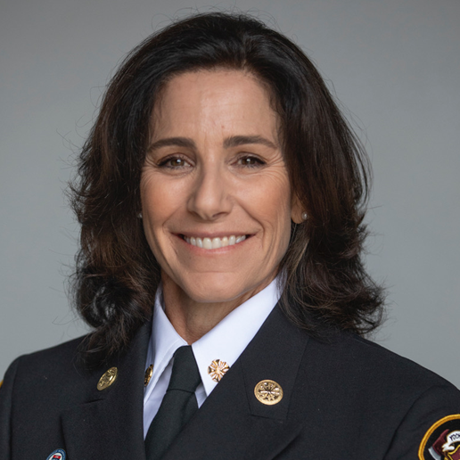


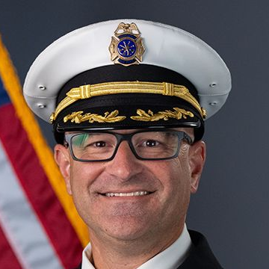
The Study Team Leadership
Rick
Martinez
Rebecca
Ramirez
Jeff
Meston
Nitish
Sharma
Derek
Parker
Project Director
Deputy Project
Director/ Operations
Senior Specialist for
Standards of Cover
Senior Specialist for
Government Finance
Senior Specialist for
Dispatch Operations
Former Sacramento Metro and West Sacramento fire chief; led the Sacramento Metro consolidation.
Former Woodland, Yocha Dehe, Rodeo Hercules FPD fire chief; California 9-1-1 Advisory Board experience.
Former South Lake Tahoe and Novato fire chief; fire service planning and EMS assessment experience.
Former Davis finance director and Cosumnes CSD chief administrative officer; municipal finance expertise.
Former Merced fire chief; former executive director of Sacramento’s regional fire/EMS communications center.
4

Slide 5
How the Study Came About and What It Covered
LEGISLATIVE DIRECTION
SB 319 (June 2025) required a joint board to study consolidated fire protection. Two elected officials each from Washoe County, Reno, and Sparks oversee the Study.
“The Study will evaluate current operations, identify opportunities for collaboration, and recommend strategies to improve service delivery, operational efficiency, and fiscal responsibility.”
Our assignment
What we examined
Our process
Assess feasibility, efficiency, and service effects
Compare governance and funding options
Recommend an implementation path
Reno, Sparks, TMFPD operations
Risk, growth, response, and coverage
Staffing, facilities, and apparatus
EMS, dispatch, governance, costs
Agency records and prior studies
Agency and stakeholder consultation
Demand, response, coverage analysis
Options for public and board review
5

Slide 6
Multiple Studies, One Consistent Message
2003
2004
2009–11
2012
2014
2019
2019
2023
Sierra Forest FPD Service Alternatives
Sierra Forest FPD Phase 2
Fire/EMS Master Plan and Standards of Cover
Washoe County EMS Systems Analysis
Blue Ribbon Committee, Regional Fire
Reno Fire Operational Analysis
TMFPD Deployment Plan
Regional Emergency Communications Memo
CONSISTENT KEY FINDINGS
Agencies rely on one another
Dispatch needs shared rules and training
Send the closest available unit
Use common performance measures
Integrate fire and EMS patient care
Address governance, finance and labor
How is this Study different? It provides options for implementation.
6

Slide 7
What This Study Found
01
Response performance needs improvement across the region, although the causes and solutions differ by agency and location.
02
Operations and governance are distinct but connected.
03
Every option faces a significant funding challenge under the study’s assumptions.
04
Maintaining current protection requires a sustainable funding plan beyond the projected continuation of existing governmental support.
05
The Study recommends a legislated Regional Fire Authority as the pathway to additional regional funding options.
7

Slide 8
The Bottom Line: Act Now and Plan in Parallel
Improve operations now
Begin Regional Alignment with common standards, coordinated response and clear accountability.
Define the service choice
Public support will be key to advancing regionalization forward.
Build the regional proposal
In parallel, select the service, funding and legislative framework for a Regional Fire Authority.
Transfer when ready
Complete required approvals, funding, workforce agreements and continuity arrangements before transferring operations.
8

Slide 9
Where Washoe is
Today
PART 2 OF 6 / WILL HELP COME WHEN I CALL?
02
The region served, the calls answered, and how response performs today
REGIONAL FIRE AND EMS STUDY
9

Slide 10
A Region with Demanding Fire Conditions
OVERVIEW
Urban
13,484
Large and occupied buildings, hospitals, schools, care homes, detention facilities, airports, and high-rises
Suburban/High-Growth
residential units in Washoe County High or Extreme Fire-Risk Zones within the study area
Expanding neighborhoods, rising demand, and the need to align coverage and infrastructure with growth
Rural
Distance, limited alternate roads, water supply, and longer reinforcement times
Wildfire
Evacuation, traffic, vulnerable residents, and structure protection during rapidly changing conditions
Call volume alone cannot determine whether a station or crew is needed.
10

Slide 11
Demand Today and Growth Ahead
OVERVIEW
97,000+
266
73–80%
unique incidents in 2025
incidents every day, on average
of each agency's calls are medical
+30,000
+5.6%
Growth areas
North Valleys, Spanish Springs, northern Sparks, and urbanizing edges
more predicted residents, 2025–2031
predicted more annual incidents, 2025–2031
Growth adds pressure where travel distances are already longer or crews are often busy.
11

Slide 12
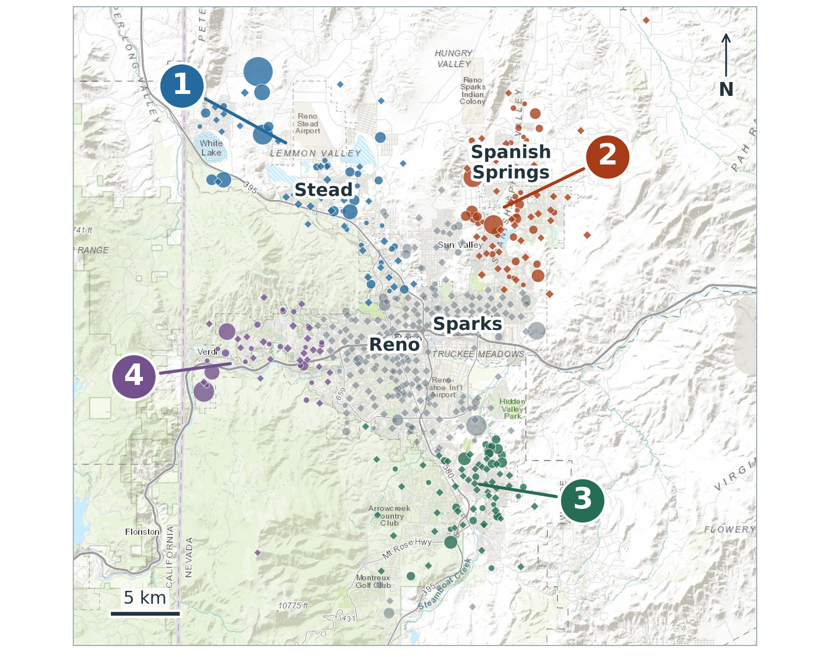
Where Growth Is Concentrated
Modeled population growth, 2025–2031
1
North Valleys / north Reno
8,297 added residents
2
Spanish Springs / northern Sparks
5,895 added residents
3
South Reno / Foothill–Thomas Creek
4,195 added residents
4
West Reno / Verdi
3,363 added residents
Larger symbols = more added residents
Basemap: Esri, HERE, Garmin, USGS, © OpenStreetMap contributors and GIS User Community.
12

Slide 13






How Response Time Is Measured
OPERATIONS AND STANDARDS OF COVER
Every emergency starts the same way: a call for help, and a wait for help to arrive.
Call answered
Call processed
Crew turns out
Travel
First arrival
Full response assembled
Every link affects how long residents wait. Improving response means working on the whole chain.
Complete ERF combines personnel, apparatus, qualifications, and assignments needed for critical incident tasks.
Study benchmarks inform comparison.
13

Slide 14
How Response Is Measured and What We Found
Response performance is a countywide problem, and each agency measures it differently.
Reno Fire Department
Sparks Fire Department
Truckee Meadows FPD
HOW IT IS MEASURED
HOW IT IS MEASURED
HOW IT IS MEASURED
No formally adopted response-time standard.
Standards adopted at the 90th percentile but not routinely tracked or reported.
Zone-based standards adopted and measured (90th / 85th percentile).
WHAT THE STUDY FOUND
WHAT THE STUDY FOUND
WHAT THE STUDY FOUND
Call processing, turnout, travel, and total first arrival exceeded benchmarks.
EMS turnout and urban travel exceeded benchmarks.
New Station 6 is already improving response.
Urban travel and other measures exceeded benchmarks.
Call processing and travel improved, 2023–2025.
Adopt common regional response times, definitions and reporting; improve call handling though dispatch recommendations.
14

Slide 15
EMS Response Trends and Contributing Factors
+31.6%
EMS call volume
FY2018–FY2024
+8.9%
Population over
the same period
Call handling and information exchange
Crew turnout and travel
Availability during overlapping calls
Translation has a significant impact on a small number of calls
15

Slide 16
Fire Response: How Fast Help Arrives
2025 structure fires: the time within which 9 out of 10 fires were reached ( 90th percentile).
FIRST CREW ON SCENE
SENT TO A HOUSE FIRE TODAY (ERF)
NFPA 1750 6:20
Urban
Reno
33
9:22 +3:02
Sparks
16
Study goal 8:20
TMFPD
16
Suburban
10:20 +2:00
NFPA 1750
21
Opportunity: one regional standard by risk level.
Study goal 12:20
Rural / wildland
15:44 +3:24
3- vs. 4-person staffing
FULL FIRE TEAM (21 PERSONNEL)
NFPA 1750 10:20
Three-person companies may need more arriving companies to reach the same team size, which can delay a full fire team (ERF).
Urban
15:32 +5:12
Suburban and rural: too few fires (8 and 7) to report a full-team time.
Bar = 2025 time · black line = goal · red = minutes over the goal
16

Slide 17
Choosing Response-Time Objectives
Proposed 90th-percentile objectives: the longest each step should take on 9 of every 10 calls.
Response step | Near term | Medium term | Long-term goal
Call processing | 2:30 | 2:00 | 1:00
Turnout – EMS | 2:30 | 2:00 | 1:30
Turnout – fire | 2:20 | 1:50 | 1:20
Travel – urban | 8:00 | 7:00 | 4:00
Travel – suburban | 9:00 | 8:00 | 6:00
Travel – rural / WUI | 14:00 | 12:00 | 10:00
Total – urban | Track → | Set target → | 6:20
Total – suburban | Track → | Set target → | 8:20
Total – rural / WUI | Track → | Set target → | 12:20
Full Fire Team (ERF)
NFPA 1750/Study Goal: 21 personnel for a low-hazard house fire; 10:20 total, urban.
Study goal: 12:00 suburban; 15:00–20:00 rural.
What leaders decide
Which objectives to adopt, and the funded plan to reach each step.
Source: Chapter 19, Table 19-2. Track = measure and publish; a target is set once agency dispatch clocks are aligned.
17

Slide 18
Where Service
Can Improve Now
PART 3 OF 6 / WILL HELP COME WHEN I CALL?
03
Faster dispatch, the closest appropriate crew, and stronger fire and EMS teamwork.
REGIONAL FIRE AND EMS STUDY
18

Slide 19




Coming Together as One Region
CLOSEST UNIT AND UNIFIED DISPATCH
Three capable agencies serving one connected emergency-response region
Major incidents routinely need help across jurisdictional lines
Reno
Sparks
One
Reno and Sparks now share a fire chief: an efficiency to recognize and build on
Region
Opportunity: make cooperation consistent, durable, and dependable
TMFPD
19

Slide 20
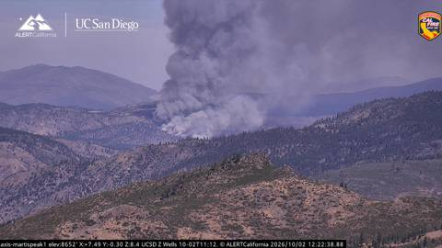
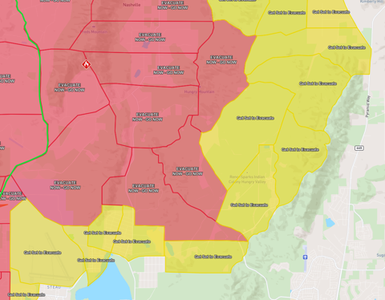
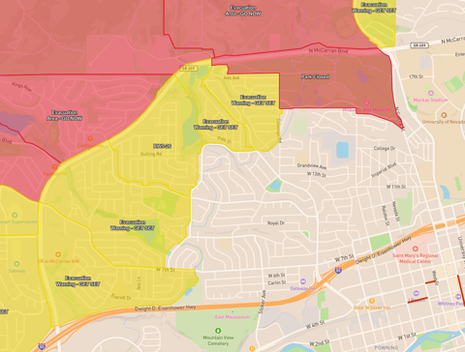
In a Major Incident, We All Depend on Each Other
CLOSEST UNIT AND UNIFIED DISPATCH
This year's wildfires drew crews from across the region for days at a time, while 911 calls kept coming everywhere else.
Wildfire smoke seen from an ALERTCalifornia camera
Evacuation zones: red = go now, yellow = get set
Evacuation zones reaching neighborhoods
Bug Fire
Hawk Fire
Bull Fire
93,733 acres 19 days
15,085 acres 18 days
1,529 acres 10 days
When crews are committed to a major fire, unified dispatch and closest-unit response keep the region covered.
20

Slide 21
What Slows Help Down Today
CLOSEST UNIT AND UNIFIED DISPATCH
Call processing in all three agencies exceeded the 60-second Study benchmark.
RENO
SPARKS
TMFPD
3:04
2:24
2:08*
Coordination concerns reported by participating agencies
Call transfers and repeated questioning
Limited shared unit visibility
Inconsistent response updates
Radio interoperability limitations
*Does not include total transfer time
21

Slide 22



Send the Closest Crew, Regardless of Boundaries
CLOSEST UNIT AND UNIFIED DISPATCH
Near a boundary, the closest crew may belong to the neighboring agency.
Before the closest crew is sent, three checks
~4,700
Available
A crew at the closer station is free to go.
2025 calls where a neighboring agency's station was at least one minute closer (modeled travel time)
Right fit / Appropriate unit
It has the people and equipment the call needs.
TMFPD already dual-dispatches with Reno and Sparks. Region-wide rules would make it routine.
Home covered
The area it leaves still has protection.
Start where the benefit is greatest, then expand as results are shown.
22

Slide 23
From Shared Operations to a Regional Center
CLOSEST UNIT AND UNIFIED DISPATCH
Today
Interim
Permanent
Separate dispatch practices. Shared regional CAD (Hexagon/Octave) is the anticipated common platform.
Enhanced shared operations under unified dispatch policy, virtual consolidation.
Regional Fire/EMS communications center with an identified back up capacity.
What matters as much as the building
Clear operating authority
Trained staff
Reliable technology
Tested backup arrangements
.
23

Slide 24


Common Standards and EMS Integration
CLOSEST UNIT AND UNIFIED DISPATCH
Common standards and training
Fire and REMSA Health (Ambulance)
November 2025 Regional SOGs
Common training and portable qualifications
Shared water, technical-rescue and wildland teams
Regional Public Safety Training Center
Joint recruit academy
Joint engineer, captain and battalion-chief training
Joint promotional processes and standards
Written patient handoff and cancellation standards
Compatible patient-record systems and shared clinical data
Shared medical direction and quality review
Return fire crews to service sooner
Track hospital offload times
REMSA Health is the region's ambulance transport provider.
Most of these steps can start now, without reorganizing or amending the REMSA franchise.
24

Slide 25




Putting It Together: Faster Help, Region-Wide
CLOSEST UNIT AND UNIFIED DISPATCH
Each improvement shortens a different link in the response chain. Together they add up to faster, more reliable help.
1
SHORTENS: CALL PROCESSING
2
SHORTENS: TRAVEL
3
STRENGTHENS: TEAMWORK
4
PROTECTS: COVERAGE
One call, one dispatch
The closest crew goes
Same training, same standards
Coverage stays close
Shared CAD and common rules cut the minutes lost before a crew is sent.
About 4,700 incidents in 2025 had a neighboring agency's crew a minute or more closer.
Crews from any agency can step in, work together safely, and build a full response faster.
Better use of existing crews, so help is still close when crews are busy.
PRESERVE EXISTING RESPONSE CAPACITY
No staffed-company closures are identified.
Nearby companies provide backup and reinforcement.
Lower call volume stations may be the only nearby protection.
Volunteers remain vital in rural and wildland areas.
Coordination improves how existing crews are used. Most steps can start now under Regional Alignment.
25

Slide 26
How the Fire Service
Could Be Organized
PART 4 OF 6 / WHO WILL BE RESPONSIBLE?
04
Four options, from today's three agencies to one regional organization.
REGIONAL FIRE AND EMS STUDY
26

Slide 27
Four Ways to Organize Fire Service
GOVERNMENTAL OPTIONS | WHO WILL BE RESPONSIBLE?
Today, three agencies cooperate both informally and formally. The question is how formal and how unified that should become.
Keep three agencies
Create one regional organization
Model 1
Model 2
Model 3
Model 4
Baseline
Regional Alignment
General Improvement District
Regional Fire Authority
Three separate agencies, as of today
Three agencies under formal regional agreements
One district under NRS Chapter 318
One authority created by state legislation
More coordination
More consolidation
The models differ in who governs, who employs the workforce, how resources are managed, and how the service is funded.
27

Slide 28


Model 1: Baseline Three-Agency Operation
GOVERNMENTAL OPTIONS | WHO WILL BE RESPONSIBLE?
1
Advantages
Continuity and direct local control
No cost or disruption of creating a new organization
Established channels for residents to work directly with their city or district
CONTINUATION OF TODAY
Reno, Sparks, and TMFPD stay separate, each with its own governing body, budget, employees, and assets.
Disadvantages
Regional decisions stay divided among separate organizations
Existing agreements do not provide a comprehensive regional service and funding framework
Does not resolve the financial outlook
Reference point, not cost-free
28

Slide 29
Model 2: Regional Alignment
GOVERNMENTAL OPTIONS | WHO WILL BE RESPONSIBLE?
2
Advantages
Can start now, without creating a new government or employer
Builds on existing cooperation and keeps local decision-making
Creates common practices that support a later transition
NRS 277.110 INTERLOCAL AGREEMENTS
Three agencies under binding agreements for response, dispatch, training, shared data, cost sharing, and public reporting.
Disadvantages
Authority and funding stay divided
Commitments must be negotiated, maintained, and enforced
Needs dispute procedures and sustained participation, not just goodwill
Recommended now
29

Slide 30
Model 3: General Improvement District
GOVERNMENTAL OPTIONS | WHO WILL BE RESPONSIBLE?
3
Advantages
Unified responsibility: one governing body and management
Consistent service expectations; coordinated staffing, training, purchasing, and capital
Uses an established legal framework
NRS CHAPTER 318
One governmental organization combining regional fire-service delivery under an established district framework.
Disadvantages
Substantial transition and higher modeled cost
Representation, employees, revenue, assets, and liabilities must be settled
Existing tax commitments limit a uniform property-tax increase
Evaluated, not recommended
30

Slide 31
Model 4: Legislated Regional Fire Authority
GOVERNMENTAL OPTIONS | WHO WILL BE RESPONSIBLE?
4
Advantages
Governance and funding designed together for Washoe's needs
A possible pathway to additional revenue sources
Protections for participating communities built into one framework
STATE LEGISLATION FOR WASHOE
One regional purpose-built organization, created through legislation that sets territory, representation, services, funding powers.
Disadvantages
Highest modeled five-year funding requirement
Requires legislation, government agreement, and public approvals
New funding powers are an opportunity, not a guarantee
Recommended long term, if funded
31

Slide 32
Governance Models: Side-by-Side Comparison
REGIONAL FIRE AND EMS STUDY
Comparison | 1. Baseline | 2. Regional Alignment | 3. General Improvement District | 4. Regional Fire Authority
Who governs | Three separate governing bodies | Three bodies, bound by interlocal agreements | One district governing body | One authority board, as set by legislation
Who employs | Each agency | Each agency | The district | The authority
Local control | Direct | Direct, with shared commitments | Through regional representation | Through representation set in law
Transition effort | None | Low to moderate | Major | Major
Revenue opportunity | Existing sources | Existing sources | Limited by existing tax commitments | New funding powers possible, not guaranteed
32

Slide 33
Fiscal Impacts
PART 5 OF 6 / WHAT WILL IT COST?
05
What it takes to sustain service, what improvements add, and the limits on new revenue.
REGIONAL FIRE AND EMS STUDY
33

Slide 34

Regional Fire & EMS Financial Models
Board financial briefing for FY2027–FY2031
Cost base, governance options
and funding choices
Financial planning estimates support the Board’s choice of service, governance and funding.
Planning estimates are not adopted agency budgets or certified revenue commitments.
Source: Chapter 30 financial model. FY2027–FY2031 planning scenario.
34

Slide 35
The Current Three-Agency Budget
CURRENT SYSTEM
FY2026 source budgets by cost category. Chart axis is capped at $50M to show the operating mix.
$87.1M
$29.6M
Reno
Sparks
$53.8M
$170.5M
TMFPD
Three-agency
direct budget
General and administrative support
Reno/Sparks support is embedded in City budgets. The model uses a 12.5% planning allocation of each Fire operating budget, not independently verified.
Source: Chapter 30 financial model. FY2027–FY2031 planning scenario.
35

Slide 36
From Agency Budgets to the Modeled Cost
FORECAST BRIDGE
USD millions. The direct forecast is supplemented by calculated support and separate cost layers.
$170.5M
$182.6M
+$15.5M
≈+$16.2M
FY2026 direct budget
FY2027 direct forecast
Calculated G&A
Other forecast costs
Cost source | FY27 | FY28 | FY29 | FY30 | FY31 | 5-year
Reno | 92.3 | 97.9 | 103.8 | 110.1 | 116.8 | 520.9
Sparks | 31.3 | 33.1 | 35.1 | 37.1 | 39.3 | 176.0
TMFPD | 59.0 | 64.9 | 71.8 | 79.6 | 88.8 | 364.1
Three-agency subtotal | 182.6 | 196.0 | 210.6 | 226.9 | 244.9 | 1,061.0
General / Administrative Costs* | 15.5 | 14.9 | 13.9 | 12.4 | 10.3 | 66.9
Three–agency budgeted costs (current staffing and service level) | 198.1 | 210.8 | 224.5 | 239.3 | 255.1 | 1,127.9
General/Admin is a 12.5% planning allocation. FY2027 modeled costs: Baseline/Alignment $214.2M; GID $273.6M; Authority $274.4M.
Source: Chapter 30 financial model. FY2027–FY2031 planning scenario.
36

Slide 37
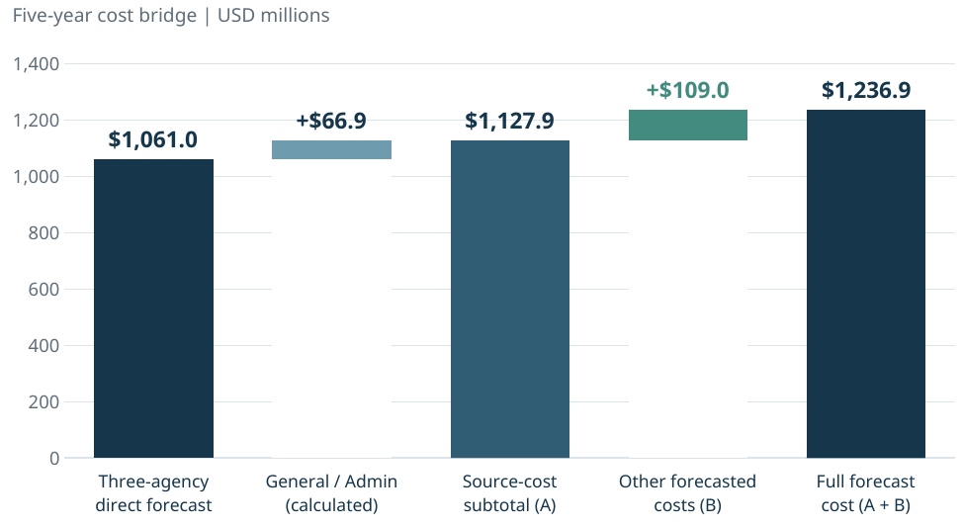
The Five-Year Baseline Cost Bridge
BASELINE / REGIONAL ALIGNMENT
The $1,127.9M source subtotal becomes $1,236.9M after $109.0M of separately modeled costs.
Other costs | 5-year
4-person staffing | $26.9M
OPEB past-service | $23.3M
Uncertainty provision | $11.3M
Unborrowed capital | $47.5M
Total | $109.0M
Source and full totals are checkpoints. Each component is included once. General/Admin is a calculated scope balance, not a verified allocation. New debt is $0.
Source: Chapter 30 financial model. FY2027–FY2031 planning scenario.
37

Slide 38
Complete Baseline Cost and Source-Cost Comparison
FORECAST BRIDGE
USD millions. The source subtotal excludes separately modeled costs and is not the total cash requirement.
A Baseline / Regional Alignment full cost build
Cost layer | FY2027 | FY2028 | FY2029 | FY2030 | FY2031 | Five-year
Three-agency direct forecast | $182.6M | $196.0M | $210.6M | $226.9M | $244.9M | $1,061.0M
General / Administrative Support (calculated) [1] | $15.5M | $14.9M | $13.9M | $12.4M | $10.3M | $66.9M
Baseline / Alignment source cost (A) | $198.1M | $210.8M | $224.5M | $239.3M | $255.1M | $1,127.9M
4-person staffing enhancement | $2.1M | $4.3M | $6.6M | $6.8M | $7.0M | $26.9M
OPEB past-service funding | $4.7M | $4.7M | $4.7M | $4.7M | $4.7M | $23.3M
Operational uncertainty provision | $2.0M | $2.1M | $2.2M | $2.4M | $2.6M | $11.3M
Unborrowed additional capital cash | $7.4M | $12.3M | $12.7M | $9.9M | $5.2M | $47.5M
Other forecasted costs: subtotal (B) [2] | $16.1M | $23.4M | $26.3M | $23.8M | $19.4M | $109.0M
Baseline / Alignment total forecast cost (A + B) | $214.2M | $234.2M | $250.8M | $263.0M | $274.6M | $1,236.9M
B Separate source-cost comparison only
Source subtotal | FY2027 | FY2028 | FY2029 | FY2030 | FY2031 | Five-year
Baseline / Alignment source cost (A) | $198.1M | $210.8M | $224.5M | $239.3M | $255.1M | $1,127.9M
Regional Fire Service Operating and Support Costs | +$14.5M | +$15.8M | +$17.2M | +$18.1M | +$19.0M | +$84.5M
GID / Authority source cost (not all-in cash) | $212.6M | $226.6M | $241.7M | $257.4M | $274.2M | $1,212.4M
Source: Chapter 30, Tables 30-9, 30-11, 30-14 and 30-17. Calculations use unrounded values.
38

Slide 39
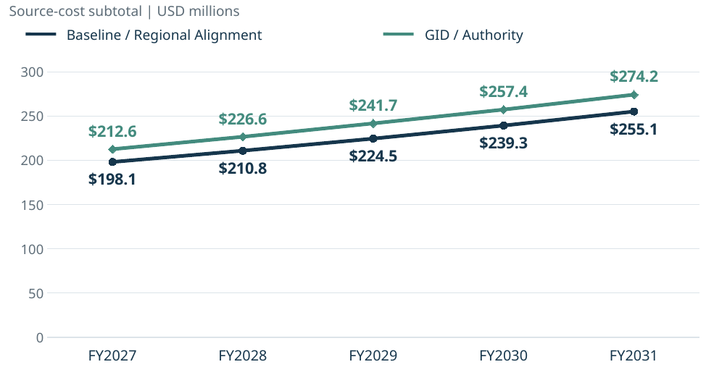
GID and Authority Add $84.5M in Source Costs
SOURCE-COST COMPARISON
Both successor models use the same source forecast. These are subtotals, not complete cash requirements.
$1,127.9M
Baseline / Alignment source
+$84.5M
Regional Fire Service Operating
and Support Costs
Planning allowance subject to account-level reconciliation.
$1,212.4M
GID / Authority source
Added scope ($M): FY27 +14.5; FY28 +15.8; FY29 +17.2; FY30 +18.1; FY31 +19.0. Source subtotals exclude staffing, OPEB, provisions, capital, formation and liquidity.
Source: Chapter 30 financial model. FY2027–FY2031 planning scenario.
39

Slide 40
Four-Model Cost and Funding Comparison
BOARD COMPARISON
FY2027–FY2031. Common source costs plus non-overlapping additions. All amounts in USD millions.
Option / reference | Common source cost | 4-person staffing addition | Other operating / capital costs | Regional support + other increases [2] | Formation + opening cash [3] | Total forecast cash uses | Additional lawful support
Baseline (Current Staffing/Service Level) | $1,127.9 | — | — | — | — | $1,127.9 | $0.0
Baseline (fully modeled) | $1,127.9 | $26.9 | $82.1 | — | — | $1,236.9 | $285.9
Regional Alignment | $1,127.9 | $26.9 | $82.1 | — | — | $1,236.9 | $285.9
GID | $1,127.9 | $26.9 | $82.1 | $96.3 | $55.0 | $1,388.2 | $437.2
Legislated Authority | $1,127.9 | $26.9 | $82.1 | $98.9 | $60.3 | $1,396.1 | $445.1
Additional lawful support = total forecast cash uses − $950.974M assumed continuation support − $0 new borrowing
Common additions: $109.0M
Staffing $26.9M; OPEB $23.3M; uncertainty $11.3M; capital $47.5M.
Formation cash: GID $55.0M; Authority $60.3M. Includes transition, $1.5M settlement and $37.4M/$37.5M opening cash.
Regional support: $84.5M each. Admin/stranded: GID $10.9M; Authority $13.5M. Additional uncertainty: $0.8M each.
Source: Chapter 30, Tables 30-1, 30-9, 30-11, 30-14 and 30-17. Totals use unrounded model inputs.
40

Slide 41
Annual Additional Support by Cost Component
ANNUAL COST COMPOSITION
USD millions. FY2027 successor costs include opening cash.
Recurring residual | 4-person staffing | OPEB | Admin / stranded / provision
Capital | Transition + settlement | Opening cash
Baseline / Alignment
GID
Legislated Authority
Annual totals: 37.5, 51.0, 60.9, 66.1, 70.4
Annual totals: 96.9, 73.3, 85.2, 89.6, 92.1
Annual totals: 97.7, 74.1, 86.2, 92.2, 95.1
Recurring residual = source recurring cost less continuation support. Other segments are separate staffing, OPEB, administration, capital and formation cash.
Source: Chapter 30 financial model. FY2027–FY2031 planning scenario.
41

Slide 42
Common Costs and Entity-Specific Costs
COST COMPONENTS
Five-year totals in USD millions. The options share the same service and capital base.
Five-year cost component | Baseline / Alignment | GID | Authority | Board interpretation
Operating source cost | $1,127.9M | $1,212.4M | $1,212.4M | G&A: $66.9M neutral; $151.5M successor. $84.5M increment requires reconciliation.
4-person staffing + OPEB | $50.2M | $50.2M | $50.2M | Common service and legacy-benefit layer.
Admin + stranded + uncertainty | $11.3M | $23.1M | $25.7M | Entity options add administration and predecessor overlap.
Net capital cash | $47.5M | $47.5M | $47.5M | Same candidate capital cash in all models.
Transition + settlement | — | $17.6M | $22.8M | Conversion and personnel / claims cash.
Opening unrestricted cash | — | $37.4M | $37.5M | Two months of FY2027 recurring cost, held as an asset.
Total forecast cost | $1,236.9M | $1,388.2M | $1,396.1M | Gross cash uses before continuation support.
Less continuation support | ($951.0M) | ($951.0M) | ($951.0M) | Assumed direct-agency funding, not a signed allocation.
Additional lawful support | $285.9M | $437.2M | $445.1M | Funding requiring lawful authorization.
Source: Chapter 30 financial model. FY2027–FY2031 planning scenario.
42

Slide 43
Common Service, Legacy and Capital Costs
COMPARABLE BASE
These layers support a comparable service package in every option.
Common modeled layer | FY2027 | FY2031 | 5-year | Why it is included
4-person staffing enhancement | $2.1M | $7.0M | $26.9M | Funds the common 2 / 4 / 6 / 6 / 6 continuous-seat ramp.
OPEB past-service funding | $4.7M | $4.7M | $23.3M | Adds a 15-year cash-funding proxy for legacy post-employment benefits.
Net additional capital cash | $7.4M | $5.2M | $47.5M | Candidate project cash after a 50% assumed overlap with source spending.
Operational uncertainty provision | $2.0M | $2.6M | $11.3M | One percent of source recurring cost; successor cases carry $12.1M.
Deployment ramp
9.5 FTE in FY2027
28.4 FTE in FY2029–31
$951.0M continuation support is an assumed direct-agency funding proxy, not a certified schedule. The separate 17-location four-person sensitivity is outside the base budgets until overlap is documented.
Source: Chapter 30 financial model. FY2027–FY2031 planning scenario.
43

Slide 44
Baseline: $285.9M in Additional Support
MODEL ONE
The complete common package retains three agencies and creates no new entity.
$1,127.9M
+$61.5M
$1,189.4M
+$47.5M
$1,236.9M
Operating source
Recurring overlays
Recurring total
Capital / formation
Forecast cost
Funding line | FY27 | FY28 | FY29 | FY30 | FY31 | 5-year
5-year forecasted cost / annual cash uses | $214.2M | $234.2M | $250.8M | $263.0M | $274.6M | $1236.9M
Continuation support (assumed current direct agency funding) | $176.7M | $183.2M | $189.9M | $196.9M | $204.2M | $951.0M
ADDITIONAL LAWFUL SUPPORT | $37.5M | $51.0M | $60.9M | $66.1M | $70.4M | $285.9M
Recurring overlays: staffing $26.9M + OPEB $23.3M + provision $11.3M. Capital $47.5M; formation $0. Baseline is the lowest-cost tested option. Existing employers retain liabilities, debt, insurance and asset obligations.
Source: Chapter 30 financial model. FY2027–FY2031 planning scenario.
44

Slide 45
Regional Alignment: $285.9M in Additional Support
MODEL TWO
The model holds the same service package and funding proxy as Baseline in every year.
$1,127.9M
+$61.5M
$1,189.4M
+$47.5M
$1,236.9M
Operating source
Recurring overlays
Recurring total
Capital / formation
Forecast cost
Funding line | FY27 | FY28 | FY29 | FY30 | FY31 | 5-year
5-year forecasted cost / annual cash uses | $214.2M | $234.2M | $250.8M | $263.0M | $274.6M | $1236.9M
Continuation support (assumed current direct agency funding) | $176.7M | $183.2M | $189.9M | $196.9M | $204.2M | $951.0M
ADDITIONAL LAWFUL SUPPORT | $37.5M | $51.0M | $60.9M | $66.1M | $70.4M | $285.9M
Recurring overlays: staffing $26.9M + OPEB $23.3M + provision $11.3M. Capital $47.5M; formation $0. Alignment coordinates governance, standards, aid, data, training and procurement. New net costs require a verified offset or separate funding and approval.
Source: Chapter 30 financial model. FY2027–FY2031 planning scenario.
45

Slide 46
GID: $437.2M in Additional Support
MODEL THREE
A new employer adds regional support, administration, predecessor overlap, transition and opening cash.
$1,127.9M
+$84.5M
+$73.2M
$1,285.7M
+$102.5M
$1,388.2M
Common operating
Regional support
Recurring overlays
Recurring total
Capital / formation
Forecast cost
Funding line | FY27 | FY28 | FY29 | FY30 | FY31 | 5-year
5-year forecasted cost / annual cash uses | $273.6M | $256.5M | $275.2M | $286.5M | $296.3M | $1388.2M
Continuation support (assumed current direct agency funding) | $176.7M | $183.2M | $189.9M | $196.9M | $204.2M | $951.0M
ADDITIONAL LAWFUL SUPPORT | $96.9M | $73.3M | $85.2M | $89.6M | $92.1M | $437.2M
Capital/formation: $47.5M capital + $16.1M transition + $1.5M settlement + $37.4M opening cash. FY2027 includes $37.4M opening cash and $1.5M settlement, funded once. The $84.5M support allowance requires account-level reconciliation.
Source: Chapter 30 financial model. FY2027–FY2031 planning scenario.
46

Slide 47
Regional Authority: $445.1M in Additional Support
MODEL FOUR
The Authority uses the same regional support assumption as the GID, with higher administration, stranded and transition allowances.
$1,127.9M
+$84.5M
+$75.8M
$1,288.3M
+$107.8M
$1,396.1M
Common operating
Regional support
Recurring overlays
Recurring total
Capital / formation
Forecast cost
Funding line | FY27 | FY28 | FY29 | FY30 | FY31 | 5-year
5-year forecasted cost / annual cash uses | $274.4M | $257.3M | $276.1M | $289.1M | $299.3M | $1396.1M
Continuation support (assumed current direct agency funding) | $176.7M | $183.2M | $189.9M | $196.9M | $204.2M | $951.0M
ADDITIONAL LAWFUL SUPPORT | $97.7M | $74.1M | $86.2M | $92.2M | $95.1M | $445.1M
Capital/formation: $47.5M capital + $21.3M transition + $1.5M settlement + $37.5M opening cash. FY2027 includes $37.5M opening cash and $1.5M settlement. Enabling legislation must define governance, funding, liabilities, assets and transition terms.
Source: Chapter 30 financial model. FY2027–FY2031 planning scenario.
47

Slide 48
Capital and Lifecycle Views
CAPITAL AND LIFECYCLE
The capital cash plan, conditional facilities portfolio and lifecycle screen can overlap.
$47.5M
$116.95M
$19.30M / yr
343 units
Capital cash included
in every base option
Conditional station
portfolio outside base
Gross lifecycle screen,
not an added funding gap
Fleet replacement
stock: $139.18M
New / replacement builds | Modernization | Net repairs
Screen | Annual amount | Basis
Facilities | $10.880M | 32 stations x $17M x 2% planning convention
Heavy / specialty apparatus | $8.423M | Reno $3.799M + Sparks $1.213M + TMFPD $3.410M
Total annual screen | $19.303M | Long-run planning floor; not added to the base cash plan
Medic / ambulance subset | $1.277M | 17 units / $6.386M; already included in apparatus screen
Builds $102.0M; modernization $11.05M; repairs $3.90M.
Facilities: six $17M build/replacement allowances total $102.0M, plus $11.05M modernization and $3.90M net repairs after the known Reno overlap.
Source: Chapter 30 financial model. FY2027–FY2031 planning scenario.
48

Slide 49
Agency Shares Are a Policy Decision
FISCAL EQUITY
Historical cost weights illustrate scale. The final agreement must assign revenues, obligations and service costs.
Agency | Illustrative weight | Baseline / Alignment | GID | Authority
Reno | 51.0% | $145.8M | $223.0M | $227.0M
Sparks | 16.6% | $47.5M | $72.7M | $74.0M
TMFPD | 32.4% | $92.6M | $141.6M | $144.1M
Regional total | 100.0% | $285.9M | $437.2M | $445.1M
Final agreement: retained payroll and liabilities by legal owner, directly traceable services, readiness and workload shares, asset/debt ownership, restricted revenues, contribution ceilings, annual true-up, entry/withdrawal and disputes.
Source: Chapter 30 financial model. FY2027–FY2031 planning scenario.
49

Slide 50
Funding Tools for Each Governance Option
REVENUE AND FUNDING
No new source is credited in the base. Recurring operations require stable recurring funding.
Recurring operating funding | Capital and one-time sources | Cost and phasing tools
Multi-year member / predecessor contributions under binding agreements | Pay-go reserves and annual replacement contributions | Phased implementation and annual contribution ramps
Reallocation of existing appropriations after verified cost and service transfer | Debt, lease-purchase or other financing for eligible long-lived assets | Verified operating efficiencies and expenditure reductions
Dedicated recurring revenue authorized through legislation and/or voter action | Grants and restricted reimbursements for eligible projects | Liability-funding changes supported by actuarial and legal review
Cost recovery and service charges where legally permitted | Legally available cash, asset transfers or sale proceeds after restrictions and encumbrances | Shared procurement, asset reuse and avoided capital, reported separately from recurring savings
Before selection: validate authority, payer shares, Fire-specific City funding, revenue yield/timing, debt capacity, restricted-fund eligibility, General Fund effects, annual true-up and existing obligations. One-time sources cannot sustain recurring operations.
Source: Chapter 30 financial model. FY2027–FY2031 planning scenario.
50

Slide 51
Five Finance and Service Gates
BOARD DIRECTION
Advance coordination within approved spending while completing the evidence and funding package.
Gate | Required decision / evidence
1 Validate the base | Reconcile budgets, General/Admin, OPEB, debt, capital and retained obligations.
2 Choose service package | Define staffing, deployment, service standards, stations, dispatch and lifecycle needs.
3 Select governance | Compare all four options on the same service and evidence base.
4 Approve funding plan | Commit annual member contributions, lawful taxes/fees, opening cash and capital financing.
5 Authorize implementation | Signed agreements, asset/liability schedules, labor terms, cash-flow controls and go/no-go gates.
Five-year added support: Baseline/Alignment $285.9M; GID $437.2M; Authority $445.1M.
Finance, operations, labor, legal and tax teams complete the package. Formation requires annual commitments, opening liquidity, asset/liability agreements and verified predecessor cost releases.
Source: Chapter 30 financial model. FY2027–FY2031 planning scenario.
51

Slide 52

Dispatch Financial Impact and Board Decision
Regional Fire & EMS communications, FY2027–FY2031
Choose the service and funding path
Current baseline, operating options, staffing and workload, capital and transition, and member funding.
Planning estimates are not adopted assessments, appropriations or successor budgets.
Source: Chapter 35 financial model. FY2027–FY2031 planning scenario.
52

Slide 53
Shared / Virtual Dispatch Is the Financial Benchmark
BOARD DECISION
Deeper integration raises five-year cost and implementation risk and must purchase measurable service gains.
Five-year net funding requirement ($M)
Near-term action
Fund common governance, policy, QA, data, CAD configuration and tested failover. Existing centers remain.
Financial threshold
Shared / virtual costs $93.9M over five years, $8.6M above current and below the deeper-integration options.
Premiums: shared $8.633M; staged $41.447M; centralized $46.958M.
Permanent-center test: faster transfers, reliability, QA, surge capacity and continuity beyond what the shared model can deliver.
Source: Chapter 35 financial model. FY2027–FY2031 planning scenario.
53

Slide 54
FY2027 Dispatch Baseline and Restricted Credit
CURRENT BASELINE
The $15.027M net figure is a planning proxy after a restricted CAD/E911 credit, not a successor appropriation.
$15.828M
− $0.801M
= $15.027M
Gross cost
Restricted E911
Net proxy
Reno is an adopted whole-dispatch activity. Sparks is a staffing proxy. The TMFPD–REMSA fee and regional CAD/RMS amount are proposed.
E911 technology support must be eligible, approved and available in the same fiscal year.
If the E911 credit is unavailable or ineligible, member cash rises dollar for dollar.
Source: Chapter 35 financial model. FY2027–FY2031 planning scenario.
54

Slide 55
The Current Dispatch Operating Network
CURRENT OPERATING NETWORK
The successor model must define what transfers, what stays local and which predecessor costs end.
Operating organization | Current role
Reno Dispatch | City General Fund. Police, fire, EMS and 911 workflow.
Sparks Dispatch | Police Administration. Police, fire and medical calls.
REMSA | TMFPD fire / EMS contract and clinical / ambulance interface.
Washoe County | Regional CAD/RMS, radio, E911 and central-service functions.
Shared foundation: CAD/RMS, E911, P25 radio, recording, station alerting, network and continuity.
Transferring fire work does not automatically remove local staffing, facilities, systems, contracts or support obligations.
Source: Chapter 35 financial model. FY2027–FY2031 planning scenario.
55

Slide 56
Dispatch Options: Cost, Control and Implementation
OPERATING OPTIONS
Enhanced shared / virtual is the benchmark. Deeper integration requires stronger evidence and a funded release plan.
Option | Five-year net | Above current | Operating approach
Enhanced shared / virtual | $93.908M | +$8.633M | Common controls, policy, QA, CAD and failover. Existing centers remain.
Governmental lead agency | $126.825M | +$41.550M | One public host operates the agreed scope. Local work stays until released.
Centralized regional center | $132.233M | +$46.958M | Unified primary center with capable backup. Highest facility / transition burden.
Staged shared-to-unified | $126.722M | +$41.447M | Shared controls first, with conditional unified operation across two capable sites.
Select a higher-cost model only when it delivers measurable benefits beyond enhanced shared / virtual dispatch.
Source: Chapter 35 financial model. FY2027–FY2031 planning scenario.
56

Slide 57
Staged Dispatch Implementation
STAGED OPTION
The $41.447M five-year premium is a transition and operating ramp, not a level annual assessment.
Annual increment above current ($M)
Period | Phase and conditions
FY27–FY28 | Shared controls: governance, data, policy, QA, CAD configuration and tested failover.
FY29 | Design: staffing, employer, sites, labor, procurement and funding package.
FY30 | Build and parallel operation: integrate, train, commission, test rollback.
FY31 | Stabilize: cut over only after sustained service and budget thresholds.
$126.722M total net funding. $41.447M above current. $32.814M above enhanced shared / virtual.
Source: Chapter 35 financial model. FY2027–FY2031 planning scenario.
57

Slide 58
Dispatch Staffing and Whole-Center Workload
STAFFING AND WORKLOAD
The 49-FTE concept is not a payroll reduction. Paid posts and relief must follow whole-PSAP workload and concurrency.
Illustrative complete-service role | FTE
Dispatchers | 32
Shift supervisors | 6
Admin supervisors | 2
Directors | 2
QA / training | 2
CAD / GIS / IT | 3
Finance / admin | 2
Total | 49
Six-month CAD entry mix (thousands), Jan–Jun 2023
Fire / EMS = 10.3% of CAD entries
Coverage screen: four 24/7 posts require about 20.0 FTE at 1,750 productive hours each, before supervision, simultaneous work, training, relief, vacancies and surge.
Source: Chapter 35 financial model. FY2027–FY2031 planning scenario.
58

Slide 59
Dispatch Capital and Transition Costs
TECHNOLOGY, FACILITIES AND TRANSITION
USD millions. Components are embedded in option pricing. Reconcile sources and uses before adding amounts.
Replacement contribution
Shared $0.806M
Lead $1.873M
Central $2.260M
Largest cost driver
Facility capital rises from $0.9M shared to $13.8M centralized. Price a two-site design from actual sites.
Totals: shared $3.293M; lead $12.792M; central $25.536M.
Capital control: one asset/project ledger by site, owner, payer, E911 eligibility, reuse, support date and replacement timing.
Source: Chapter 35 financial model. FY2027–FY2031 planning scenario.
59

Slide 60
Dispatch Savings Tests
SAVINGS TESTS
No modeled option reaches the 5% or 10% target after successor and retained local costs are funded.
FY2027 recurring-cost test ($M)
Five-year premiums above current ($M)
Required annual reduction: $0.791M at 5%; $1.583M at 10%.
Changing member allocation redistributes cost. It does not reduce regional cost.
Source: Chapter 35 financial model. FY2027–FY2031 planning scenario.
60

Slide 61
Residual and Stranded Costs: The Risk of Paying Twice
RESIDUAL AND STRANDED COSTS
A saving requires predecessor spending to end after successor and retained local costs are funded.
Cost layer | What remains in the regional total
New regional function | Payroll, governance, technology, facilities, transition and replacement.
Retained predecessor obligations | Police/911, backup sites, licenses/cyber, central services, REMSA/EMS, radio and debt.
Total regional cost | New regional cost + retained local cost until a documented budget release.
Maximum transferable amount = predecessor cost removed − replacement, overlap and release costs
Evidence required
Board reporting
Named position/contract, annual cost and end date, replacement/overlap cost and adopted budget action.
Gross reduction, successor replacement, retained local cost, one-time implementation and net recurring saving.
Source: Chapter 35 financial model. FY2027–FY2031 planning scenario.
61

Slide 62
Member Funding and Retained Costs
FUNDING ARCHITECTURE
The agreement separates readiness, workload, direct-beneficiary costs, restricted credits, capital and annual true-up.
Net member funding = gross successor operations + retained local costs + capital/replacement + transition/parallel operation − eligible E911, grants and releases
Allocation layer | Basis
Base readiness | Minimum posts, governance, core facilities and continuity.
Variable workload | Handling time, CAD/unit work and radio demand.
Direct beneficiary | Agency-specific interfaces, subscribers and dedicated posts.
Annual true-up | Rolling measures, direct-cost changes, entry, withdrawal and disputes.
E911 support must be eligible, approved, nonduplicative and timed to the technology expense. It is not unrestricted payroll or general-facility revenue.
Source: Chapter 35 financial model. FY2027–FY2031 planning scenario.
62

Slide 63
Dispatch Decisions and Implementation Gates
BOARD DIRECTION
Advance shared controls. A permanent center follows due diligence, funding, parallel operation and service acceptance.
Gate | Scope / required action
1 Define scope | Fire/EMS, police/records, REMSA, sites, service standards and affordability.
2 Validate baseline | Rosters, payroll, workload, contracts, assets, indirect costs and E911 ledger.
3 Fund shared controls | Governance, data, policy, CAD, QA/training, mutual support and COOP.
4 Build business case | Staffing, employer, sites, technology, labor, capital and member funding.
5 Parallel and test | Recruit, integrate, train, exercise failover and fund rollback capacity.
6 Cut over and true-up | Release predecessor costs only after sustained service and budget thresholds.
Immediate action: authorize and fund enhanced shared / virtual controls and performance measurement, asset reconciliation and tested failover.
Permanent-center gate: approve and fund whole-PSAP workload/staffing, labor, REMSA, assets, sites, member shares, retained costs and predecessor releases.
Source: Chapter 35 financial model. FY2027–FY2031 planning scenario.
63

Slide 64
Recommendation and Next Steps
PART 6 OF 6 / THE CHOICE AHEAD
06
What the Study recommends, and the decisions leaders and residents face.
REGIONAL FIRE AND EMS STUDY
64

Slide 65
Recommended Approach: Two Tracks in Parallel
RECOMMENDATION AND THE CHOICE AHEAD
TRACK 1: NOW
Formal agreements, named leads, identified funding, and public reporting. Focus on call handling, closest-unit dispatch, reinforcement, and coverage.
Establish Regional Alignment
TRACK 2: IN PARALLEL
Service, funding, and legislative proposal; arrangements for employees, assets, debt, and legacy obligations. Timing depends on funding, legislation and readiness.
Develop the Regional Fire Authority
Supporting program: a separately funded regional Fire/EMS communications center
Transfers occur only when funding, approvals, workforce agreements, and systems are ready.
65

Slide 66
The Path Ahead: Near, Medium and Longer Term
IMPLEMENTATION AND THE PATH AHEAD
Work begins once the participating governments authorize implementation. Phases overlap; readiness and funding set the pace.
NEAR TERM
MEDIUM TERM
LONGER TERM
Organize and fund the work
Improve service and build the proposal
Form the Authority, if supported and funded
Name a coordinator, task force and agency leads
Assign staff, launch working groups
Draft the Alignment agreements and associated financial impacts
Establish public engagement plan
Put common practices in place and correct problems
Refine the service and funding package with the public
Align dispatch and advance the communications center
Secure legislation, revenue and opening cash
Settle workforce, assets and liabilities
Transfer only when all actions have been satisfactorily taken
Regional Alignment continues throughout.
Timing depends on authorization, funding, legislation and readiness.
Source: Chapter 39, §§39.3–39.17; Chapters 27–31.
66

Slide 67
SERVICE DELIVERY
Does consolidation result in better fire service?
When it is funded and well implemented.
Yes.
One organization, one accountability: one administration, one service commitment
One regional map: crews and stations deployed region-wide, not by boundary
One way of operating: shared academy, tactics, qualifications and promotions
Coordinated investment: stations, apparatus and equipment planned regionally
Governance and funding designed together: through a legislated Regional Fire Authority
Better service comes from the funded operating plan, not the merger alone. Regional Alignment starts many of these gains now.
WASHOE COUNTY REGIONAL FIRE AND EMS STUDY
67

Slide 68


The Choice Ahead
Keeping or improving protection requires additional, authorized funding
Without it, residents may need to accept a lower level of service
Public should be appropriately informed before services are altered
What level of service do I expect?
What am I willing to pay?
Who will be Responsible?
68

Slide 69
Questions & Discussion
WASHOE COUNTY REGIONAL FIRE AND EMS STUDY
69

