Slide 1
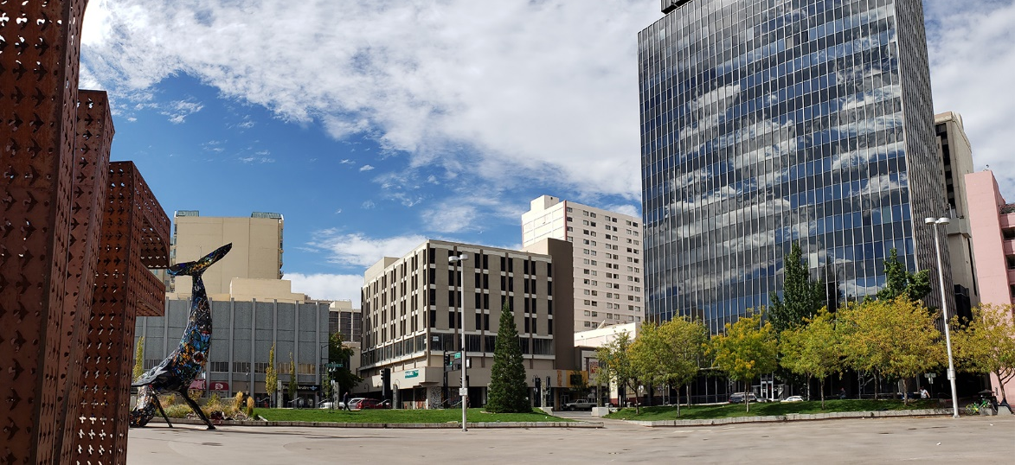
Community Homelessness Advisory Board (CHAB) Meeting
December 2, 2025

Slide 2
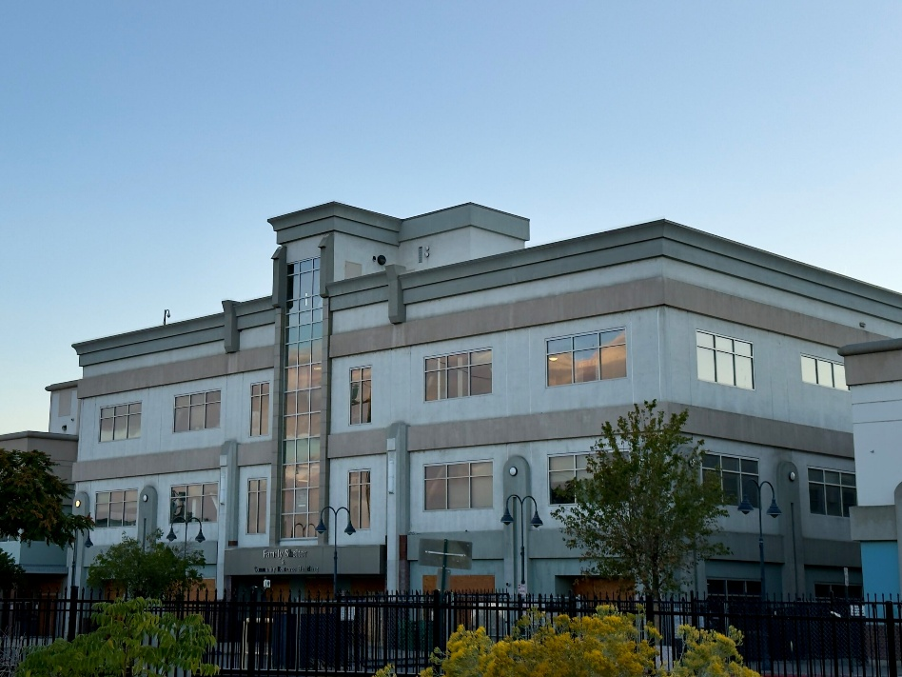
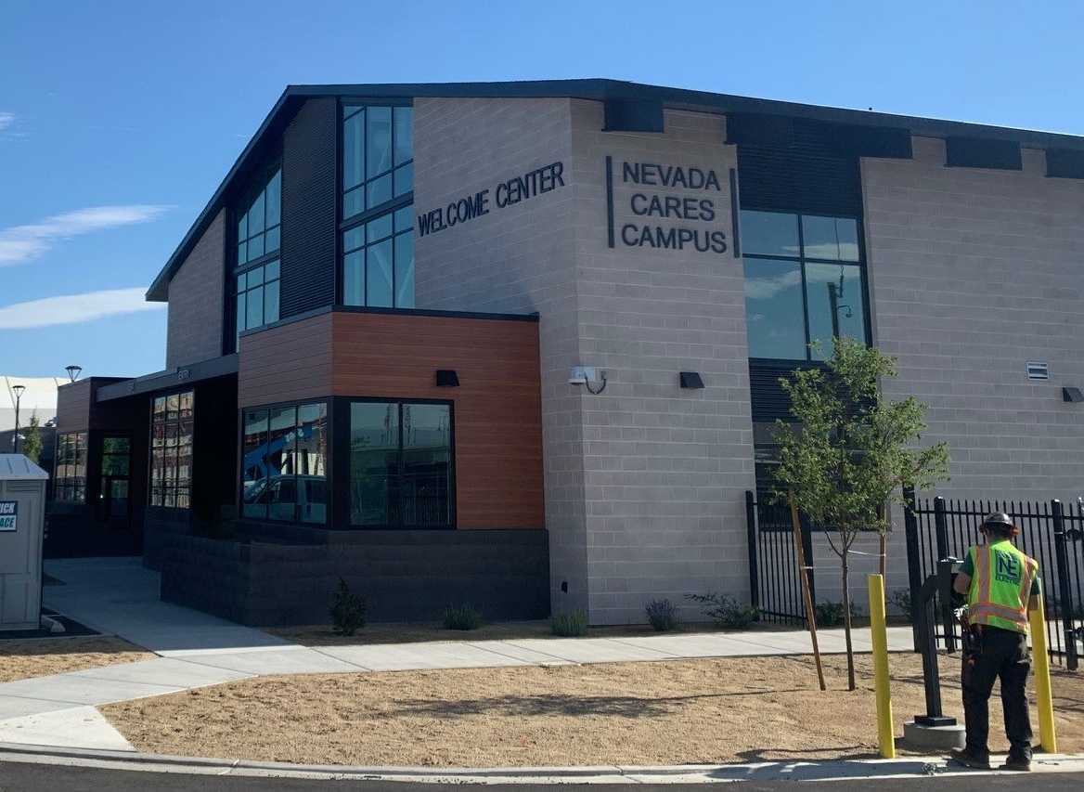
Background & Context
2004 – 2020
Reno = Lead agency for homelessness
2021 – Present
Washoe County = Lead agency on homelessness
Notes:
August 2004 – November 2020: City of reno is the lead agency for homelessness
November 2020 - An interlocal agreement (through June 2021) established an initial transfer of homeless services and shelter operations to Washoe County, including shifting the lead entity role for the CoC.
September 2021 - The interlocal agreement was extended permanently following the initial phase, formally establishing regional roles for housing and homelessness
Washoe County officially assumed responsibility for shelter operations and homelessness services.
City of Reno remains the lead entity for the HOME Consortium.

Slide 3













Regional Roles as of September 2021
Emergency Shelter/
Transitional Housing
Permanent Supportive
Housing
Affordable Rental
Housing
Market Rental
Housing
Home Ownership
0-30% AMI
30-60% AMI
60-120% AMI

Slide 4
City of Reno Homeless Fiscal Impacts
General Fund - $5,129,048
ARPA - $1,401,671
Grants - $442,359
Other Funds - $495,092
Housing and Neighborhood Development - $50,000
Reno Police, Fire, & Security - $2,491,463
Community Engagement & Services - $1,275,492
Parks and Recreation - $512,591.00
Municipal Court - $550,297
City Attorney’s Office - $249,205
FY25 Homeless Response
$7,468,170
Total Expenditures
Notes:
While regional shelter and homeless service operations transitioned to Washoe County in 2021, the City continues addressing a variety of homeless related community impacts citywide.
This includes addressing nearly 6,000 community-initiated service requests, conducting 148 clean-up operations, and collecting 4,064 yards of trash. That equates to a line of trash the length of 34 football fields.
As highlighted, FY25 fiscal impacts amounted to $7.4 million, with the vast majority coming from Reno’s General Fund. This includes significant staff time in multiple departments including Reno Police and Reno Fire, Clean and Safe, responding to encampments, fires, calls for service, clean-up operations, security contracts and equipment, and additional programs, like Reno Works, designed to help transition unsheltered individuals to shelters, housing, and resources.
Council also directed ARPA funding to support citywide outreach contracts with Karma Box and RISE, directed funds to a pilot Rapid Rehousing Program, which you’ll learn about momentarily, and efforts to mitigate impacts along the Truckee River.
As we present to you today, I’d like to highlight that our outreach contracts have ended and will not be renewed as we don’t have a dedicated funding source. This is impacting our service delivery citywide as we have fewer resources available.
(Maybe Community Court ending in the sentence above?)
Other Notes:
General funds include staffing, programs, contracts, Allied security, security equipment, RPD Help program, fire calls for service, etc.
Grants were primarily for Community Court
Other funds included street funds and opioid funds

Slide 5
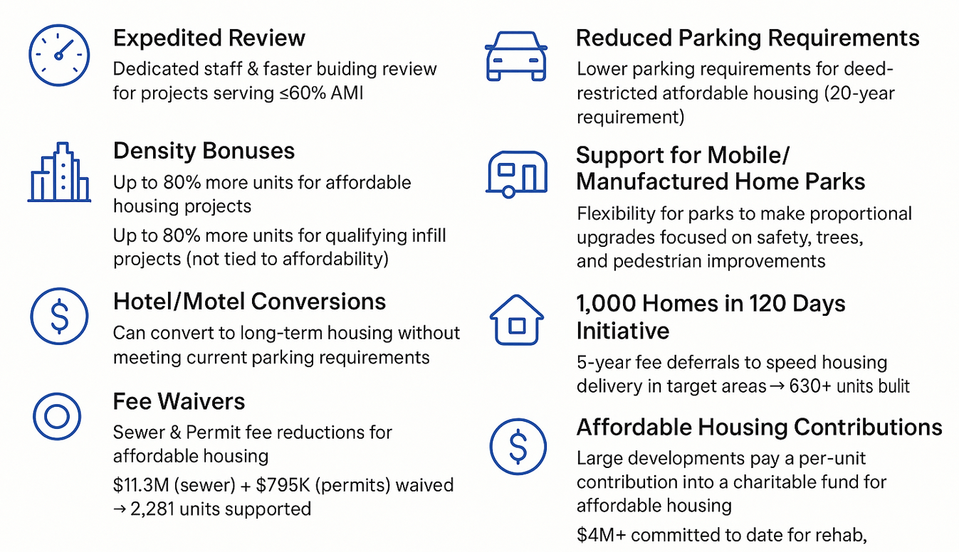

City of Reno Affordable Housing Development Incentives
Notes:
Letters of Support Value: $344,000,000
Expedited Permit Review
Projects serving 60% AMI and below receive dedicated staff support.
Helps speed projects through the building review process.
Reduced Parking Requirements for Affordable Housing and Infill
The Zoning Code allows for reduced parking requirements for projects that meet certain affordability requirements. They must be deed restricted to maintain those affordability requirements for 20 years.
Density Bonus for Affordable Housing Projects and for Infill
The Zoning Code allows for increased density of up to 80% more apartment units than the zoning otherwise allows for affordable housing projects. Projects still have to meet requirements for setbacks, building height, landscaping, and parking.
The Zoning Code allows for increased density of up to 80% more units than the zoning otherwise allows for infill market rate units that meet certain size requirements. Projects still have to meet requirements for setbacks, building height, landscaping and parking. This is not tied to affordability, but does support infill and increase the overall housing supply.
Support for Mobile Home and Manufactured Home Parks
The majority of the City’s existing manufactured and mobile home parks no longer conform to the zoning standards that we enforce today. To incentize improvements to the outdated mobile home parks, the Zoning Code allows for flexibility by allowing park owners to provide proportional improvements to achieve closer conformance, with a priority on public safety, planting of trees, and pedestrian improvements.
Support for Converting Existing Hotels/Motels into Permanent Housing
Many existing hotel and motels are starting to convert to apartments and permanent housing. To provide more flexibility, the Zoning Code allows hotels and motels to convert to long-term permanent housing without having to meet the current parking requirements.
Fee Waivers for Sewer Connection and Building Permit Fees
Following state law changes passed in 2019, Reno codified standards to reduce or waive building permits and sewer hookup fees for affordable housing projects. To date, fee reductions/waivers have totaled $11,318,400 in sewer connection fees and $795,536 in building permit fees. This helped to bring 2,281 housing units to the market.
Incentive Program to Bring Housing to Market Faster
In 2019, the City of Reno approved and implemented the Mayor’s initiative for 1,000 homes in 120 days. The program deferred building permit and sewer hookup fees for 5 years to help expedite the development of new housing in target areas. This program has helped to bring over 630 new units to the downtown and midtown area.
Affordable Housing Contributions for Large Developments
Recognizing the dire need for affordable housing, in 2020 Council started conditioning new housing projects to pay a per-door affordable housing charitable donation. As the projects build out, they are required to pay a contribution that goes towards affordable housing projects, including rehab, new construction, and other needs. The intent of the affordable housing charitable donation by developers was to create a fund for affordable housing, while also providing the developers with a tax incentive. The City partnered with the Community Foundation of Northern Nevada to set up and manage the affordable housing charitable donation fund. To date, over $4 million has been set up to be donated over time.
Council letters of support
City council provided letters of support for affordable housing projects to help developers receive necessary funding to complete project financing. The value of the letters of support from FY21-25 is $344,000,000

Slide 6
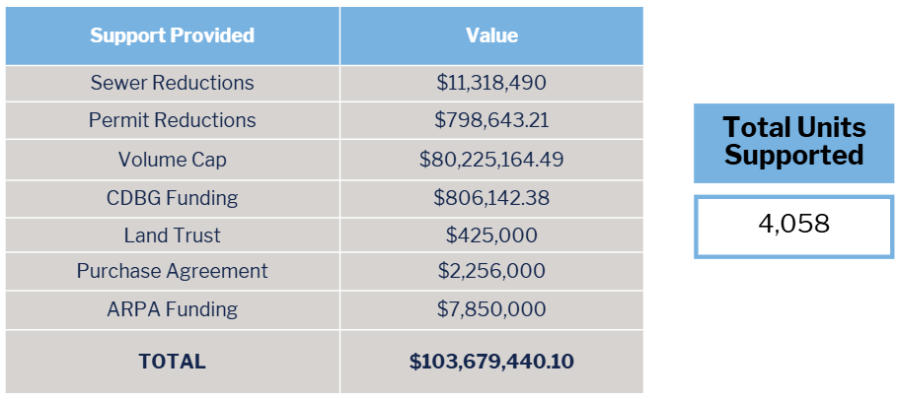
City of Reno Affordable Housing Support FY21-25
Notes:
**INCLUDES SOME UNITS WITH HOME FUNDING

Slide 7
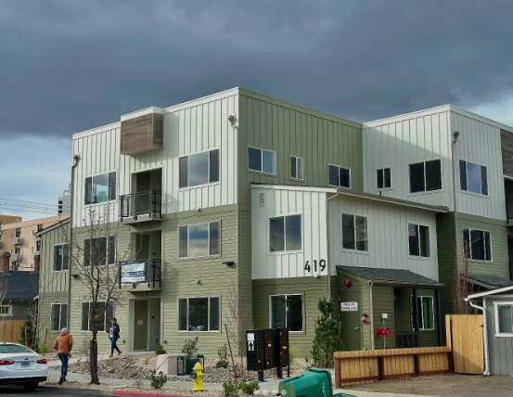
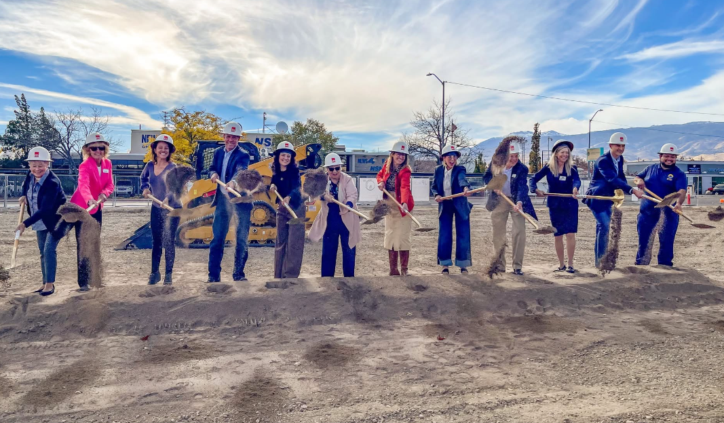

Washoe County HOME Consortium Impact:
FY21-25
🏠 HOME Funds & Housing Production
  Total HOME Funds Loaned: $14,840,998.50
  Total Units Supported: 2,431
📍 Geographic Distribution of New Units
  Reno: 1,908 units
  Sparks: 328 units
  Unincorporated Washoe County: 195 units
🛠️ HOME-ARP Supportive Services
  Allocated: $1,013,384
  Expended to Date: $261,831.86
  Households Supported: 333
Notes:
Coming to Market: 748
HOME funding supported units approved: 2,536
HOME funding supported units built: 1,838
Support units (OTHER than HOME): 2,150
TOTAL UNITS SUPPORTED: 4,686
Total number of units built: 1,838
Total number of units coming to market (pre-construction): 698

Slide 8

City of Reno Rental Assistance Allocations FY21-25
City of Reno
City of Sparks
Unincorporated
Washoe County
$14,909,888 Expended
$335,147 Expended
5901 Households
656 Households
$1,775,888 Expended
137 Households
6,694
Households
Assisted
$17M
Expended
Notes:
51% of residents assisted were below 30% AMI
39% of residents assisted were below 60% AMI
10% of residents assisted were below 80% AMI
In FY2021 we assisted a total of 1,075 households which expended $1,734,715.63 in assistance. We launched our housing assistance application portal, Neighborly, in April of 2021 so we don't have the regional breakdown for FY21 year.

Slide 9
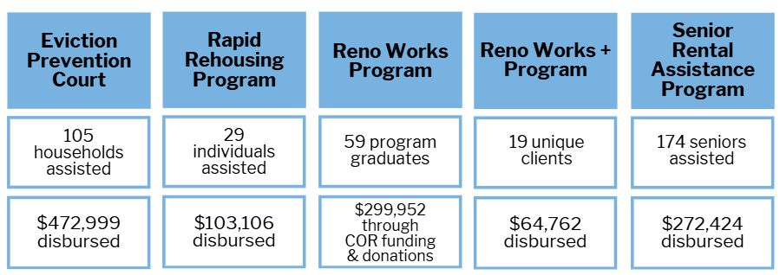
Strengthening Housing Stability:
Other Program Results (FY21-25)

Slide 10
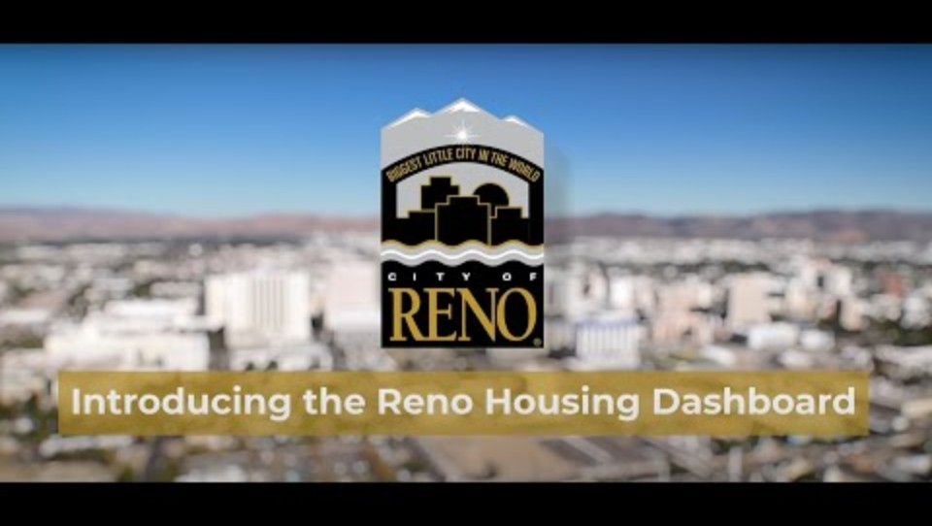
Continuing the Momentum…
Housing Needs Assessment completed in September 2025
New, interactive dashboard launched October 2025
Notes:
There’s more work to be done…
Housing Needs Assessment completed in September 2025
New, interactive dashboard launched October 2025

