Slide 1


Community Homeless Advisory Board
Ryan Gustafson, Human Services Agency Director
December 2, 2025

Slide 2
FY 25 Shelter Demographics – Our Place Family

Slide 3
FY 25 Shelter Demographics – Our Place Family

Slide 4
FY 25 Shelter Demographics – Our Place Women’s

Slide 5
FY 25 Shelter Demographics – Our Place Women’s

Slide 6
FY 25 Shelter Demographics – Nevada Cares Campus

Slide 7
FY 25 Shelter Demographics – Nevada Cares Campus

Slide 8
FY 25 Shelter Demographics – Safe Camp

Slide 9
FY 25 Shelter Demographics – Safe Camp

Slide 10
Shelter Length of Stay – FY 2025
Methodology
Includes all clients active in the date range
For clients not exited, length of stay calculated from entry date to 6/30/25
Average Length of Stay
Emergency Shelter: 54 days
Safe Camp: 122 days
Our Place Family Shelter: 120 days
Our Place Women’s Shelter: 28 days
Notes:
Oldest active enrollment from 2022

Slide 11
Emergency Shelter Expectations
Applies to all programs (Nevada Cares Campus Emergency Shelter, Safe Camp and Our Place)
Case Manager:
Clients must make progress towards housing plan
Clients must meet with Case Manager every 30 days or 2-day sit-out is issued
2 day sit out at first occurrence--if the behavior continues, sit out time increases
For Housing Plan, must be developed within 14 days of entry
Housing Plan:
Must be developed with case manager in the first 14 days
Continuous progress required to stay at all programs
Bed Availability:
Waitlist applies if full capacity
No automatic return after 2 day sit-out
Housing Opportunities:
Maximum of 3 declines, if third viable option is declined, 2 day sit out
Daily Checks:
Wellness and safety check, also verifies bed use at emergency shelter
Safe Camp clients must be in pod daily; absent 2 days = exit
Exceptions: Hospital stays 3-5 days under consideration with communication from client and confirmation from medical provider

Slide 12
Partners and Resources - Onsite
Employment/Skills Training Partners
EmployNV
Nevada Department of Employment, Training, and Rehabilitation - Vocational Rehab
Chamber of Commerce,
Northern NV Literacy Council
Reno Works
Shelter Operators (Resume/Job Search Assistance)
Soulful Seeds
Resource Partners
Phones
Clothing
Move in kits & furniture
Hygiene Products
Pet health and supplies
Identification Benefit Partners
Department of Welfare and Social Services (DWSS)
Food Bank of Northern Nevada (FBNN)
Managed Care Organizations (MCOs)
Law Enforcement
Washoe County Sheriffs Office
Medical Partners
Washoe County Human Services Agency (WCHSA) Nursing Staff
Community Health Alliance (CHA)
Managed Care Organizations (MCOs)
NN HOPES
UNR School of Medicine
OnMed Station
REMSA
Mobile Medical (Greenwell, Doctoroo, Caremore)
WC Health
Mental Health/Substance Use Treatment providers
Resource Fairs
Regularly bring resources on campus to engage participants
Boost client participation
Strengthen relationships between clients and providers
Key Resources Offered
Community Services
Employment Opportunities
Program Sign-Ups
Assessments (often needed for service/program referral)
Partner Recruitment
Actively recruiting additional community partners!
If Interested in participating, please email: regionalhomelessservices@washoecounty.gov

Slide 13
Outcomes and Exits – FY 2025
Expressed as % of total exits
Permanent Housing
Cares Campus Emergency Shelter: 275 people — 14.74%
Safe Camp: 25 people — 15.34%
Our Place Women’s: 48 people — 7.51%
Our Place Family: 216 people — 66.46%
Transitional Housing
Cares Campus Emergency Shelter: 36 people — 1.93%
Safe Camp: 3 people — 1.84%
Our Place Women’s: 5 people — 0.78%
Our Place Family: 0 people — 0%
Clients who exited to permanent housing and did not return to homelessness in the following 6 months across all HHS Programs plus CrossRoads Programs
Clients exiting to Permanent Housing between July 1 – Dec 31, 2024: 83%
Clients exiting to Permanent Housing between Jan 1 – June 30, 2024: 79%

Slide 14
Clients Homeless Upon Arrival in Washoe County

Slide 15
Permanent Supportive Housing (PSH) Building Update
Staff Hired
Mental Health Counselor Supervisor
Mental Health Counselor
Nurse
Employment Specialist
PRSS
Positions Still in Process
Mental Health APRN
Substance Use Specialist
Peer Recovery Specialist
Building Status
8 Residents have moved in as of 11/20/25
Project Evaluation
The project will be evaluated by the Urban Institute
Evaluation contracted by Nevada Housing Division

Slide 16
Point in Time (PIT) Count - Methodology
Overview
Required annually by the U.S. Department of Housing and Urban Development (HUD)
Timing Requirements
Must occur during the last 10 days of January
Waiver required to conduct it outside this timeframe
2025 PIT Count
Statewide date: January 22, 2025
No unsheltered count conducted in 2025 per Northern Nevada Continuum of Care Leadership Council vote on November 5, 2024
Data Sources
Sheltered data collected through:
HMIS (Homeless Management Information System)
Agency submissions for non-HMIS participating agencies
Notes:
Nonparticipating agency—HOPE Springs

Slide 17
Point in Time (PIT) Count - 2019 through 2025

Slide 18
Total Point in Time Count (PIT) Count – 1/22/2025
Sheltered Only
Total: 1,389 people (Emergency Shelter + Transitional Housing)
Change from 2024: -8 individuals
By Program:
Emergency Shelter: 1,106 (-25 from 2024)
Transitional Housing: 283 (+17 from 2024)
By Gender:
Male: 947 (68%)
Female: 429 (31%)
Other / Non-Binary / Transgender / Questioning: 13 (1%)
Unsheltered
Total: Not counted in 2025
Notes: No unsheltered data collected

Slide 19
Housing Inventory Count (HIC) Bed Utilization – 1/22/2025
Emergency Shelter
Beds Available: 1,263
Utilization Rate: 88%
Transitional Housing
Beds Available: 433
Utilization Rate: 64%
Permanent Supportive Housing (PSH)
Beds Available: 538
Utilization Rate: 92%
All Bed Types Combined
Beds Available: 1,696
Utilization Rate: 85%

Slide 20
Conclusions – 2025 PIT/HIC
Overall Trends
Slight decrease in total homelessness, but total numbers remain similar to last year
PIT Count is a one-time annual snapshot (does not capture year-round trends)
Many communities across the county are seeing significant increases
Data & Analysis
90% of providers enter data into HMIS (Enables more frequent community-wide trend analysis)
Timely and accurate data entry is critical for accurate insights
Utilization
Emergency Shelter and Permanent Supportive Housing have higher utilization rates than Transitional Housing
Challenges & Needs
If inflow exceeds outflow, homelessness numbers will continue to grow
Increasing affordable housing stock for extremely low-income households (≤30% AMI) is essential for further reductions

Slide 21
Total Point in Time Count (PIT) Count - 2026
Planning & Scope
WCHSA HHS is currently planning the 2026 PIT Count
Will include both Sheltered and Unsheltered populations
Unsheltered Count
Scheduled to start at 4:00 AM on 1/29/2026
Conducted by Street Outreach teams
Teams have knowledge of encampment locations
Teams have existing rapport with unsheltered populations to improve engagement and accuracy
Helps identify vulnerable populations not accessing shelters

Slide 22
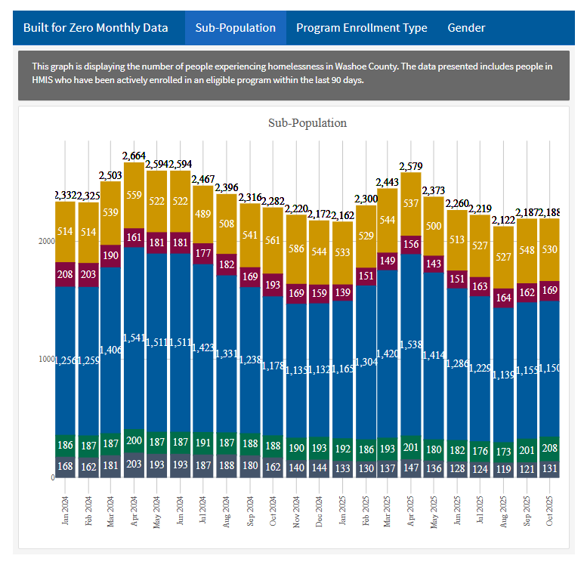
Actively Homeless Count – Inflow / Outflow
Year-Over-Year Trend
Small year-over-year reductions in the actively homeless population
Inflow vs. Outflow
Inflow must stay lower than outflow to see steady monthly reductions
When inflow exceeds outflow, homelessness increases
Data Access
Monthly trends available on the Population Dashboard
Dashboard located on the HHS website

Slide 23
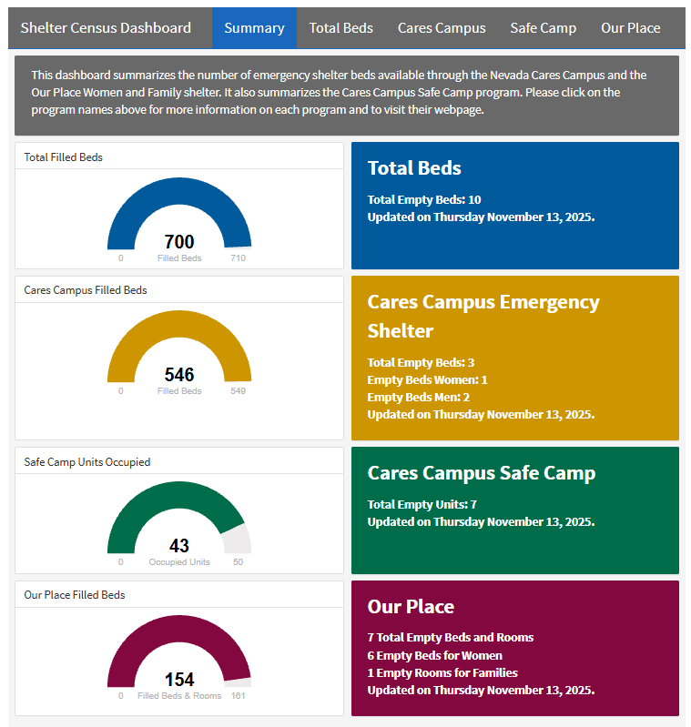
Shelter Census
Dashboard Updates
Dashboard refreshed every business day by 9 AM
Calling facility is best mechanism to confirm bed availability
Shelter Bed Utilization
Tracks daily beds for:
Cares Campus Emergency Shelter
Safe Camp
Our Place Women’s & Family Shelter
Data Access
Bed availability shown daily on the Census Dashboard
Dashboard located on the HHS website

Slide 24
Challenges
Housing cost
Rents continue to rise, with no signs of slowing down
Affordable housing isn’t keeping pace with population growth in Washoe County
Unemployment remains elevated, exceeding the national average
Few new resources are being added to fill the gap
Funding ending
Previously available resources for rental assistance, deposits and eviction prevention have ended
HUD Continuum of Care Funding Cuts
Funding reduction: $1,970,126 for existing housing programs in Washoe County
Estimated 88 households will lose housing
Potential $2,409,000 cost if those households access emergency shelter instead of being housed

Slide 25
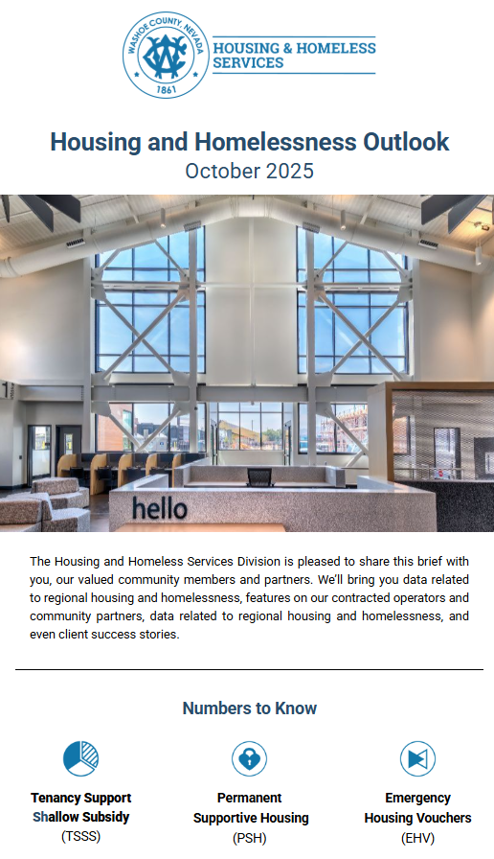
HHS Communications
Housing and Homeless Outlook Newsletter
Provides regular updates on programs and homeless trends
Highlights services available and program changes
Access & Frequency
Available on HHS Website
Updated monthly with current program information and data
Impact
Keeps community and stakeholders informed about
Resources
Key data and metrics
Program opportunities

Slide 26
What’s to Come
On-Campus Services/Programming
DMV onsite for convenient access to identification and licenses
OnMed station is live to support healthcare needs
Employment-focused Resource Fair – January 14th, connecting participants with jobs and programs
Adding work/volunteer expectations for clients at all programs to increase client engagement
Safe Parking Pilot Program
Resource Center
Added separate additional drop-in space for inclement weather/resting station
Resource Center focused on services, referrals and partner space
Physical separation of facility to support Resource Center purpose
Website Updates
Adding actively homeless inflow/outflow visualizations for real-time community trends
Enhancements to data dashboards for easier public access and interpretation
Housing
Working toward full capacity at Cares Campus PSH
Expanding housing programs to accommodate more individuals in need

Slide 27

Questions or Comments? Feel free to ask, we're happy to discuss
Thank You!

