Slide 1

Prepared by Hampton House Garden
Good Neighbors Warming Center
Warming Center Report 2024-2025
Brought to you by the Faith Communities of
Reno First United Methodist Church, Lutheran Church of the Good Shepherd, Trinity Episcopal Cathedral, St. Thomas Aquinas Cathedral, Reno Initiative for Shelter and Equality (R.I.S.E.), Hampton House Garden, Laundry to the People, Family Soup Mutual Aid, Reno Hearts You, Mary Ortega (City of Reno) and Many, Many Wonderful Community Members

Slide 2
Introduction
Good Neighbors Warming Center began in 2024. Each year various faith leaders host a candlight vigil in the Downtown Believe Plaza to honor the lives lost among the homeless population in Washoe County. Many of of these deaths are a result of prolonged exposure to harsh weather while living outside. Local groups and churches feel called to serve our most vulnerable neighbors however we can. Over the past few years, dozens of community-supported, ad-hoc mutual aid coalitions have formed ‘street teams’ to deliver hand warmers, food, soups, blankets and hygiene items to help the unhoused population survive the cold months, but it was never quite enough. After many harsh Winters, deaths on the rise and shelter beds regularly full, the community stepped up to strategize and implement a more robust approach to this complex local issue.

Slide 3





Partnerships
Downtown Faith Leaders
R.I.S.E.
Mutual Aid Groups
Community Volunteers
Hampton House Garden, Laundry to the People, Family Soup Mutual Aid, Northern Nevada Harm Reduction Alliance, Reno Hearts You
Special Thanks to
The Holland Project
Mary Ortega from the City of Reno

Slide 4
Background
Washoe County continues to lack regularly available shelter beds even after the construction of the 700 bed C.A.R.E.S. Campus. County-wide, available beds for women and families are the most scarce; often, there are none available. Residents, mutual aid groups and faith leaders have expressed great concern for our neighbors experiencing homelessness, especially in the Winter months. Advocates have repeatedly testified at government meetings about the need for additional shelter space especially for women and families. This Winter would be the first where homelessness would be officially criminalized in the wake of a recent Supreme Court decision and the municipal ordinances that followed it. No municipalities agreed to provide additional shelter space this Winter beyond the existing locations, which - as already stated - often operate at capacity.
Problems
Goals
  Unhoused single women and families have the fewest beds available County-wide.
  Many women report experiencing violence and feeling extremely unsafe at the CARES Campus.
  Provide 25 safe, warm beds, hygiene items, clothing, and a warm breakfast every day.
  Collect data on guests and volunteers in order to present our findings
  Establish strong connections between faith communities, mutual aid groups, R.I.S.E., businesses and people living in Washoe County
  Dispel misconceptions about homelessness

Slide 5
Methodology
Implementation
MOU Terms of Agreement
Process
-
A weekly schedule with Faith leaders; Warming Center changes locations every Tuesday. The Holland Project lends their van for weekly moves.
Outreach is done at Family Soup Mutual Aid weekly distribution, Hampton House and Laundry to the People to those in need.
Inform community, mutual-aid groups, people experiencing homelessness, as well as the City of Reno, Washoe County, The CARES campus staff, hospitals, REMSA and Private Secutity on duty while the Warming Center is open.
R.I.S.E. Board of Directors approves 30k for Warming Center initiative and MOU.
Churches agree to provide space to sleep, access to restroom and kitchen, and to promote volunteer opportunities to congregations.
R.I.S.E. provides insurance, three trained staff, training videos and contracts for volunteers.
Lily will source and coordinate volunteers, supply needs, information collection and laundry logistics.
Lily and Ilya meet with Faith leaders to sign MOU with R.I.S.E. which sets responsibilities for each party.

Slide 6
Project Structure
Shelter
Safety
Cleanliness
  Zero calls for service during the 3-month program
  Multiple volunteers on-site for every shift, all night long
  Robust training required for volunteers
  Relationships built with Warming Center guests over the course of their stay help to build rapport and create a safe environment where conflict can be de-escalated quickly and effectively
  High and consistent standard for regular cleaning and hygiene
  Volunteers encouraged to wear masks
  Bathrooms stocked and cleaned by Church facilities management
  Sleeping bags and linens washed several times a week by laundry volunteers so that bedding is never re-used
  Warming Center provides sleeping bags and bedding to minimize risk of bed bugs or other clothing/fabric-transmitted pests or illnesses
  25 cots from 9pm - 6am
  Warm hand-off at 6am including breakfast and coffee donated by community members and church congregants.
  Hire trained staff to oversee guests and help volunteers.
  Engage the community to help with laundry, moving, overnight shifts, breakfasts and spreading the word.

Slide 7
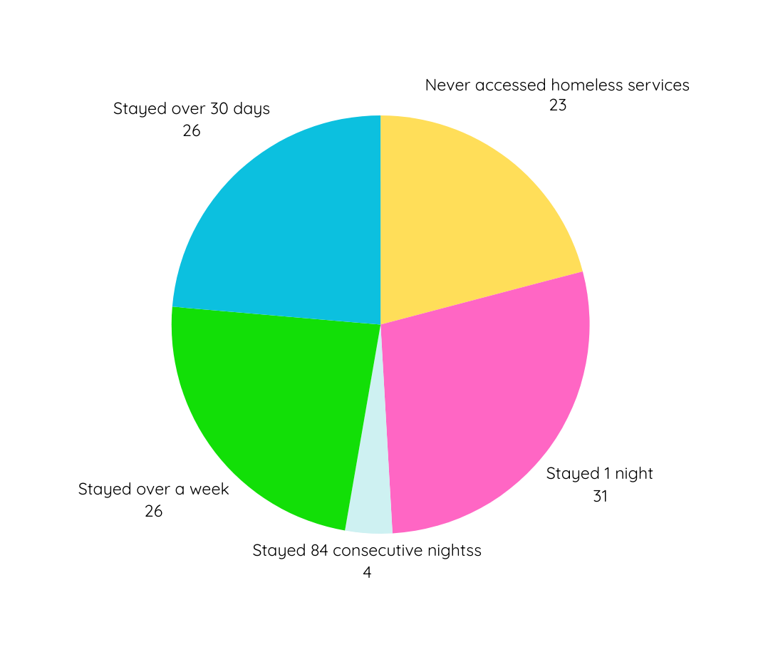
Guest Data
84 nights total 12/17/24 – 3/10/25
Stayed over 30 days
Stayed over 1 week
Stayed 84 consecutive nights
Never accessed homeless services before (not in HMIS)
Stayed 1 night

Slide 8
Volunteer Data
84 nights total 12/17/24 – 3/10/25
416 | Sign Ups
47 | 3 or more times
11 | 6 or more shifts
3 | over 10 shifts

Slide 9
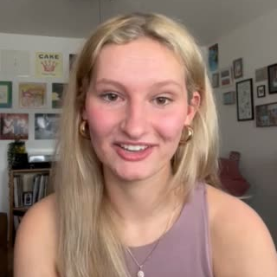
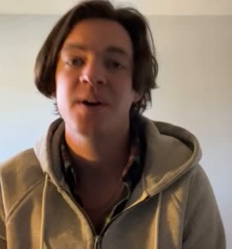
Volunteer Testimony

Slide 10
Finance Breakdown
Dollar Amount | Income/(Expense) Description | Details/Funding Source (paid by R.I.S.E. unless stated otherwise)
$6,805 | Community donations | Sourced through social media on Mutual-Aid platforms
($23,772.09) | Employee wages | Paid by R.I.S.E.
($3,000) | Contract expenses | Project management, misc. costs
($576.25) | Laundry | Reimbursed to volunteers
($600) | Liability insurance | Policy to cover churches per MOU agreement
($2,045.12) | Supplies, sleeping bags, cleaning, hygiene, etc. | R.I.S.E.
($104.41) | PayPal fees | For reimbursement to volunteers
($30,100.87) | Total Operating Costs
$23,295.87 | Total cost to R.I.S.E. | Offset by community donations!

Slide 11
Price Per Bed Comparison
Program | Costper Bed/Client | Housing type provided
GNWC | $14/night | Bed in open church facility
Cares Campus | $68.4/night | Bed in open structure
Hope Springs | $45.6/night | Private room
OurPlace | $27.2/night | Semi private room only place for families
Data from “An in depth Guide if Homelessness in Washoe County | Data from “An in depth Guide if Homelessness in Washoe County | Data from “An in depth Guide if Homelessness in Washoe County
Data from “An in depth Guide if Homelessness in Washoe County | Data from “An in depth Guide if Homelessness in Washoe County | Data from “An in depth Guide if Homelessness in Washoe County
Data from “An in depth Guide if Homelessness in Washoe County | Data from “An in depth Guide if Homelessness in Washoe County | Data from “An in depth Guide if Homelessness in Washoe County
Data from “An in depth Guide if Homelessness in Washoe County | Data from “An in depth Guide if Homelessness in Washoe County | Data from “An in depth Guide if Homelessness in Washoe County
Data from “An in depth Guide if Homelessness in Washoe County | Data from “An in depth Guide if Homelessness in Washoe County | Data from “An in depth Guide if Homelessness in Washoe County

Slide 12
Analysis
Data Collection:
  The most surprising piece of data is the 23 guests who were not found in the HMIS system. If we extended the shelter to serve single men, couples, and/or people with pets we would likely find many more community members experiencing homelessness, which would shift the official statistics currently available.
Brainstorming Sessions:
  Throughout the warming center project Lily met with Faith leaders, volunteers and R.I.S.E. staff to identify and provide needed supplies and to check on progress and the condition of guests.
  Ilya and Lily met to troubleshoot, plan and delegate laundry, volunteers, and weekly church moves.
Testing and Refinement:
  In the future it would be helpful to have a common computer or tablet to allow staff to HMIS and collect more data.
  Additional hosting sites could allow for other populations to be served beyond women and families.
  It may be easier and more efficient to move churches monthly rather than weekly.

Slide 13
Conclusion
By all indicators, the Good Neighbors Warming Center was a successful pilot program and an invaluable contribution to community safety and well-being this past Winter. We absolutely plan to coordinate and open a Warming Center again for Winter 2025/2026, with much more time to prepare and a solid, activated, and dependable base of volunteers and partners organizations ready and eager to work together again.
We would love to open similar programs in other parts of Reno/Sparks/Washoe County, as the need for a place to stay warm and survive the Winter is certainly not limited to Downtown. We would also love to open Warming Centers to serve single men, couples, and people with pets - for this we need more partners, more willing facilities (Churches are great!), and more community goodwill, which is what we are building with you all here today!

Slide 14
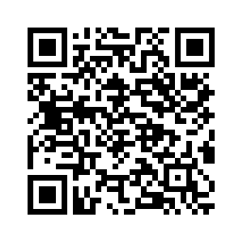
Thank you
Learn more and get involved!

