Slide 1

Good Grid:
Initial Assessment for Washoe County
Prepared for: Community Homelessness Advisory Board
Sarah Taylor-Barkley and Hanna Stewart, Good Grid

Slide 2
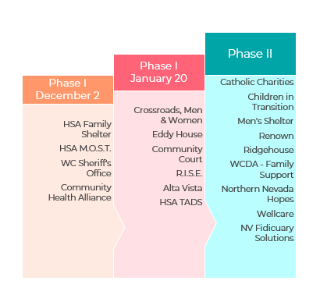
Support in NV
Partners
Notes:
Flat icon and fonts don’t match

Slide 3

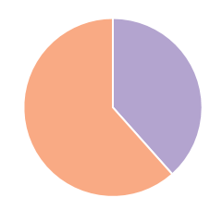

Support in NV
177
Total Clients from Family Shelter
added to Good Grid
Demographics
*From HSA Family Shelter as of January 22, 2019
21 34 57
85%
are currently homeless
62%
homeless or housing- insecure children
Average adult client is
34 years old

Slide 4
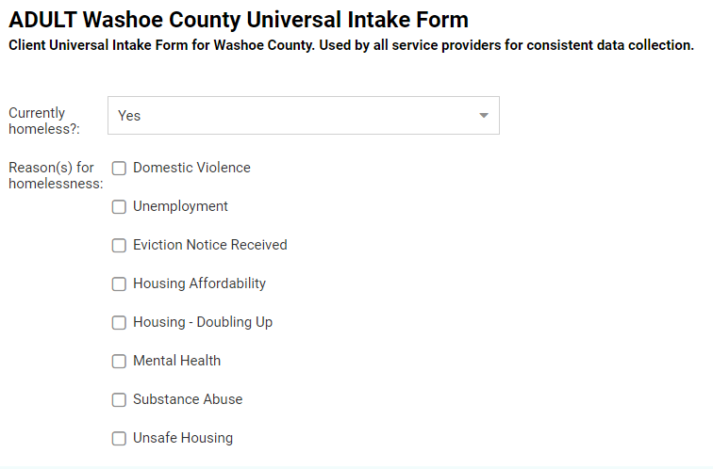
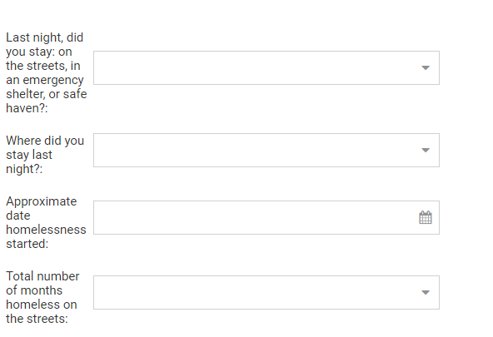
Support in NV
80
Customized data points
Universal Intake Form

Slide 5
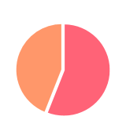




Support in NV
Universal Intake Form Data
*From 82 Adult + Child Intake Forms as of January 22, 2019
1 in 2 Women is a domestic abuse survivor
1 in 3 Adults reported mental health issues
55%
of adults are
unemployed
$202 Average monthly income for families
56%
Receive non-cash benefits like SNAP or TANF
Notes:
Put a star by 82 forms, smaller font
Make all font same size, emphasize with color

Slide 6
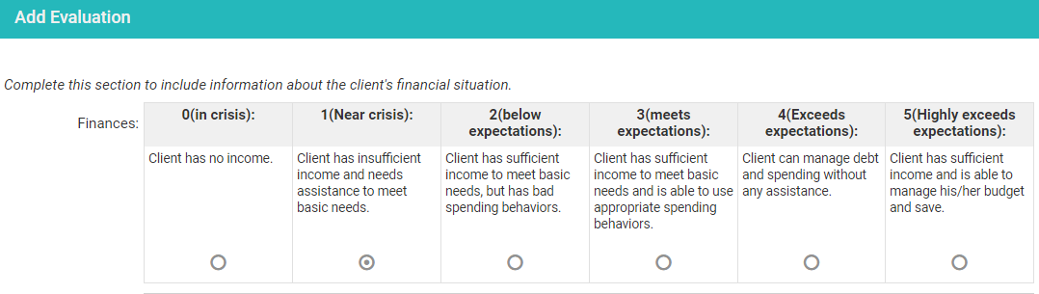
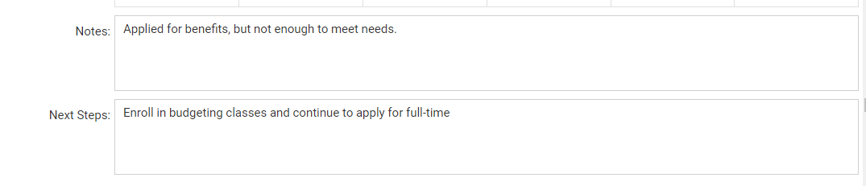
Support in NV
14
Categories scored from 1-5 for easy assessment of client needs.
Evaluation Matrix
Notes:
Needs to be flat
Remove lines at back
Small description of scoring

Slide 7
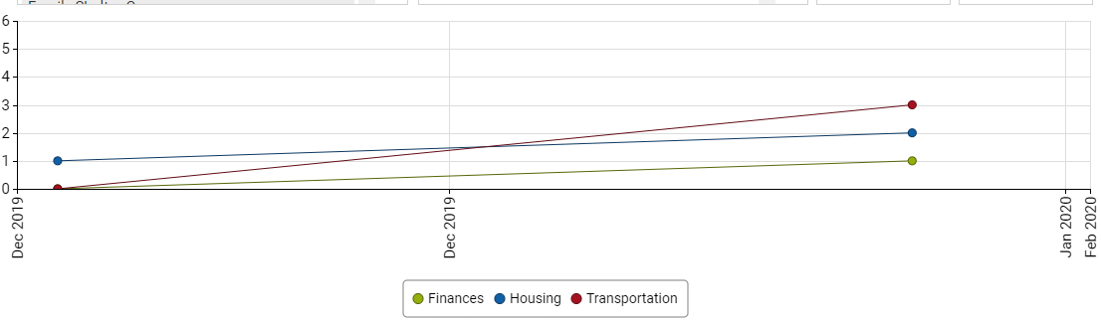
Support in NV
Evaluation Matrix
Track client progress in any or all of the assessment categories.

