Slide 1

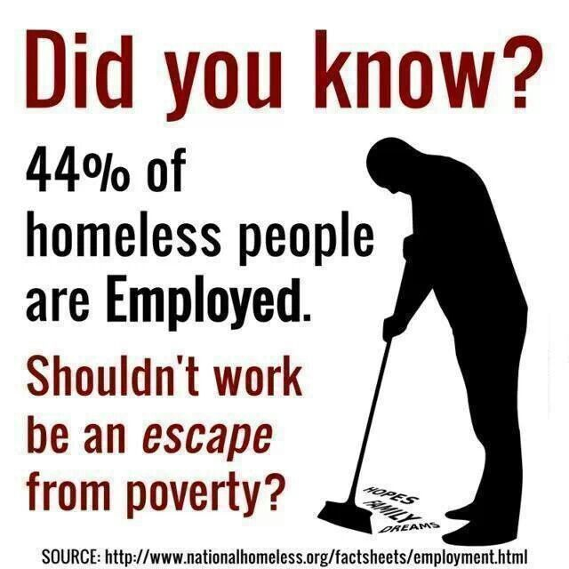
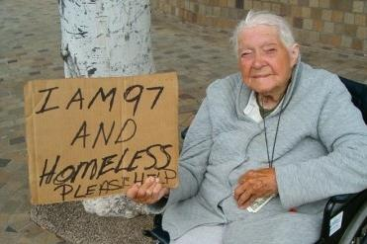
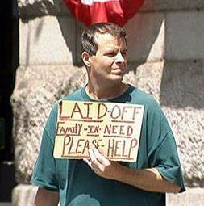
Homelessness
Notes:
The Face Of Homelessness

Slide 2

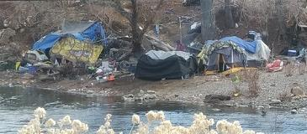
See “Seattle Is Dying”
Is Reno- Sparks Next?
Notes:
Photo Thanks To Jeff Church & Paul White

Slide 3

Zero Homelessness Is Possible
Collaborative Mythology
Community-Wide Commitment
System That Monitors Each Person In Real-Time
Increase Affordable Housing
Fund Programs And Facilities Adequately

Slide 4
Communities Achieving Zero
Arlington County VA: 229,164
Bergen County NJ: 938,506
Ft Myers/Lee County FL: 701,892
Gulfport/Gulf Coast Regional MS: 485,889
Lake County/North Chicago IL: 703,910
Lancaster City & County PA: 536,624
Montgomery County MD: 1,040,116
Norman/Cleveland County OK: 274,458
Riverside City & County CA: 2,361,026
Rockford, Boone County IL: 340,463
Abilene TX: 122, 999
Average Size 661,000
Notes:
Washoe Population:

