Slide 1
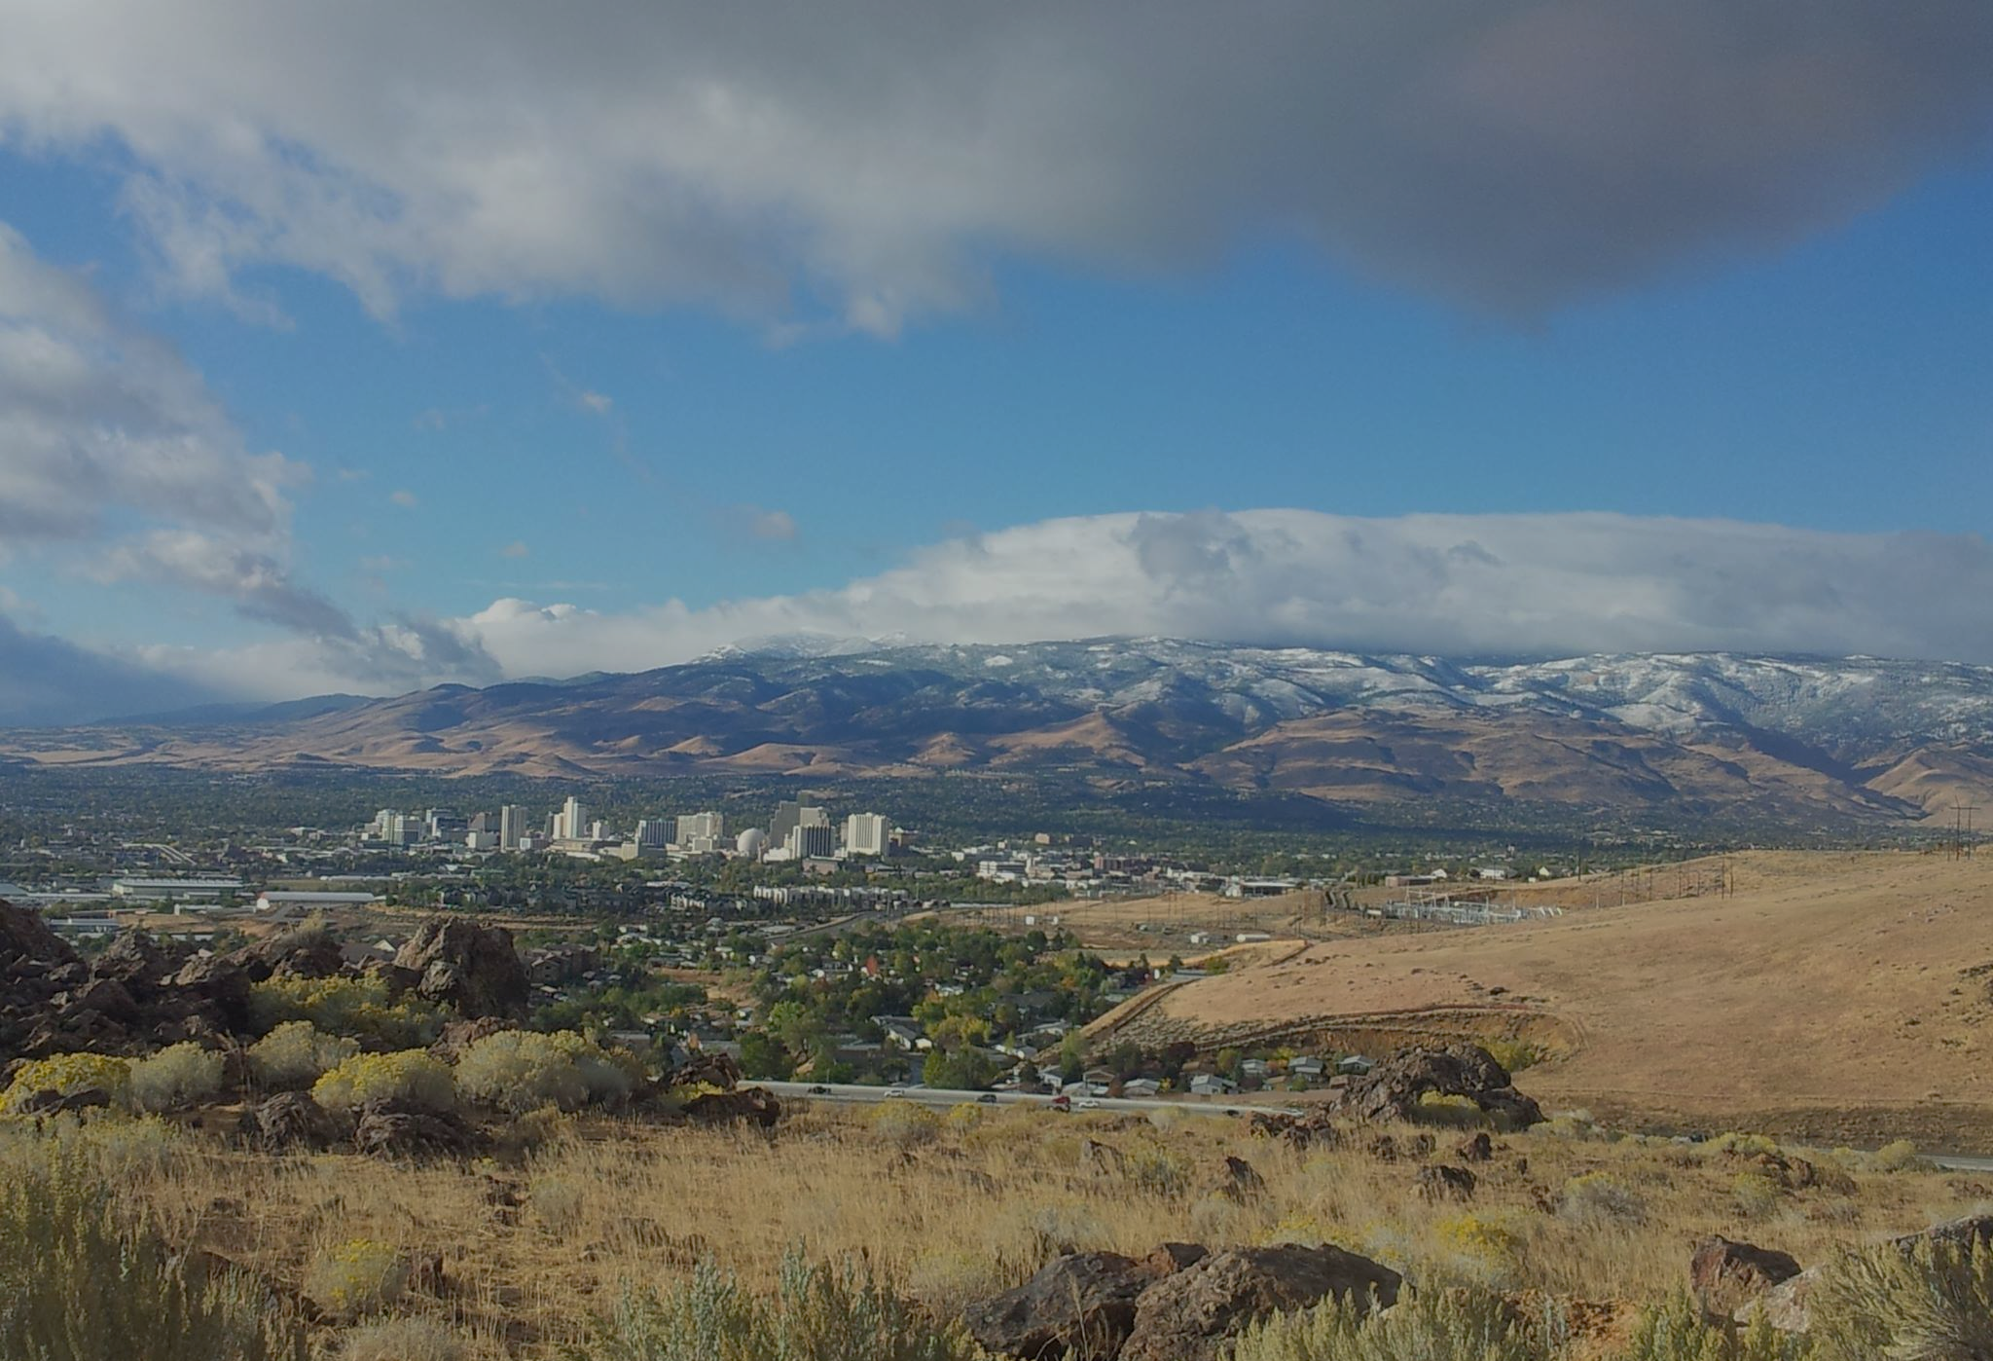
2012-21 Washoe County, Nevada Air Quality Trends Report
Brendan Schnieder, Air Quality Specialist
Washoe County Health District, Air Quality Management Division
June 23, 2022
Reno NWS

Slide 2
National Ambient Air Quality Standards
The Clean Air Act requires the Environmental Protection Agency (EPA) to establish National Ambient Air Quality Standards (NAAQS) for pollutants considered harmful to public health and the environment.
Currently, there are six criteria air pollutants.
Five of those six are monitored every hour of every day in Washoe County.

Slide 3
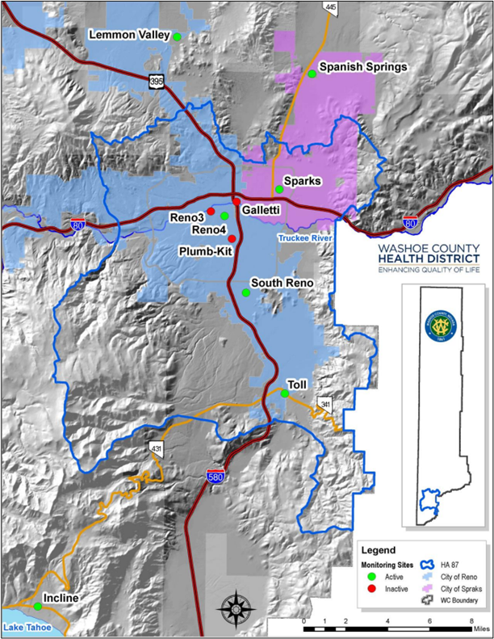
Background
The Annual Trends Report is an ambient air monitoring project assessment report used to satisfy the requirements of the federally approved Quality Assurance Project Plan (QAPP).
It has been published by AQMD every year since 1989.
Details ambient air quality data and information for criteria air pollutants over the last year and trends in the data over the last 10 years.

Slide 4
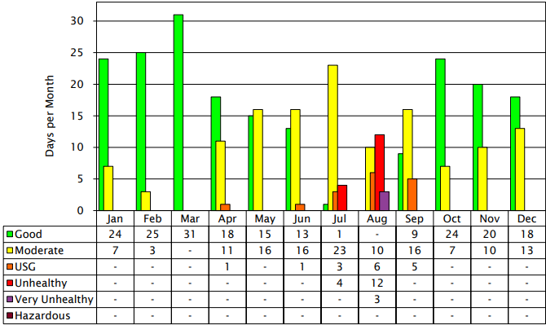
2021
Entered the year with a Green burn code streak dating back to January 3, 2018. Record-breaking 398 consecutive Green burn codes issued.
There were 35 days that exceeded at least one of the NAAQS for either ozone, PM10, and/or PM2.5.
There were 25 days that exceeded the 2015 8-hour ozone NAAQS.
Four out of the 25 were not influenced by wildfire smoke.

Slide 5
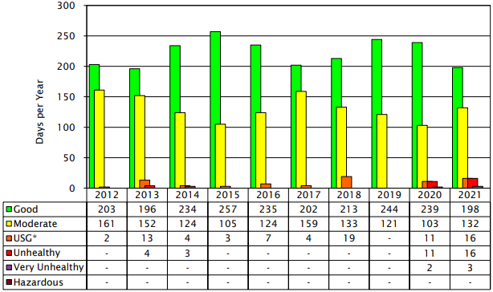
2012-2021
The last ten years has shown the improvements we have made in reducing emissions in the wintertime, but also shows the impact wildfire smoke has had.

Slide 6
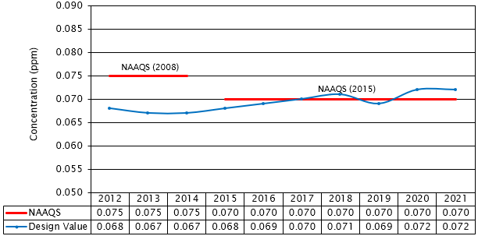
Ozone Design Value
New NAAQS?
We are currently in violation of the 2015 8-hour Ozone, 2006 24-hour PM2.5, and PM10 NAAQS.
The NAAQS for ozone and PM are currently being reviewed and could be strengthened.

Slide 7
Takeaways
Air pollution levels in Washoe County have improved in the wintertime over the last 10 years due to wood-burning device regulations and programs like the burn code.
Air pollution in the summertime is getting worse due to wildfire smoke and local sources of air pollution like motor vehicles.
The Trends Report is used to help make air quality planning decisions in how to attain the NAAQS.

