Slide 1
SpeakUp Washoe

Slide 2
Introduction
Washoe County: SpeakUp
Introduction
What is SpeakUp?
Constituent Experience
Engagement/Outreach
In Conclusion
Notes:
Introduction – Erick Willrich, Assistant to the County Manager; I manage the Board of County Commission Agenda on behalf of the Commission & County Manager
What is SpeakUp?
Constituent Experience
Engagement/Outreach
In Conclusion

Slide 3
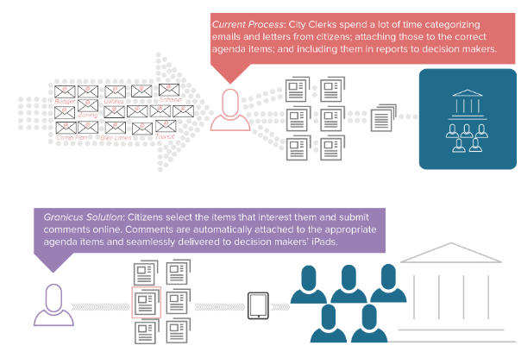
What is SpeakUp?
Washoe County: SpeakUp
SpeakUp
“eComment allows your citizens to review agenda items in detail, indicate their position on an item, request to speak in a live meeting and submit their comments online.”
Register to Speak
Notes:
SpeakUp Washoe County is an online portal designed to enhance community engagement.
eComment – A product within the SpeakUp platform, which allows constituents an additional opportunity to share in a short-written dialogue, their opinion on individual or all agenda items listed in a meeting.
Register to Speak – An opportunity for constituents to sign-up electronically ahead of the Board of County Commission Meeting to speak, in-person, on individual or all board items

Slide 4
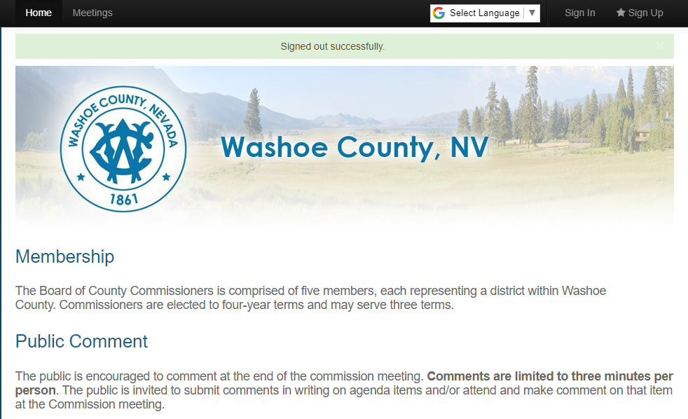
Constituent Experience
Washoe County: SpeakUp
Advantages
Personalized Profile
Comments
Position
Support, Oppose, or Neutral
Language Options
Notes:
Advantage
Comments are real time
Familiarity with social media platforms,
Convenience of their environment, i.e., home, office, etc..
eComment removes the impact of speaking in-person
Register to Speak – convenience of placement in public comment que
Reduced Staff time for 311 and Clerk’s office – minimized to no emails
Personalized Profile
Next Slide
Required setup, managed through the website not WC personnel
Email
Comments
Public facing and real time
Position
Contributor can take a position - Support, Oppose, or Neutral
Explained in next slides
Language
Google language assistance on SpeakUp page
Administrative Policy – Guidance and regulatory stance by OCM Admin.
Removing comments
Alignment with in-person interaction
Guidance in banning constituent use
Profanity limitations – filters report to administrator (OCM Admin.)
Slang – does not report, manual review

Slide 5
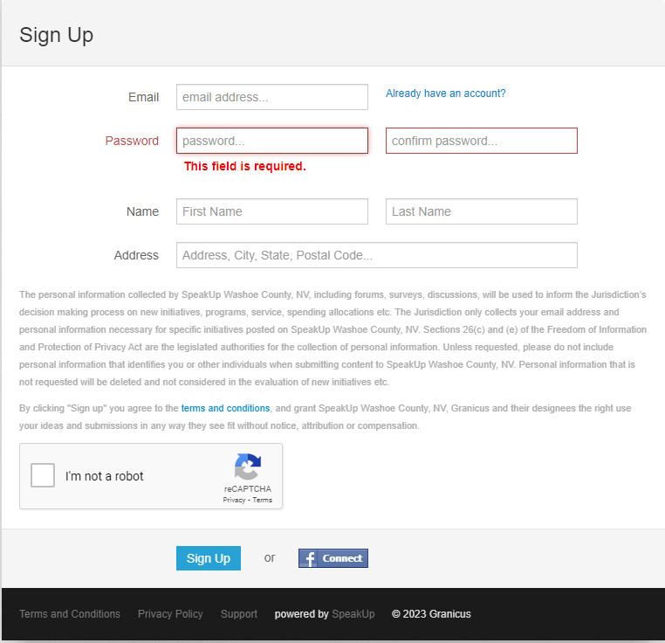
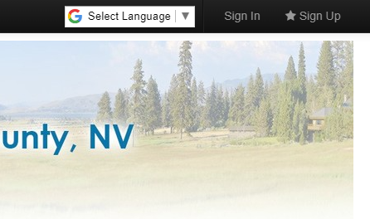
Constituent Experience
Washoe County: SpeakUp
Step 2
How do I sign up?
Register at Washoe County SpeakUp Web Portal
https://washoe-nv.granicusideas.com/
Step 1
Notes:
How do I sign up?
Granicus Support Page - https://support.granicus.com/s/article/Signing-Up-and-Signing-In-to-SpeakUp?c=govAccess%20Suite&p=SpeakUp
Register at Washoe County SpeakUp Web Portal - https://washoe-nv.granicusideas.com/
Visit the portal first
Disclaimer
Safe way to comment
Information is not used outside of the system
No selling or sharing or personal information – i.e., email address, address, phone number, etc.
Public comments are listed with constituent name
Reporting through google analytics
Complete the Sign-Up
Required Information
Email
Password (reset through Granicus, not monitored by WC)
First Name
Last Name
Address
OR
Facebook Connect

Slide 6
Constituent Experience
Washoe County: SpeakUp
Meetings
Sign In
How does it work?
Sign In & review agenda
Or
Review meetings without Sign In
Notes:
Sign-In
Review BCC Agendas - past and future
Quick access to Register to Speak or leave an eComment
Meetings
Review BCC Agendas without logging into the portal - past and future
No option to Register to Speak or eComment

Slide 7
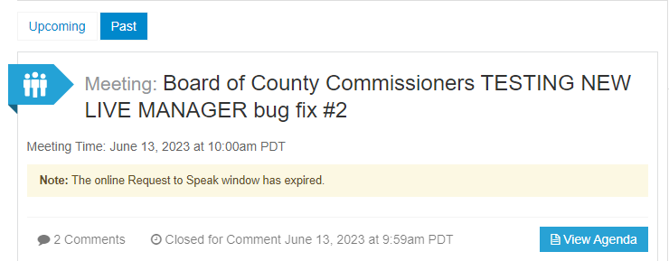
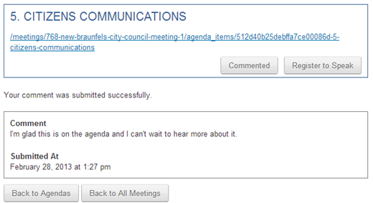
Constituent Experience
Washoe County: SpeakUp
eComment
View Agenda
Comment
Notes:
eComment
Provide eComment & Register to Speak (in-person public comment)
View Agenda
Click on the “View Agenda” Button
Review agenda item(s) and select to Comment or Register to Speak
Limited to one eComment per item
Comment
Select the “Comment” button to leave an eComment
2250 Words or an equivalent to a 3-minute presentation, like public comment.
Take a position
Support / Oppose / Neutral
Offers a quick reference for board members on public position

Slide 8
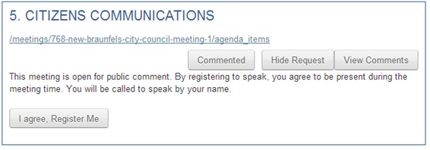
Constituent Experience
Washoe County: SpeakUp
Register to Speak
View Agenda
Speak during public comment
Notes:
Register to Speak
Register to Speak (in-person public comment) & eComment
View Agenda
Click on the “View Agenda” Button
Review items and select to Comment or Register to Speak
Register to Speak
Select on the Register to Speak button to sign up ahead of the meeting
Added to the Que for comment AHEAD of in-person sign-up
Must appear in person at the physical location of the board meeting to speak on item(s).

Slide 9
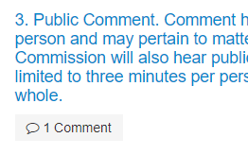
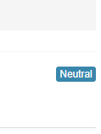
Constituent Experience
Washoe County: SpeakUp
Previewing eComment(s)
SpeakUp portal
Notes:
View eComment(s)
Visit the SpeakUp portal and review eComment in real time
See Position
Support, Oppose, or Neutral
Fair and balanced opinion

Slide 10
Engagement / Outreach
Washoe County: eComment & SpeakUp
Introduction
Commissioners
Citizen Outreach
Media
Board of County Commissioners Presentation
Notes:
The success of eComment & SpeakUp is largely dependent on how well we promote it in the community.
Introduction - https://www.screencast.com/t/7ooxXBCCRils
Commissioners
1:1 w/Comm.
Introduction to Commission, sharing how SpeakUp works – eComment & Register to Speak.
Show live demonstration. You can show them other Granicus clients (ADD LINK TO WC DEMO) and/or use a test meeting.
Citizen Outreach
Email Blast to WC distro-list (MailChimp)
On-going reminders - Agenda posting days
Local Organizations - CABS, CMAC, IVCBA, etc.
Social Media (Twitter, Facebook, etc.
On-going reminders - Agenda posting days
Flyers
News Outlets
Press release - https://support.granicus.com/s/article/SpeakUp-Outreach-Checklist?c=govAccess%20Suite&p=SpeakUp#bottom-of-page
https://support.granicus.com/s/article/SpeakUp-Launch-Kit?c=govAccess%20Suite&p=SpeakUp
BCC Presentation
July 18

Slide 11
In Conclusion
Washoe County: SpeakUp
What is SpeakUp?
Constituent Experience
Engagement & Outreach
Questions?
Notes:
What is SpeakUp?
Constituent Experience
Engagement & Outreach
Questions?

Slide 12
Thank you
Erick Willrich
Assistant to the County Manager
ewillrich@washoecounty.gov

