Slide 1
County Communication Resources
Alexandra Wilson Community Outreach Coordinator
Notes:
Commissioner Andriola really wanted to be here to open this item but had a conflict due to the meeting moved to March 26. Andriola’s mission is to empower the CAB board with all the tools that are available to home in on how we can garner the best information in terms of feedback for her to be a better conduit and representative of D4.
Keep that in mind, while we’re going through all the tools! ☺

Slide 2
Resources List
MailChimp - County Email Blast
Social Media (Facebook, Nextdoor, X)
Zencity (Engage, Survey, Insights)
Jurisdictional Publications
Media & Communications
Commissioner Support
Washoe311
eComment/SpeakUp/Public Comment
Website

Slide 3
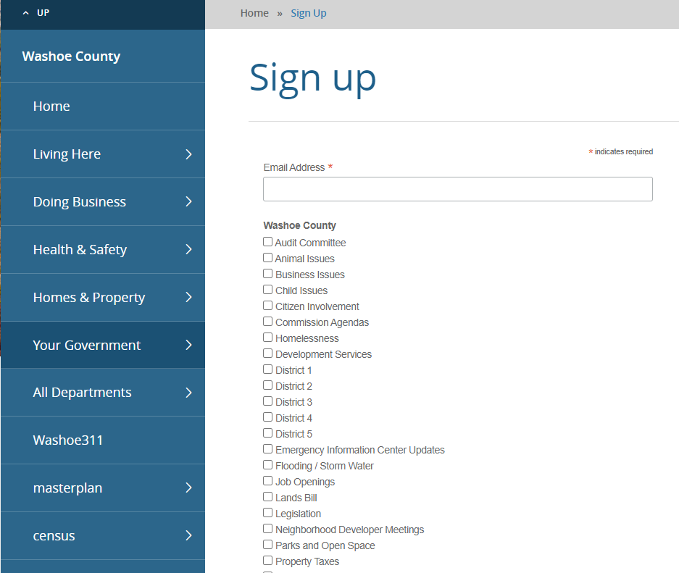
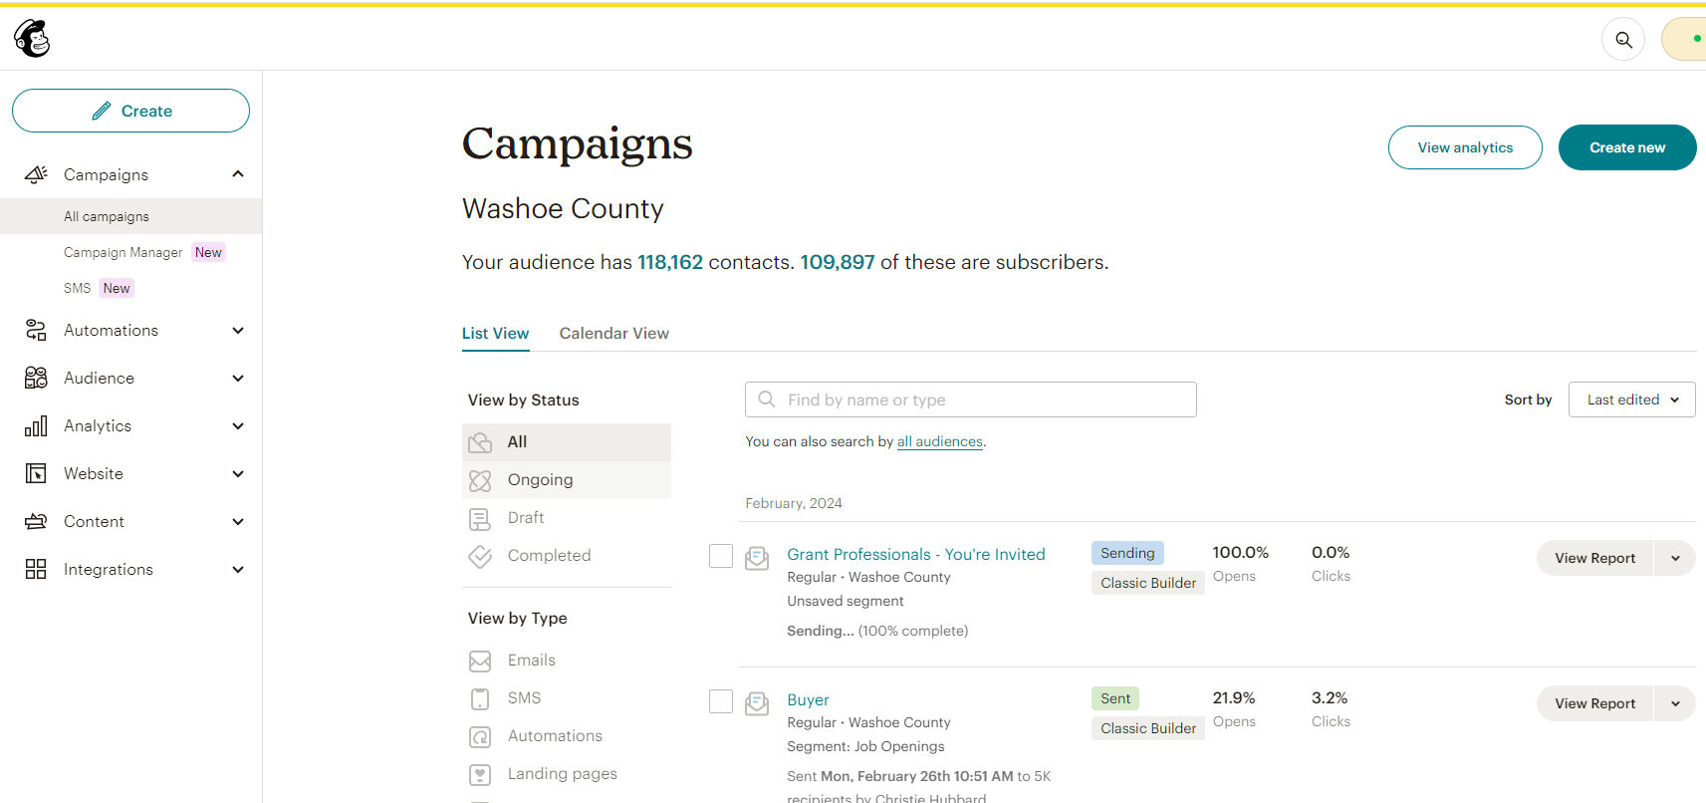
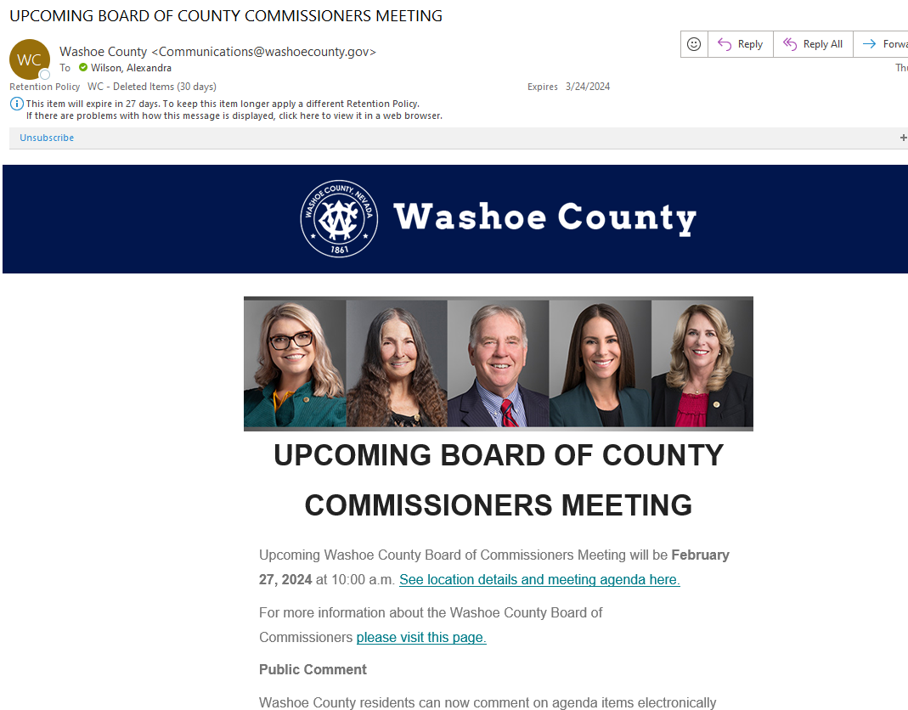
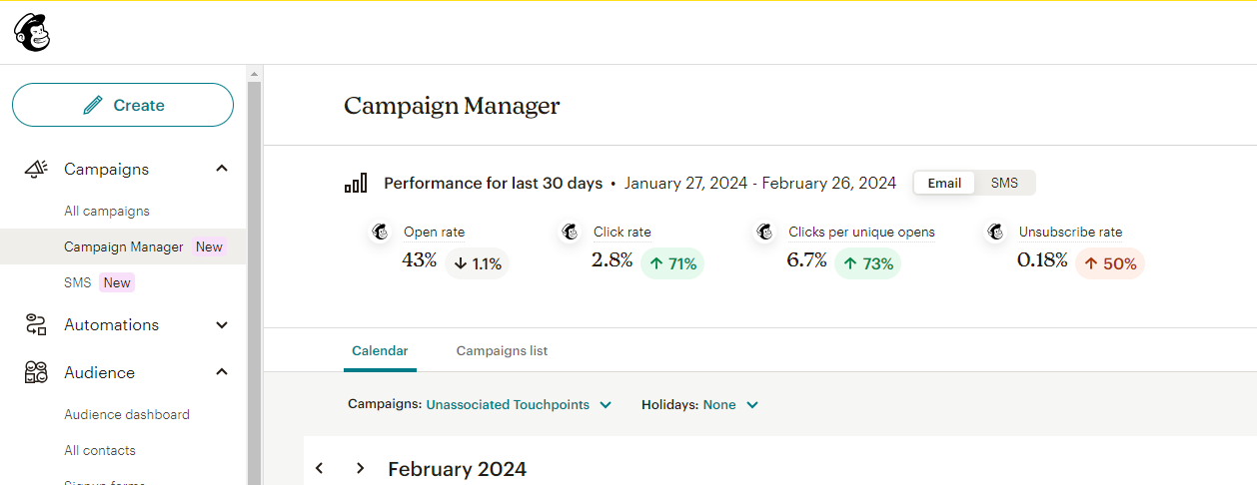
MailChimp – County Email Blast
Automation & scheduling
Set & forget
Target Audience
Sign-up lists
Topic based
Analytics
Open rate, click-through, & other metrics
Notes:
Emails that go to your inbox. We’ll go over sign ups to receive these notices later on.

Slide 4
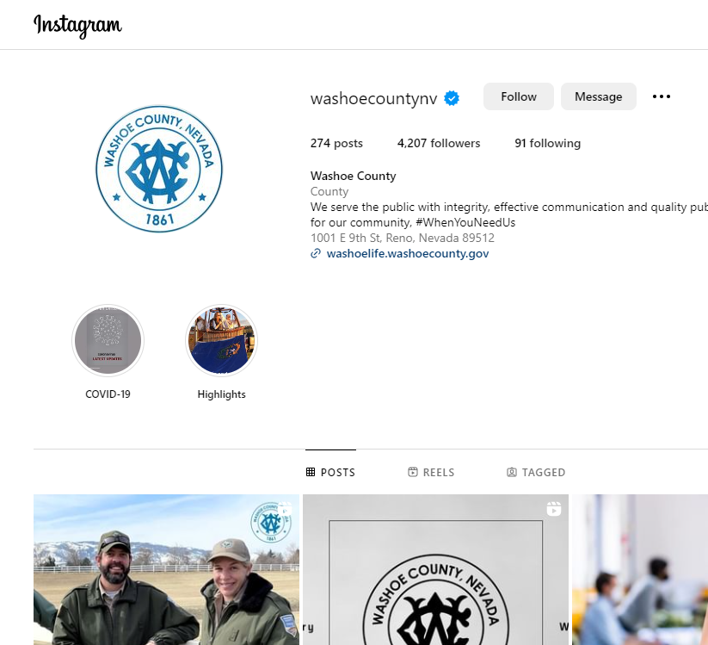
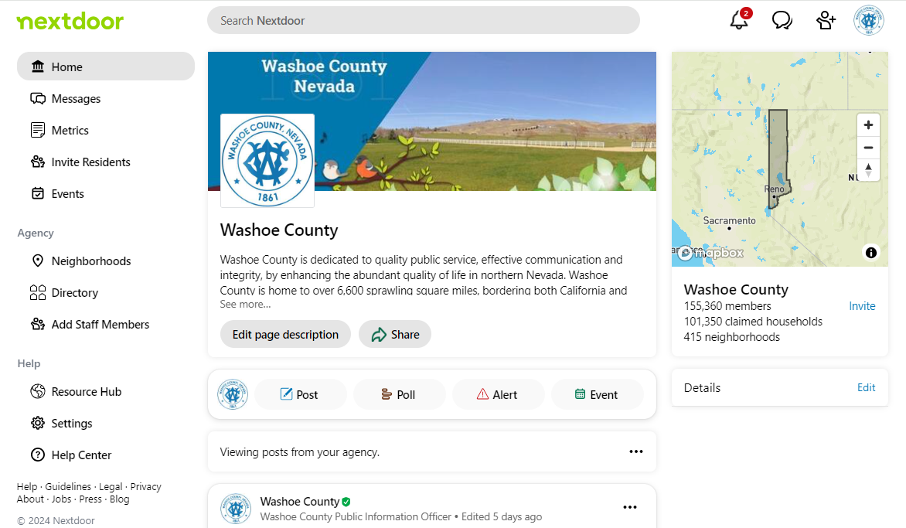
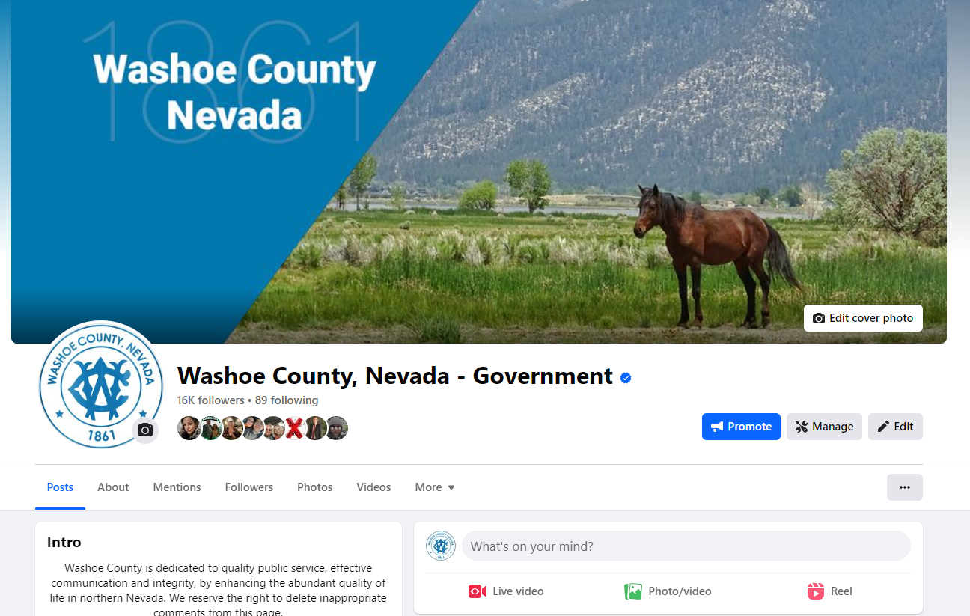
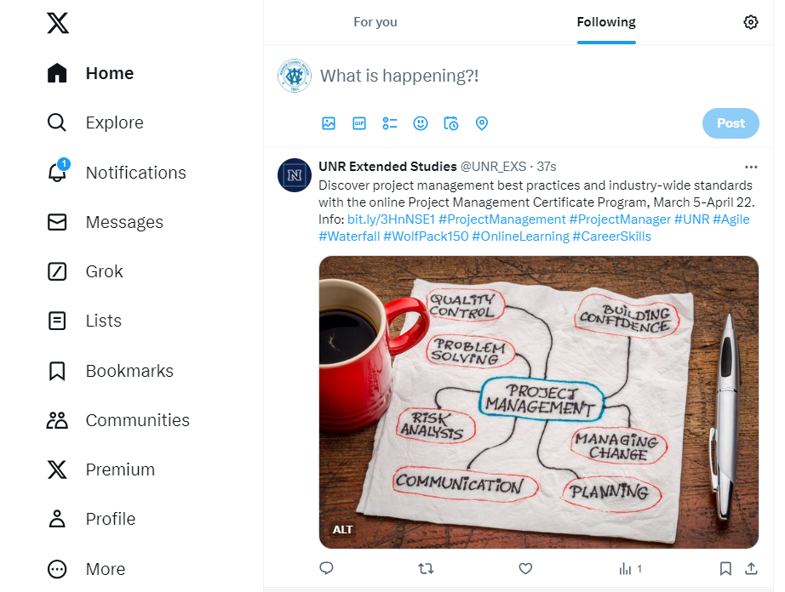
Social Media
Facebook
Groups
Nextdoor
X (Formerly Twitter)
Instagram
Older Target Audience
Jurisdiction
CAB/Neighborhood/Commission Districts
Polls
Data Collection
Live Updates
Emergency Communications
Younger Target Audience
Stories/Contests
Go Live
Events

Slide 5
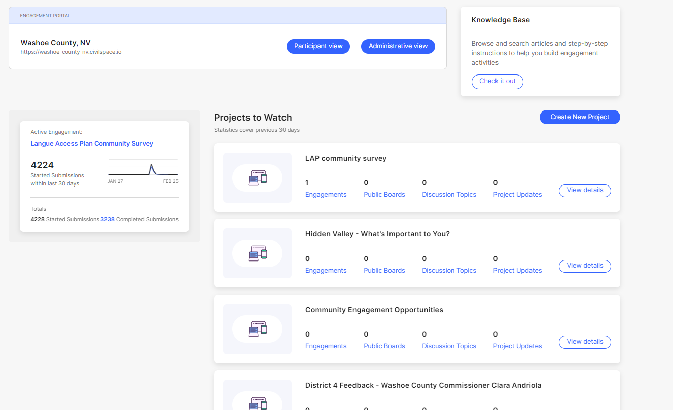
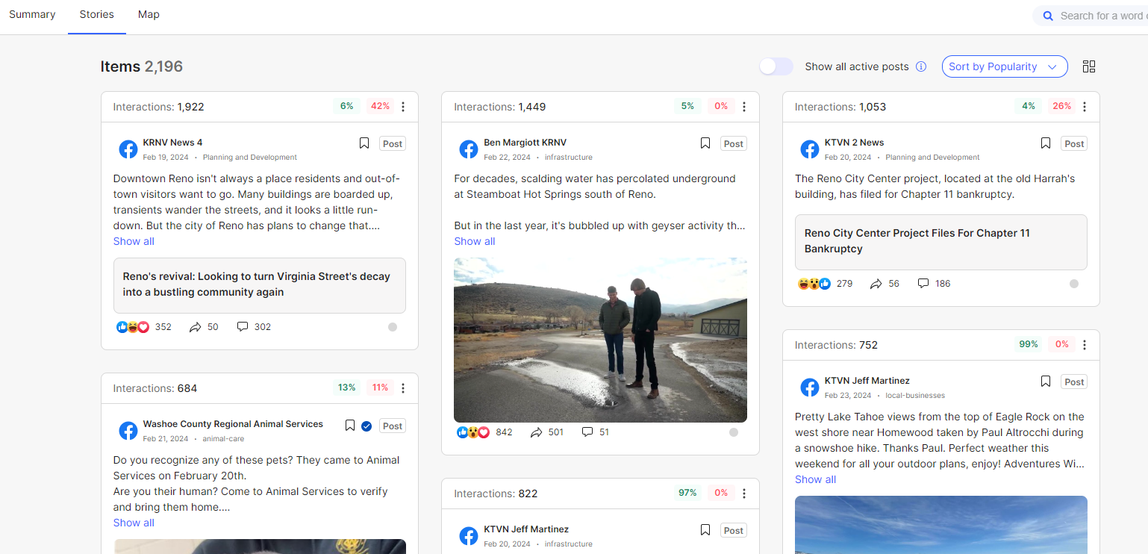
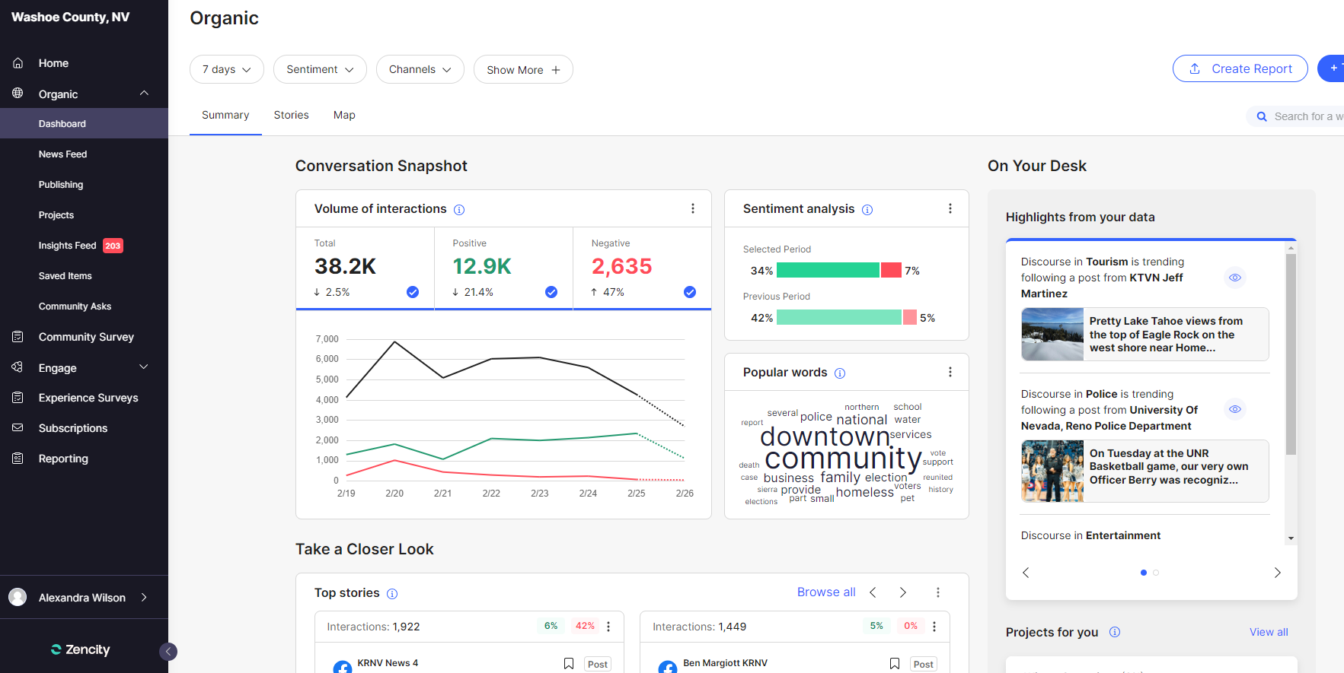
Zencity
Engage – Public Page
Project Specific
Timeline
Open Forum (chat, upvote, topic)
Real-Time Feedback
Discussion Topics
Digital Interactive Participation
Survey
Customizable
Geo Breakdown
Complementary to email blasts
Results & Analysis
Notes:
ZenCity is a civic engagement platform designed to help local governments and municipalities gather and analyze public opinions and feedback. The platform uses artificial intelligence and data analytics to collect and interpret data from various sources, including social media, community forums, and other online platforms.
Ex. of Projects/Insights: Winter Operations, Elections, Horse Zoning, District 4 sentiment, Homelessness, etc.

Slide 6
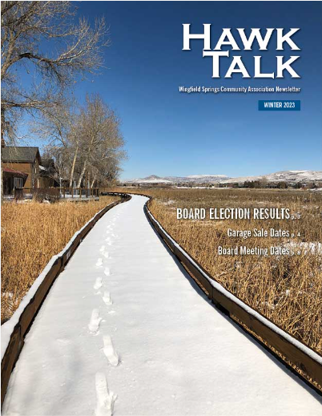
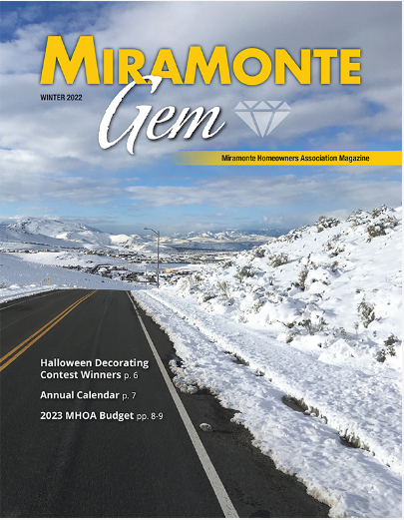
Jurisdictional Publications
HOA/Neighborhood Specific
The Vistas View
Miramonte Gem
Hawk Talk
Foothills Messenger
Somersett Living
Caughlin Rancher
ArrowCreek View
Galena Times
Hidden Valley Association Newsletter
Senior Spectrum
Ads, Surveys, Articles:
WCLA
Boards/Commissions
eComment
Seniors
West Hills
Building Codes/Ordinances

Slide 7
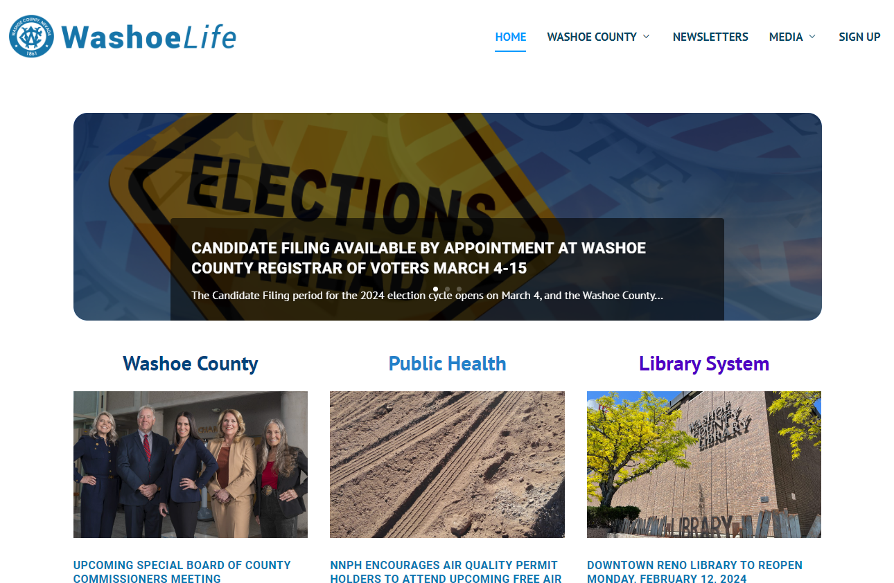
Media & Communications
Media Partners
Washoe County Television (WCTV)
Live web streaming & Video-on-demand
Podcast
WashoeLife

Slide 8
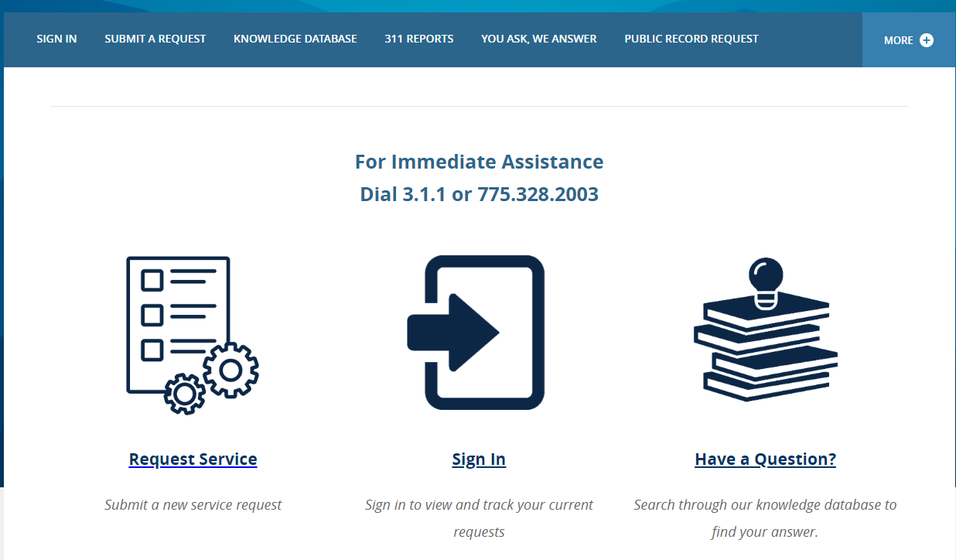
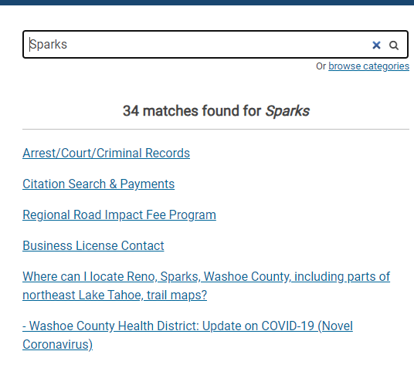
Washoe311 Service Center
Call Center
Knowledge Database
Public Records Requests (PRRs)
Data Reports
Notes:
Call Center:
2023 - 20,616 Requests For Service
2022 – 25,220 Requests For Service
2020 – 36,227 Requests For Service
Knowledge Database: Pulled up information for Sparks, updated based on requests
PRRs:
2023 - 2,387
2024 – 561
Reports: Top requests, data like request #, summaries per district/department/request type

Slide 9
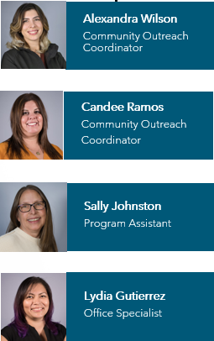
Commission Support
Citizen Advisory Boards (CABs)
8 total
Boards/Commissions
53 total – 31 BCC Appointed
Washoe County Leadership Academy (WCLA)
Board of County Commissioner (BCC)
Requests for Service
District Funds
Resident Requests For Service
Travel
Event/Tables/Tickets/Memberships
Community Events & Programming
Notes:
CABs - Trainings, public meeting facilitation, speaker coordination, minutes, etc.
Boards/Commissions – applications, tracking mechanism (Granicus), staff report, follow-up
WCLA – 30-35 selected participants for 9 months (behind the scenes of Washoe)
BCC – Requests on/off dais, donations to non-profits/gov’t entities, escalated constituents
Events – elected to support org’s like KTMB, NNBCAS, NV Women’s Fund, TMCC, NV Veteran’s Memorial, etc.
Community Events – Topic based meetings (Senior Scams Seminar, Washoe Tahoe Workshop, SOS, Lands Bill (@ SS & County Complex), Emergency Preparedness (Hidden Valley)

Slide 10
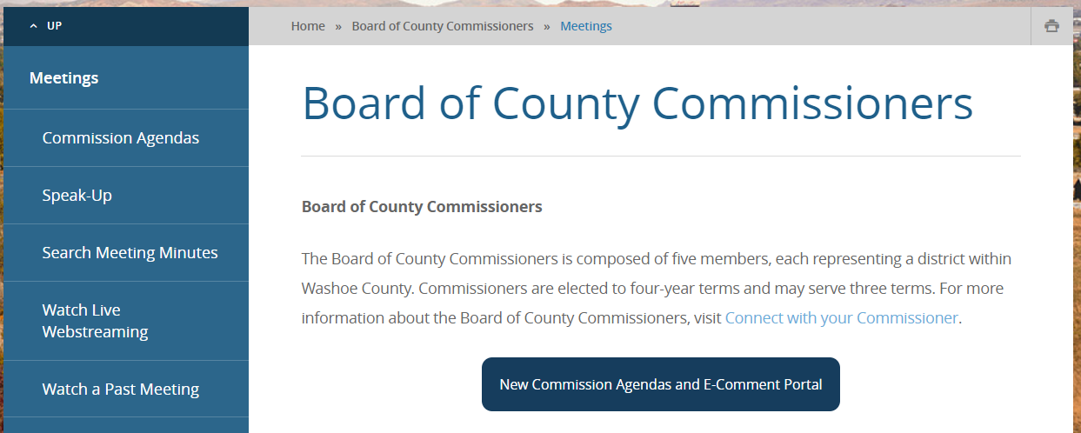
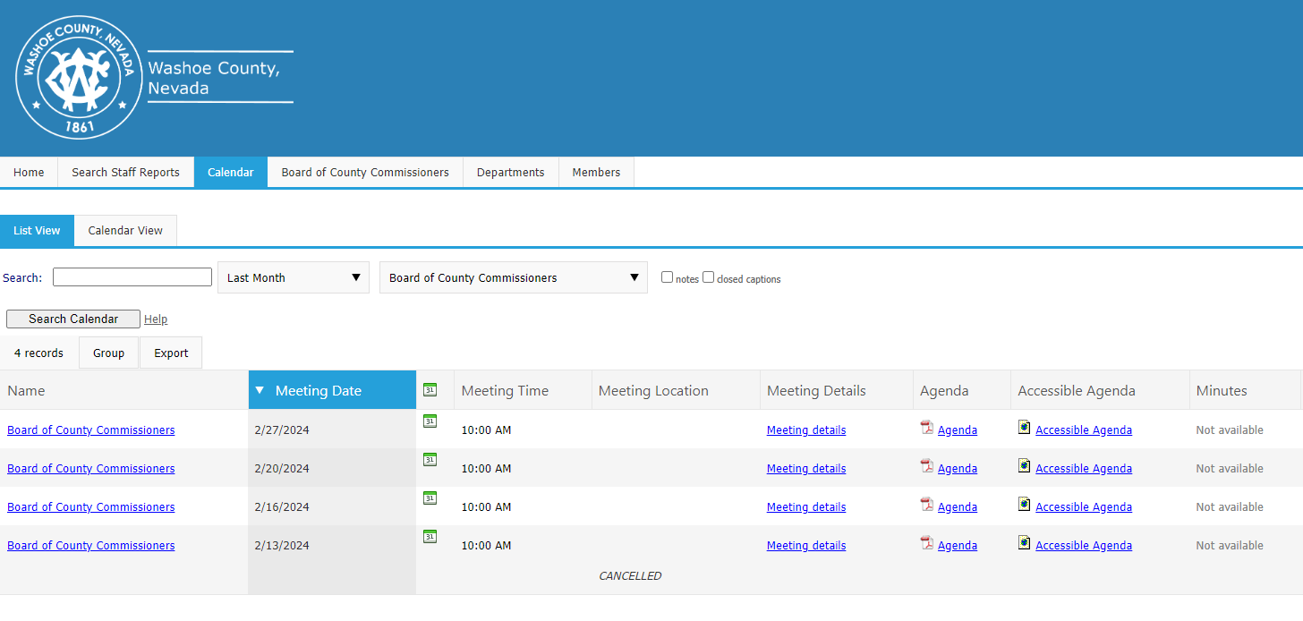
SpeakUp Washoe
eComment - Additional opportunity to share in a short-written dialogue, your opinion on individual or all agenda items listed in a meeting.
Register to Speak – Electronic sign-up, ahead of the BCC to speak in-person, on board items
Notes:
SpeakUp Washoe County - online portal designed to enhance community engagement.
eComment – A product within the SpeakUp platform.
Registration
Choose a position (support/oppose/neutral)
Commissioners see this on their tablets & agenda packets – comment in realtime.
Other residents can see comments too!
Language options
Register to Speak – Why wait in line? Must appear in person but put in ahead of the que. After agenda is posted.

Slide 11
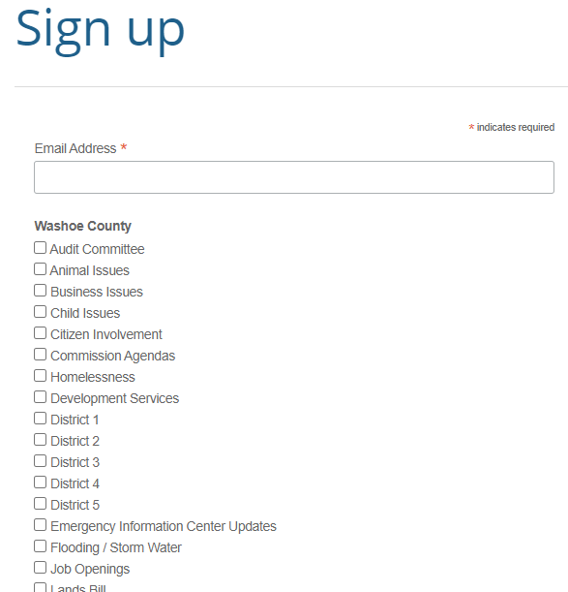
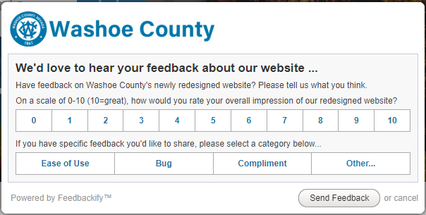
Website
Topic Driven Headers
Searchable Content
Emergency Alerts
Meeting Schedules
Feedbackify
Latest News &
Announcements
Sign-Ups
Notes:
Headers – Designed with residents in mind.
Content – May not know where to look but know what they want. Sub headers include most requested information & can be updated.
Emergency Alerts – Banner on top of website – RED. This is in addition to other emergency alerts (EM).
Meeting Schedules – Listed in sequential order, upcoming. Auto populates when a meeting is generated.
Feedbackify – 1-10 scale. Type of feedback. Comment section. Located on all pages. Sent to Communications Division.
Latest News – Auto populated by WashoeLife, rotating banner. What you need to know!
Sign-Ups – Bottom of every page. 35 topics to subscribe. Directly to inbox. #1!!

Slide 12
Thank you
Questions?
Notes:
We understand that everyone has a preference of communication and that we cannot capture EVERYTHING. However, this is a snippet of all the things we utilize to both gather and send information and appreciate any feedback/suggestions.

