Slide 1
NATIVE AMERICANS IN THE GREAT BASIN
James J. Phoenix
Pyramid Lake Paiute
SEP 2024
For over 10,000 years, we as Native People are still here
Notes:
Good morning everyone, my name is James Phoenix. I am a member of the Pyramid Lake Paiute Tribe on my fathers side. and I am also Kickapoo from North Eastern Kansas on my mothers side.
Haoo Mu, Pesa Awamooah, Nu Mashina Me Neena, Nu Kooyuee Tu Kuta, E Naa & E Pea, Albert and Anita Phoenix, Nu Saha way,
Thank you for inviting me to speak at your gathering.

Slide 2
AGENDA
Native Americans in the Great Basin
Nevada Urban Indians 1975
Tribal Sovereignty
Right to Vote
Questions and Answers

Slide 3
Native Storytelling
Native storytelling is a traditional way of passing down knowledge, culture, beliefs, and history through generations.
Stories helped Native Americans remain connected to each other and their homelands when they were forcibly relocated.
Today I will tell my story about the Natives in the Great Basin

Slide 4
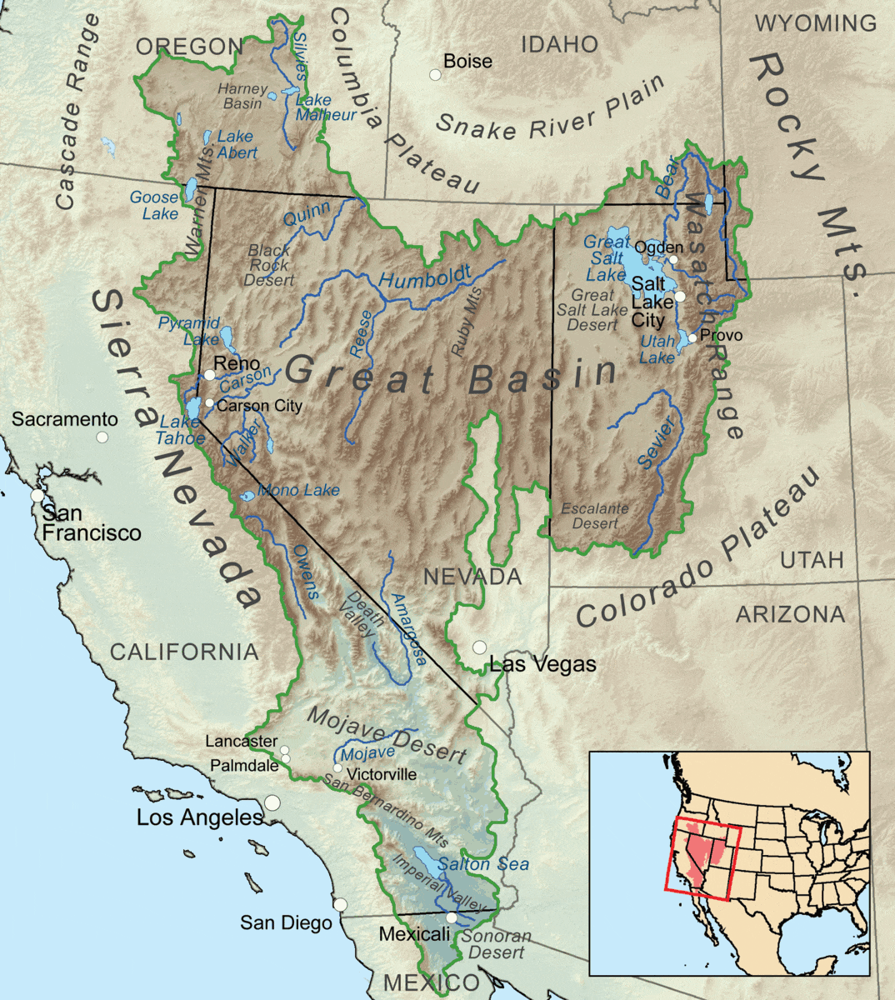
AGENDA
Notes:
The Great Basin is a desert region in the western United States that stretches from the Rocky Mountains to the Sierra Nevada. The Native Americans who lived there were hunter-gatherers who lived in mobile, kin-based bands. They primarily ate seeds, piñon nuts, and small game.
Just imagine yourself in the mid 1800s, your a Native American living in your environment, your home, your people, when suddenly outsiders unknown to you come into your home, and more and more keep coming,
Many Native American tribes lived in the Great Basin, including:
Shoshone: The Western Shoshone were a subgroup of the Shoshone.
Paiute: The Paiute were often divided into Northern, Southern, and Owens Valley groups.
Washoe: The Washoe spoke a Hokan language.
Ute: A major tribe in the Great Basin.
Mono: A major tribe in the Great Basin.
Goshute: A major tribe in the Great Basin.
Bannock: A major tribe in the Great Basin.
But I am going to focus on your area here in Northern NV.

Slide 5
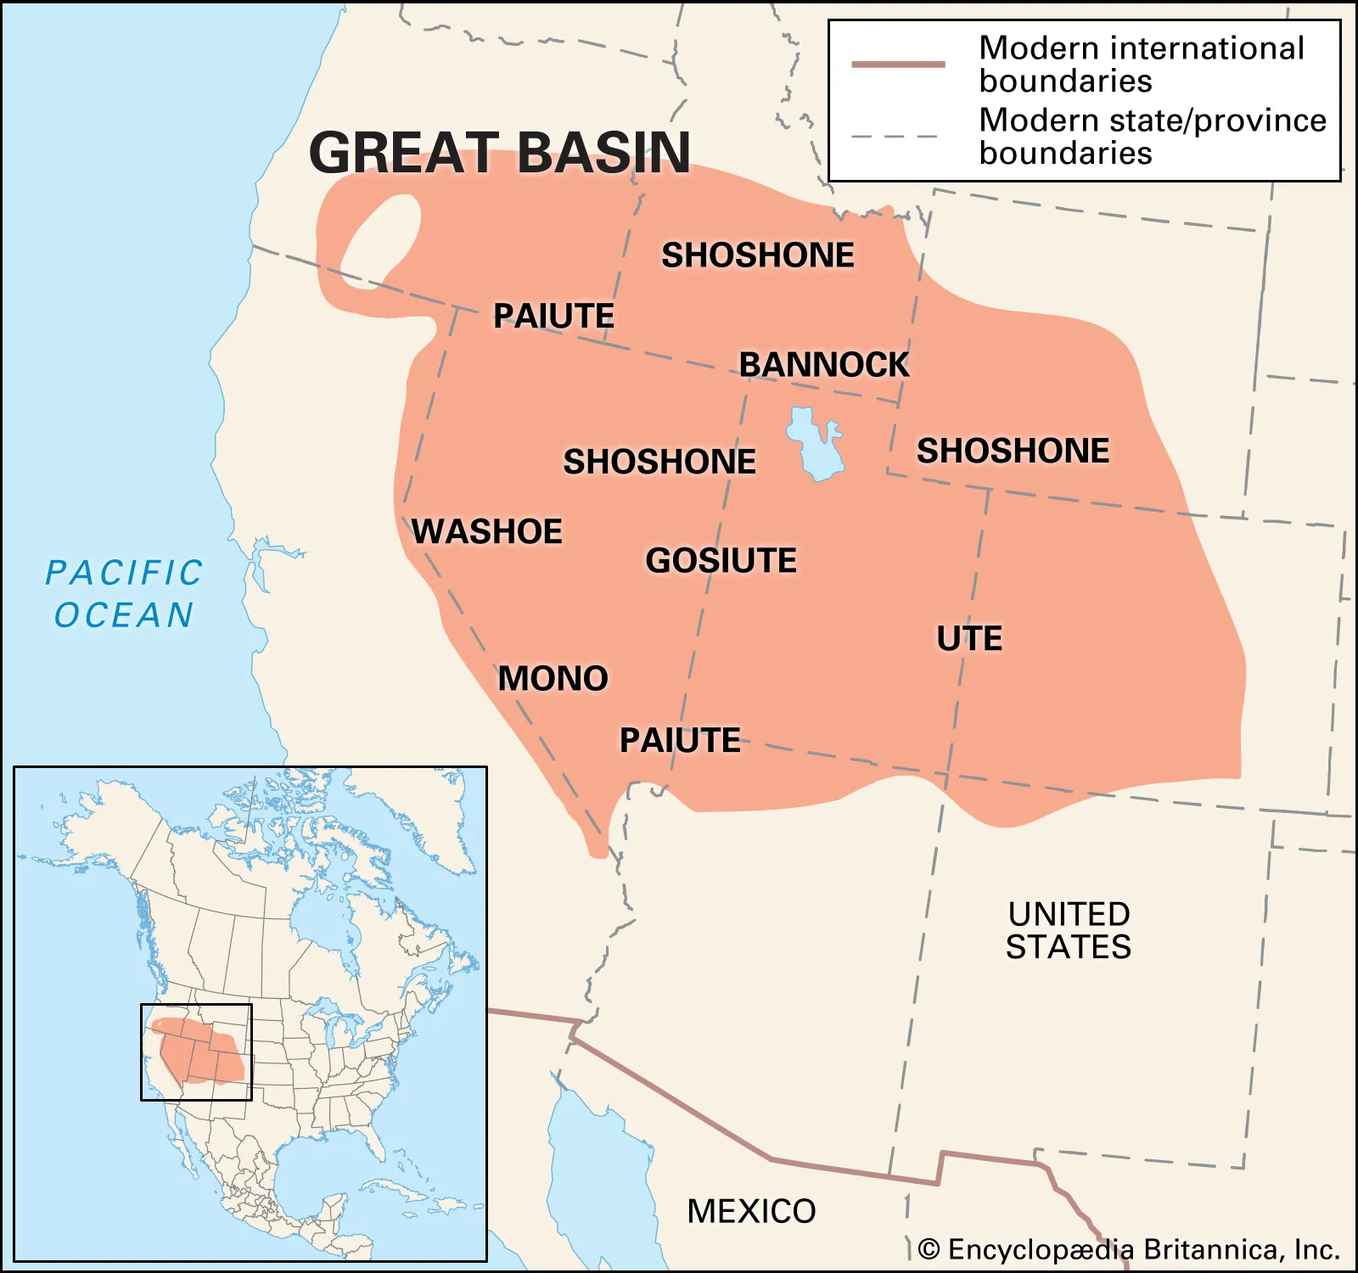
Notes:
This is what I found online that illustrates the tribes in the area as early as the 1900s or even later.
I will focus on our region here in Northern NV.

Slide 6
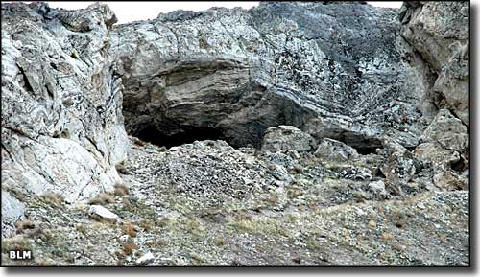
Notes:
Lovelock Cave
People occupied Lovelock Cave for over 4,000 years. The initial discoveries of artifacts and excavations, in the early 20th century, were not very well executed, which resulted in a loss of archaeological information. However more recent investigations were more careful and meticulous. A wealth of knowledge pertaining to life on the Great Basin has come from this important site because many unique artifacts have been successfully recovered.

Slide 7
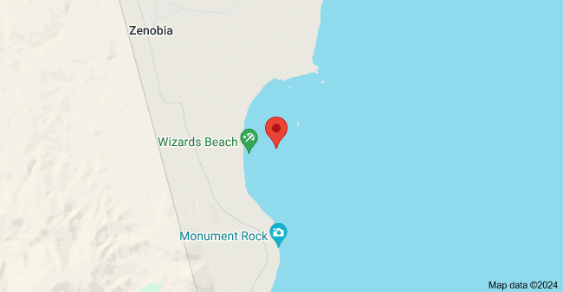
Notes:
In 1978, the human bones were discovered that have been dated to 9,200 years ago. This find is known as Wizards Beach Man. It is at the northern end of Pyramid Lake.

Slide 8
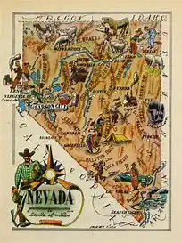
NATIVE AMERICANS IN THE GREAT BASIN
Three (3) original tribes in the Great Basin (Paiute, Shoshone, Washoe)
The Pyramid Lake Paiute Reservation was established in 1874 and operates under the Indian Reorganization Act Constitution and By-Laws approved by the Department of Interior.
Shoshone Reservation was established in 1867 by President Andrew Johnson by Executive Order on June 14, 1867.
Washoe Colonies established 1917. They are inhabitants of Lake Tahoe and the Great Basin.
Reno Sparks Indian Colony established 1917 by the federal government for non-reservation Indians from the three (3) established tribes (Paiute, Shoshone, Washoe)
Nevada Urban Indians Inc. Established 1975 to provide outreach and referral services in the Washoe County
Notes:
So over 10,000 years ago through modern science and research, it is proven there were people that inhabited this area.
Key points about Native life in the Great Basin in 1860:
Subsistence:
Most tribes relied on a combination of hunting small animals like rabbits and antelope, gathering seeds, roots, and berries, and fishing in available water sources.
Mobility:
Due to the scattered food sources, most Great Basin tribes were nomadic, moving seasonally to access different food sources.
Social Structure:
Family units were the core of social organization, with groups often coming together for larger hunts or ceremonies.
Impact of Horses:
While some tribes had access to horses by 1860, their use was not widespread in the Great Basin, impacting hunting strategies.
Conflict with Settlers:
As white settlers began moving into the region, tensions were rising over land use and resource access, leading to increasing conflict and displacement of Native populations.
Specific Tribes:
Shoshone:
One of the major tribes in the Great Basin, known for their hunting skills and adaptability to the harsh environment.
Paiute:
Another prominent tribe, often divided into smaller bands based on local resources.
Washoe:
Primarily located near Lake Tahoe, they were known for their basket weaving traditions.
Giants and Little People

Slide 9
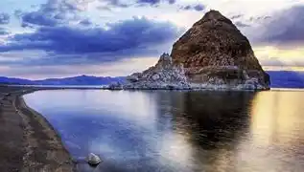
PYRAMID LAKE PAIUTE TRIBE
The Pyramid Lake people survived in the Great Basin over 10,000 years.
The Pyramid Lake Paiute Tribe is located 35 miles north of Reno.
Pyramid Lake Tribe Museum & Cultural Center
Pyramid Lake War 1860
Story of the Stone Mother
Population to date is approximately 3,000 enrolled members.
https://pyramidlake.us/museum

Slide 10
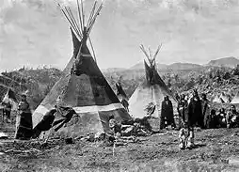
SHOSHONE TRIBES
The Shoshone lived in the western Great Basin over 10,000 years. The Shoshone of historic times were organized into four groups: Western, or unmounted, Shoshone, centred in Nevada; Northern, or horse, Shoshone of northern Utah and Idaho; Wind River Shoshone in western Wyoming; and Comanche in western Texas, a comparatively recent offshoot of the Wind River group.
In Nevada:
Duck Valley Shoshone-Paiute Tribe
Duckwater Shoshone Tribe
Ely Shoshone Tribe
Fallon Paiute Shoshone Tribe
Fort McDermitt Paiute-Shoshone Tribe
The tribal population is approximately 6,000

Slide 11
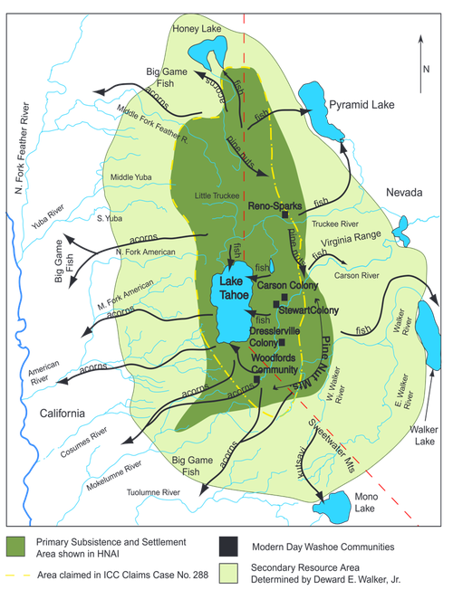
WASHOE TRIBE
Washoe people have lived in the Great Basin and the eastern Sierra Nevada mountains for at least the last 10,000 years.
Washoe people territory is comprised of Lake Tahoe at its heart, to include Carson-Dresslerville-Stewart Colonies, and Woodfords Community.
The Washoe people are a distinct group who share commonalities with both the Great Basin and California Cultures.
The population to date is approximately 1,200 members
https://washoetribe.us/

Slide 12
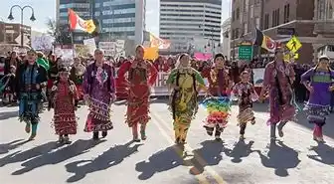
RENO SPARKS INDIAN COLONY
The Reno Sparks Indian Colony was established in 1917 whereas the federal government purchased 20 acres for non-reservation Indians who came to work and “camped” along the river. People called it the “Encampment”.
The Reno Sparks Colony has expanded its property to approximately 15, 292 acres with 1200 tribal members. They have property in South Reno, Verdi, Sparks, and Hungry Valley Spanish Springs area.
The local population is approximately 1,200 members; consisting of Paiute, Washoe, and Shoshone natives.
https://www.rsic.org/

Slide 13
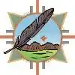
NEVADA URBAN INDIANS INC.
During the mid-20th century, the Federal Government strongly encouraged Indians to stake out new lives in urban areas.
Nevada Urban Indians, Inc. (NUI) established in 1975 to provide outreach and referral services to American Indians living in the urban areas of Washoe County and Carson City.
Its mission is to promote American Indian/Alaskan Natives' culture, health, and well-being in the Northern Nevada region.
Nevada Urban Indian population is estimated at 6,600 Native Americans in the area.
https://www.nevadaurbanindians.org/
Notes:
The Indian Relocation Act of 1956, also known as Public Law 959 or the Adult Vocational Training Program, was a federal law that encouraged Native Americans to move from reservations to urban areas. The act's goals included:
Vocational training: Providing vocational training for Native Americans
Moving expenses: Paying moving expenses for Native Americans
Health insurance: Providing health insurance for Native Americans
Assimilation: Encouraging Native Americans to assimilate into the general population
Employment opportunities: Encouraging Native Americans to move to urban areas for more employment opportunities
Some critics of the act say it was an attempt to weaken tribal and community ties, and to encourage Native Americans to leave their traditional lands and reservations.

Slide 14
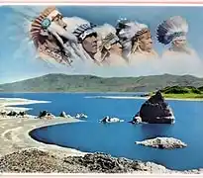
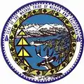
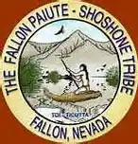
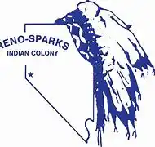
TRIBAL SOVEREIGNTY
Native Americans have significant rights of self government under the U.S Constitution, which has its root from their own sovereignty.
There are 574 federally recognized American Indians and Alaska nation in the United States.
Native American Tribes are sometimes described as “Nations within a Nation”.
Sovereignty for tribes includes the right to establish their own form of government, determined membership, enact legislation and establish law enforcement and court systems.

Slide 15
RIGHT TO VOTE
The 15th Amendment, passed in 1870, “The right of citizens of the United States to vote shall not be denied or abridged by the United States or by any State on account of race, color, or previous condition of servitude”.
The Snyder Act of 1924 explicitly declared Native Americans to be U.S. citizens that they became eligible to vote. Native Americans are citizens of the United States and have the right to vote in federal, state, and local elections.
Native Americans can also vote in tribal elections - think of them as having dual citizenship in two sovereign nations, the U.S. and their tribe.
Tribes run their own elections

Slide 16
TRIBAL GOVERNMENT
Tribal Council Governing Body
Constitution and By-Laws
Tribal Administration
Tribal entities
____________________________________________________________________________________
- EMS - Emergency Management - Public Utilities - Enrollment
- Tribal Court - Natural Resources - Public Relations - Police
-Social Services - Committees - Clinic -Finance

Slide 17
SUMMARY FOR OVER 6,000 YEARS, WE AS NATIVE PEOPLE ARE STILL HERE
Native Americans in the Great Basin
Tribal Government Structure
Native American Right to Vote
Nevada Urban Indians Inc.
Questions and Answers

Slide 18
SUMMARY FOR OVER 10,000 YEARS, WE AS NATIVE PEOPLE ARE STILL HERE
Native Americans in the Great Basin
Nevada Urban Indians Inc.
Tribal Sovereignty
Right to Vote
Questions and Answers

