Slide 1
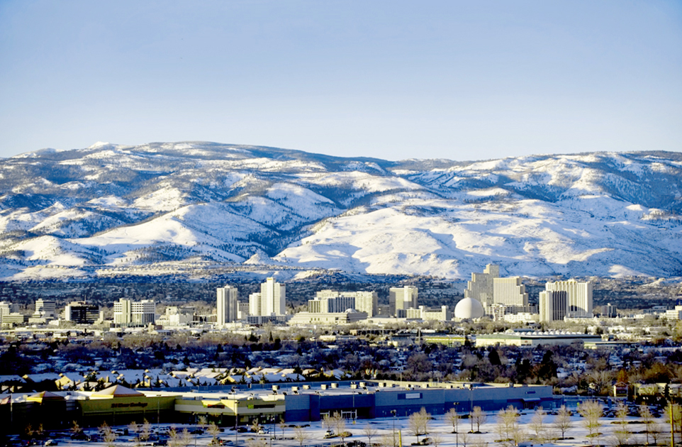
Verdi Area Multimodal Transportation Study
March 20, 2023

Slide 2
Study Purpose
Conduct multi-modal analysis to identify:
Corridor gaps in connectivity (vehicular, ped, bike, transit)
Crash and congestion hot spots
Design a strategy for developing regional road transportation improvements
Identify short- and long-term improvements
Solicit feedback from and inform agencies, stakeholders, and general public throughout the process
Development permitting/requirements handled by respective local agency
Planning
Existing conditions/ needs assessment
Community visioning
Evaluation of alternatives
Action plan/ recommended improvements
Environmental
Environmental study (state or NEPA process)
Preliminary engineering
Agency issues decision
Design
Detailed corridor design
Right-of-way, utilities, and other impacts
Construction plans, permits, and funding secured
Construction
Build and deliver
WE ARE HERE
Notes:
Add develop vision (is it a freeway, arterial or blend?)

Slide 3
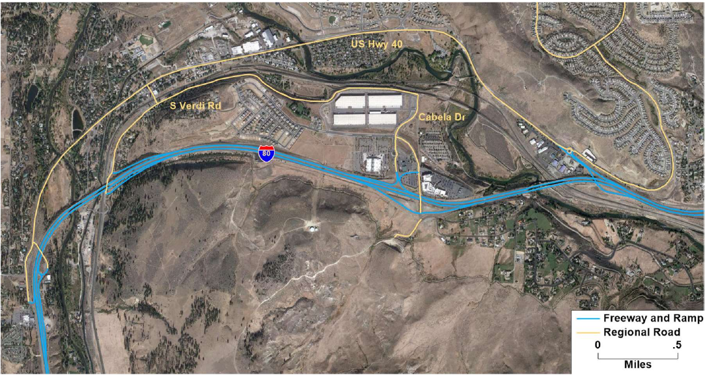
Study Limits

Slide 4
Goals and Objectives
Review existing conditions 
Identify gaps and needs 
Provide proposed project recommendations 
Primary focus on regional roads
Stakeholder outreach

Slide 5
Existing Conditions Summary
Significant new development
Crashes primarily on I-80 (86% of overall crashes)
Traffic growth more significant at interchanges
Limited truck parking with spillover along 3rd Street and Verdi Road
Lack of pedestrian connectivity
Opportunity to enhance recreational bicycle access
OHV concerns and confusion on regulations/ordinances

Slide 6
UNR Speed Study
Center for Advanced Transportation Education and Research (CATER)
Connected Vehicle Data
Sampling
Weekday - March 9th – 11th
Weekend – March 13th & 14th
Route | Posted | Weekday | Weekend | Data Sets
US 40 East | 45 mph | 37 mph | 38 mph | 210
US 40 West | 45 mph | 37 mph | 39 mph | 74
I-80 East | 65 mph | 70 mph | 70 mph | 308
I-80 West | 65 mph | 70 mph | 70 mph | 474
Bridge St | 25 mph | 15 mph | 18 mph | 43
S. Verdi Rd | 25 mph | 28 mph | 28 mph | 23
Average Speed

Slide 7
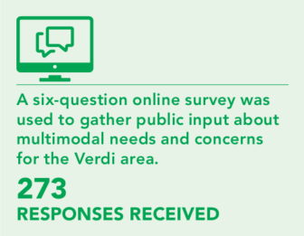
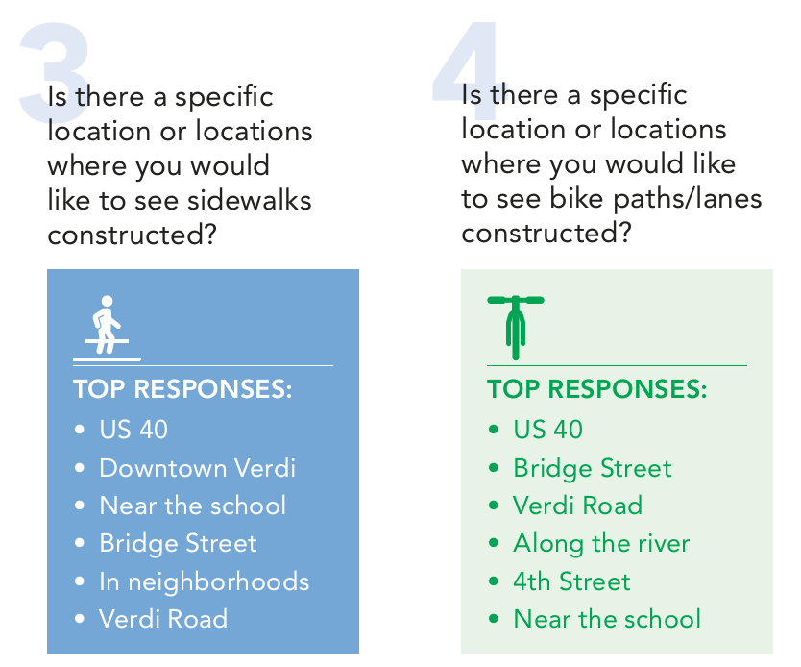
Public Outreach and Feedback
Coffee with the RTC Study Team – June 10, 2022
On-site tablets with survey
Fact sheets
Areas of Concern
Vehicular Speeds
Verdi Road
Bus Service
More Walkable/Bikeable
Better Freeway Access
Intersection Safety
Wildlife Concerns
No More Development
Leave Verdi Alone

Slide 8
Proposed Area Improvements - Interstate 80
Near Term (NDOT Contract 3947 – Begin Spring 2023)
Wildlife Fencing 
Removal of I-80 Rumble Strips 
Mid Term
Median Cable/Barrier Rail Installation
Bridge Improvements (IIJA Funding)
Widen I-80/Truckee Bridges (IIJA Funding)
Long Term
Widen I-80 to Three Lanes
Reconfigure/Reconstruct Gold Ranch Interchange and Bridge

Slide 9
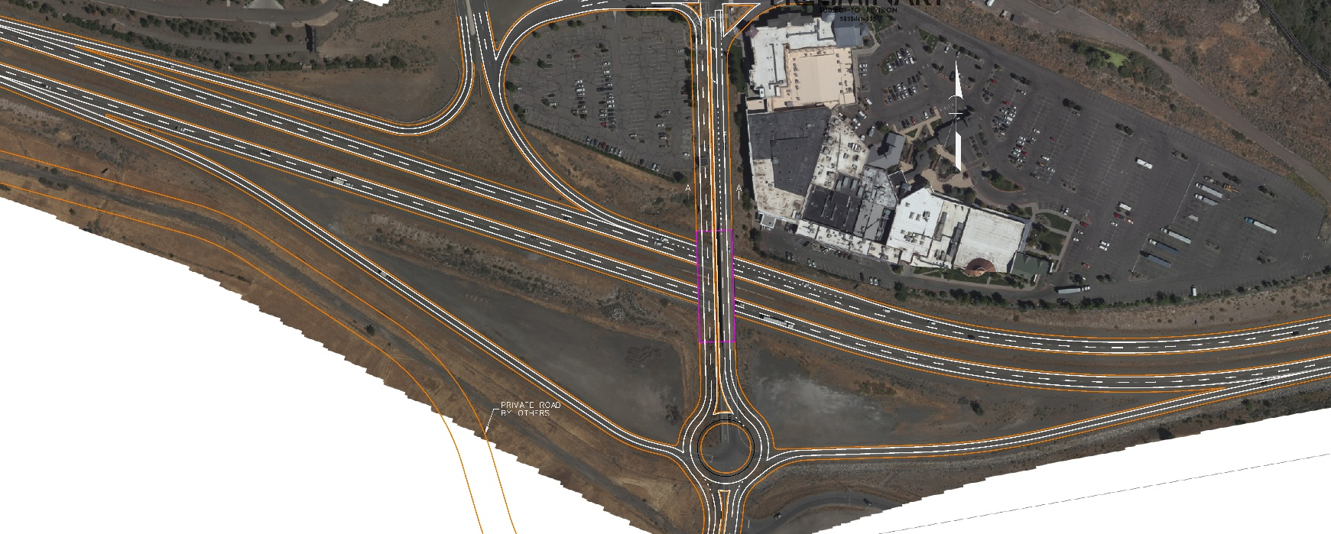
Proposed Area Improvements - Interstate 80
P-n-R

3rd Street


Gold Ranch Interchange
Garson Road
Garson Road Interchange
Preliminary Subject to Change

Slide 10
Proposed Area Improvements – Regional Roads
Vehicular
Verdi Road
Paved width 22’ and 2’ – 4’ gravel shoulders
Steep slopes each side (cut-south, fill-north)
Community concerns of cars going down slope
Portion within UPRR right-of-way
420 AADT (2021)
Poor cost/benefit & prioritization
Option 1 - $$$$
Two-way roadway – 11’ lanes and 2’ shoulders
Provide guardrail on north side
Significant retaining wall work on south side
5’-8’ tall
Option 2 - $
Convert to one-way
Provide guardrail
10’ travel lane, 8’ shared use path
Either option may require upgrades to UPRR/Bridge Street signal crossing

Slide 11
Proposed Area Improvements – Regional Roads
Pedestrians and Bicyclists
Enhance Edinburgh roundabout
Provide bicycle ramps to utilize crosswalks
Shared Use Paths
3rd Street
Bridge Avenue
3rd Street to Verdi Elementary
3rd Street to Verdi Road (UPRR Crossing)
Bridges
Truckee 3rd Street (east)
Truckee 3rd Street (west)
Canal 3rd Street
Crystal Peak Drive under I-80

Slide 12
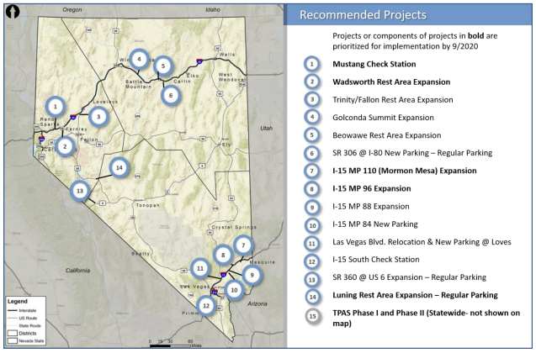
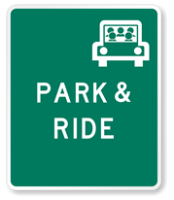
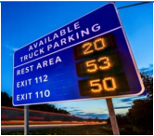
Proposed Area Improvements – Additional
Freight
Freight plan to continue addressing truck parking and advance notification of I-80 closures
Private parcels near Gold Ranch and Mogul & 4th Street
RTC regional freight study (upcoming)
Park-n-Rides
New Gold Ranch interchange
Partnership with Boomtown Casino
Transit
Focused educational outreach to Verdi area
Speed Management
Reduce lanes to 11’ on 3rd Street (US 40) from Exit 2 to Exit 5
Continue working with law enforcement

Slide 13
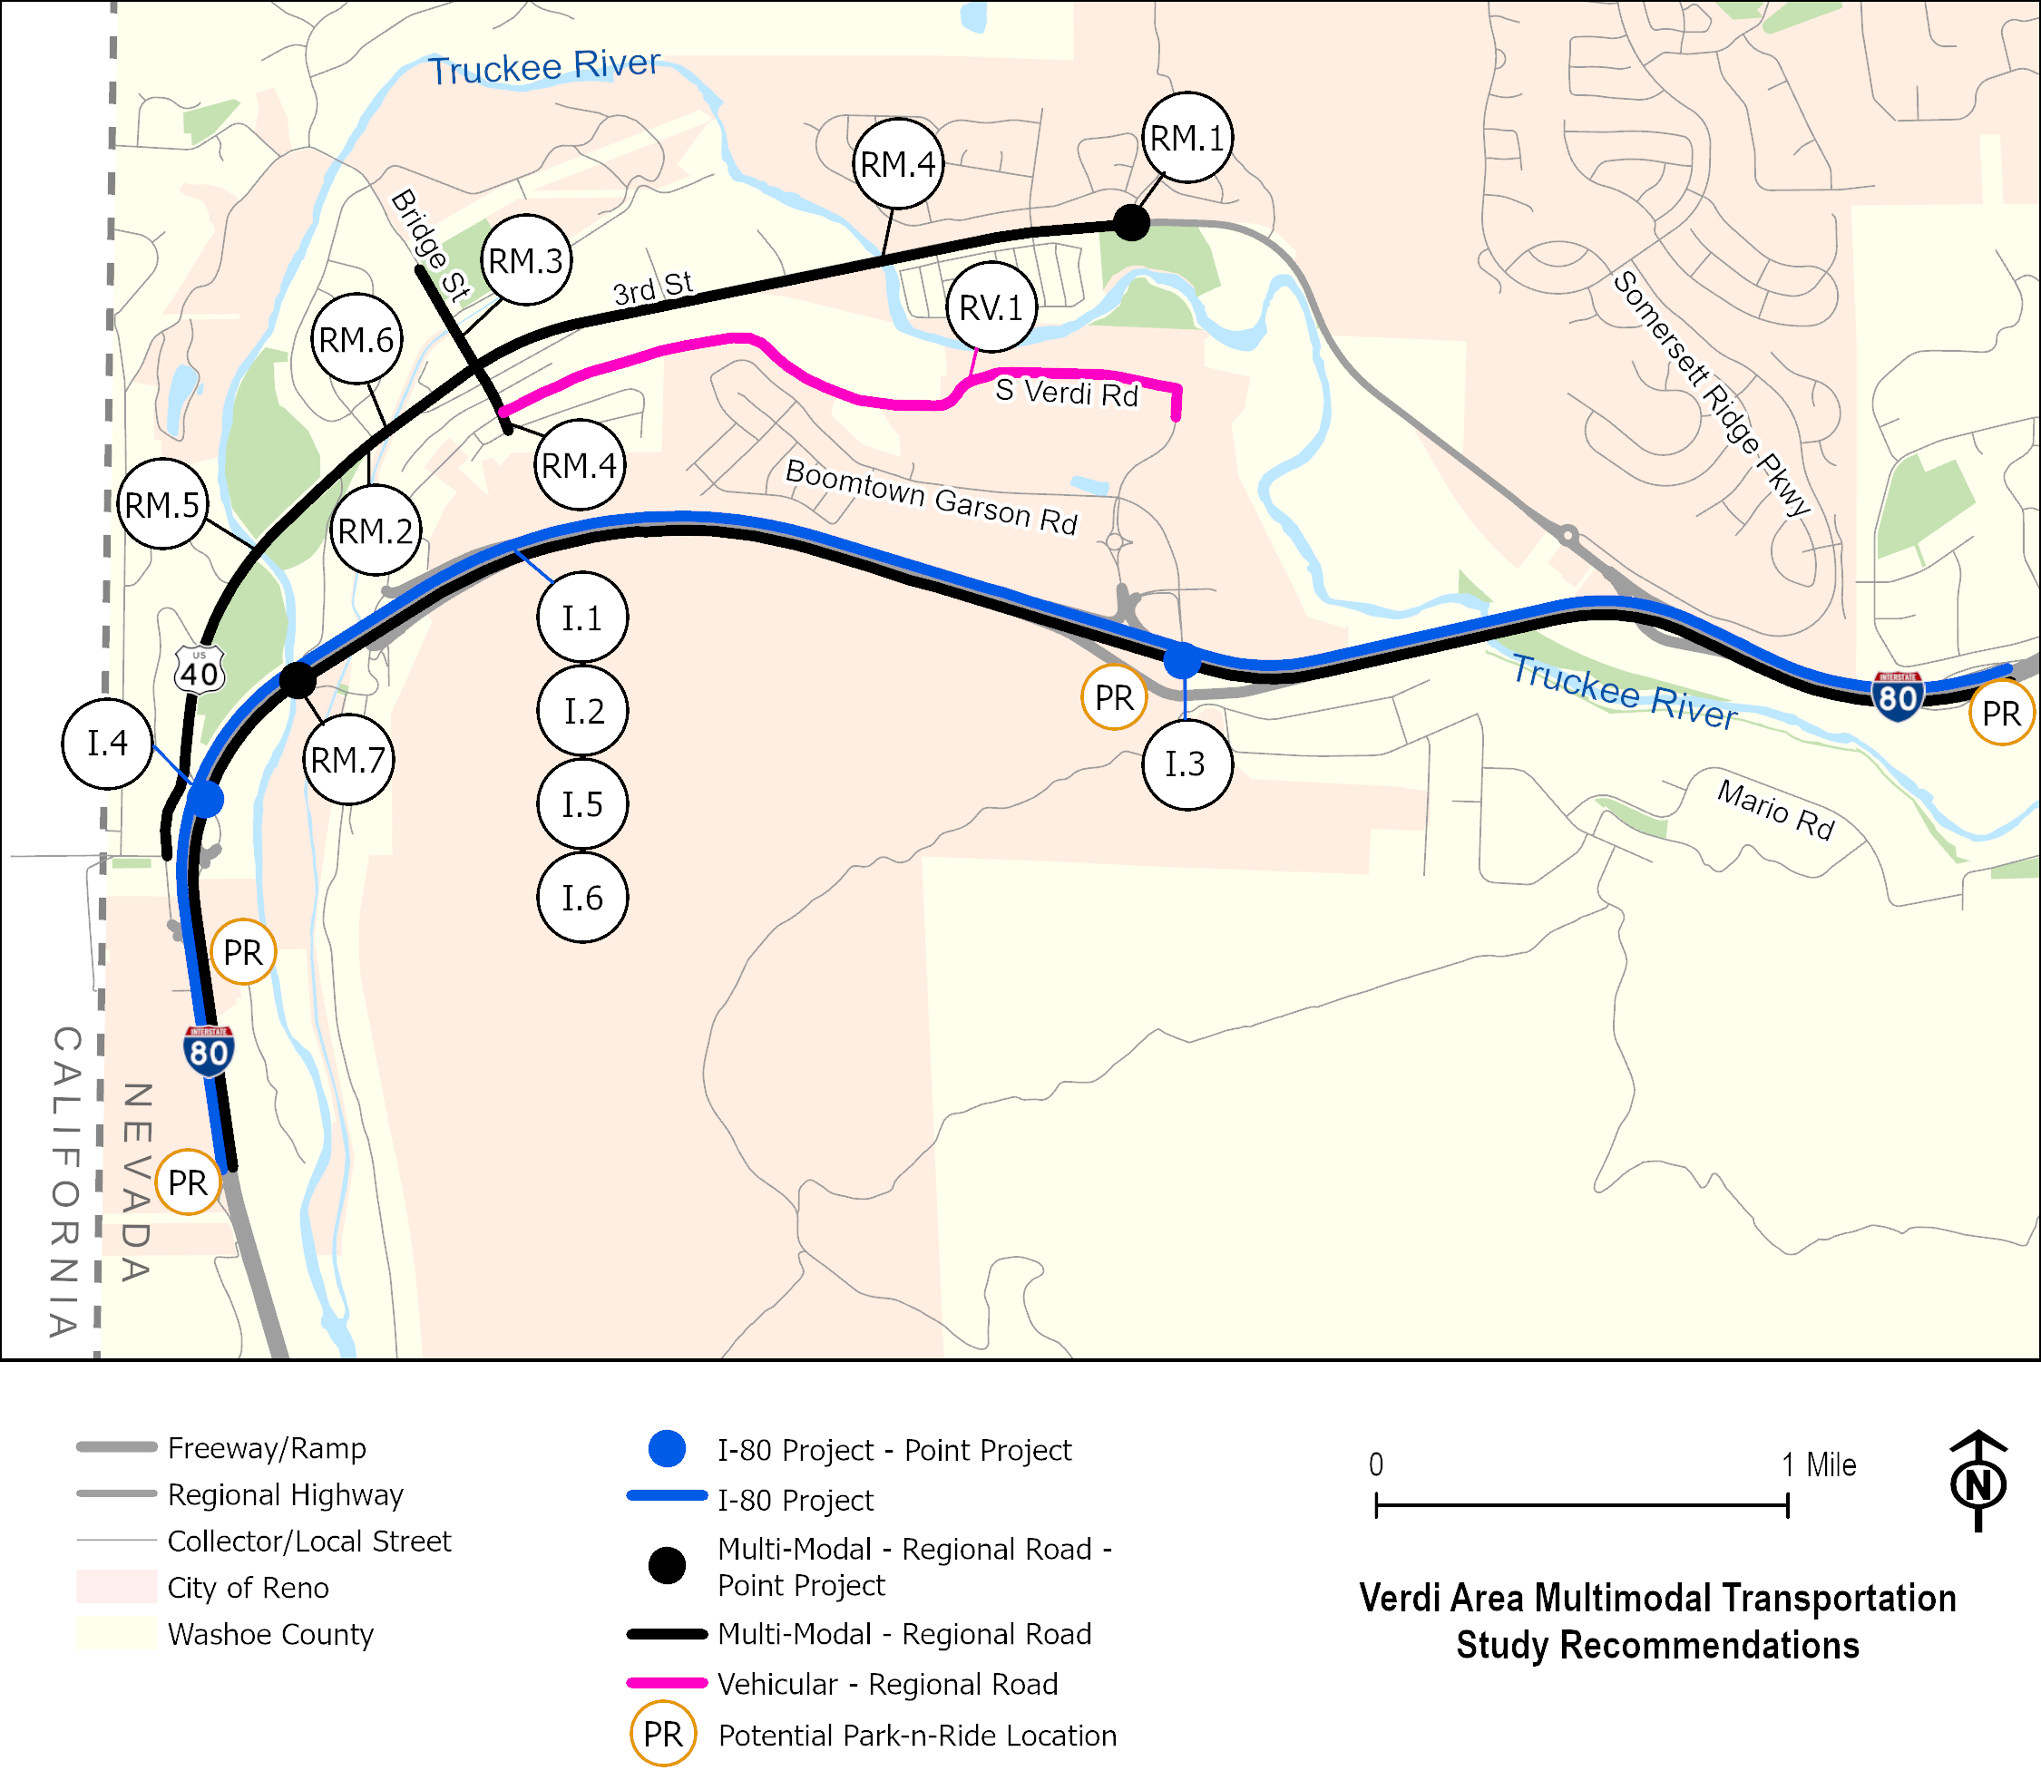
Proposed Area Improvements - Summary

Slide 14
Next Steps
Adjust recommendations based on CAB/NAB feedback
Prepare draft report
Solicit public feedback
Agency review
Address comments and submit final report

Slide 15
THANK YOU
Regional Transportation Commission of Washoe County
In association with
CA Group and Parametrix
Truckee Meadows/Verdi
Citizen’s Advisory Board Meeting
xwang@rtcwashoe.com
chad.anson@c-agroup.com
Building A Better Community Through Quality Transportation
rtcwashoe.com

