Slide 1

Opening Title

Slide 2
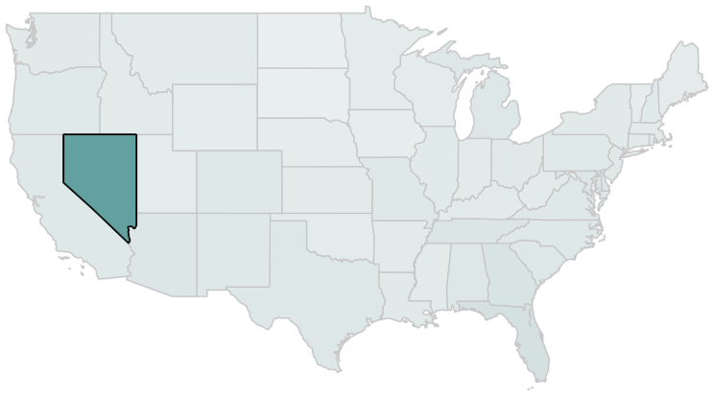
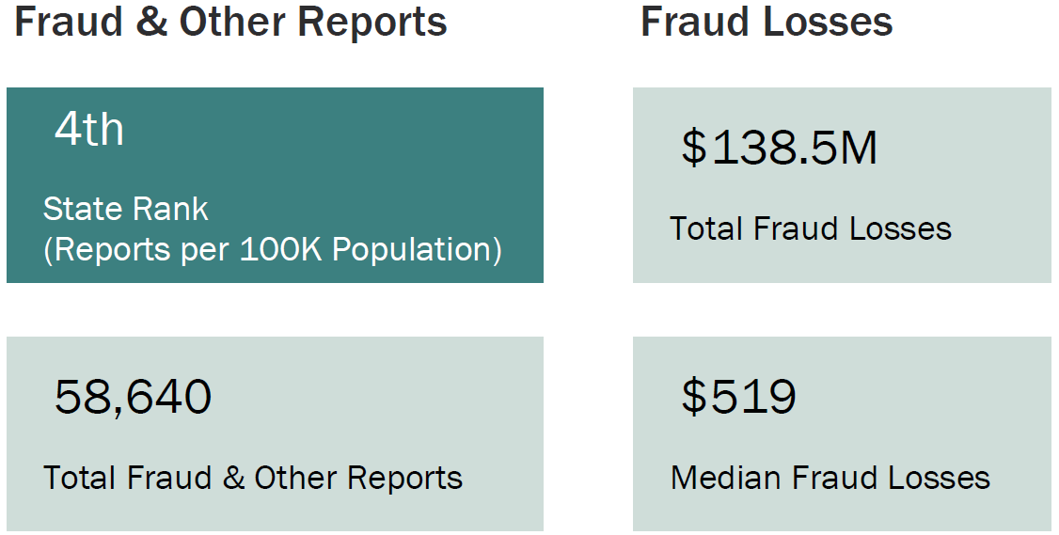
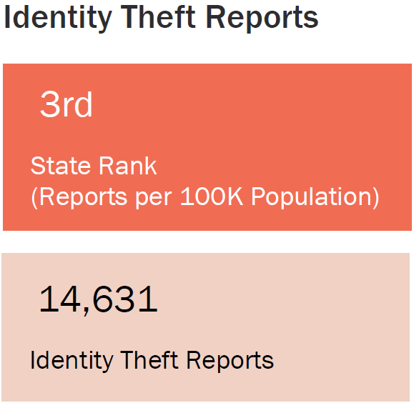
How Does Nevada Rank?
Source: Consumer Sentinel Network Data Book 2024

Slide 3
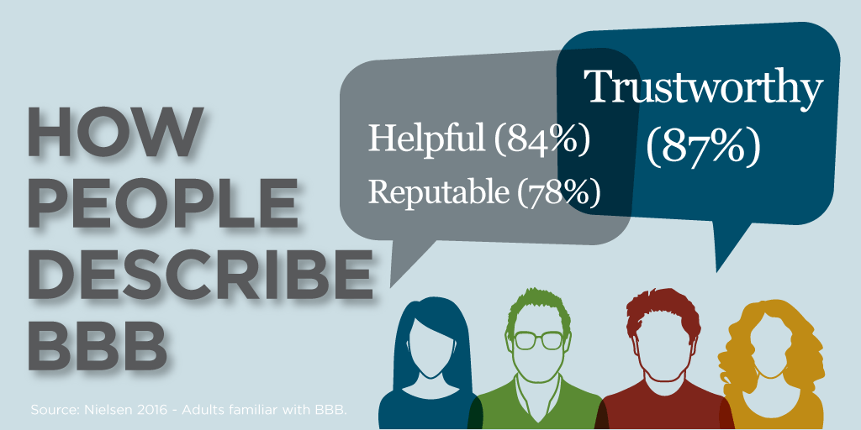
Who We Are
BBB Business Profiles
Charity Evaluations
Dispute Resolution
BBB Scam Tracker
Customer Reviews
Consumer/Business Education
The Better Business Bureau is a not-for-profit organization established in 1912 by legitimate business owners to raise the bar for ethical business.

Slide 4
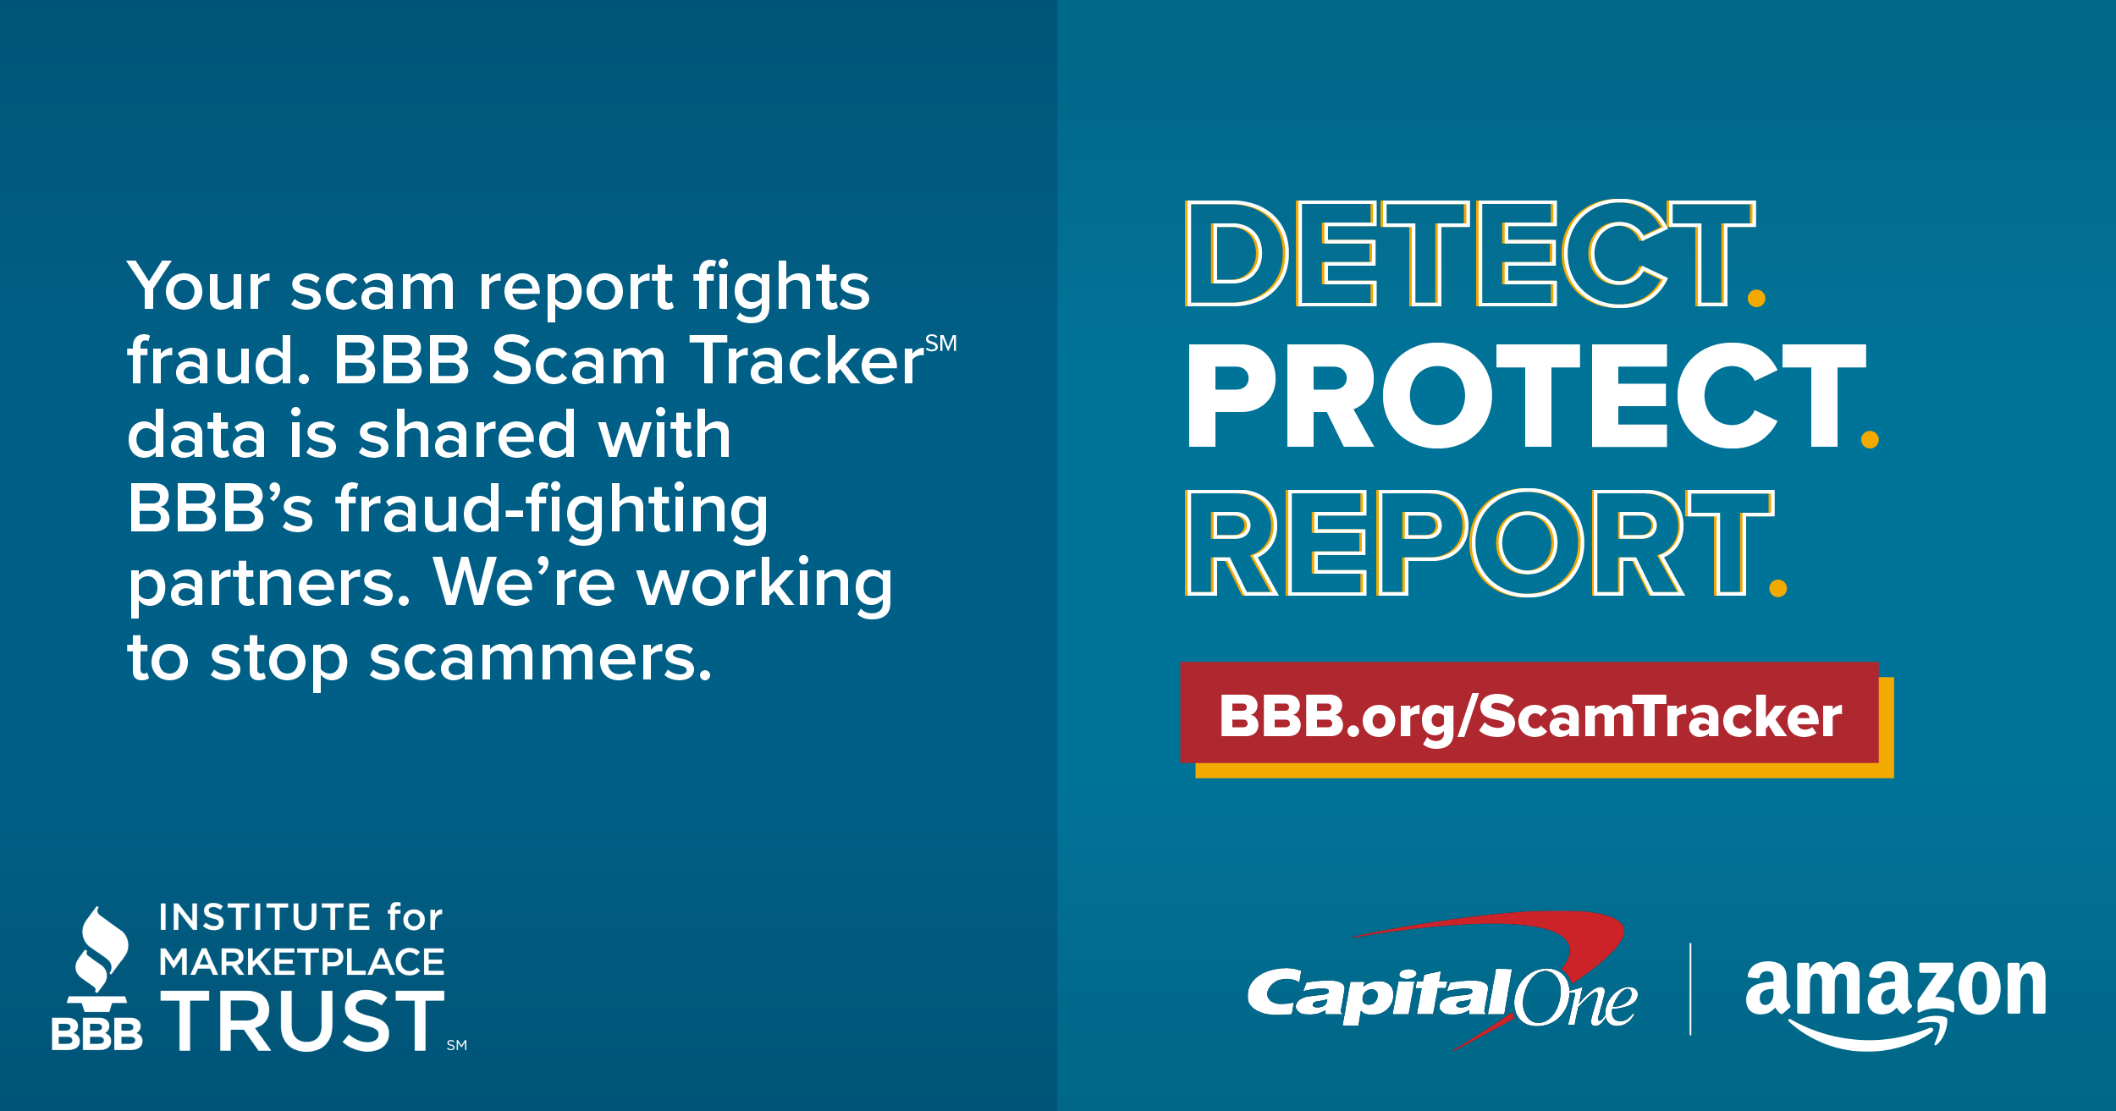
BBB Scam Tracker

Slide 5
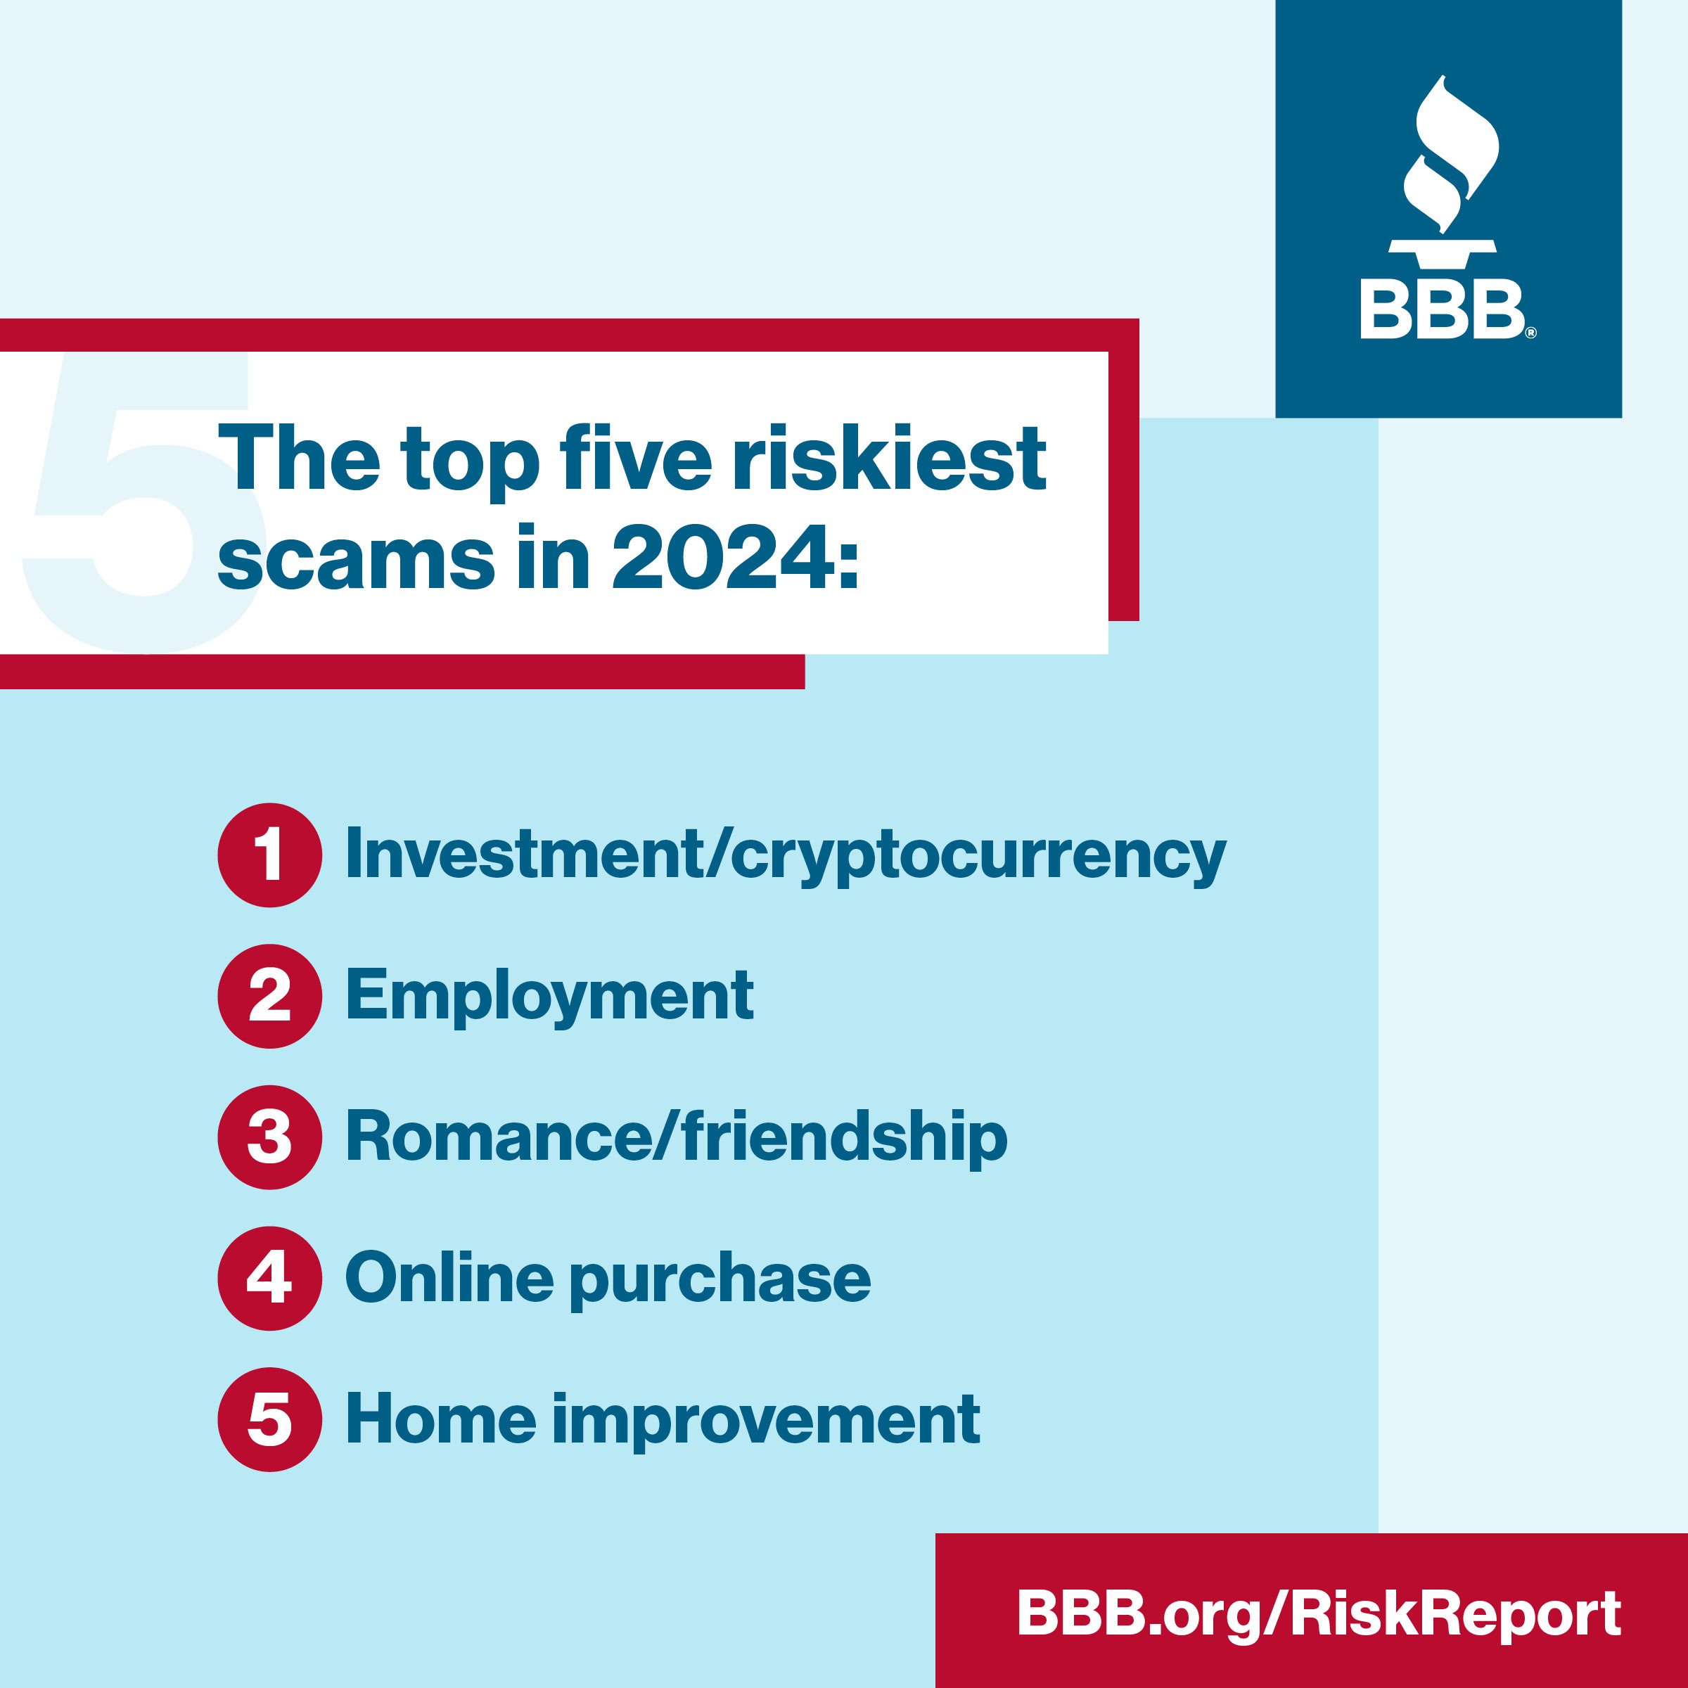
BBB Scam TrackerSM

Slide 6
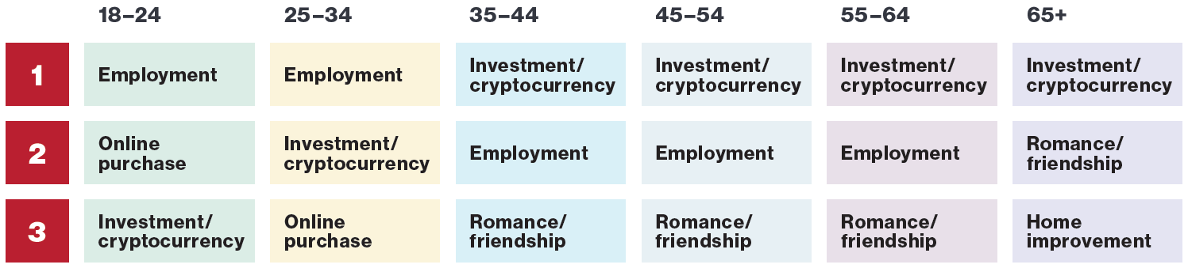
Riskiest Scams By Age

Slide 7
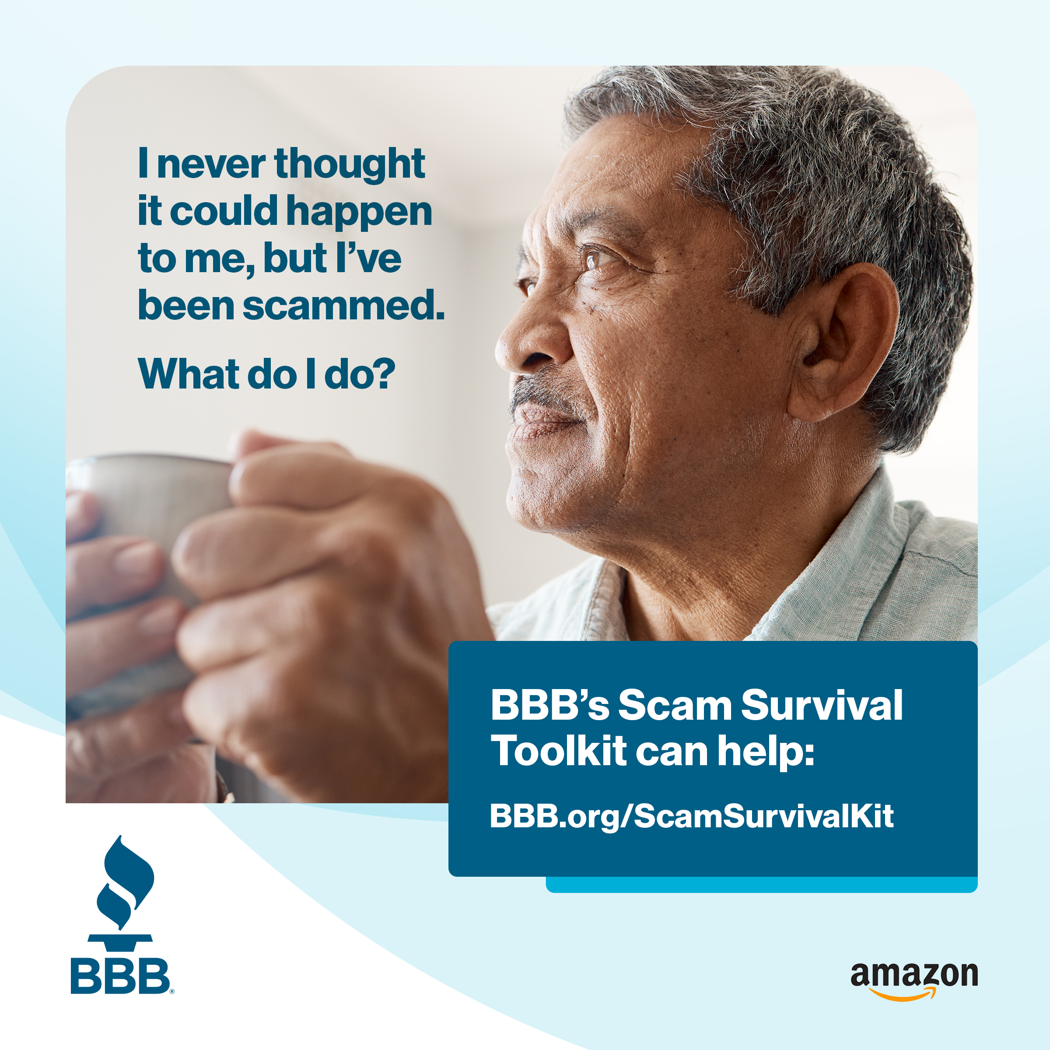
BBB’s Scam Survival Toolkit

Slide 8
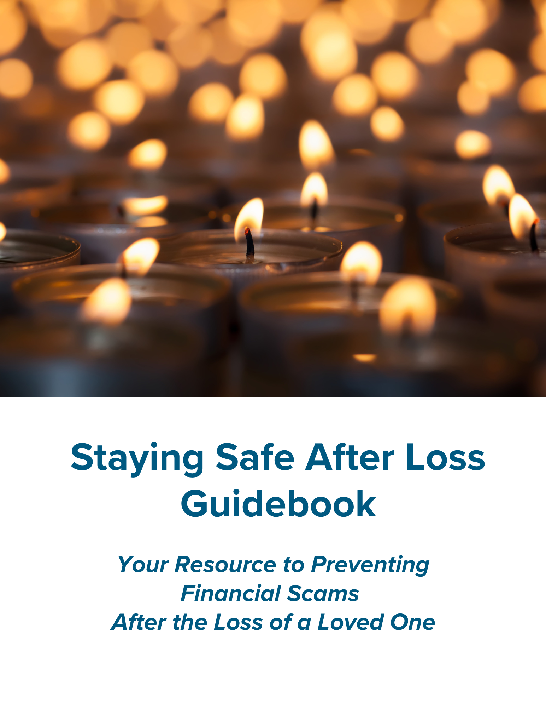
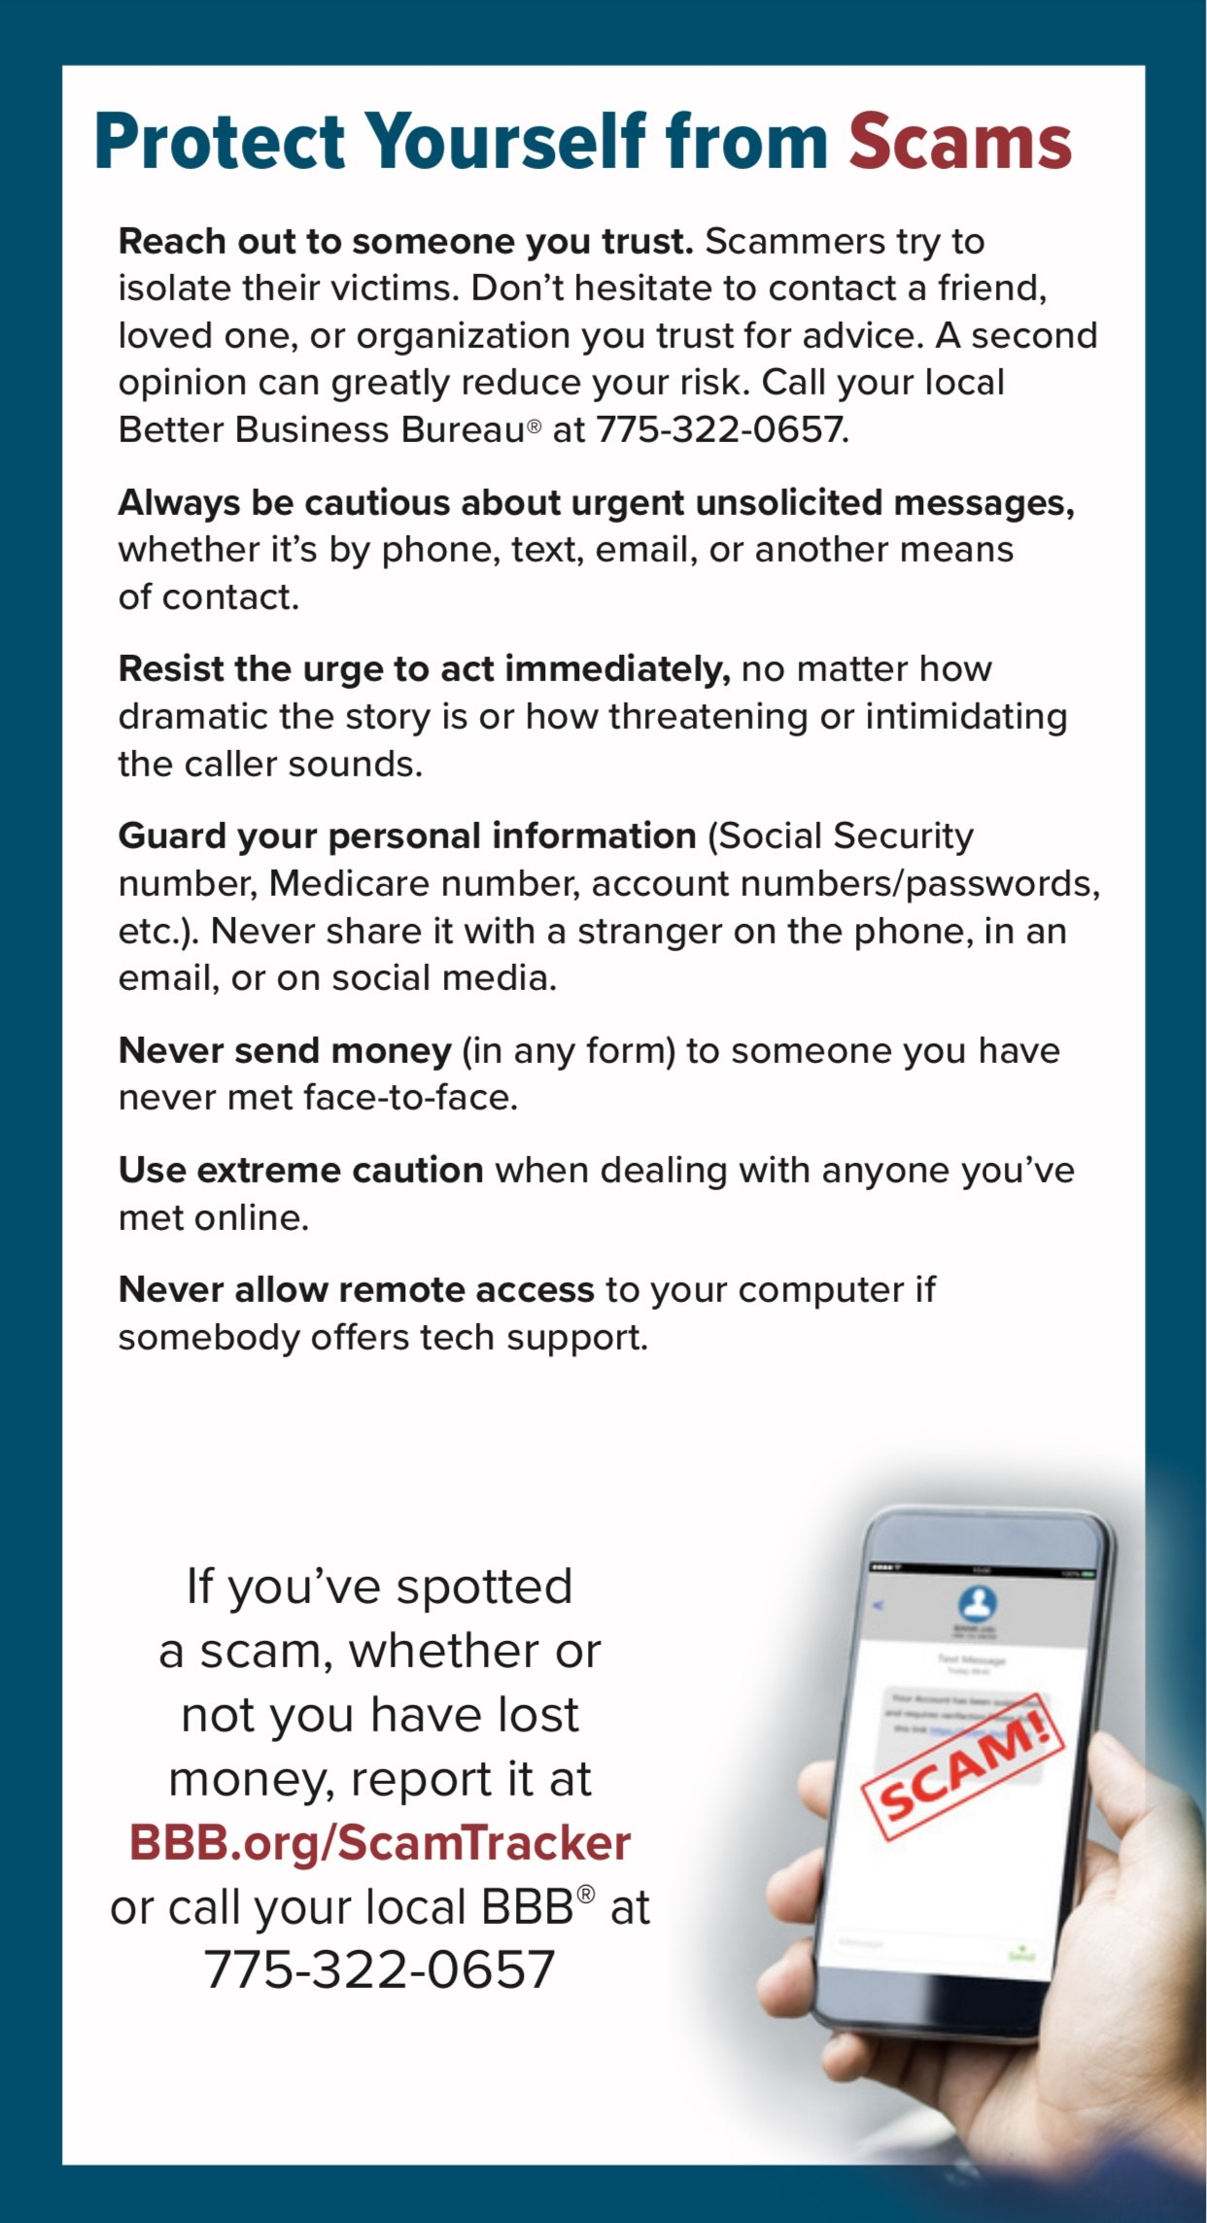
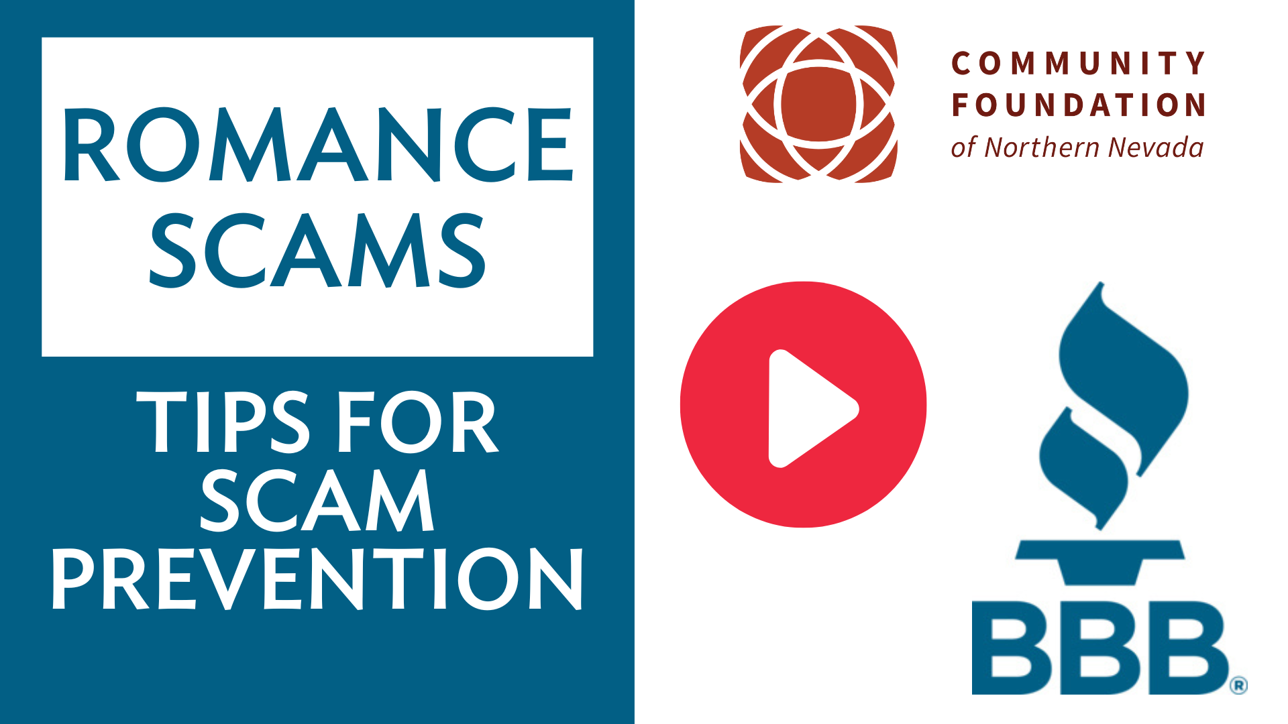
Preventing Financial Scams
BBB.org/Reno

Slide 9
REPORT
BBB.org/ScamTracker
ReportFraud.ftc.gov
IC3.gov
ConsumerAffairs.nv.gov
ag.nv.gov

Slide 10
THANK YOU!
Timothy Johnston, Vice President
tjohnston@mw.bbb.org
775-322-0657
BBB.org

