Slide 1
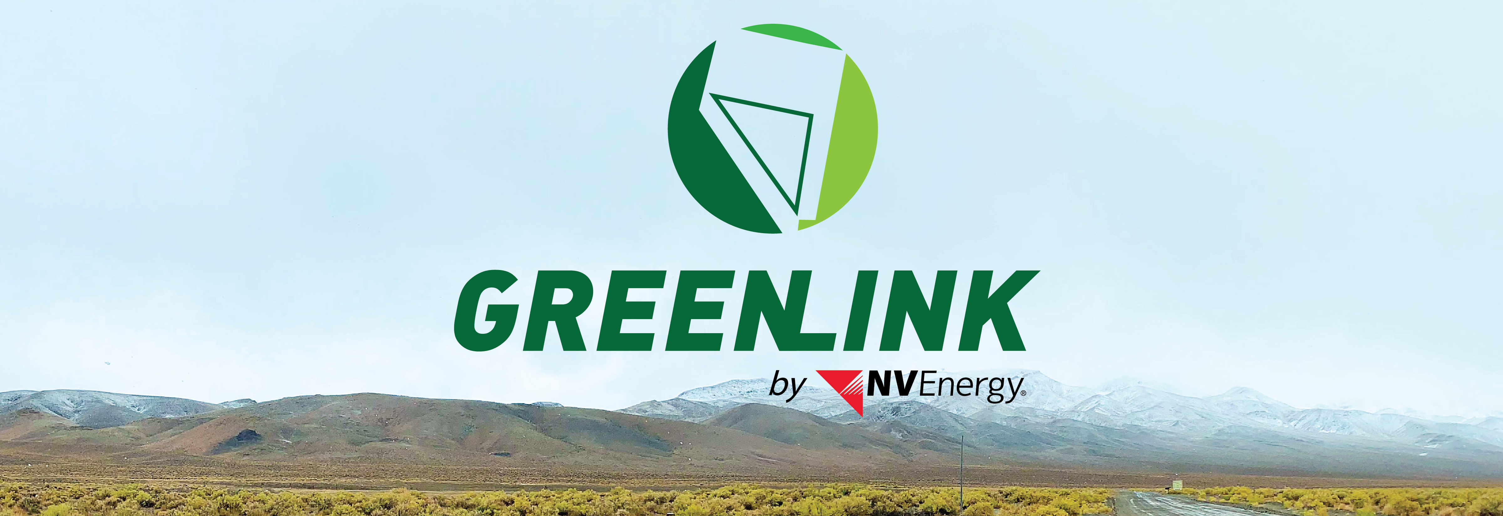

South Truckee Meadows/Washoe Valley
Citizen Advisory Board
Charles Hutchinson, AICP
Permitting Manager

Slide 2

Agenda
Welcome and Introductions
Greenlink Nevada Transmission Project
Common Tie Component
Local Government Permitting
Construction Activities
Questions & Answers
Project Contact Information

Slide 3
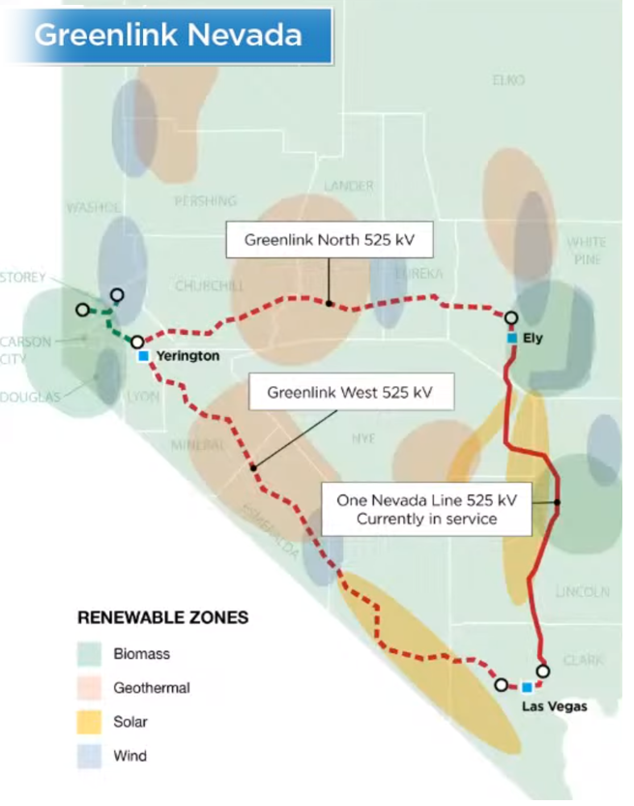
Greenlink Nevada Transmission Project
Greenlink Nevada is a transmission initiative that will make Nevada a leader in the clean energy economy
System Reliability
Improves system reliability and ability to transfer electricity within Nevada and to other states
Increases system capacity to serve public energy needs
Economic Benefits
Generates economic activity and creates good-paying jobs statewide
Helps facilitate long-term, statewide economic growth in northern and southern Nevada
Environmental Benefits
Moves Nevada closer to a future powered by 100% renewable energy and reduces Nevada’s carbon footprint

Slide 4
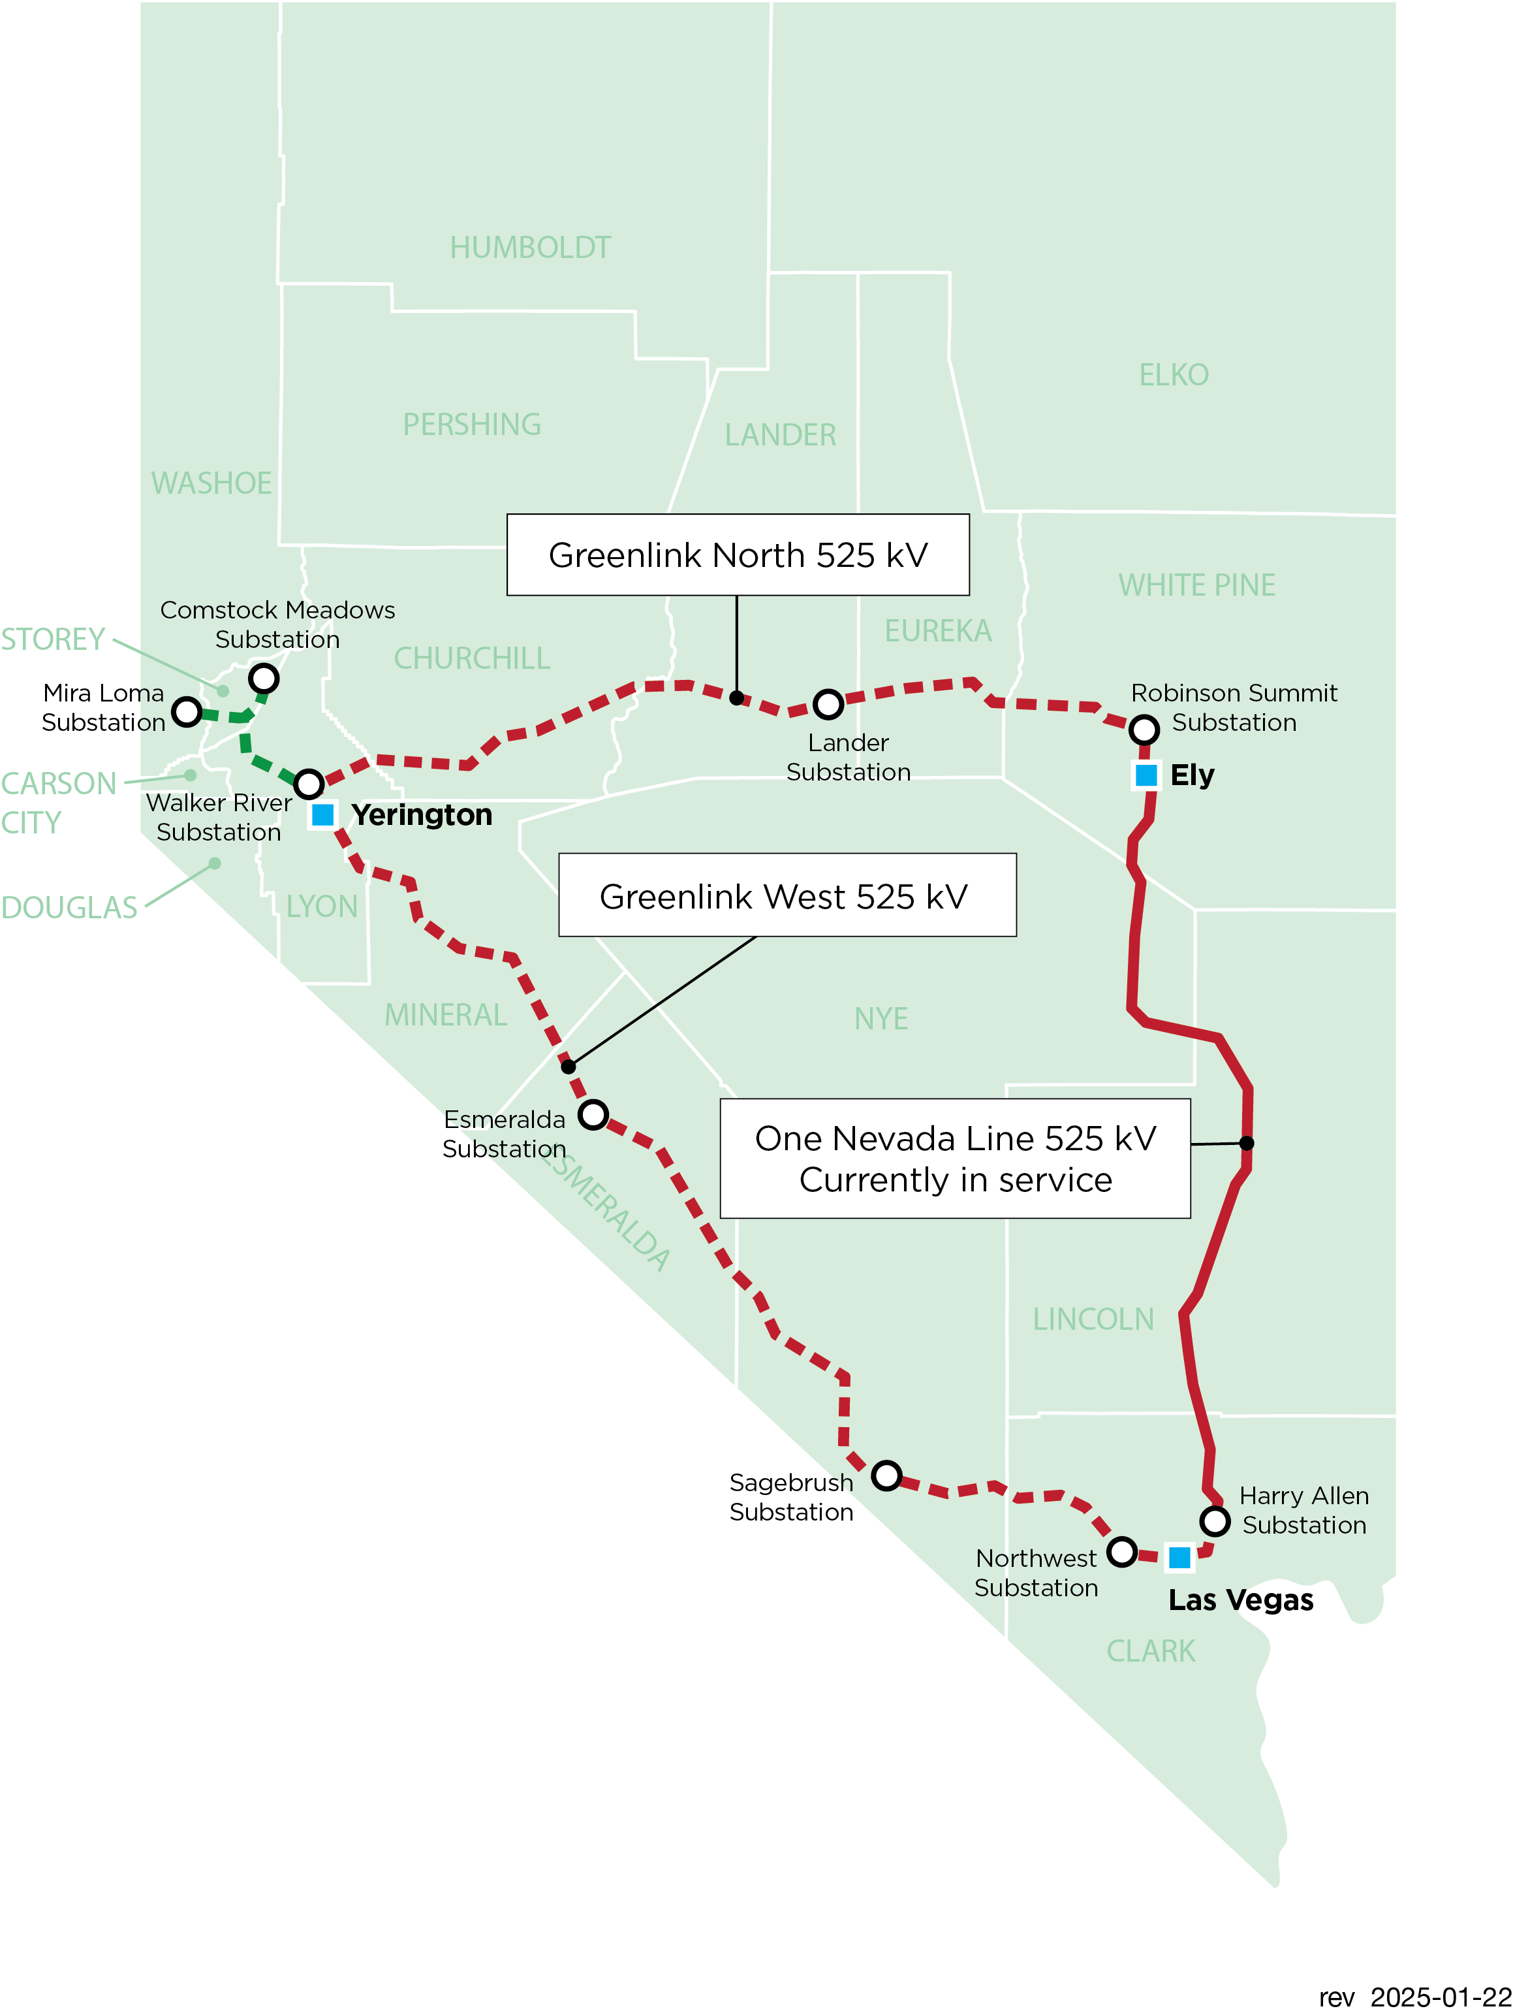
Greenlink Nevada Transmission Project
Greenlink West
Northwest to Walker River (Fort Churchill) 525 kV Transmission Line
Harry Allen to Northwest 525 kV Transmission Line
Northwest Substation expansion
Sagebrush (Amargosa) & Esmeralda 525/230 kV collector substations
Common Tie
Walker River (Fort Churchill) 525/345/230/120 kV Substation
Mira Loma to Walker River (Fort Churchill) 345 kV Transmission Line
Comstock Meadows #1 to Walker River (Fort Churchill) 345 kV Transmission Line
Comstock Meadows #2 to Walker River (Fort Churchill) 345 kV Transmission Line
Mira Loma Substation
Comstock Meadows Substation
Greenlink North
Robinson Summit to Walker River (Fort Churchill) 525 kV Transmission Line
Lander 525/230 kV Collector Substation
Robinson Summit 525/230 kV Substation

Slide 5
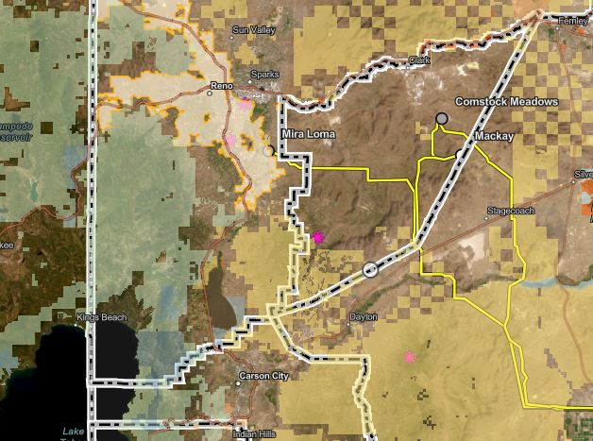
Common Tie Component
345 kV Transmission Line Routes
Existing Substation
Microwave Site
Land Jurisdiction
BLM – tan
BOR – orange
State of Nevada – blue
City of Reno – white
Private – unshaded
County Boundary

Slide 6
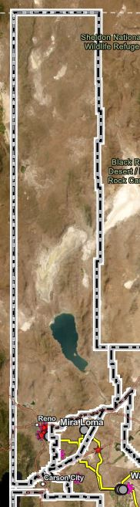
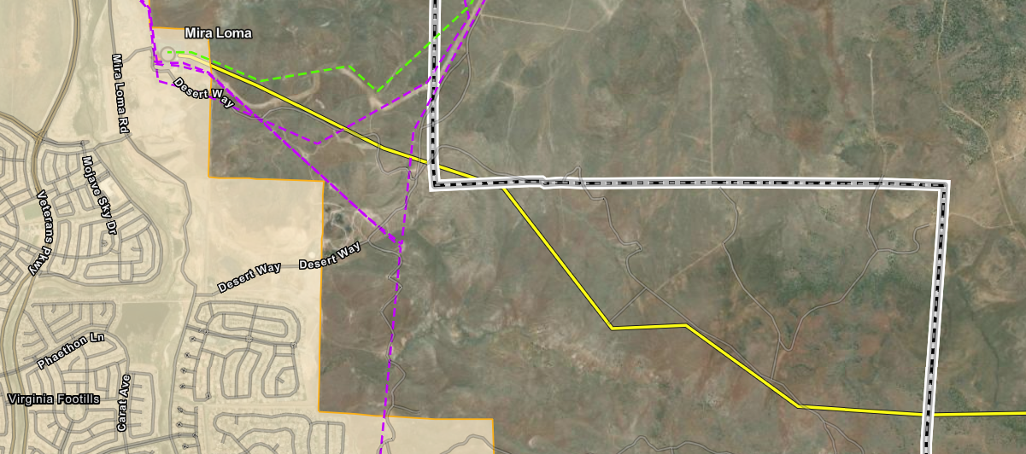
Common Tie Component Transmission Line Route in Washoe County
Storey County
City of Reno
Washoe County
Proposed Mira Loma – Walker River 345 kV Transmission Line
Existing 120 kV Transmission Line
Existing 345 kV Transmission Line

Slide 7
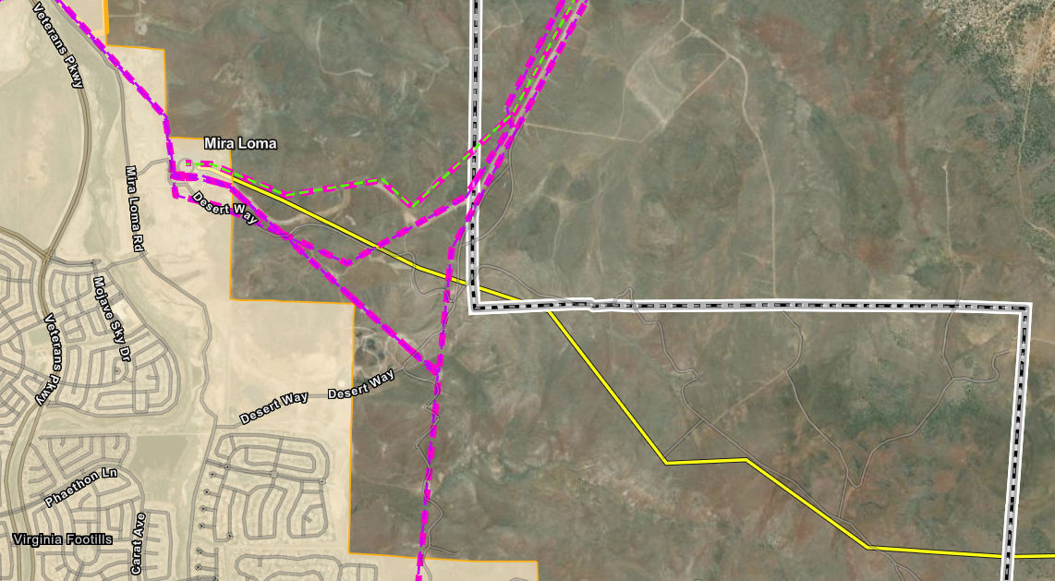
Common Tie Component Transmission Line Route in Washoe County
Storey County
City of Reno
Washoe County
Proposed Mira Loma – Walker River 345 kV Transmission Line
Truckee Meadows Regional Planning Agency Utility Corridor
-------------------

Slide 8
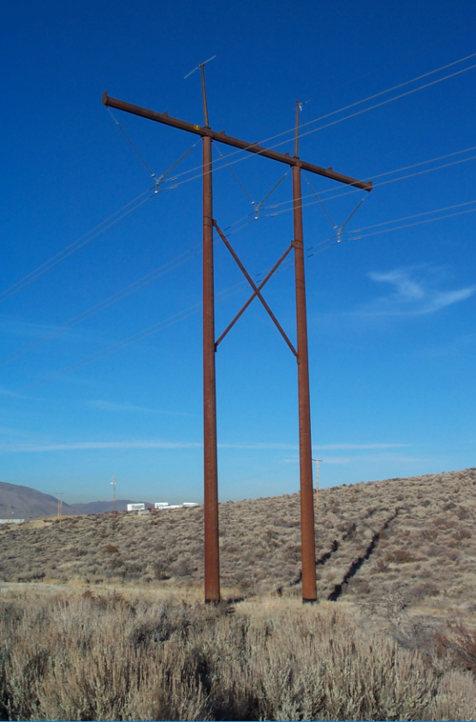
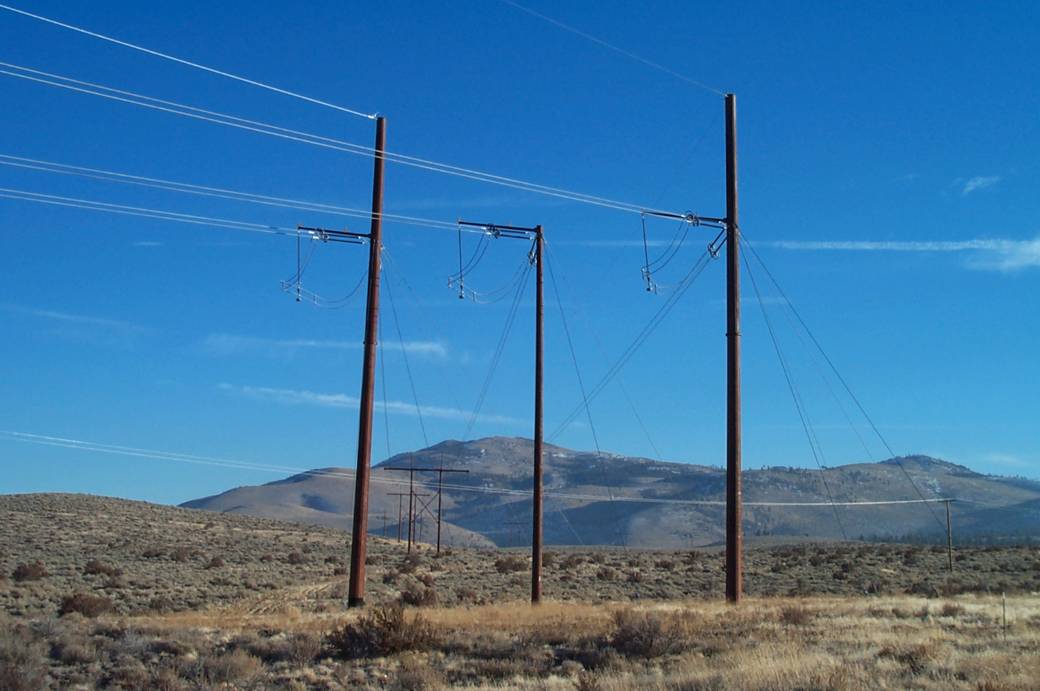
Common Tie Component Typical 345 kV Transmission Structures
H-Frame Tangent Structure
Height Range: 85’-125’ Typical
160’ Maximum
3-Pole Dead-End and Angle Structures
Height Range: 75’-140’

Slide 9
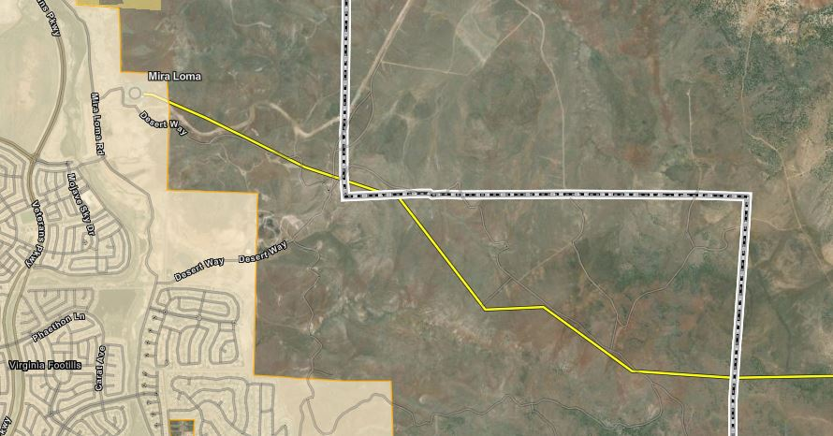
Common Tie Component Transmission Line Route in Washoe County
1.1 miles
2.3 miles

Slide 10
Local Government Permitting Washoe County
Current Permitting and Construction Schedule
Mira Loma – Walker River 345 kV Transmission Line
Planning Commission Public Hearing June 2025*
Board of County Commissioners (BOCC) Public Hearing July 2025*
Receive Approval from BOCC July 2025*
Construction Schedule October 2025 – January 2027*
* Expected

Slide 11
Regional Planning Truckee Meadows Regional Planning Agency
Review Process
Mira Loma – Walker River 345 kV Transmission Line
NV Energy submits Special Use Permit (SUP) application to Washoe County.
Washoe County sends SUP application to TMRPA and requests comments.
TMRPA will respond with an Initial Review Memorandum.
Official TMRPA review process does not begin until Washoe County BOCC approves SUP application.
TMRPA review process is approximately 30-60 days, depending on the schedules for Regional Planning Commission and Regional Planning Governing Board.
TMRPA approval: September 2025 (expected)

Slide 12
Construction Activities
Construction Sequence
Surveys for special status plants, wildlife, and cultural resources
Access road improvements, where needed
Right-of-way surveying and staking
Foundation installation
Transmission structure installation
Wire-stringing
No long-term impacts to wild horse populations
No temporary or permanent work camps established along transmission line route
No fences, walls, or barricades erected
No obstructions to water sources
Minimal land converted to utility use, i.e., transmission structure footprints
Grazing can continue after work at a particular transmission structure is complete
The

Slide 13
Questions & Answers

Slide 14
For more information…
Project Contact Email:
Greenlink@nvenergy.com
Visit us at:
http://www.nvenergy.com/greenlink

