Slide 1

Getting Defensive
How to prepare you home for Wildland Fires

Slide 2
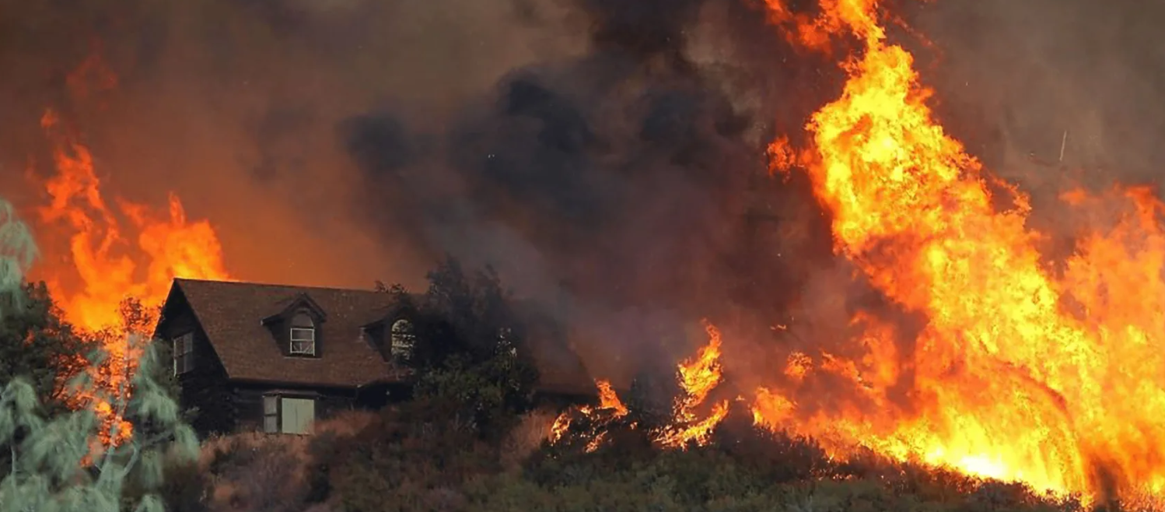
The Biggest Drivers of
Wildland Fire in the WUI
Fire Weather Factors
Increased Temperatures
Low Relative Humidities
Extreme “Red Flag” conditions in the Summer
High winds before fall/winter storms
Ember Fall out
Local Factors
Proximity to unmanaged lands (Wildland Fuels)
Fuel buildup around structures
Home ignitability
When Should I Start Paying Attention?

Slide 3
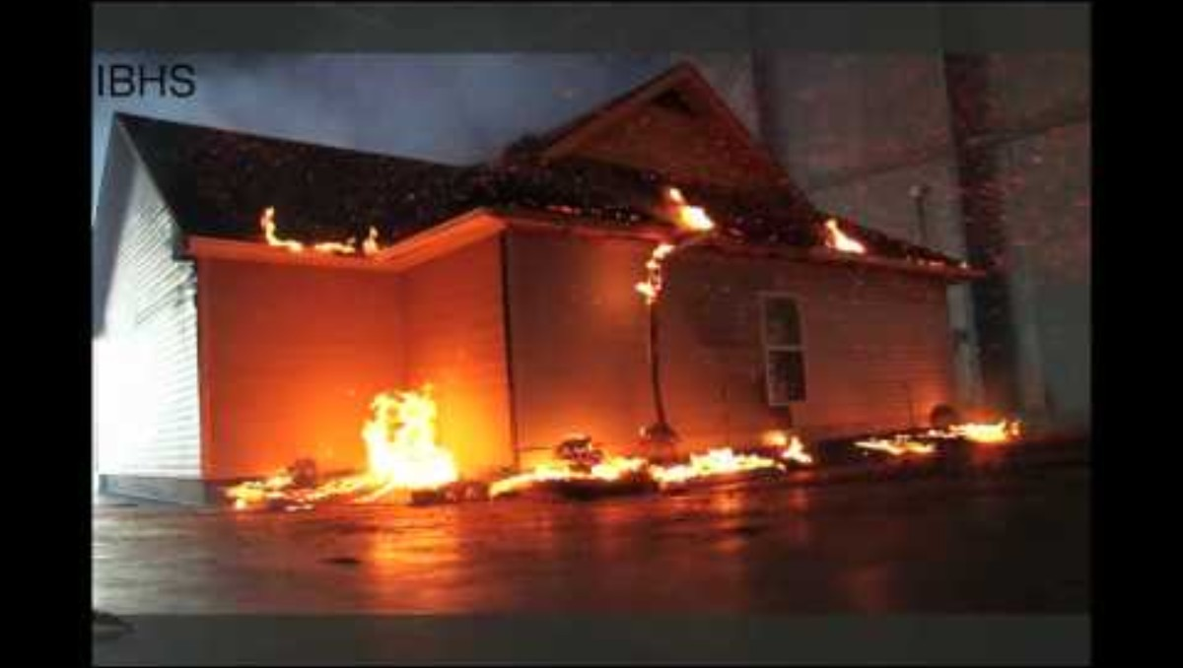

Slide 4
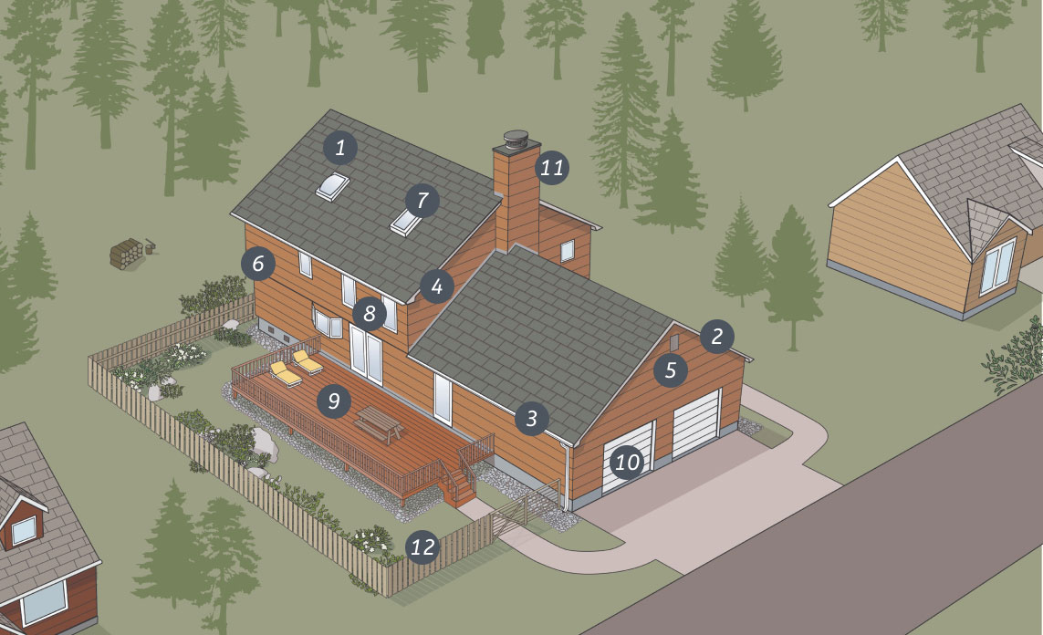
Home Hardening
The Built Environment
Improve the fire-resistant qualities of you home by making changes to your:
  Roof
  Eaves
  Rain Gutters
  Vents
  Siding
  Decks
  Fences
  Garages
Livingwithfire.org

Slide 5
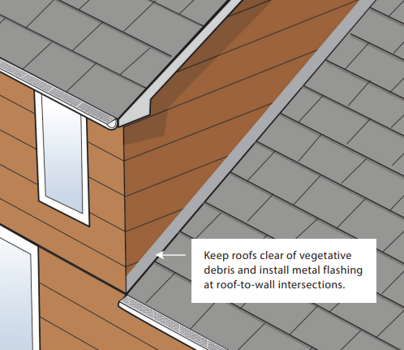
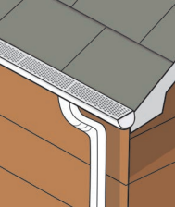
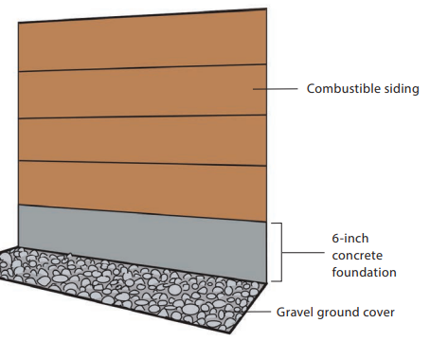
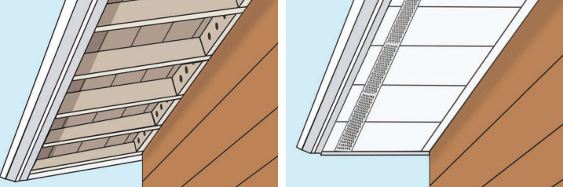
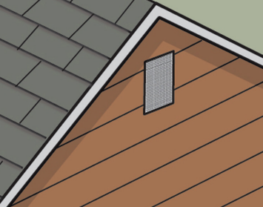

Slide 6
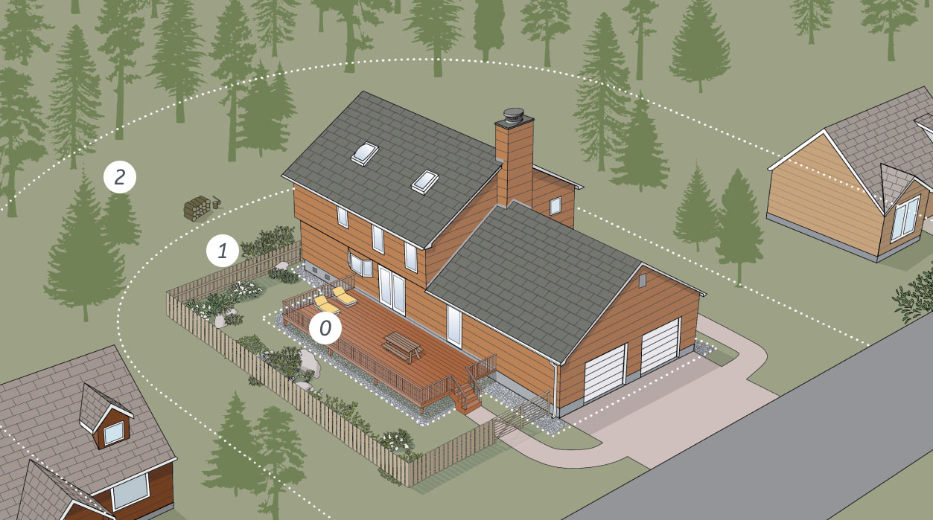
DEFENSIBLE SPACE What is it? Why it Matters?
DEFENSIBLE SPACE IS THE BUFFER AROUND A HOME where the vegetation has been managed to reduce the wildfire hazard. Creating defensible space increases the chance of home survival and provides a space for firefighters to safely defend the home during a wildfire event.
ZONE 0 - Ember-Resistant Zone (0-5 feet)
ZONE 1 - Lean, Clean, Green Zone (5-30 feet)
ZONE 2 - Reduced Fuel Zone (30-100+ feet)
Livingwithfire.org

Slide 7
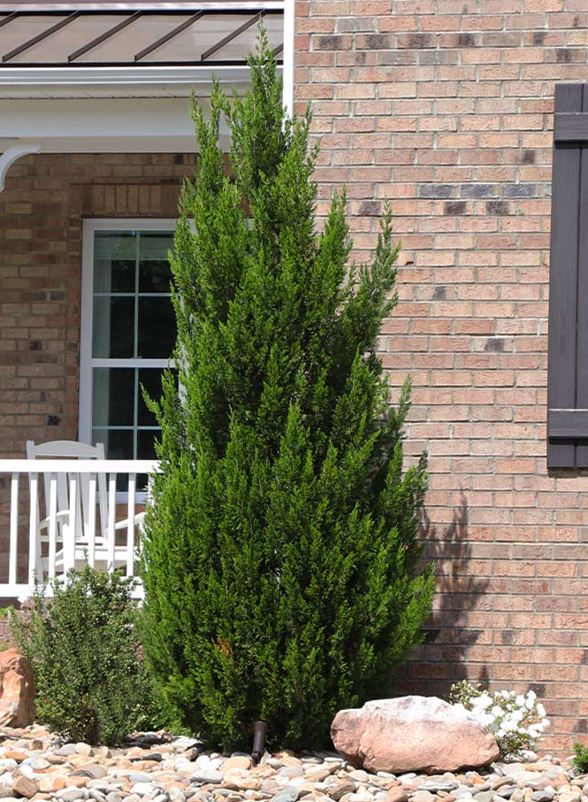
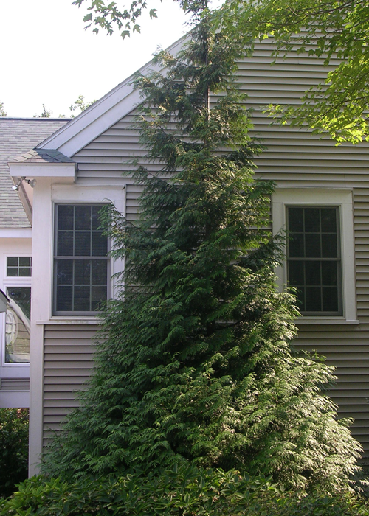
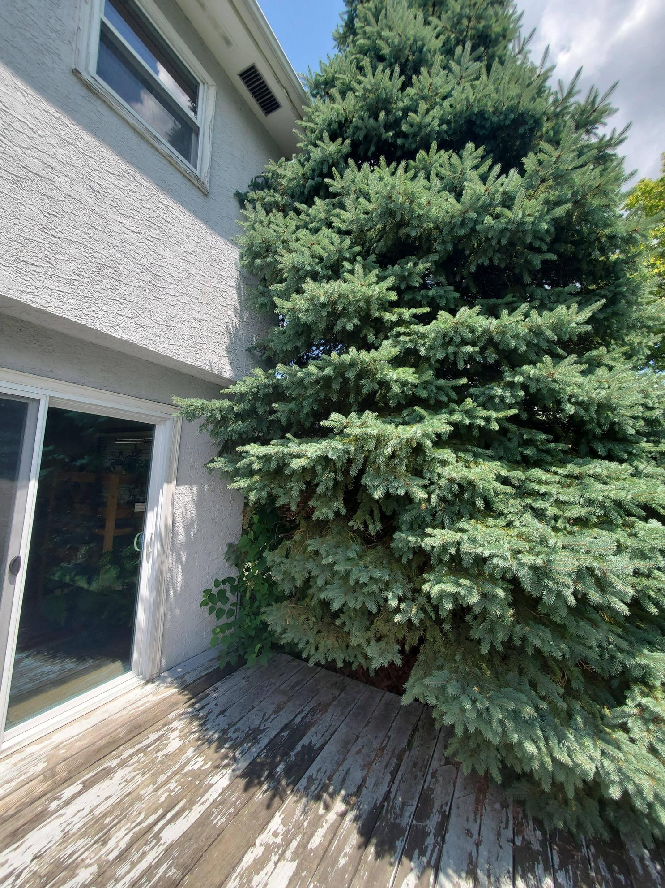
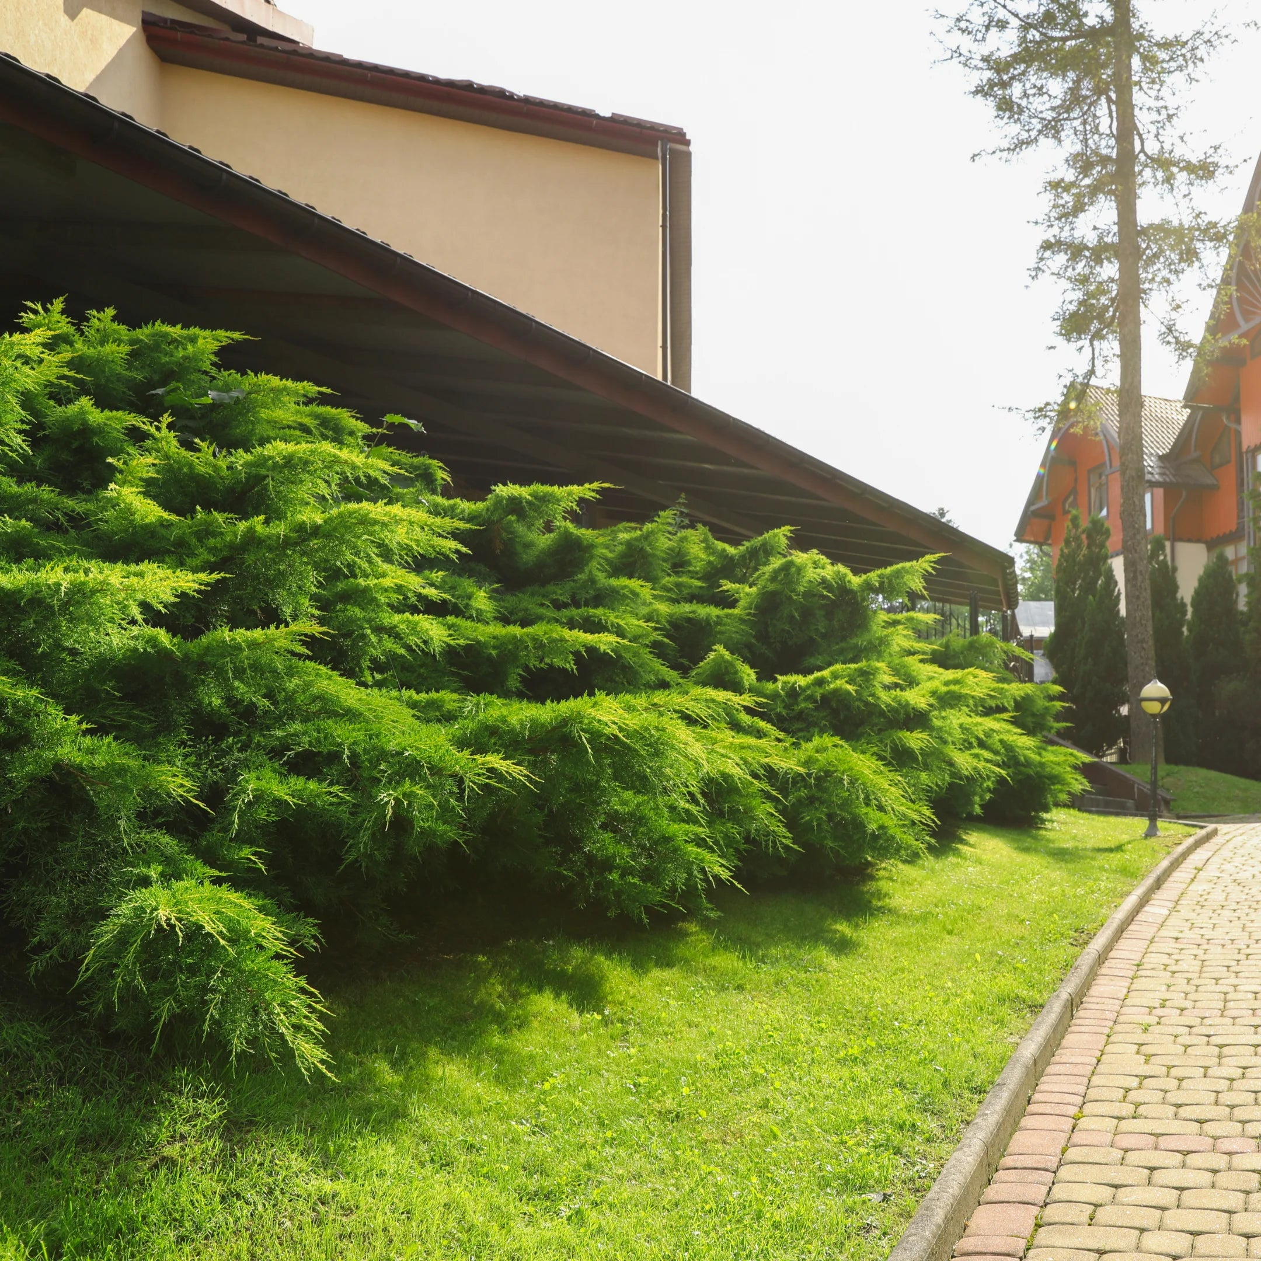
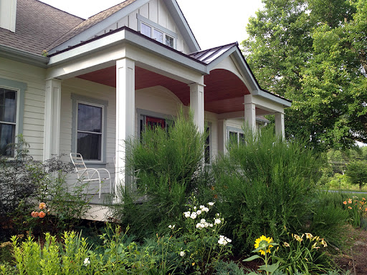
DEFENSIBLE SPACE Mitigation Actions in Zone 0
Eliminate all vegetation in the ember-resistant zone. However, if that is not possible…
Use gravel, decomposed granite, rock, concrete, brick, pavers or other hardscape features to create an ember-resistant zone
Do not plant shrubs, bushes, trees or any woody vegetation under first-story windows or soffit vents, in front of foundation vents, or in corners.
Remove woodpiles, wood mulch or flammable vegetation. Flammable vegetation includes juniper, Mugo pine, Austrian black pine, Arborvitae, cedar, large exotic grasses and Scotch broom.
Remove the dead and dying vegetation, such as trees, shrubs, branches, leaves, twigs, grass, weeds, and pine needles.

Slide 8
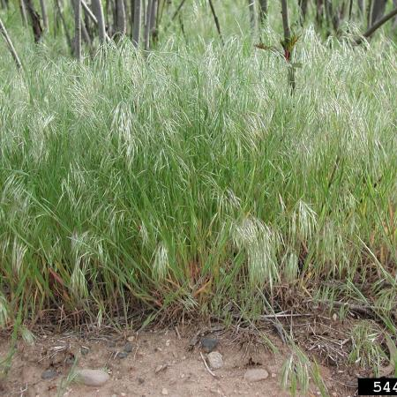
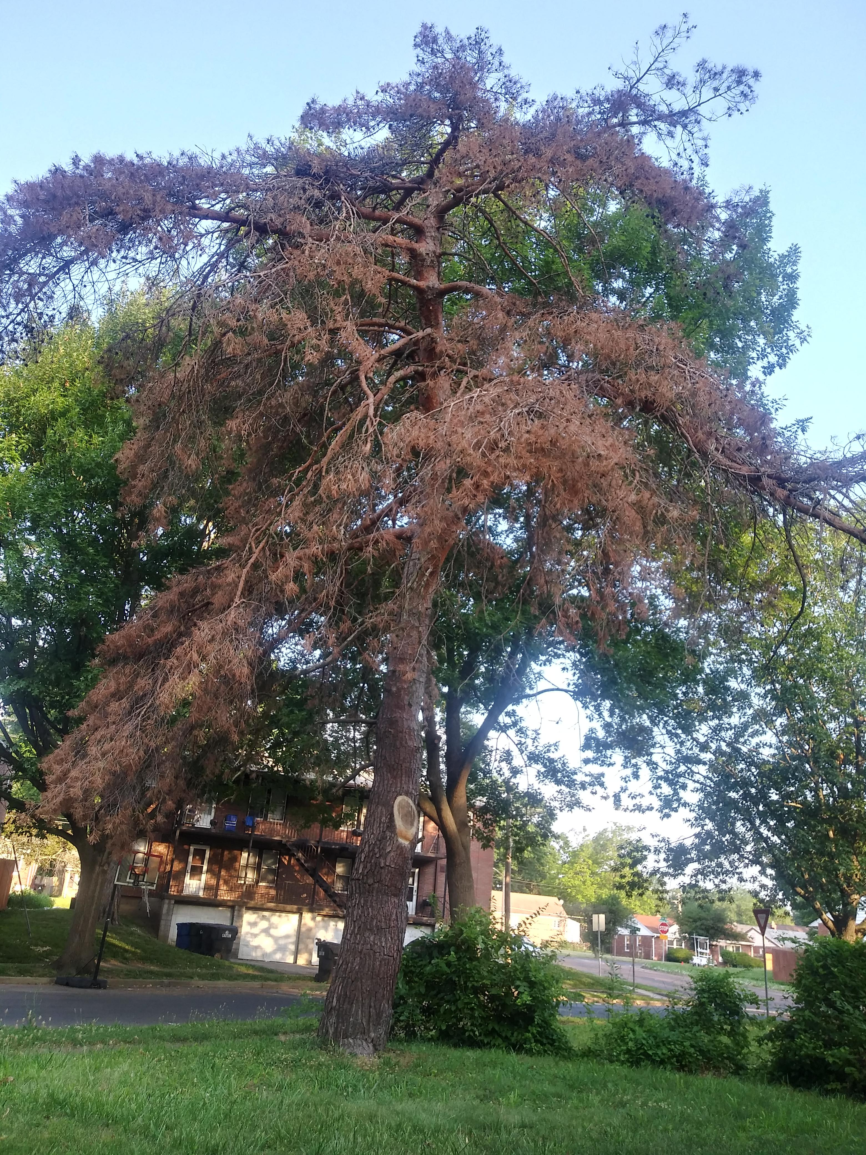
DEFENSIBLE SPACE Mitigation Actions in Zone 1
Trim tree branches within 10 feet of the home, chimney, deck or roof and within 10 feet of other trees.
Limit the use of wood mulch to create “islands” of mulch by surrounding the mulch with green, irrigated vegetation or hardscape/ignition-resistant materials to prevent the flammable mulch from extending to the home.
Remove dead vegetation, including shrubs, trees, dried grass, flowers, weeds, twigs and branches.
Favor deciduous shrubs and trees or vegetation that sheds its leaves instead of evergreens.
Keep firewood at least 30 feet from any structure.
Clear weeds and flammable plants within 10 feet of a propane tank or gas meter.
Keep plants well irrigated during the dry months.

Slide 9
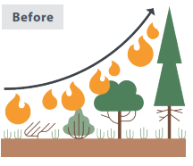
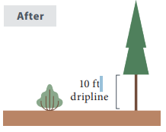
DEFENSIBLE SPACE Mitigation Actions in Zone 2 and beyond
Clear dead vegetation such as dead shrubs, fallen branches, dried grass and weeds.
Create a separation of twice the height between individual shrubs or small clumps of shrubs.
Maintain an average canopy spacing of 10 feet between the canopies of all trees, such as Jeffrey pine, White fir, or Pinyon and Juniper.
Remove weakened, damaged or dead trees
Eliminate ladder fuels, such as shrubs, lower branches and smaller trees under the drip line. Do not remove more than one-third of the tree’s branches, as it will impact tree health.

Slide 10



Resources to Keep you Aware!
Sign up for Washoe County Alerts with:
www.washoecounty.gov/em/RegionalAlerts.php
Become Familiar with Perimeter
https://perimetermap.com/
Community Connect
https://www.communityconnect.io/info/nv-truckeemeadows
Washoe County Emergency Management
https://www.washoecounty.gov/em/

Slide 11
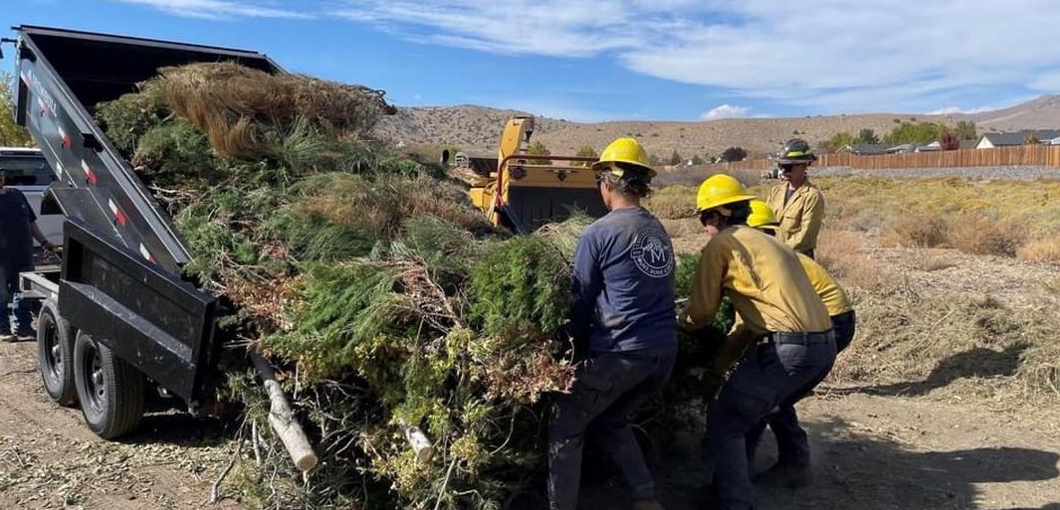
TMFPD Resources
Greenwaste Days
  Every Spring* and Fall
Curbside Chipping
  Limited to the elderly and disabled
Open Burning
  During the months of December and April
Defensible Space
Inspections/Recommendations
Firewise USA

Slide 12
Thank you!
Contact: Brett Taylor
Email: btaylor@tmfpd.us
Cell: (775)722-8992

