Slide 1
Wildland Fires Get Prepared and Stay Safe
Citizen Advisory Board Presentation

Slide 2
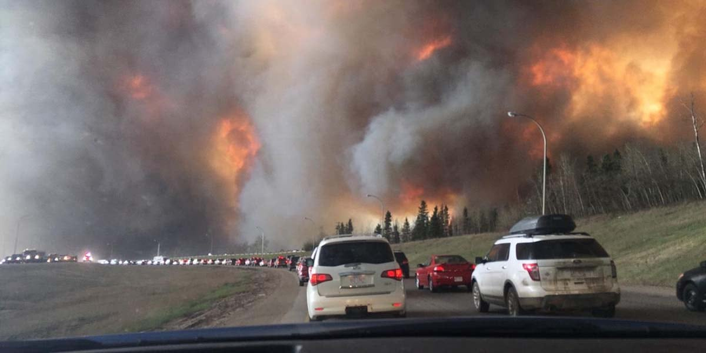
Wildfires Happen! What Do We Do About it?
Education
Understand the basics of fire behavior and fire weather
Get Ready
Prepare your home to survive a fire
Become a Fire Adapted Community
Get Set
Prepare for the eventuality of a fire
What will you do when it happens?
Go!
Have a plan to evacuate safely in the event of a fire

Slide 3
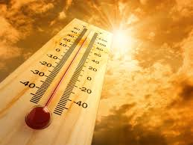
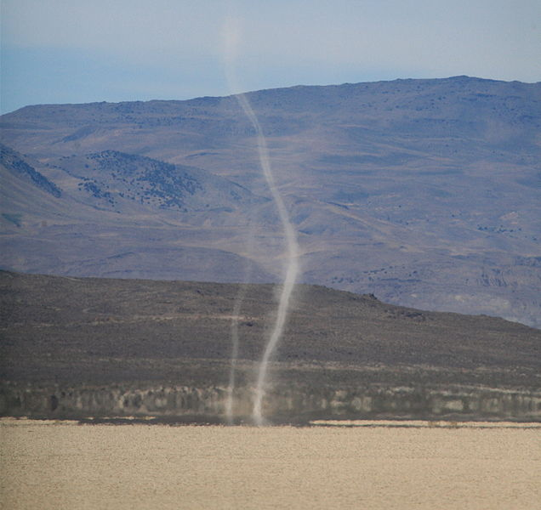
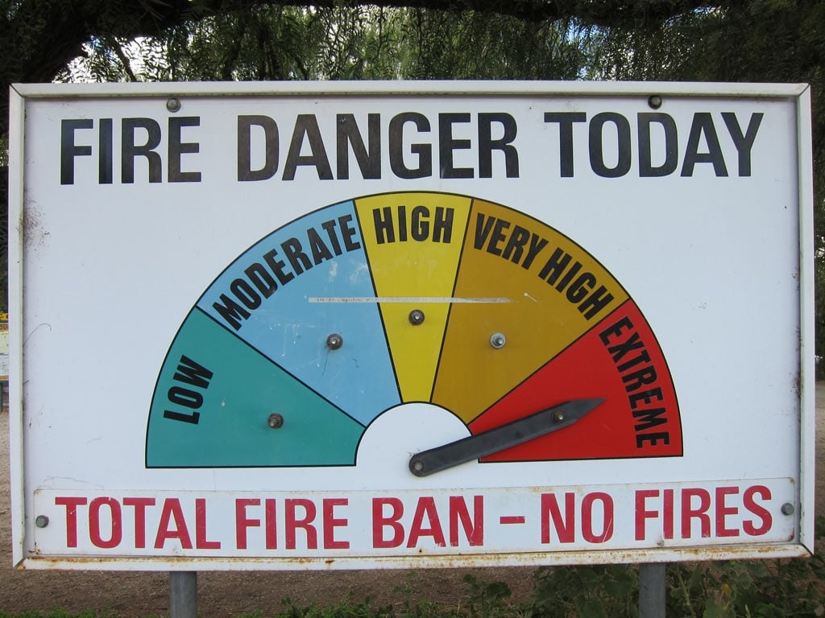
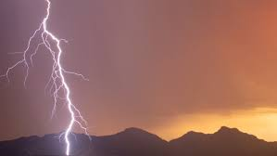
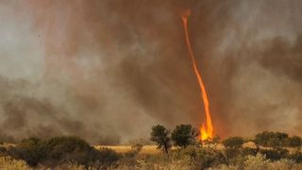
The Biggest Drivers of Wildland Fire
Fire Weather Factors
Increased Temperatures / Low Relative Humidities
Dry Lightning
High Winds
Local Factors
Downslope Winds in the afternoon
Extreme “Red Flag” conditions in the Summer
High wind events in the fall
When should I
Start Paying Attention?

Slide 4
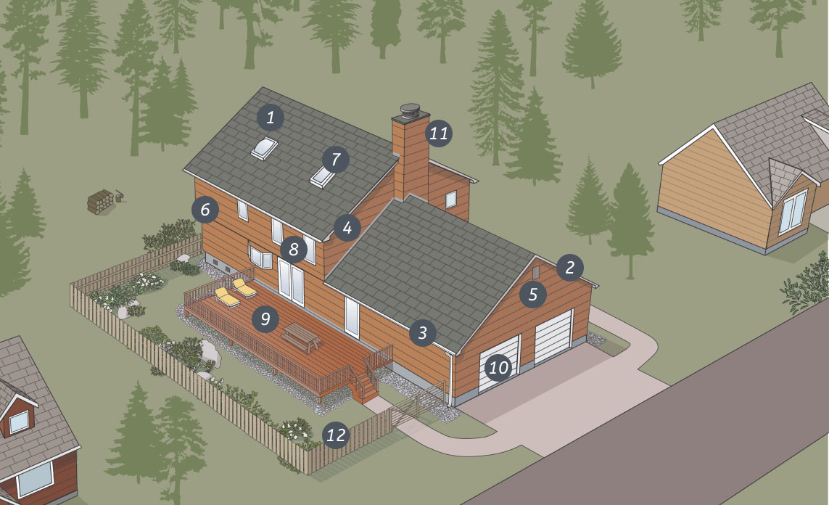
Make Your Home Fire Safe!
Improve the fire-resistant qualities of you home by making changes to your:
Roof
Eaves
Rain Gutters
Vents
Siding
Decks
Fences
Garages
Livingwithfire.org

Slide 5
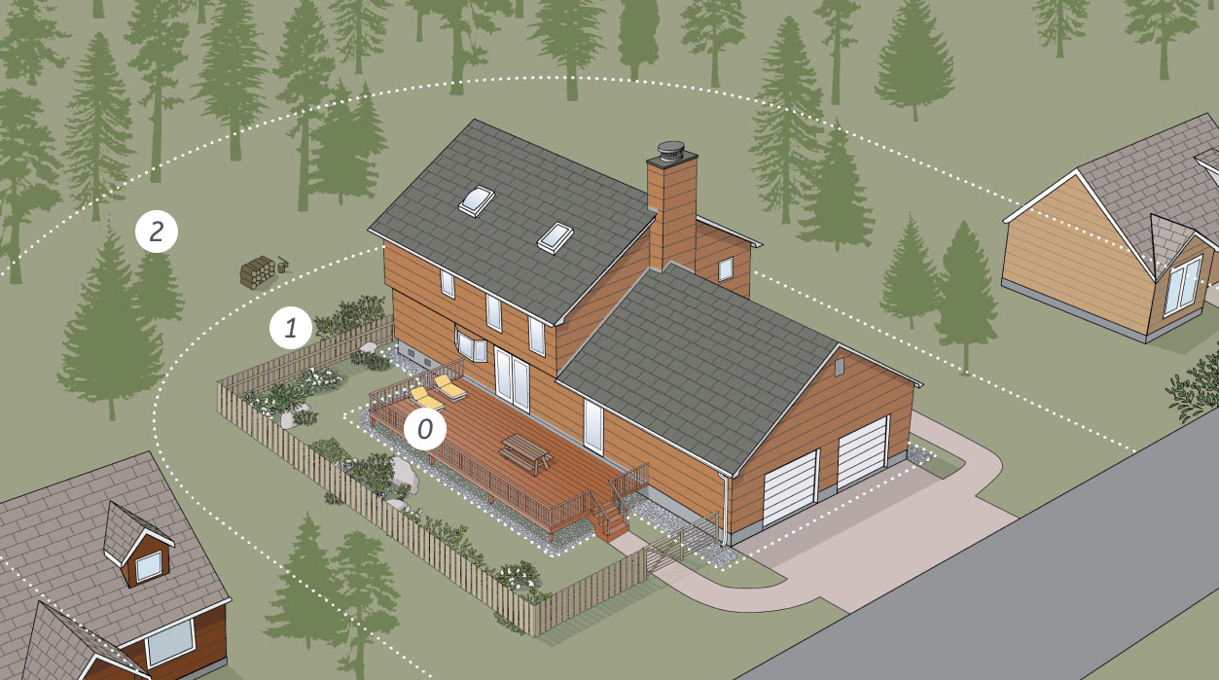
DEFENSIBLE SPACE What is it? Why it Matters?
Ember-Resistant Zone
0-5 feet
Lean, Clean, Green Zone
5-30 feet
Reduced Fuel Zone
30-100+ feet
Livingwithfire.org

Slide 6
Get SET!
Create an Action Plan for your Household!
Checklist Can Include:
Evacuation plan
People and Pets!
Inside and Outside Checklists
Meeting locations
Communications plans
Sign up for Washoe County Code Red
www.washoecounty.gov/em/RegionalAlerts.php
Become Familiar with Perimeter
https://perimetermap.com/
Stay up to date on Fire Weather Conditions and Local Fire Activity
https://www.weather.gov/wrh/fire?wfo=rev

Slide 7
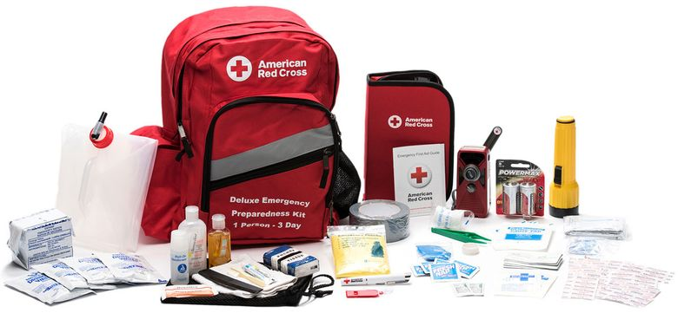
Get SET!
Create an Emergency Supplies Kit for a GO BAG!
3-day food/water supply (1 gallon/person/day, non-perishable foods)
First Aid Kit and sanitation supplies (toilet paper, baby wipes, etc.)
Flashlight
Battery-powered Radio
Extra batteries
Extra set of Car Keys, credit cards, cash
Extra eyeglasses, contact lenses, prescriptions, medications
Important household documents (Social Security Cards, Birth Certs, Insurance cards, etc.)
Paper Map paper with evacuation routes
Easily Carried Irreplaceable Items
Cell Phones and chargers
Keep a pair of shoes and flashlight ready at night in case of night evacuation

Slide 8
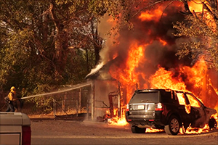
Wildfire Starts…GO!
Follow your Action Plan, Consult your Checklists, and Leave Early!
Inside Checklist
Close all windows and doors
Open inside fabric blinds/curtains
Leave some lights on
Grab your Go Bag
Outside Checklist (If time allows)
Make sure combustibles are away from the house
Don’t leave sprinklers on or water running
Close your garage door when you leave (Without power?)
Wildland Fire Order Number 6… Be Alert, Keep Calm, Think Clearly, Act Decisively!

Slide 9
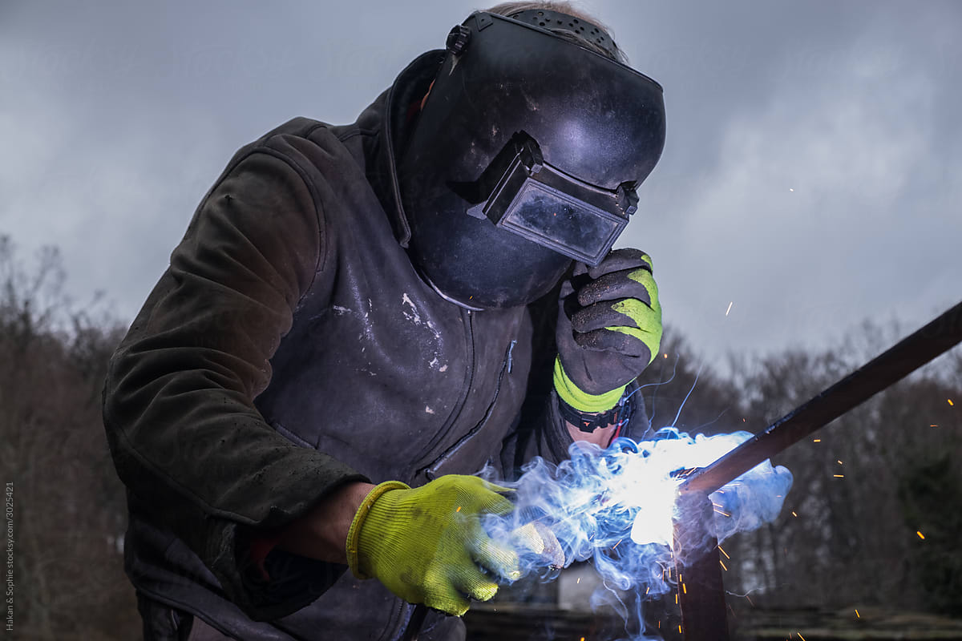
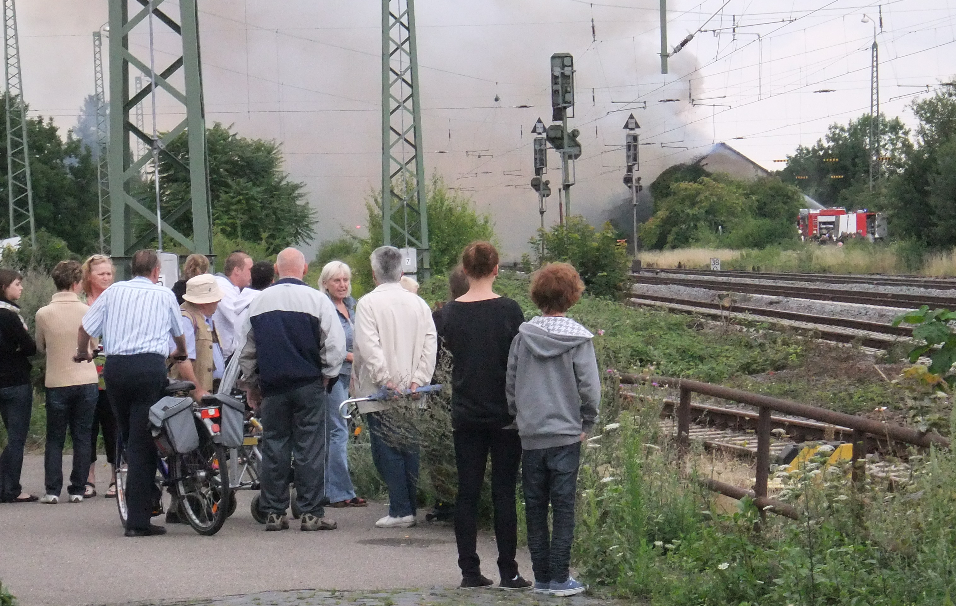
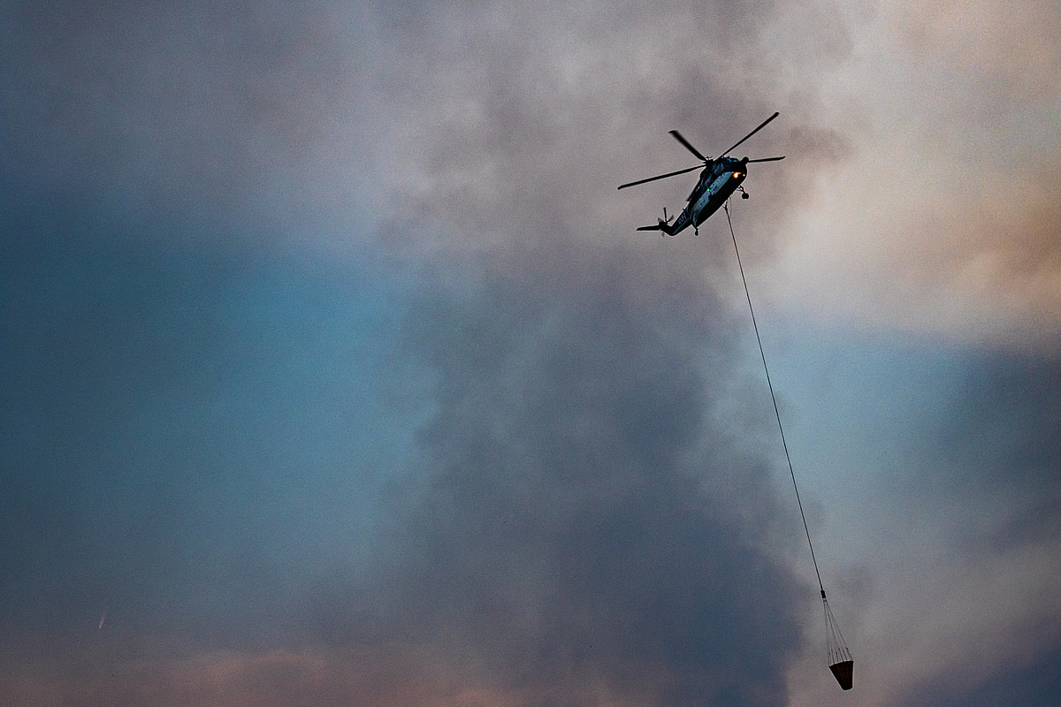
Wildfire Starts…What not to do!
DON’T – Do things that may lead to another fire!
DON’T – Go into a fire area to “See what’s happening…”
DON’T – Fly a drone anywhere near a wildland fire!

Slide 10
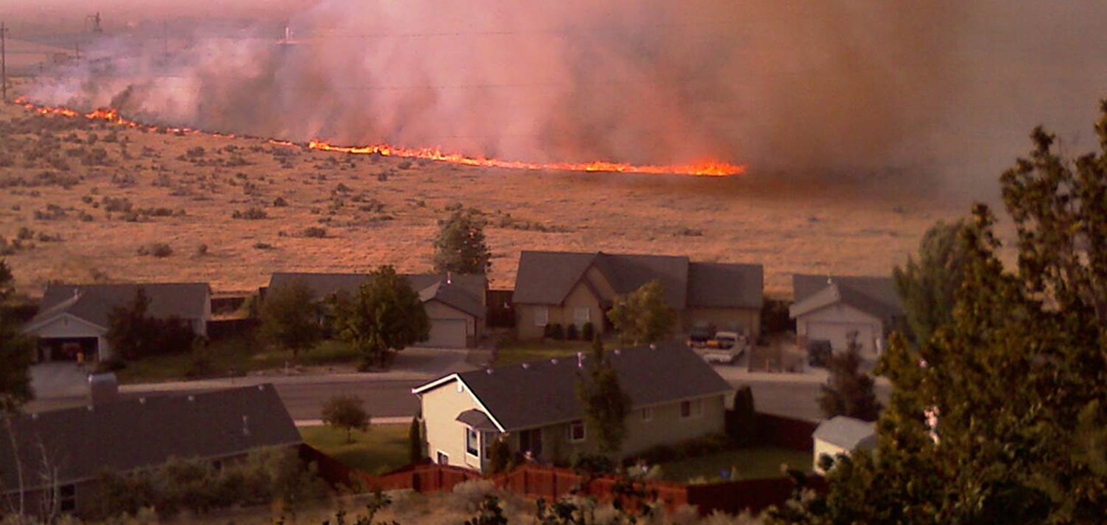
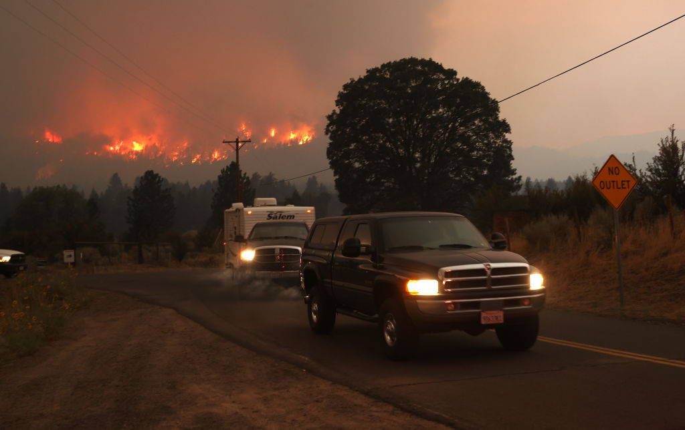
Evacuations
Leave Early – Don’t wait!
Follow the directions of the Emergency Management
Watch out for First Responders on roadways
Find your Evacuation Shelter and Relief Services
If you become trapped or require additional help, CALL 911!
Post Fire
Stay away until directed to return!

Slide 11
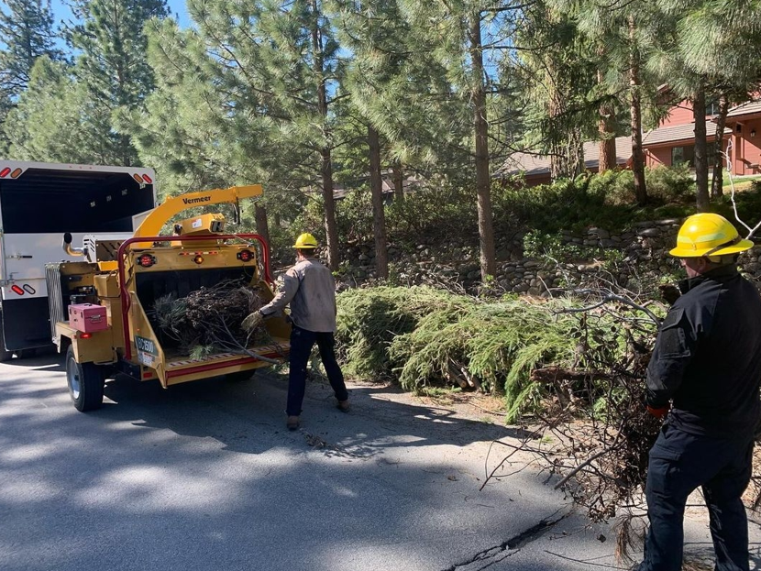
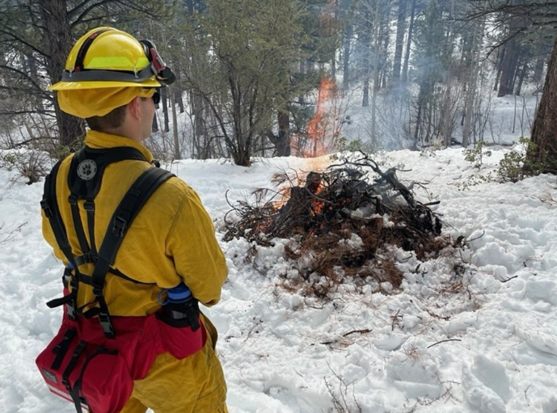
TMFPD Resources
Greenwaste Days
Every Spring and Fall
Curbside Chipping
Limited to the elderly and disabled
Open Burning
During the months of December and March
Firewise USA

Slide 13
Thank you!
Contact: Brett Taylor
Email: btaylor@tmfpd.us
Cell: (775)722-8992

