Slide 1

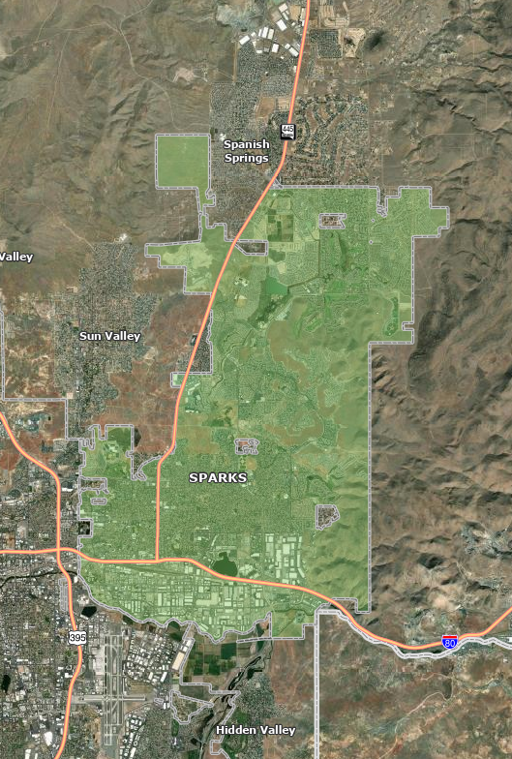

Washoe County Sheriff’s Office Homeless Outreach Proactive Engagement (HOPE) Team 2025 Accomplishments & 2026 Vision
Sergeant Kellie Wright | HOPE Team Leader, Deputy Kourtney Lusby and Deputy Levi Smith | Spanish Springs CAB | January 2026

Slide 2

Who We Are: The HOPE Team
• Established 2021 – only team serving unincorporated Washoe County
• 1 Sergeant, 2 Deputies, 2 Washoe County Human Services Agency case managers
• Daily proactive outreach in Sun Valley, Spanish Springs, Cold Springs, Spanish Springs, Washoe Valley, Verdi, Incline Village, and all rural areas
• Mission: Build trust, connect to services, resolve homelessness with compassion and accountability

Slide 3
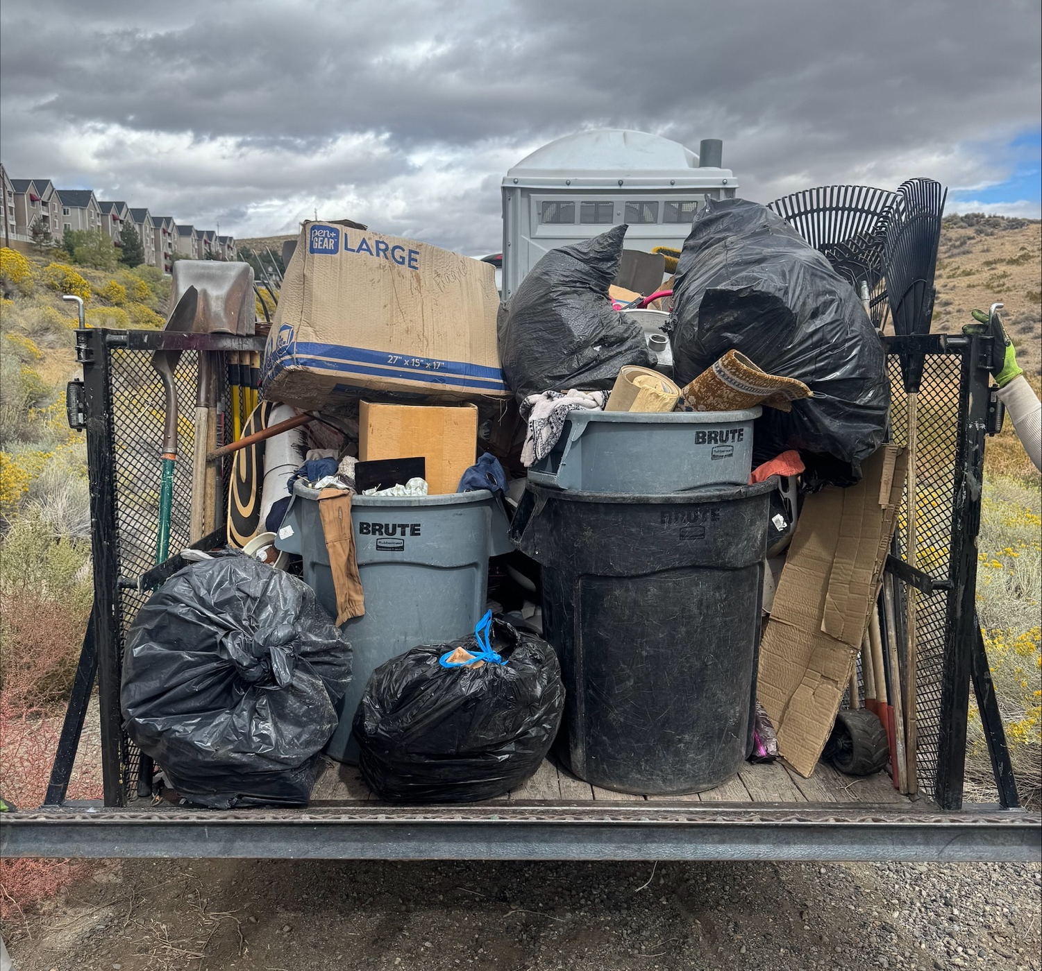
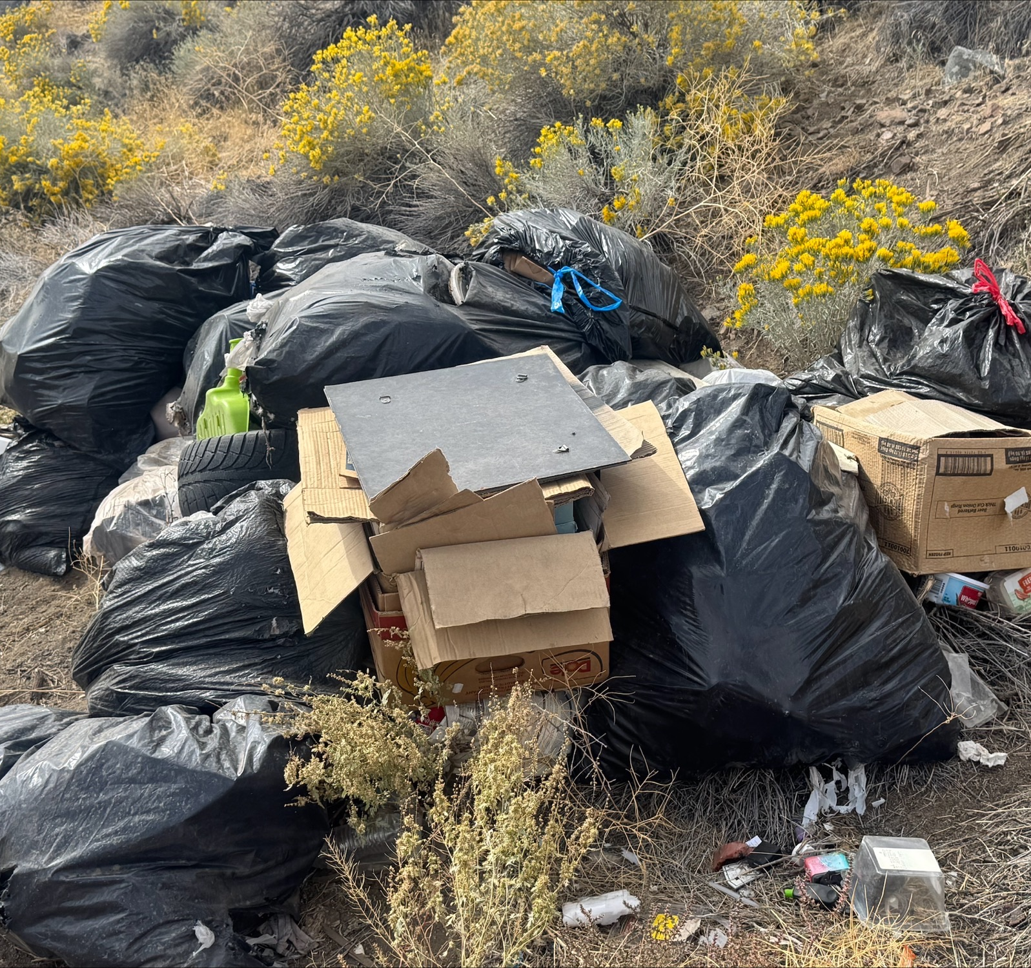
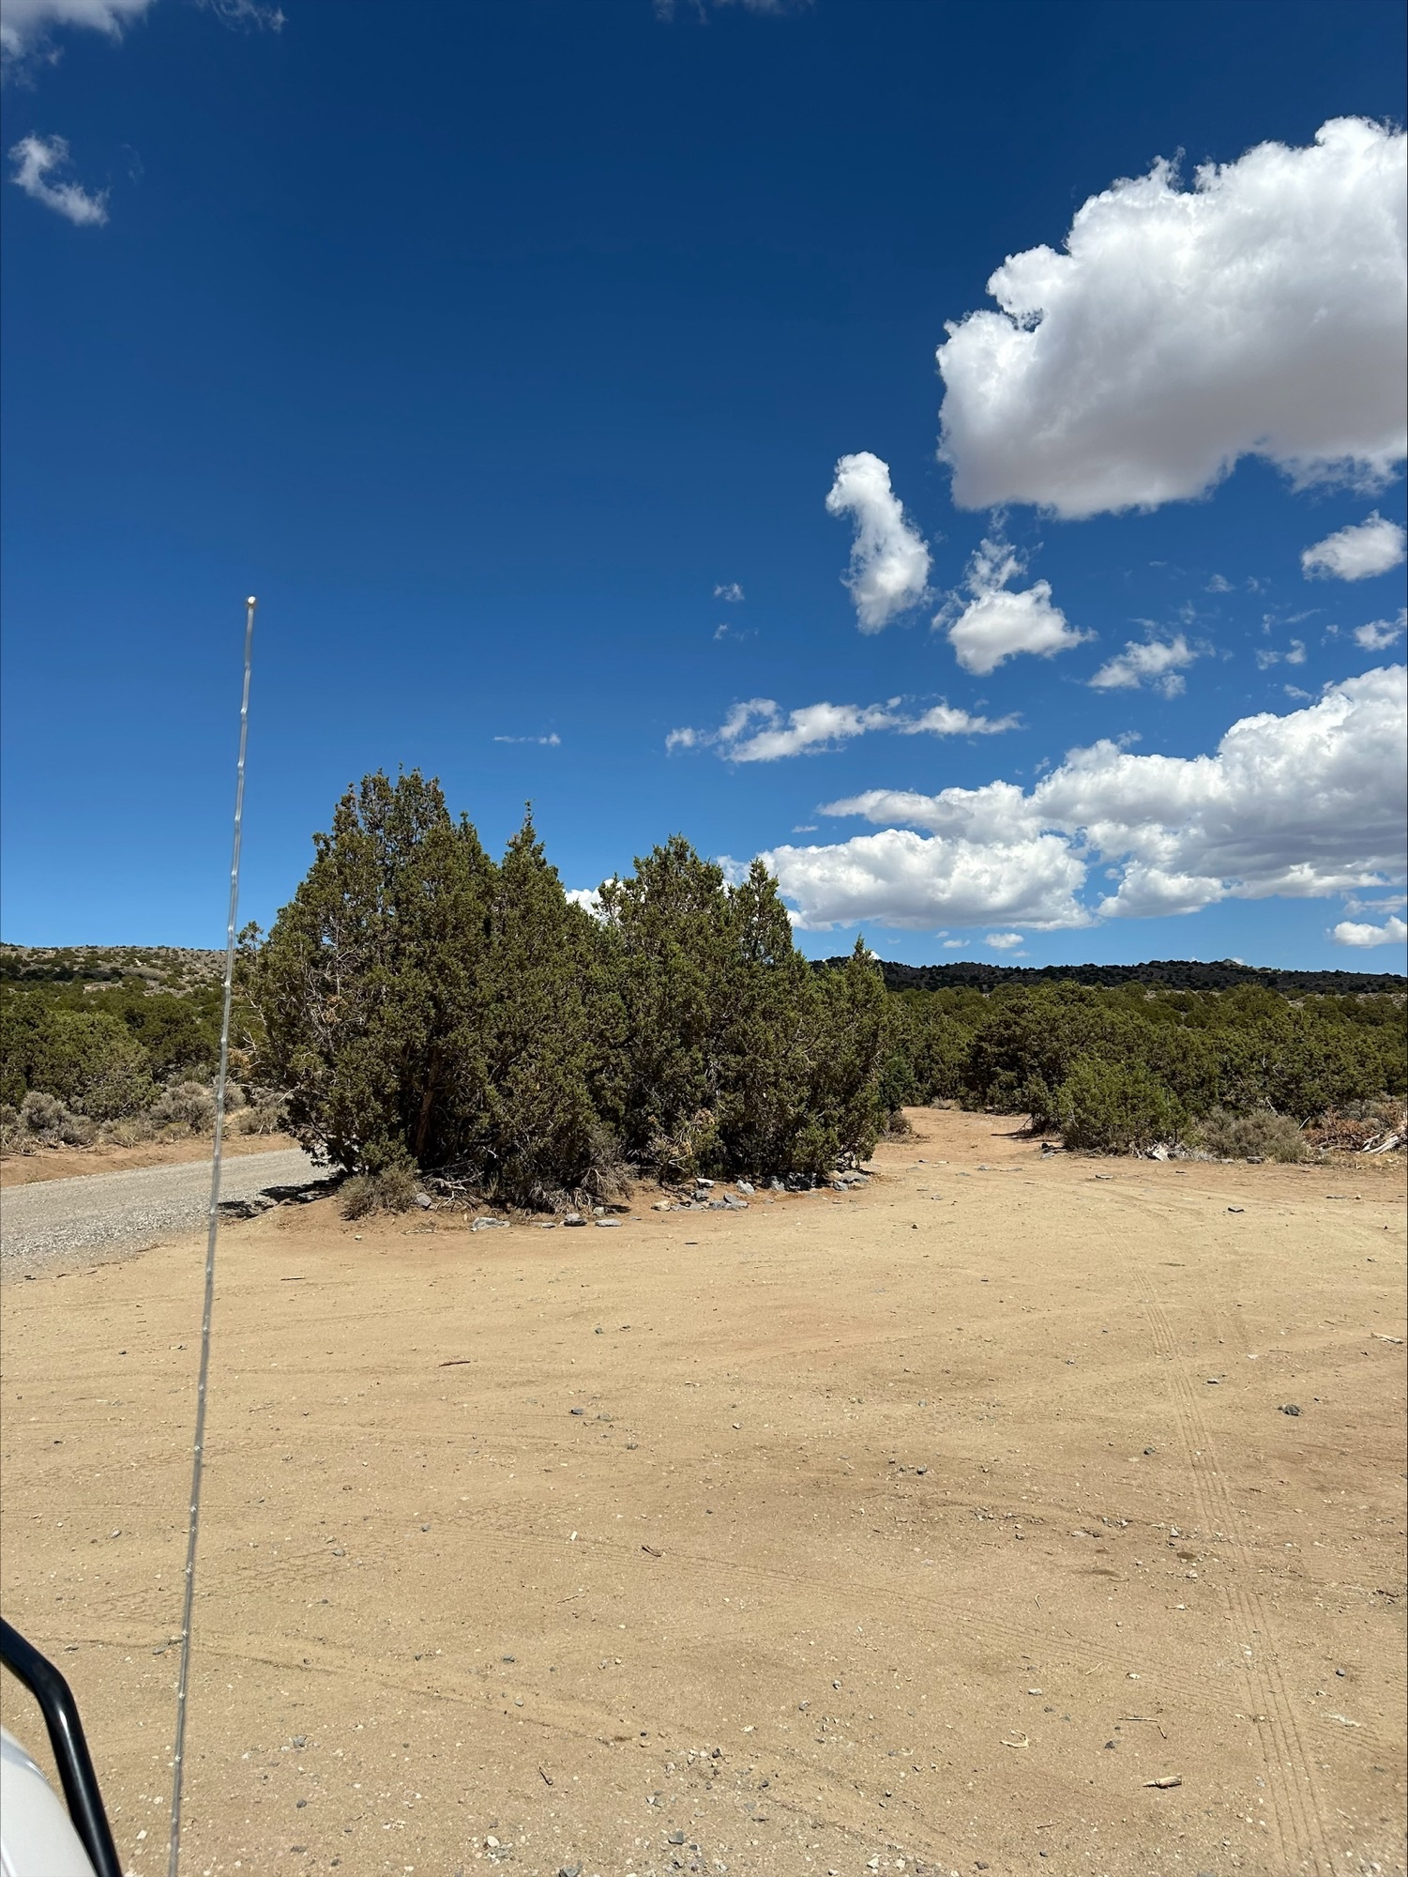

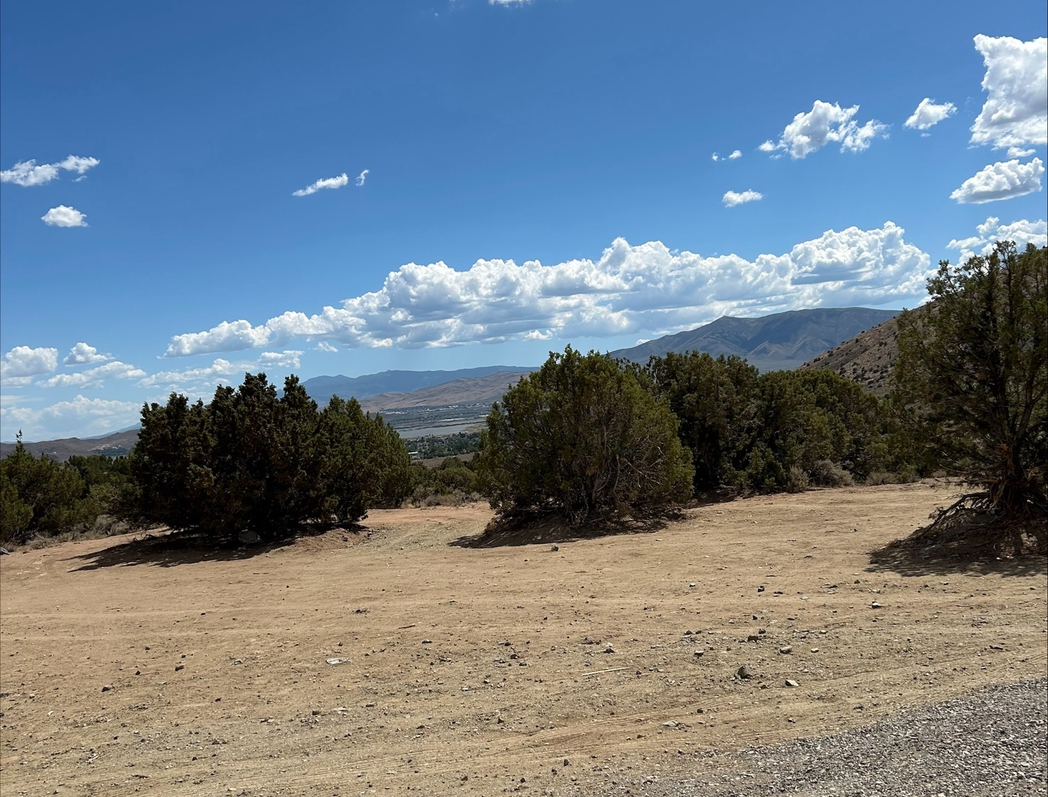
Photos of trash in the desert, and then cleaned up.

Slide 4
2025 By the Numbers
93% service acceptance rate – people want help when it’s offered with respect
Metric | 2025 | Change from 2024
Contacts | 2,930 | +34%
Resources Accepted | 2,728 | +94%
Individuals Housed (permanent) | 194 | +35%
Clean-ups Conducted | 34 | 116.5 yards removed
Citations (all types) | 5 | -67% vs 2024
Arrests | 4 | (mostly warrants)

Slide 5


Amazing Partnerships
• Washoe County Human Services Agency – our two embedded case managers are the backbone of every housing placement
• Northern Nevada HOPES – on-site behavioral health & MAT
• Sparks Police Department HOPE (Sergeant Butler) – weekly coordination, joint operations, shared intel – true regional teamwork
• BLM, Union Pacific, Reno Housing Authority, faith-based organizations

Slide 6
2026 Goals
• House 220+ individuals in permanent supportive housing
• Expand prevention & re-entry referrals (jail, hospitals, schools)
• Launch Clean Path Initiative (next slides)
• Strengthen transportation access (new JTNN/Uber Health partnership)
• Continue 85-90% housing retention through tenancy support

Slide 7
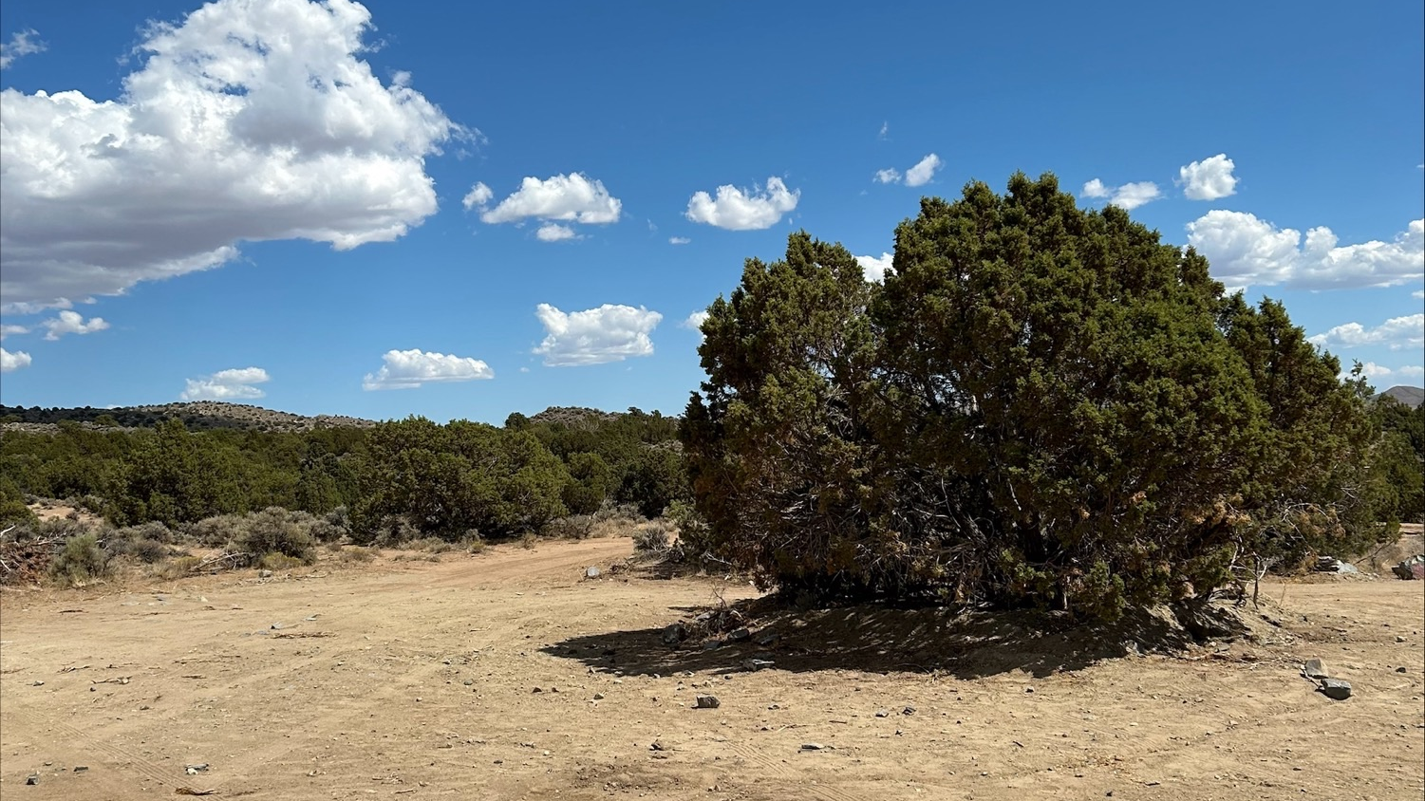
H.O.P.E. Clean Path Initiative
z
Core idea: Provide food, water, trash service, and intensive case management in exchange for clean sites and active work toward permanent housing
Launching February/March 2026 “A hand-up for rural encampments – turning survival into stability”

Slide 8
Why Clean Path? The Problem We’re Solving
PROBLEM
• Rural encampments create safety hazards, illegal dumping, fire risk, environmental damage
• Visible encampments hurt tourism & community pride
(2023 NLC study: proactive programs ↑ tourism revenue 15%)
SOLUTION
• Addresses survival needs so people can focus on housing tasks
• Proven model: Utah’s Housing First reduced chronic homelessness 91% and saved $8,000/person/year in emergency services

Slide 9
What Participants Receive
Weekly, at no cost:
• 5-gallon potable water refill
• 7-day nutritionally balanced food box
• Heavy-duty trash bags + weekly pickup
• Intensive case management (IDs, benefits, housing apps)
• On-site behavioral health therapist & peer support
• Move-in help & Welcome Home packages when housed

Slide 10
Participant Expectations (Simple & Fair)
• Keep site free of visible trash (we provide bags & pickup)
• Actively work toward permanent housing with case manager
• Weekly check-in with the team
• No new illegal activity or trespassing
“Participation is 100% voluntary – but commitment is required for continued support”

Slide 11
Accountability with Compassion
• Verbal warning → 7-day notice with final supplies → only if needed, citation for current violations.
• Re-enrollment always possible with renewed commitment
• Goal is compliance and housing – not punishment

Slide 12
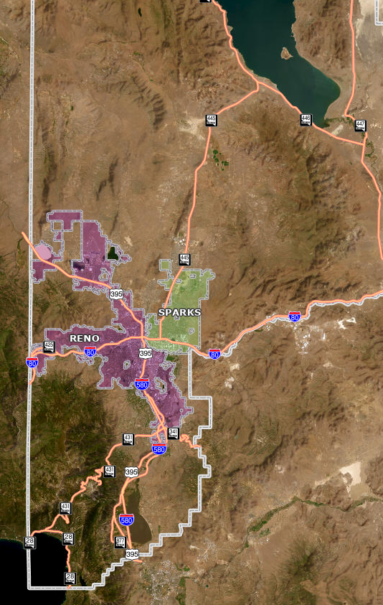
Rollout Plan
• Weekly dedicated route with HOPE vehicles
• Goal: 100–120 housed per year
• Quarterly metrics shared with commissioners & CAB
“Scalable, low-cost, high-impact – using existing team & donations”

Slide 13

How the Public Can Report & Stay Informed
• Soon: Report encampments or individuals needing help directly through the WCSO App or washoesheriff.com
• All reports come straight to HOPE Team for immediate compassionate response
• No more guessing who to call – one easy system

Slide 14
How YOU Can Help (the ask)
“The question we get most: ‘How can I help?’”
• Best way: Donate to our proven partners who help supply our Welcome Home packages – Catholic Charities of Northern Nevada – St. Vincent’s Food Pantry & Programs – Salvation Army, Reno Sparks Gospel Mission, KT Grace Foundation, Incline Pet Foundation
• Your donations = furniture, household items, hygiene kits that make a house a home
• Our Welcome Home packages wouldn’t exist without our amazing community – thank you!

Slide 15

Contact Us
WCSO App
Download links:
Apple App Store: https://apps.apple.com/us/app/washoe-county-sheriff/id610715775
Google Play Store: https://play.google.com/store/apps/details?id=wcso.washoecounty.us
Coming soon: Homeless Encampment / HOPE Support submissions and refreshed imagery
Sheriff-HOPETeam@washoecounty.gov
“We’re here for our community – let’s keep working together”

Slide 16
Questions?
“Thank you for your support – together we’re making a real difference”

