Slide 1

Spanish Springs CAB Presentation
Truckee Meadows Water Authority
December 4, 2024

Slide 2
Introduction
Danny Rotter, PE
Assistant GM / Director of Engineering
Truckee Meadows Water Authority
drotter@tmwa.com
Greg Pohll, PhD
Principal Hydrogeologist
Truckee Meadows Water Authority
gpohll@tmwa.com
Lydia Teel, PhD, PE
Emerging Resources Supervisor
Truckee Meadows Water Authority
lteel@tmwa.com
Engineering
Planning/New Business
Support across all TMWA
departments
Develop, modify, and analyze computer models to simulate groundwater flow and contaminant transport.
Develop and recommend strategies to protect regional groundwater supplies well into the future.
Evaluate groundwater data such as water levels, pumping rates, and groundwater quality and make recommendations regarding optimal operational strategies.
Advanced Purified Water Program
Drinking Water Facility Operations
Outreach and Communications

Slide 3
TMWA: Water and Growth?
TMWA Basics and Current Info
Water Resource Plan 2020-2040
Water Facility Plan 2020-2040

Slide 4
Truckee Meadows Water Authority (TMWA)
Purpose: Created in 2001 to retain local control over water resources
Original Financing: $452M Bond Issue
Governance: A Joint Powers Authority (NRS 277)
Current Members of the Board of Directors:
Naomi Duerr, Chair, Reno City Council Devon Reese, Reno City Council
Clara Andriola, Washoe County Comm. Alexis Hill, Washoe County Comm.
Paul Anderson, Sparks City Council _____________, Sparks City Council
_____________, Reno City Council
2015 Merger of Washoe County Water Utility and South Truckee Meadows General Improvement District into TMWA to form a consolidated regional water utility.
Notes:
RSW created TMWA in 2001 for the sole purpose of buying the water utility owned then by SPPCo, which is now NV Energy.
7-Member board

Slide 5
TMWA Facts and Figures
Population Served
Retail > 450,000 (>130,000 active connections)
Wholesale > 15,000 (Sun Valley GID)
Statistics
Current demand – 95,000 AF (2024) - 81,500 AF (2023) - 86,000 AF (2022)
Peak Day Demand – 149 MGD (2024) - 145 MGD (2023) - 144 MGD (2022)
Peak Day Capacity >200 MGD
Sources
Truckee River - 2 water treatment plants ( ≈ 80% of total supply)
Groundwater - 80+ production wells ( ≈ 20% of total supply)
  Aquifer Storage and Recovery (ASR)
  Fish Springs Ranch – Additional 8,000 AF groundwater supply (importation)
Creek Water – Whites Creek (Mt. Rose Water Treatment Plant)
Renewable Energy – 3 operating hydroelectric plants ( ≈ $3.5M revenue in normal year)

Slide 6
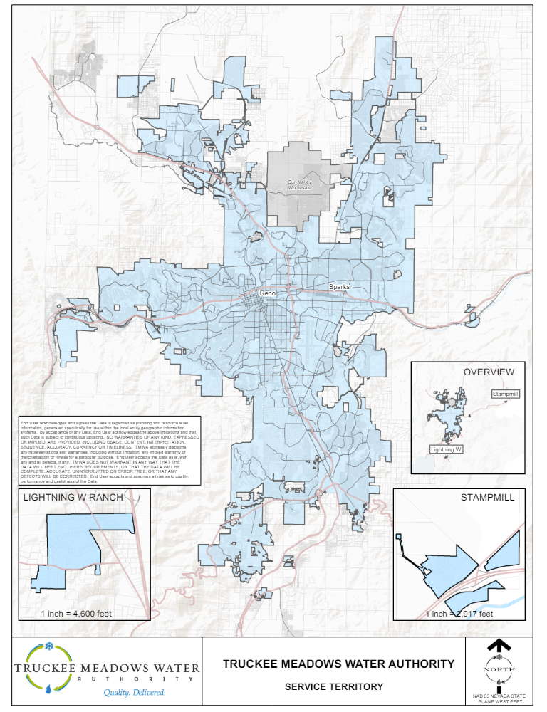
Infrastructure:
97 Tanks = 123 MG
2 Reservoirs = 50 MG
98 Wells
118 Pump Stations
5 Treatment Plants
381 Reg Stations
9 Interties
278 Pressure Zones

Slide 7
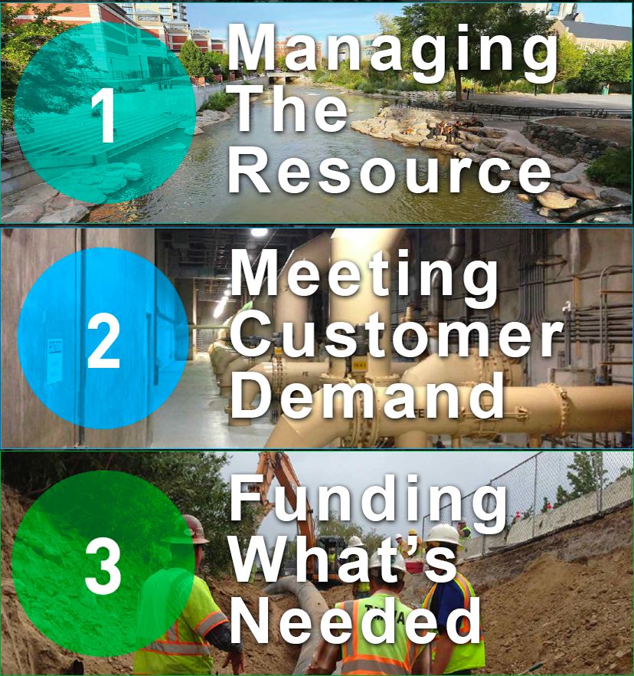
TMWA Planning Efforts
www.tmwa.com/planning
2020-2040 Water
Resource Plan
2020-2040 Water
Facility Plan
5-Year Funding
Plan Every Year

Slide 8
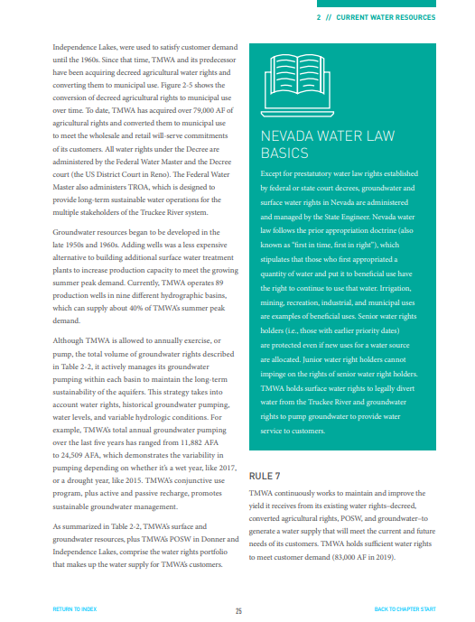

2020-2040 water RESOURCE PLAN
Tmwa.com/wrp2020
The 2020-2040 WRP is the 4th edition since TMWA’s inception in 2001
Focuses on scenario-based planning
  In-depth analysis of climate change and population growth impacts on water resources
New user-friendly formatting to engage plan readers

Slide 9
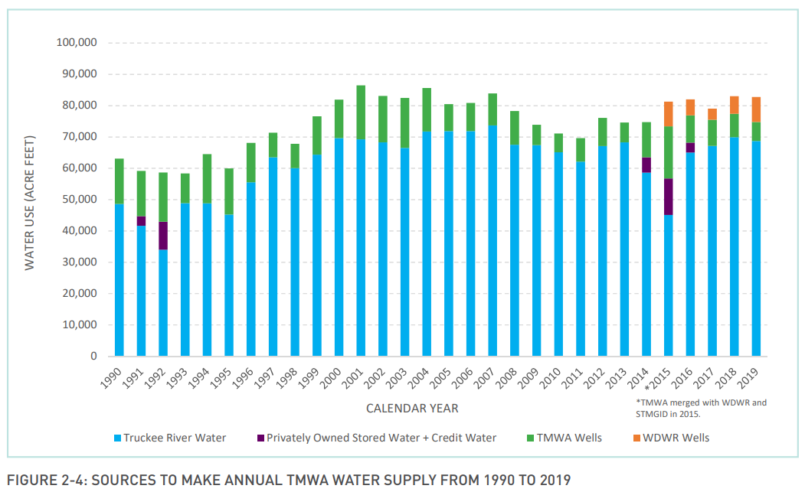
current water resources

Slide 10
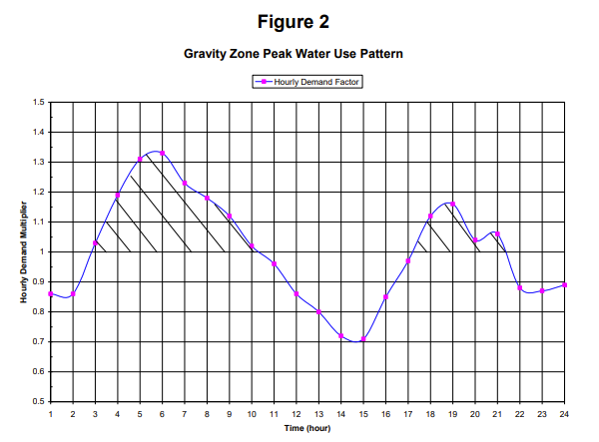
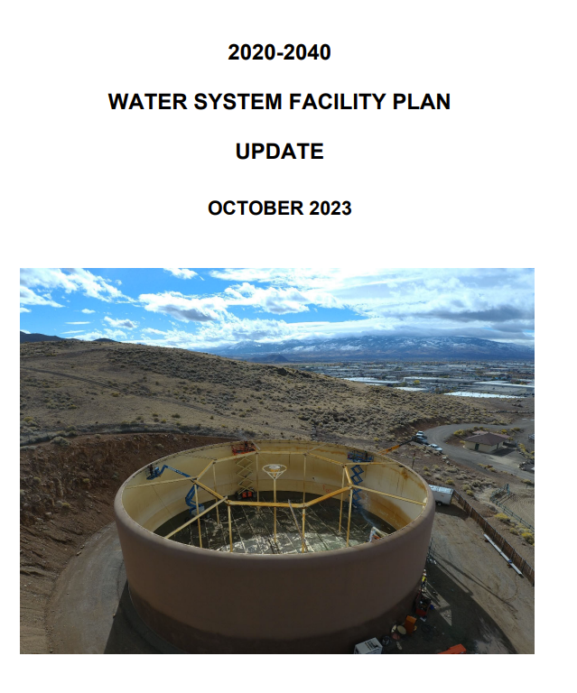
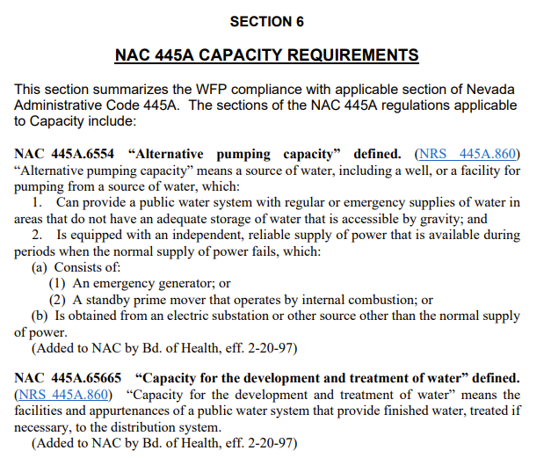
2020-2040 water facility PLAN
Tmwa.com/planning
The 2020-2040 WFP is the 4th edition since TMWA’s inception in 2001
Focuses on infrastructure
Growth needs
Aging Infrastructure needs
Reliability needs

Slide 11
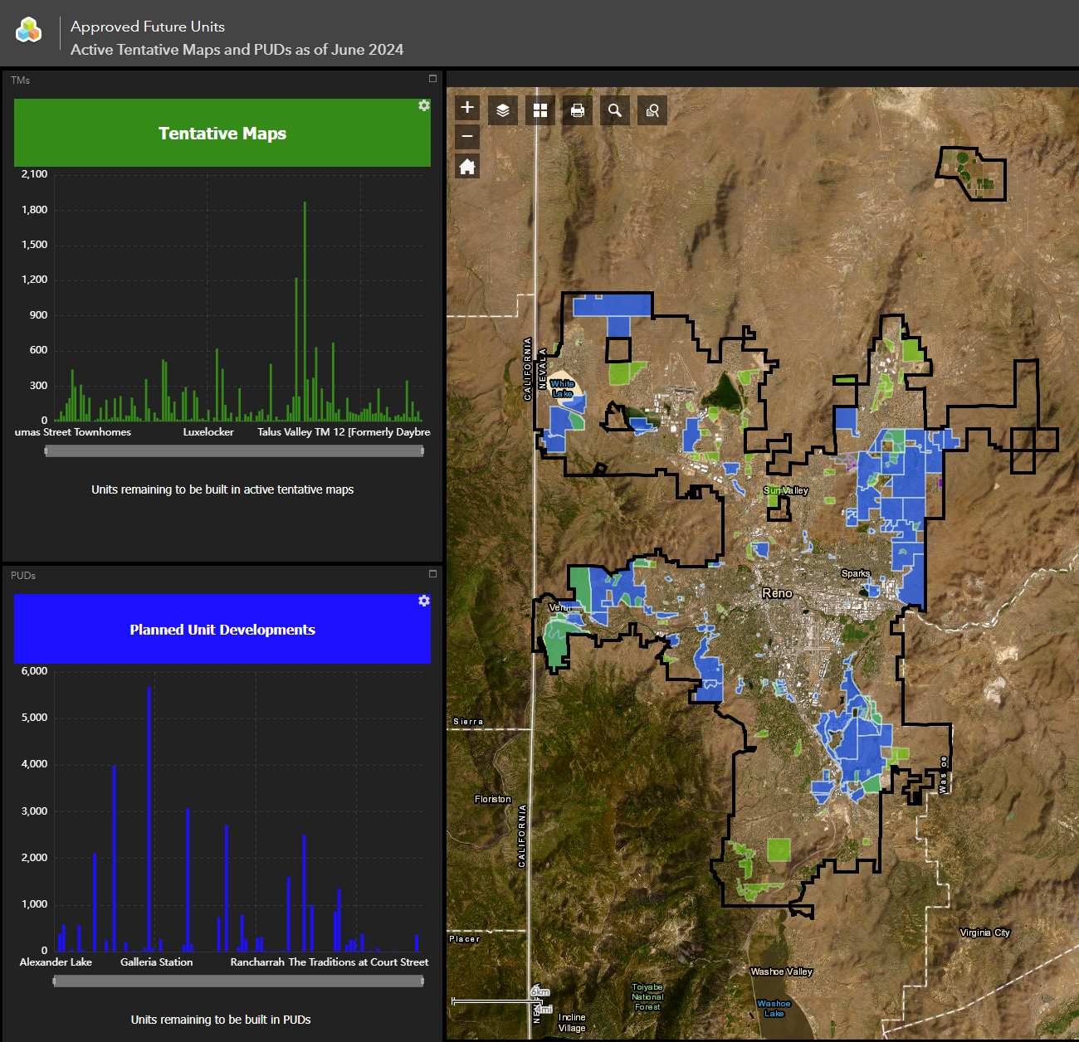

Slide 12
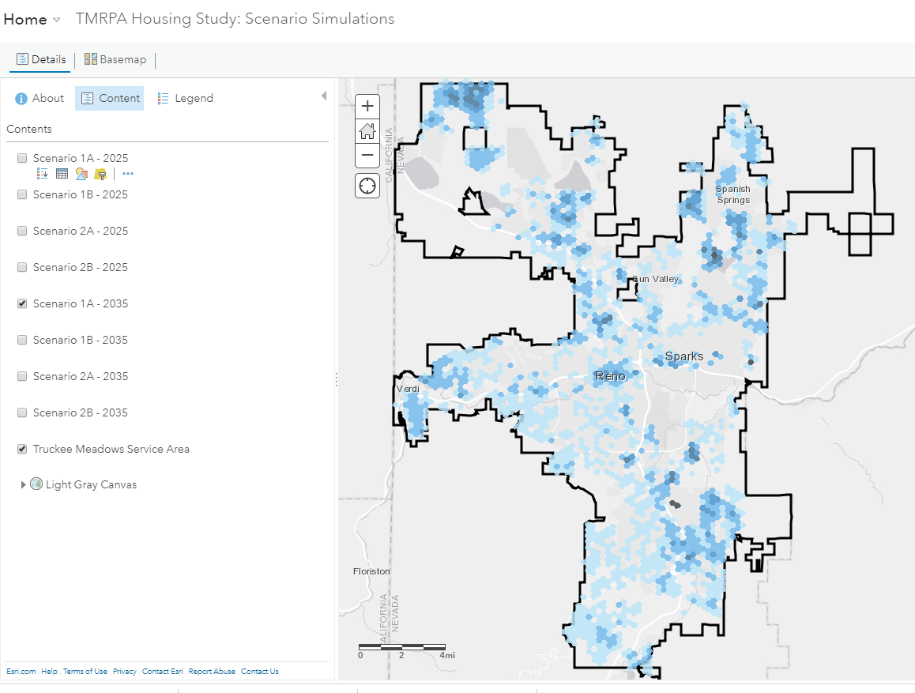

Slide 13
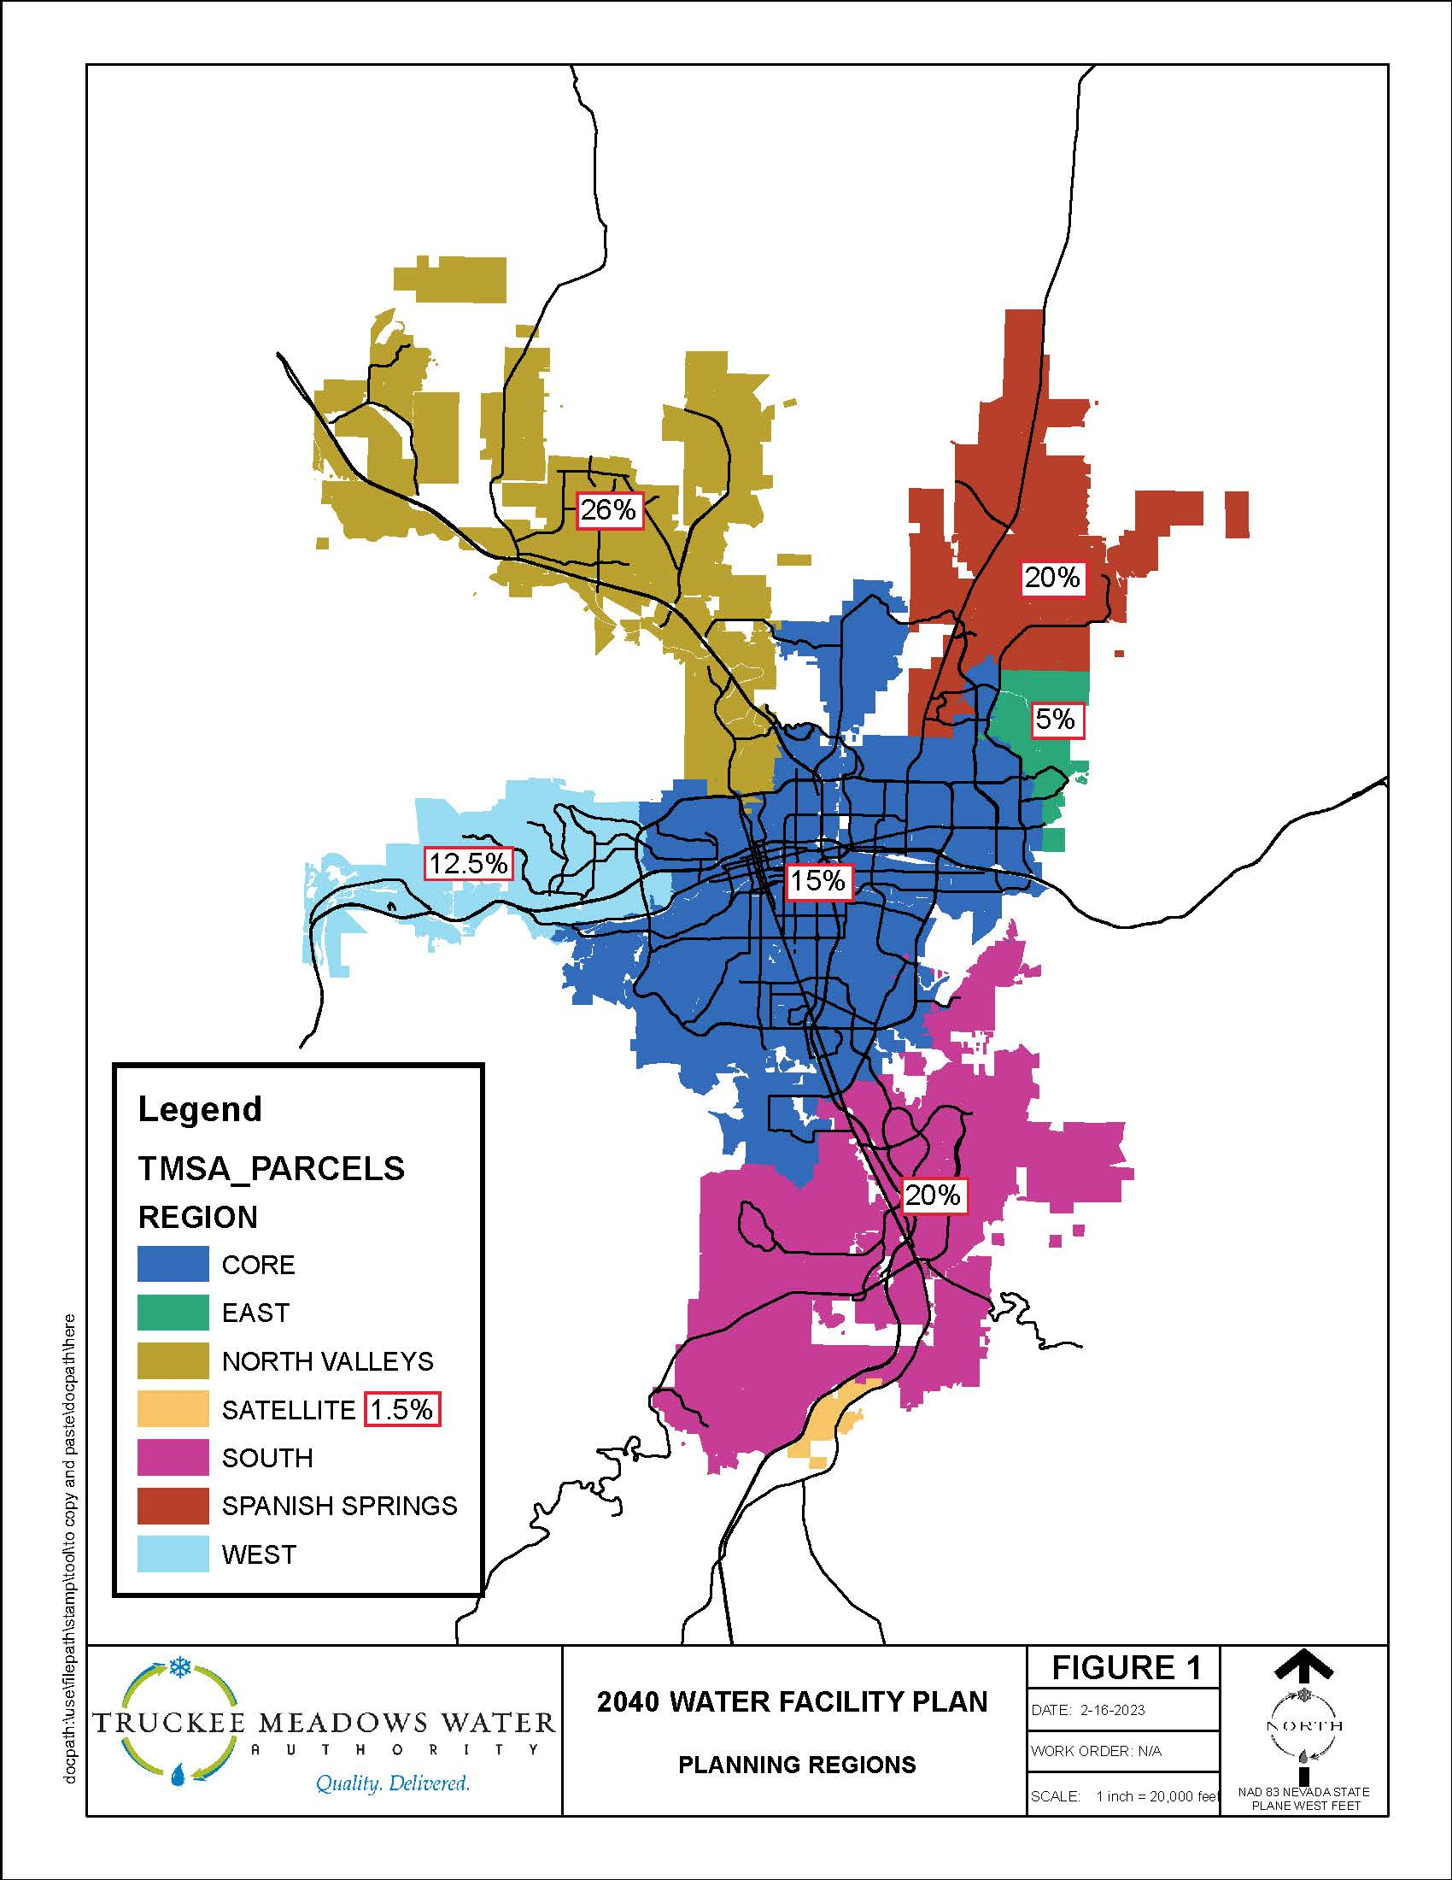
Significant Effort to Allocate Growth per 5-year Planning Period
Not All areas grow at the same rate (completely developed areas versus areas currently developing)
Incorporated data from TMRPA Growth Forecast, TMWA new business data that includes unbuilt Discoveries and staff planning knowledge in each area.

Slide 14
2040 WFP Estimated Expenditures
The primary product of the WFP is a 20-Year Capital Improvement Plan (CIP).
The WFP plan also includes consideration for emergency off-river operation, redundancy, power outages, fire events, mitigation of legacy deficiency issues, replacement/rehab of major facilities, etc.
WFP is used to update Water System Facility charges
Facility Category | 20-Year Total Cost | 20-Year Cost Allocated To Growth
Supply | $ 178,600,000 | $ 99,100,000
Storage | $ 37,200,000 | $ 18,500,000
Distribution | $201,800,000 | $ 76,500,000
Totals | $417,600,000 | $194,100,000
Average Annual
Growth Related Costs
$9,700,000
Notes:
Total Pages 780

Slide 15
Hydrogeology

Slide 16
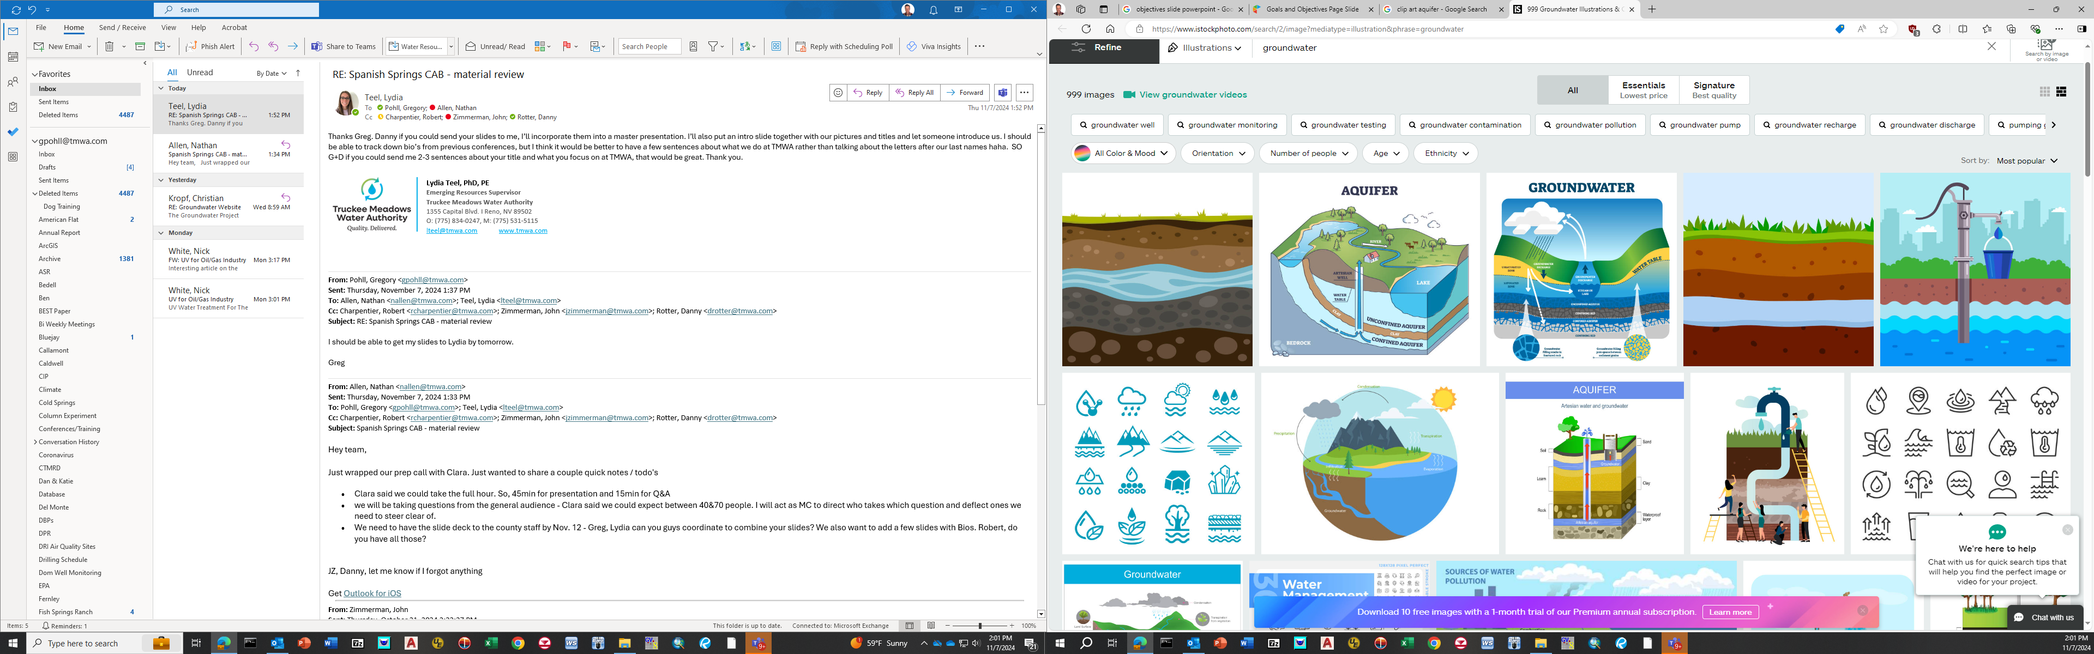
Objectives
A
Sources of Groundwater
B
Uses of Groundwater

Slide 17
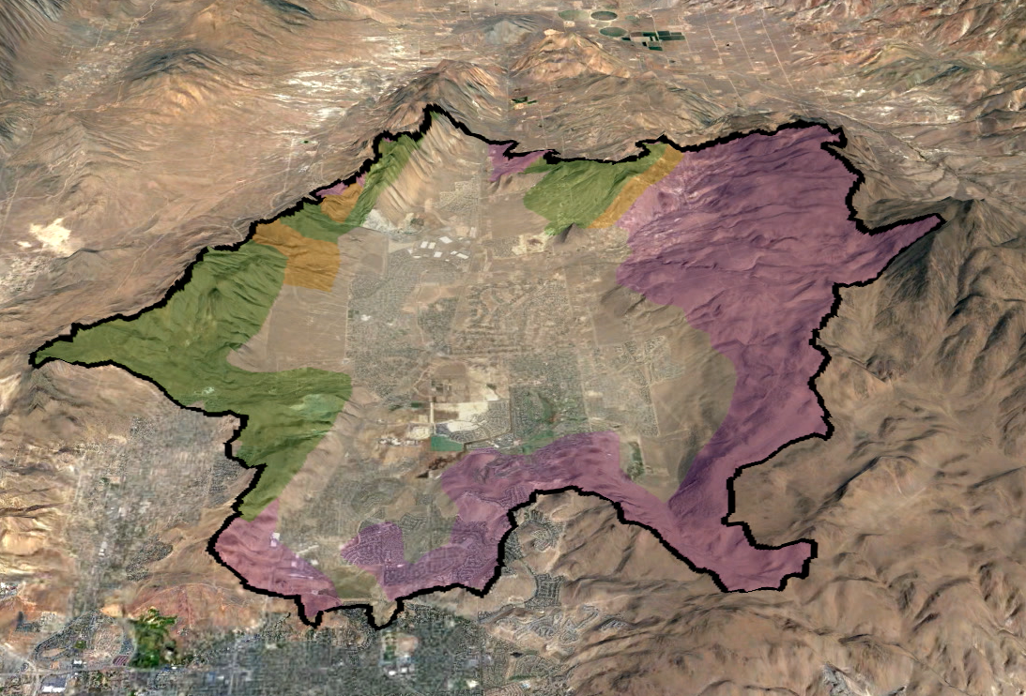
Precipitation Infiltration
600 AFY

Slide 18
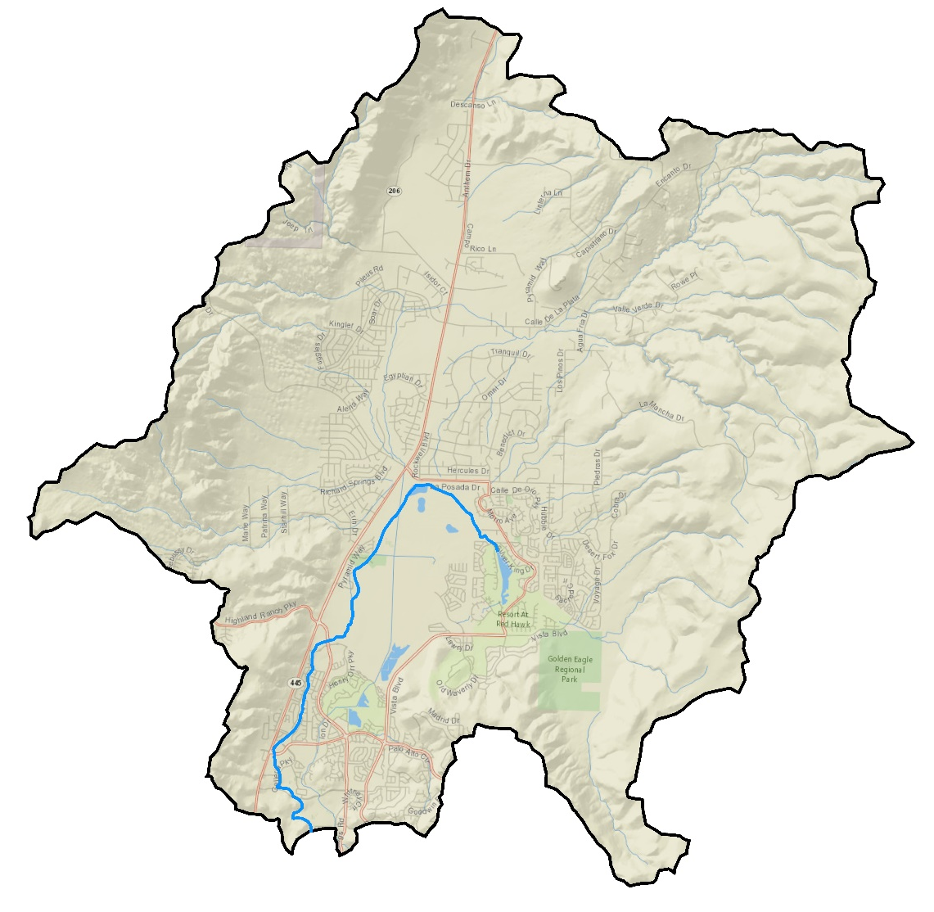
Orr Ditch Seepage
300 AFY
Orr Ditch

Slide 19
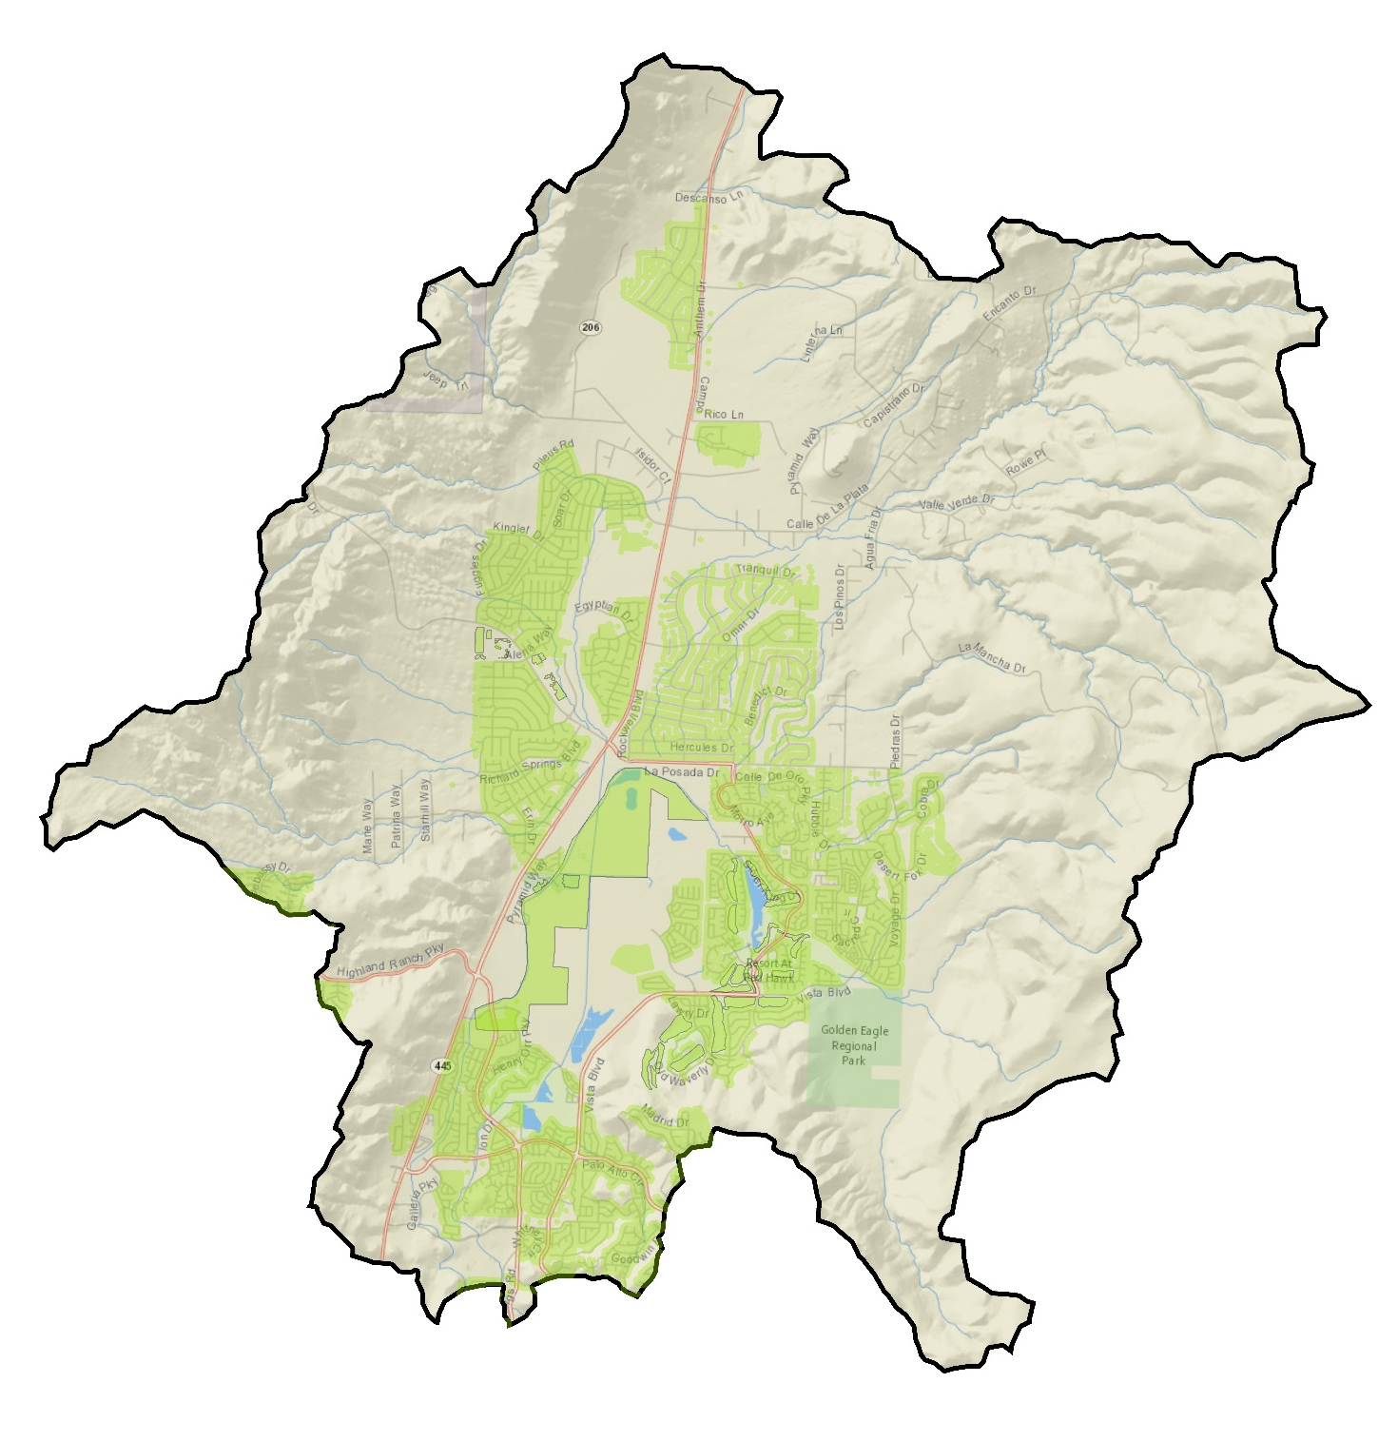
Irrigation Recharge
Landscaped
Areas
2,100 AFY

Slide 20
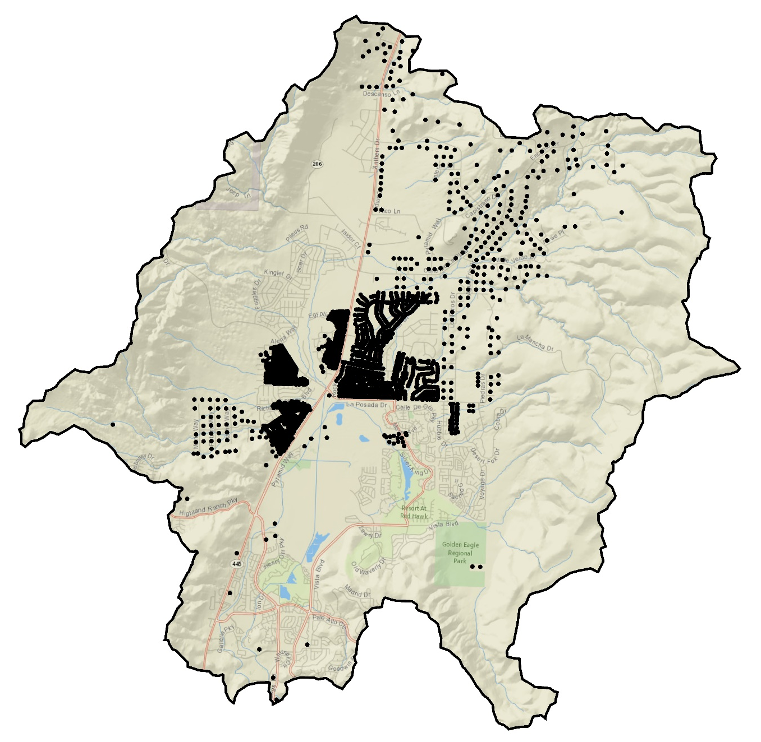
Septic Recharge
Septic
400 AFY

Slide 21
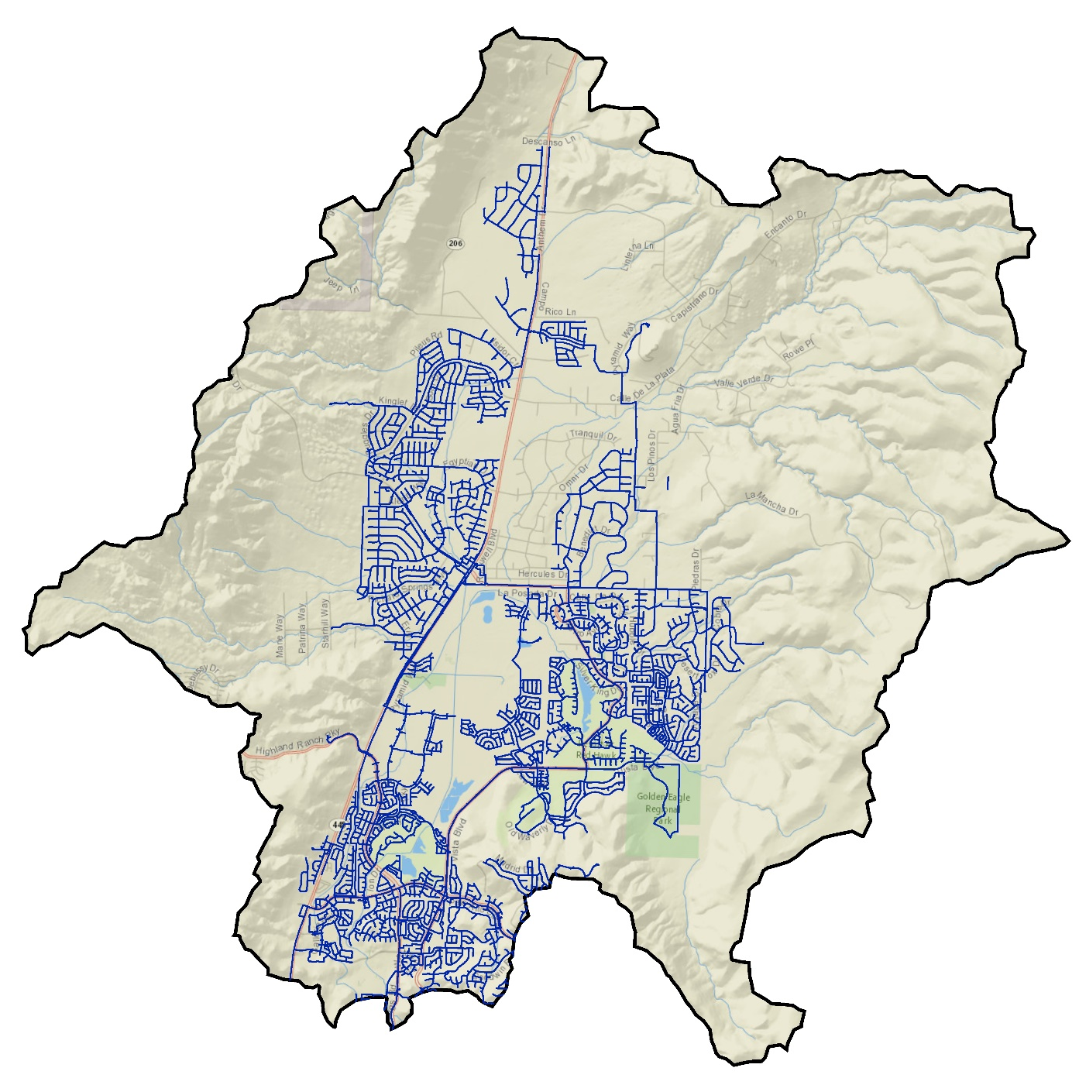
Pipe Leakage
Distribution
Pipe
500 AFY
Notes:
About 5% of annual distribution rate

Slide 22
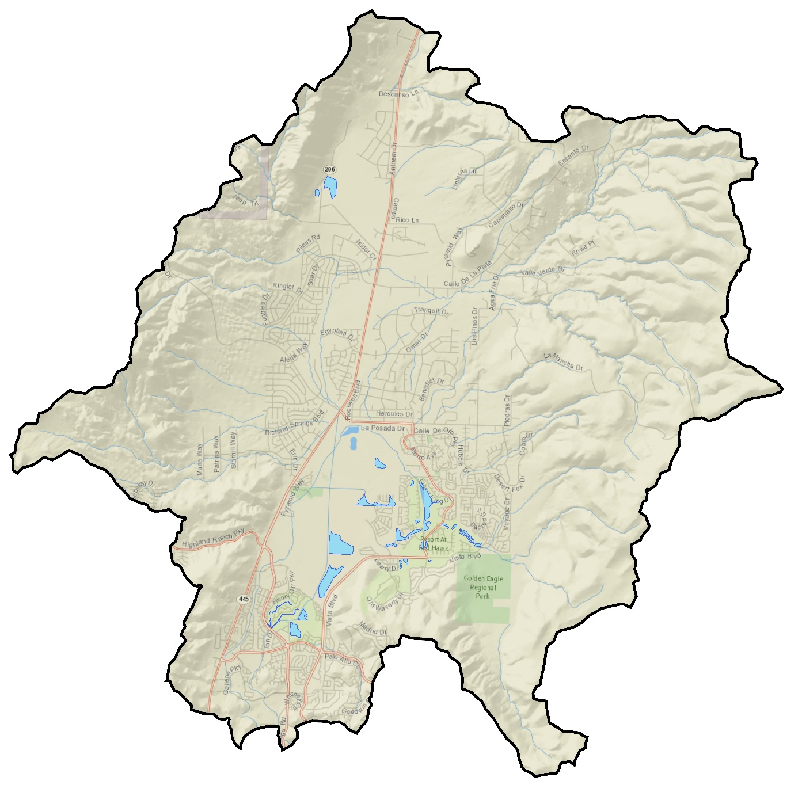
Pond Seepage
300 AFY
Pond
Notes:
About 5% of annual distribution rate

Slide 23
Summary of Groundwater Sources

Slide 24
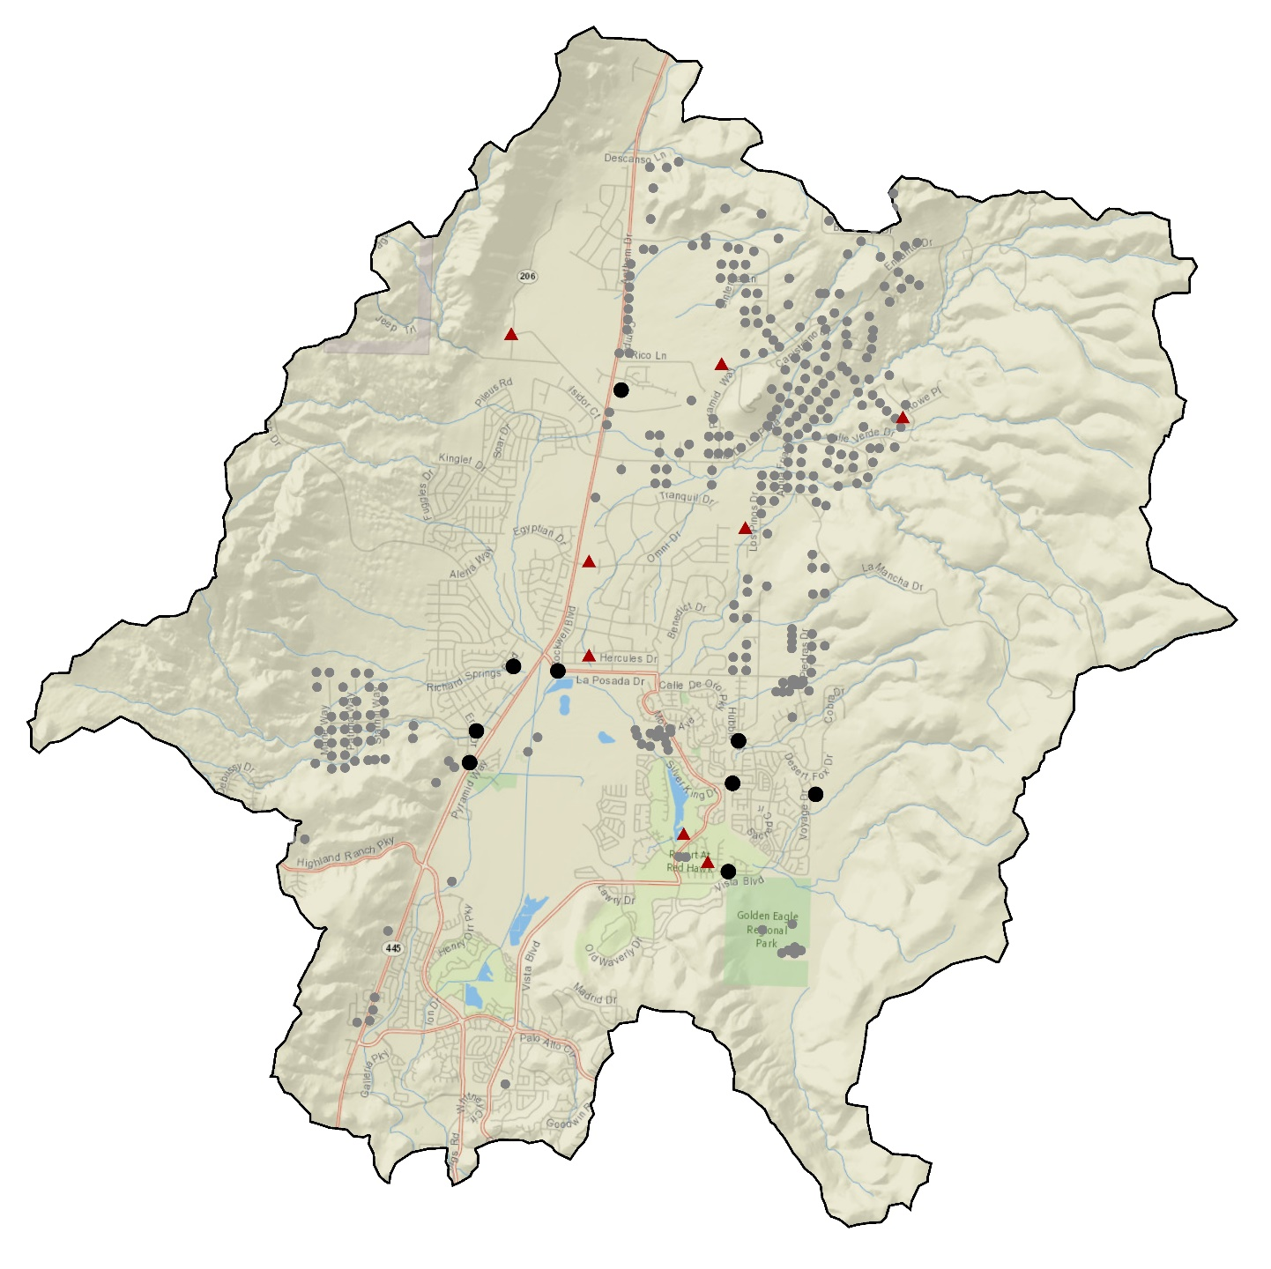

Wells

Slide 25
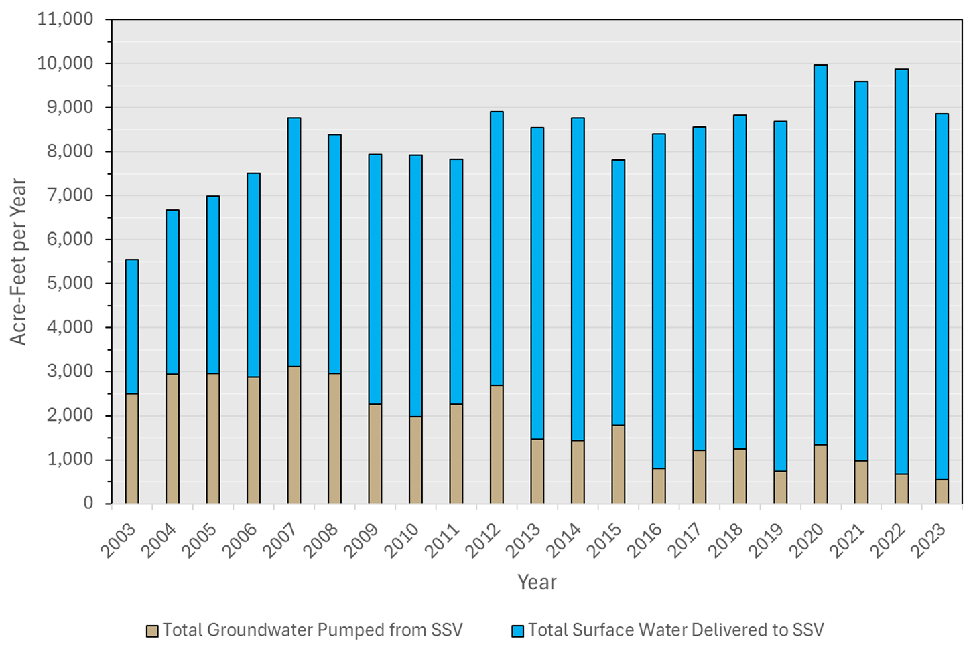
Wells

Slide 26
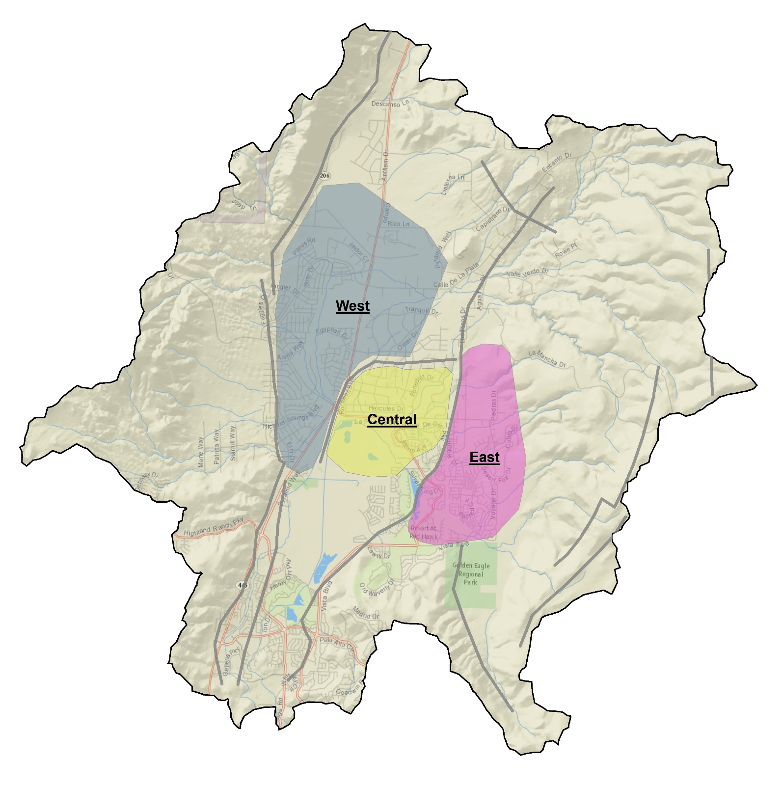
Groundwater Zones
Fault
Groundwater level trend

Slide 27
Advanced Purified Water

Slide 28
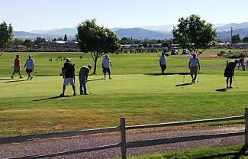
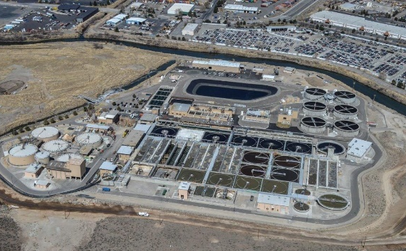
Reclaimed Water in the Truckee Meadows
Wastewater is treated and disinfected to a high level
  Safely used for irrigation, industrial uses, construction, etc.
Region has decades of experience using reclaimed water
8,000 AFA of reclaimed water used for irrigation
  10% of total regional water supply
Effluent management is challenging

Slide 29
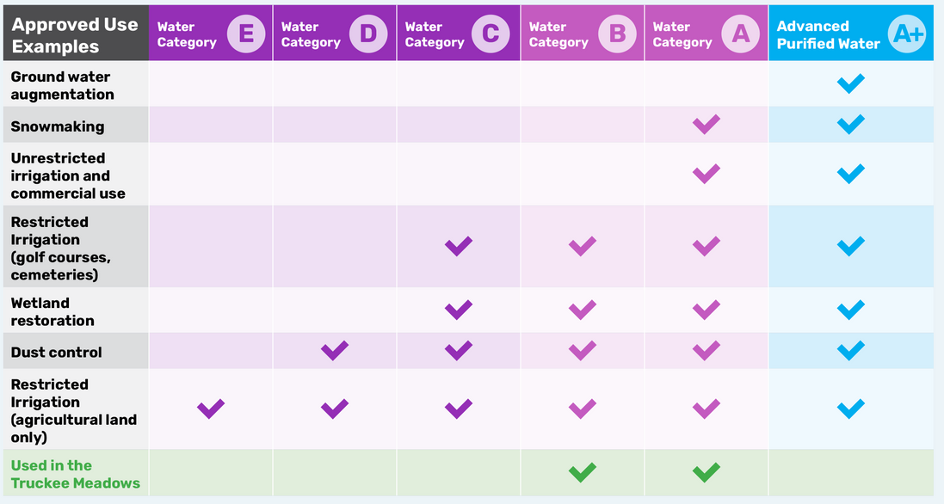
Advanced Purified Water

Slide 30
Category A+: Advanced Purified Water
Reclaimed water is purified to drinking water quality through several advanced treatment processes
Purified water is injected into an aquifer where further natural treatment occurs
Adopted in 2016 by State of Nevada after Governor Sandoval’s Drought Forum
Meets all Federal and State drinking water regulations
Reduces unregulated contaminants of emerging concern
  PFAS, pharmaceuticals, personal care products
Very common throughout the United States
Safe, reliable and sustainable with added environmental benefits

Slide 31
Advanced Purified Water
What It Is
  Sourced from regional water reclamation facilities
  Achieved through multiple advanced water treatment steps
  Regulated to rigorous State and Federal standards
  Must meet drinking water standards prior to groundwater injection
What It Isn’t
  Not being produced in our region at this time
  Not “purple pipe” reclaimed water used for irrigation. Much higher quality.
  Not appropriate to treat all effluent to an advanced purified quality

Slide 32
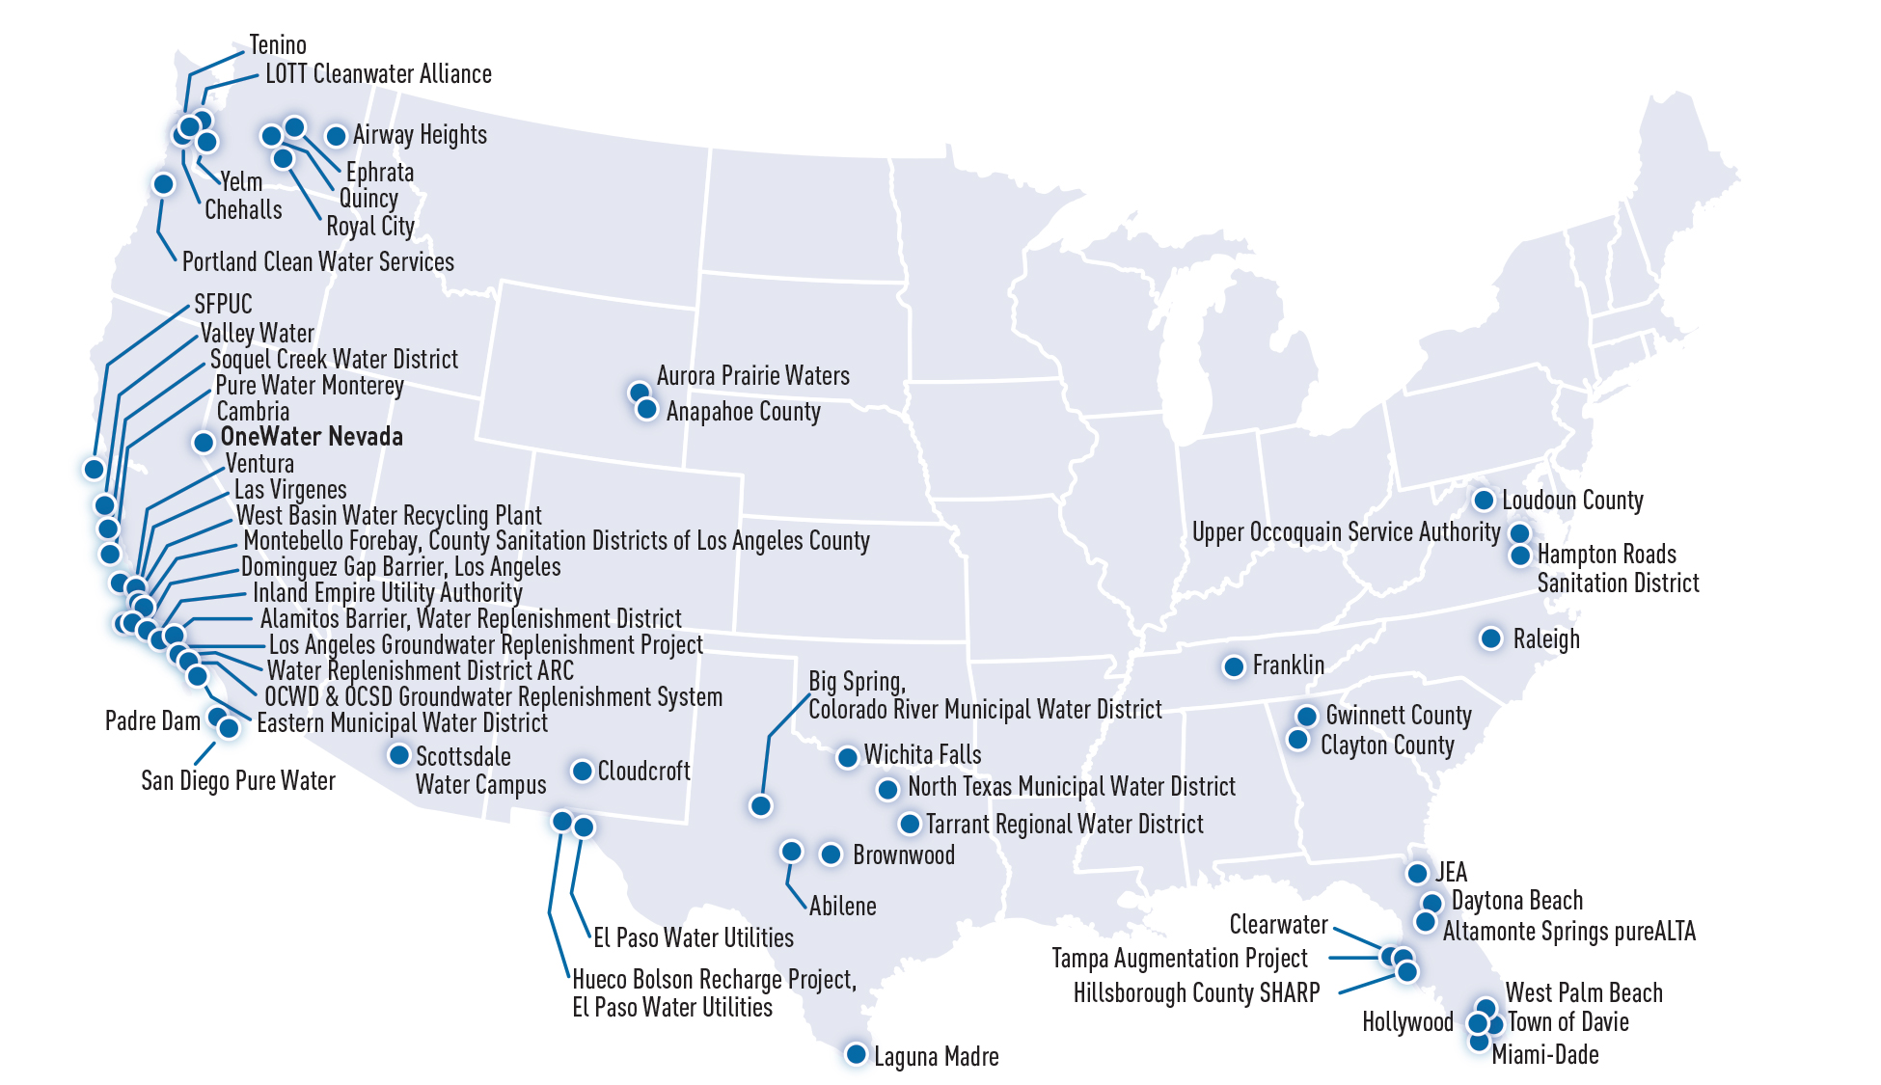

Slide 33
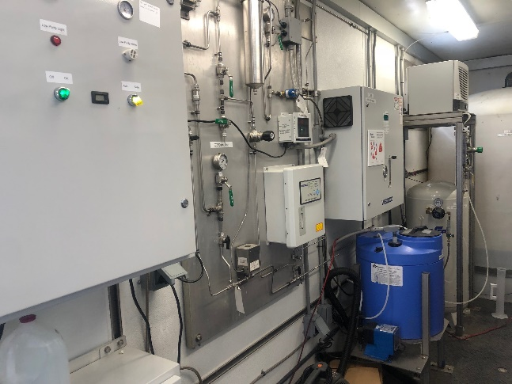
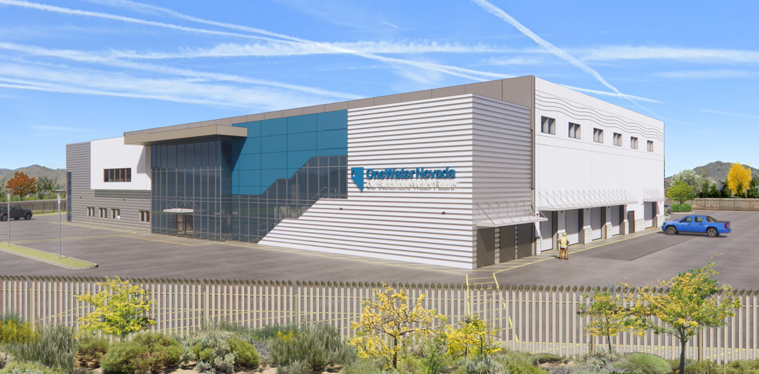
Advanced Purified Water Facility at American Flat
2 MGD Advanced Purified Water Facility
City of Reno and TMWA joint venture​
Tested treatment technology from 2017-2022
  Pilot study was first Category A+ permit in Nevada
$220+ million
  Received $30 million BOR grant June 2024
Creates a drought proof water supply
  Reduces discharge to Swan Lake
Carbon/Biological Treatment vs Membrane
  No brine/waste stream
  More sustainable and energy efficient
Suitable aquifer and hydrogeology

Slide 34
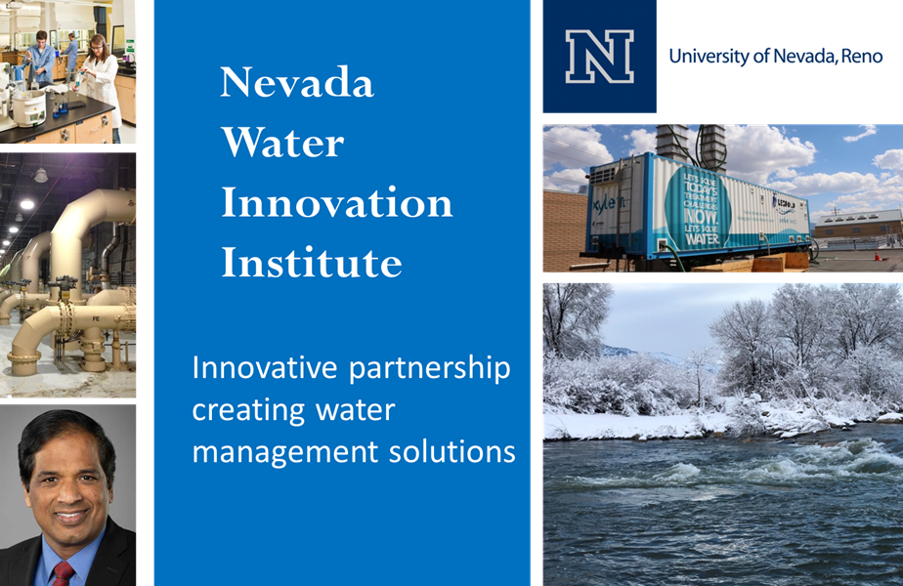
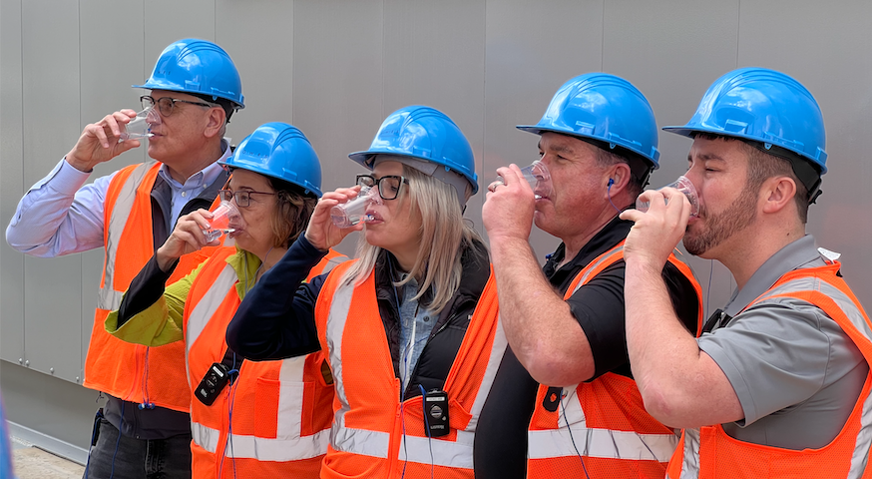
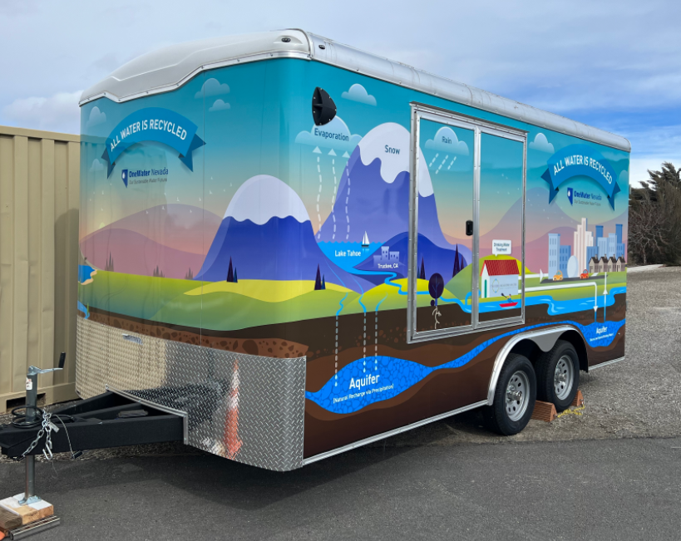
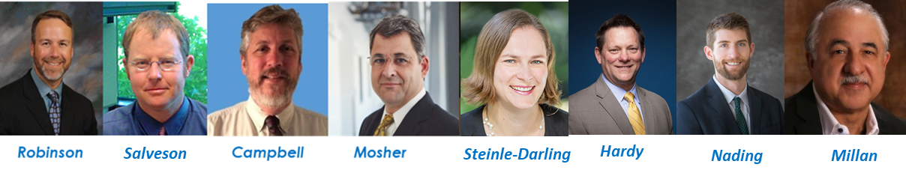
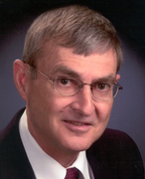
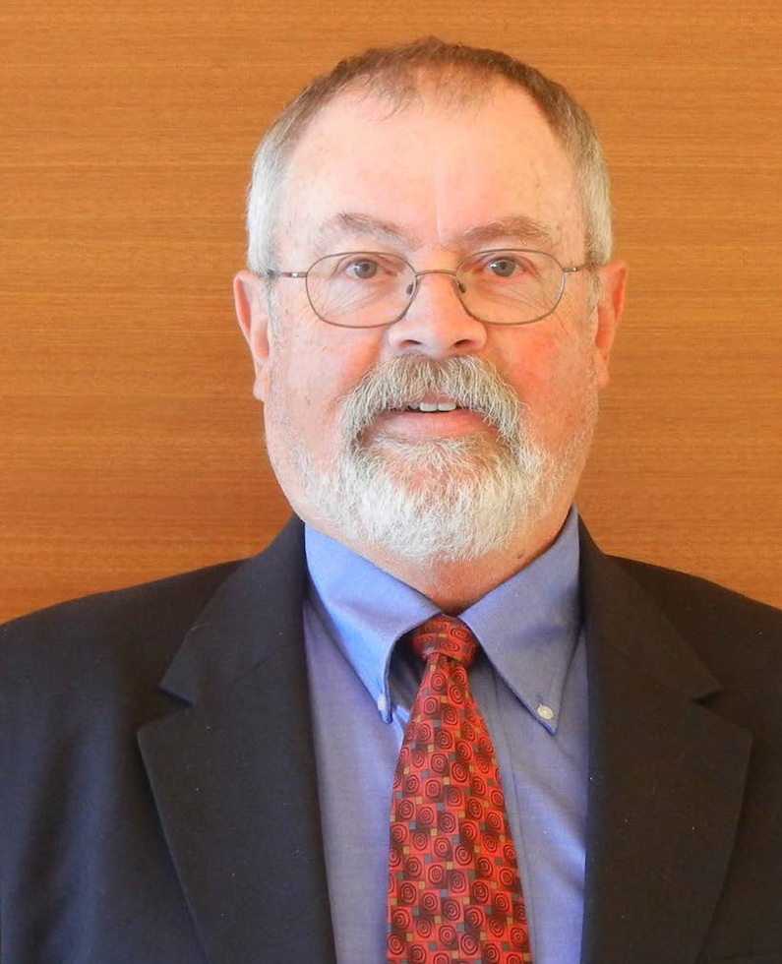


Project Components
Crook Hultquist Schumacher

Slide 35
Thank you!
Questions?
Danny Rotter, PE
Assistant GM / Director of Engineering
Truckee Meadows Water Authority
drotter@tmwa.com
Greg Pohll, PhD
Principal Hydrogeologist
Truckee Meadows Water Authority
gpohll@tmwa.com
Lydia Teel, PhD, PE
Emerging Resources Supervisor
Truckee Meadows Water Authority
lteel@tmwa.com

