Slide 1
Pyramid Highway Project Update
Scott Hein, P.E.- Assistant Director of Engineering
Nanette Maxwell- Senior Project Manager

Slide 2
1
Construction Overview
2
Project Aesthetics Update

Slide 3
PROJECT LIMITS
Project limits are from Queen Way to Golden View Drive

Slide 4
PROJECT FEATURES
Adding one lane, in each direction, between Queen Way and Los Altos Pkwy
Curb, gutter and sidewalk
Raised medians throughout
10-foot paved shared-use path
Walls north of Los Altos Pkwy
Landscaping and aesthetics
Smart traffic signals and traffic cameras
Drainage enhancements

Slide 5
SCHEDULE
Construction began in May 2023 Construction anticipated to complete in late spring/early summer 2025
SB widening Los Altos Pkwy to Queen Way: Complete
NB widening Queen Way to Los Altos Pkwy: Complete
Includes new shared-use path
Median work Queen Way to Los Altos Pkwy: In progress
All work Los Altos Pkwy to Golden View Dr: In progress
Includes new shared-use path and sidewalk

Slide 6
TRAFFIC CONTROL
Reduced 45MPH speed limit
Minor congestion delays through the work zone
Two lanes open during the daytime with shoulder closures
Narrowed lanes/shifts possible
Nighttime single-lane closures
New shared-use path open to public south of Los Altos Pkwy

Slide 7
OUTREACH AND COMMUNICATIONS
Subscribe for construction updates!
(775) 230-7282
info@pyramidhighway.com
Text PYRAMID to
(775) 242-9168
www.pyramidhighway.com
@NevadaDOTReno

Slide 8
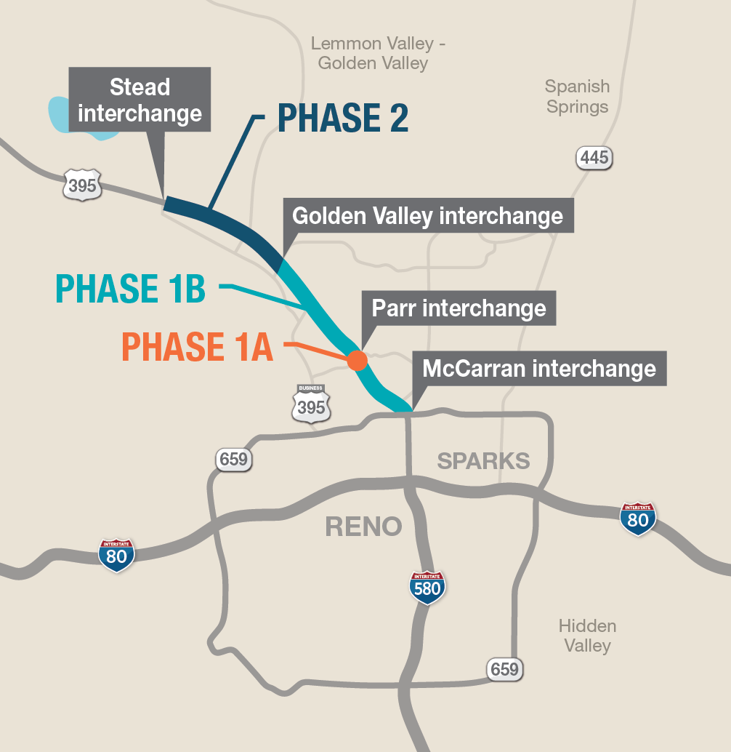
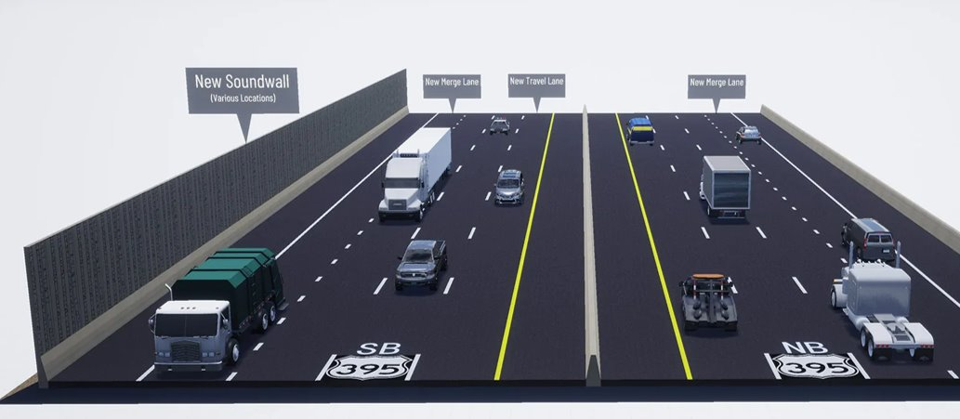
U.S. 395 NORTH VALLEYS PROJECT - Phase 1B
Widen southbound U.S. 395 to three lanes – North McCarran Blvd to Golden Valley
Resurface and add auxiliary lane between interchanges in both directions
Construct northbound “braided” freeway ramp to Golden Valley Road
MORE INFORMATION: 395NorthValleys.com

Slide 9
Project Aesthetics Update
John L’Etoile, PLA – Landscape Architect Supervisor

Slide 10
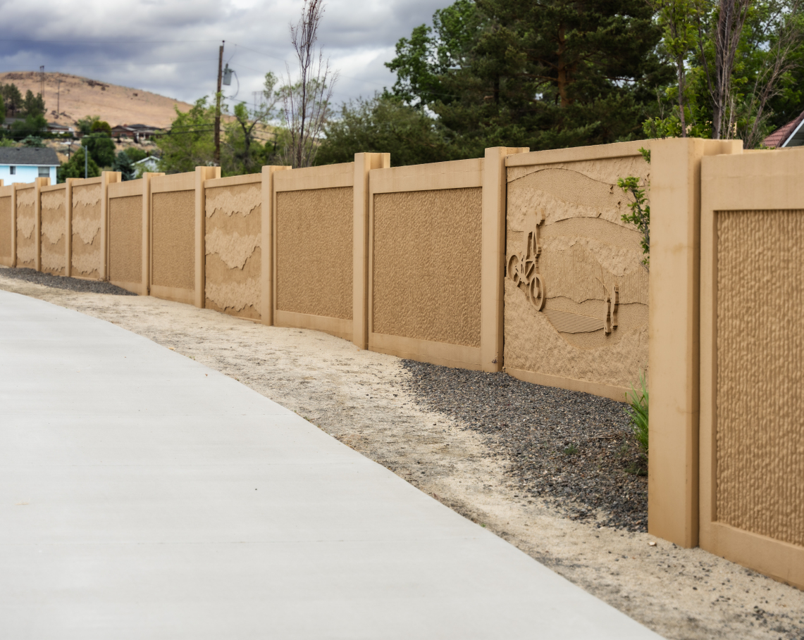
LANDSCAPE and AESTHETICS
Reduce sound and visual impacts
Reduce dust and erosion
Visually identify community’s history
EXISTING SOUNDWALLS
Pyramid and McCarran Interchange

Slide 11
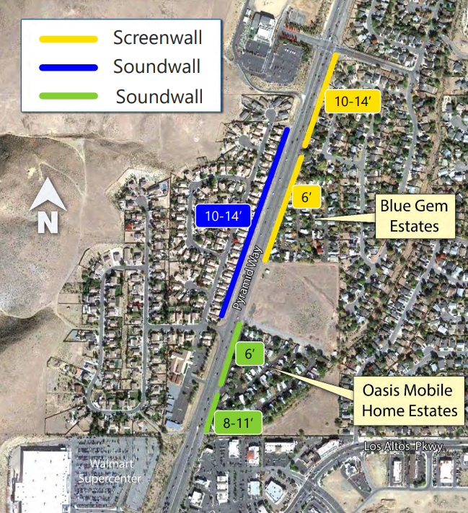
PYRAMID HWY AESTHETICS
THEME
Pyramid Lake biodiversity
FEATURES
Erosion control
Enhance median and trail
Aesthetic wall patterns
GOALS
Unify theme throughout corridor-
tie into existing Pyramid/McCarran
interchange aesthetics shown on
previous slide
Reduce noise pollution
Aesthetics to express regional context
FIVE WALLS – North of Los Altos
Screening and Soundwalls

Slide 12
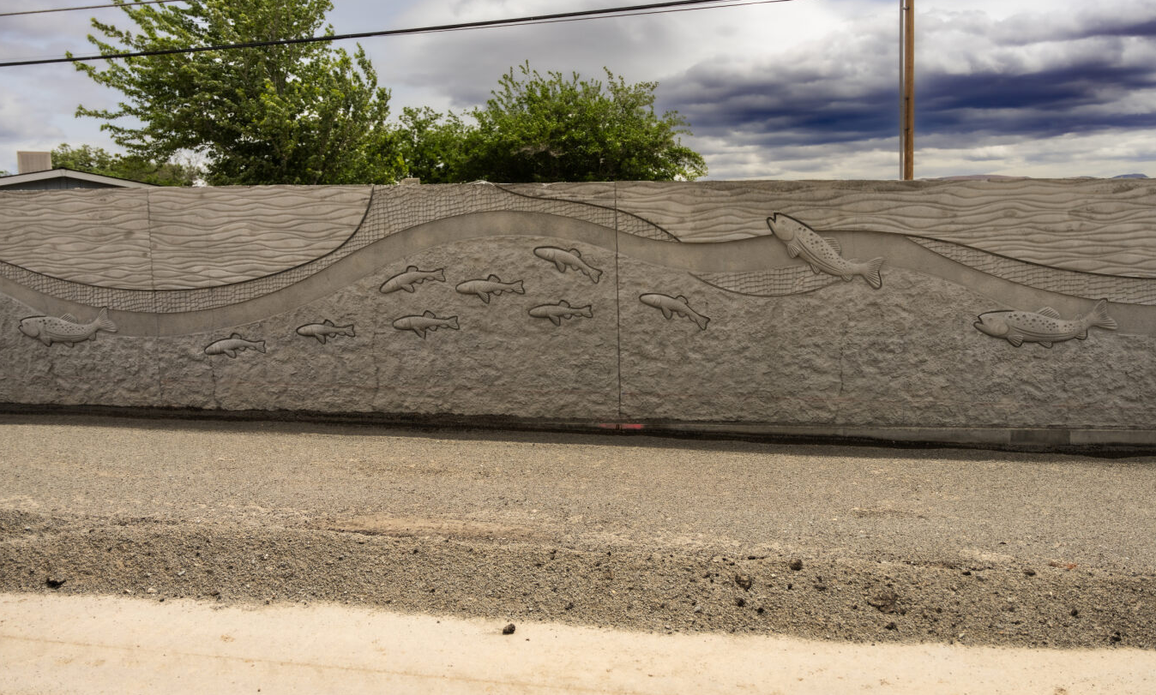
WALL STATUS
Wall construction north of Los Altos: 1/3 complete
Pedestrian path and barrier rail to be installed in front of walls
Painting and decorative rock will enhance roadside aesthetic

Slide 13
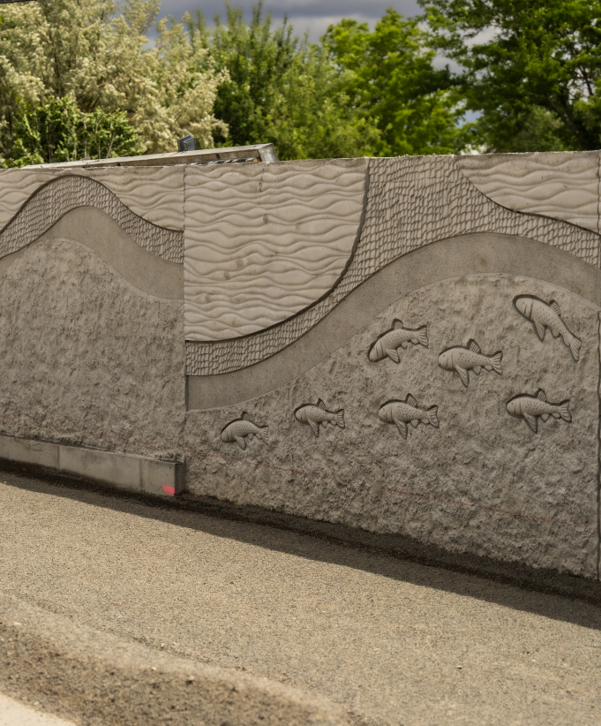
WALL STATUS
Design error led to reverse pattern
Discovered after formliners were constructed
Utilized existing panel forms and alternated sequence of waves to not delay construction or add cost

Slide 14
THANK YOU FOR COMMUNITY FEEDBACK
We appreciate the public feedback received so far
We have some options to show you for your input
Visit PyramidHighway.com before June 30
Provide Input on Concepts

Slide 15
OPTION #1 - Pelican Wave
Pelicans are cast in concrete on the taller wall being installed on the opposite side of the highway
Waves add fluidity to pattern
Powder-coated steel

Slide 16
OPTION #2 – Fish Medallion
Cui-ui fish matching the look of installed decorative figures
Powder-coated mesh round backer panel

Slide 17
OPTION #3 – Diamond Column
Cui-ui fish in stainless steel
Powder-coated steel column with fish scale diamond pattern

Slide 18
OPTION #4 - Fish and Grasses
Mimics decorative figures of cui-ui and trout already installed
Powder-coated steel and stainless steel

Slide 19
OPTION #5 – Fish Wave
Waves add fluidity to pattern
Diamonds representing fish scales add shadows and interest to the wave
Powder-coated steel and stainless steel

Slide 20
OPTION #6 – Wave Panels
Waves add fluidity to pattern
2 ribbons matching colors and textures of fish decorative figures
Powder-coated steel and stainless mesh

Slide 21
OPTION #7 – Leave As Is
42” barrier rail to be installed along roadway
Decorative rock to be installed
Shared-use trail to be constructed

Slide 22
Summary of Concepts
Option #1
Option #2
Option #3
Option #4
Option #5
Option #6
Option #7

Slide 23
To Provide Input on your Preferred Concept:
Visit PyramidHighway.com before June 30 and fill out the feedback form
You can select your preferred concepts and leave a comment
Finalized concepts will be posted to PyramidHighway.com in August. SIGN UP ON THE WEBSITE NOW FOR UPDATES.

