Slide 1

Important Things You Need to Know About Planning
Spanish Springs Citizen Advisory Board (CAB)
October 2, 2024

Slide 2
Budget/Fiscal
Abbe Yacoben

Slide 3
General Fund Sources = $503.9 M
FY 2025 General Fund Budget
General Fund Uses = $522.1 M
Notes:
Pencils to software contracts to medical supplies to utilities and is only 16%

Slide 4
Legal
Michael Large

Slide 5
Takings and Inverse Condemnation
Fifth Amendment of the U.S. Constitution
“nor shall private property be taken for public use, without just compensation.
Nev. Const. art. 1 section 8
“Private property shall not be taken for public use without just compensation having first been given.”

Slide 6
What is Property?
  For a “taking” to occur, claimant must have a stick in the bundle of rights. The bundle of property rights includes “all rights inherent in ownership, including the inalienable right to possess, use, and enjoy the property.” ASAP Storage, Inc. v. City of Sparks, 123 Nev. 639, 647, 173 P.3d 734, 740 (2007)
  Right to possess
  Right to use
  Right to enjoy
  Right to exclude

Slide 7
What is a Taking?
A taking can arise when the government regulates or physically appropriates an individual's private property.
  Physical Taking -- Physical appropriation exists when the government seizes or occupies private property or ousts owners from their private property.

Slide 8
What is a regulatory taking?
Government has the right to restrict property use but regulatory takings occur when the government goes “too far”
Two bedrock principles
  “Fairness and Justice” – Armstrong v. U.S, 364 U.S. 40 (1960)
  “Functional equivalence” with appropriation or physical ouster – Lingle v. Chevron USE, 544 U.S. 528 (2005).

Slide 9
Why is this attorney wasting my time on this?
Washoe County enacts regulations in the form of Development Code
    Board of County Commissioners, Planning Commission and Board of Adjustment are acting as “regulators”
    Approvals, Denials, Conditions on Property are all regulations impacting the bundle of rights and if they go “too far” or are not based on law, a taking can occur.

Slide 10
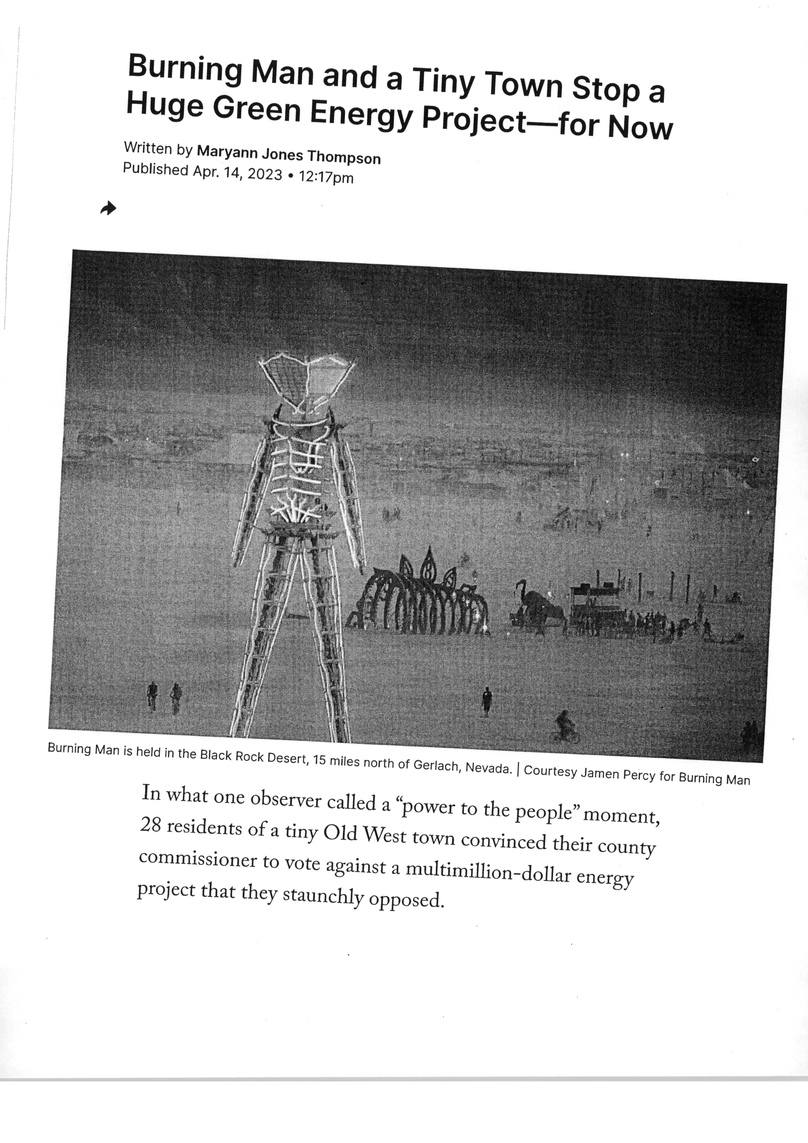
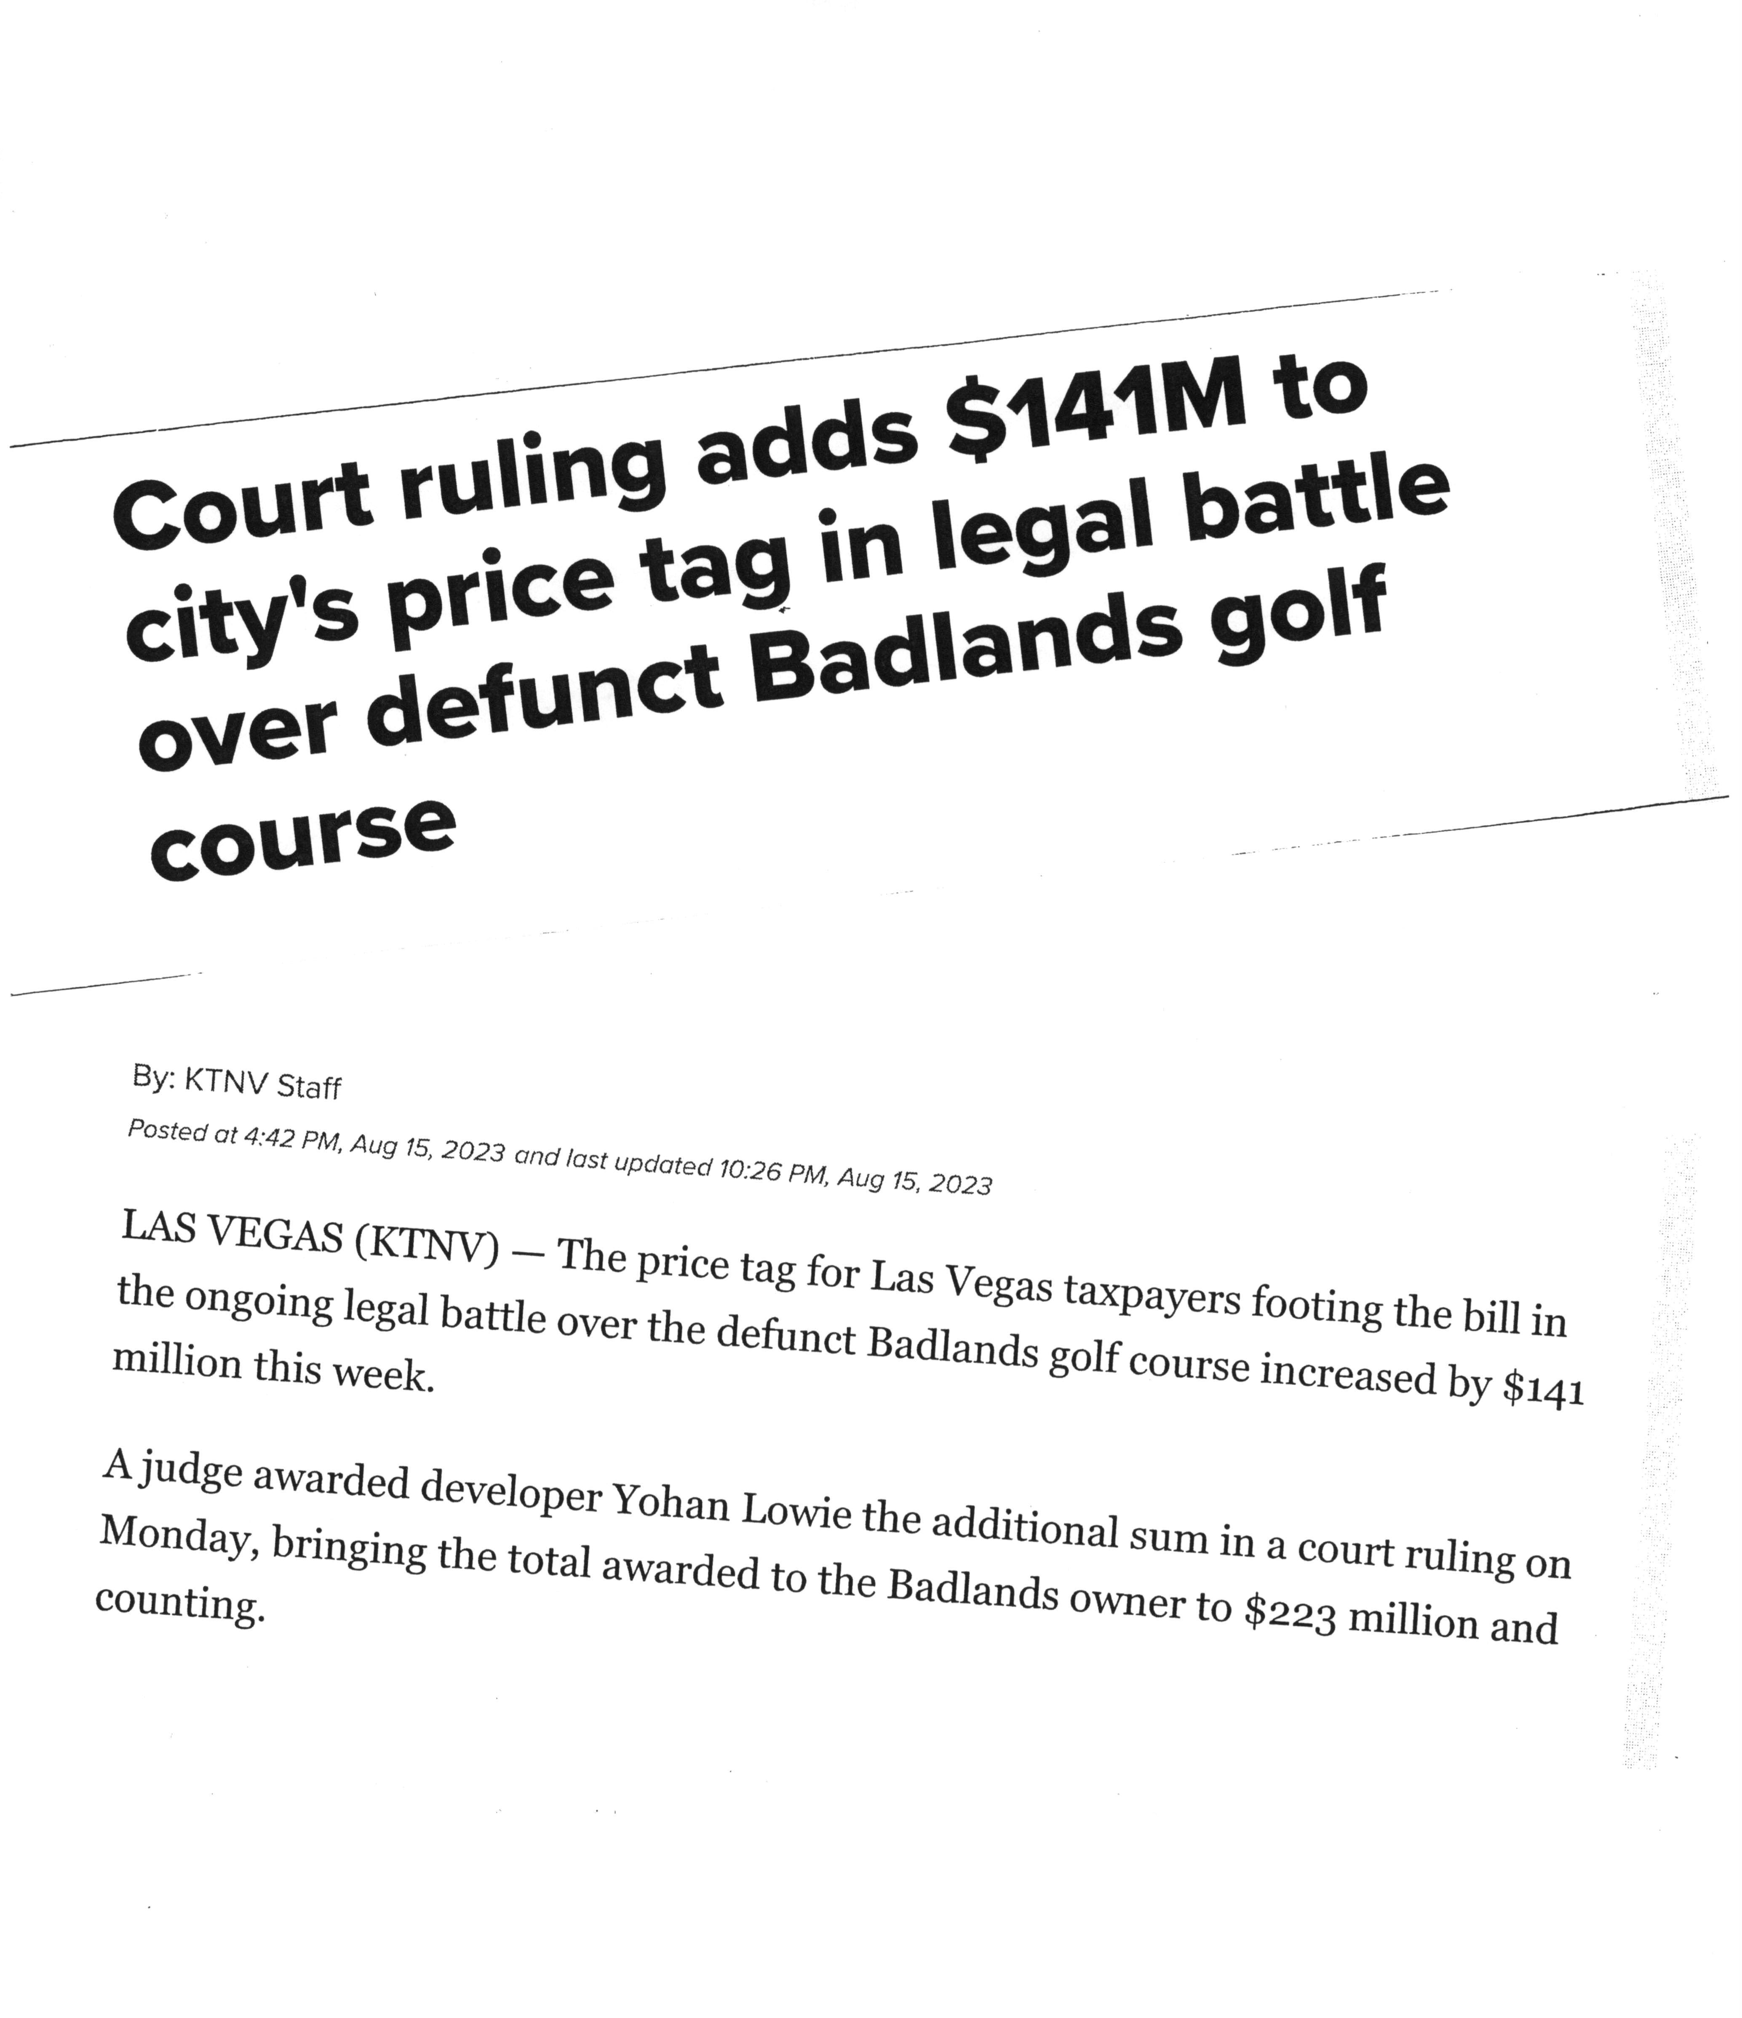
Approval, Denials, and Conditions not supported by evidence in the record can result in Takings Claims
Reno City Council approves $3.5M settlement over Stan Lucas’ Mortensen Ranch project

Slide 11
Regional Planning
Jeremy Smith

Slide 12
Regional Planning in the Truckee Meadows
Truckee Meadows Regional Planning Agency (TMRPA)
Jeremy Smith, Director
Spanish Springs CAB
10/02/2024
Notes:
Good evening Regional Planning Commission members… Chris Tolley, TMRPA
This item presents the Regional Planning Commission (RPC) with information regarding the Public Infrastructure Plan, and requests input or feedback regarding the PIP goals and scope of work

Slide 13
Overview of TMRPA
The Truckee Meadows Regional Planning Agency was created by state statute in 1989
  First regional plan 1991
  5-year update cycle
Created to foster collaboration and facilitate master planning in the Truckee Meadows
  3 Jurisdictions
  Affected entities

Slide 14
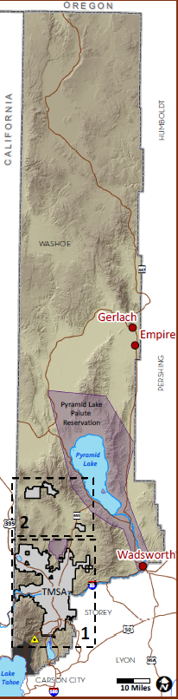
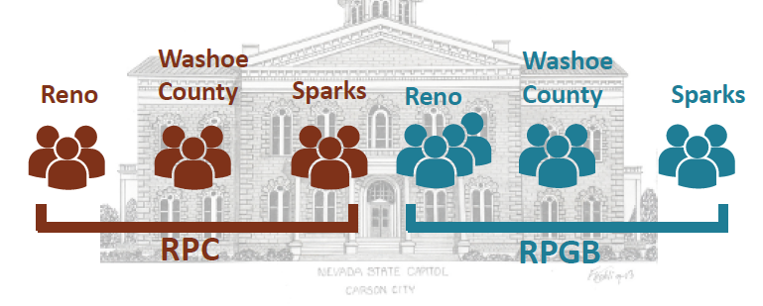
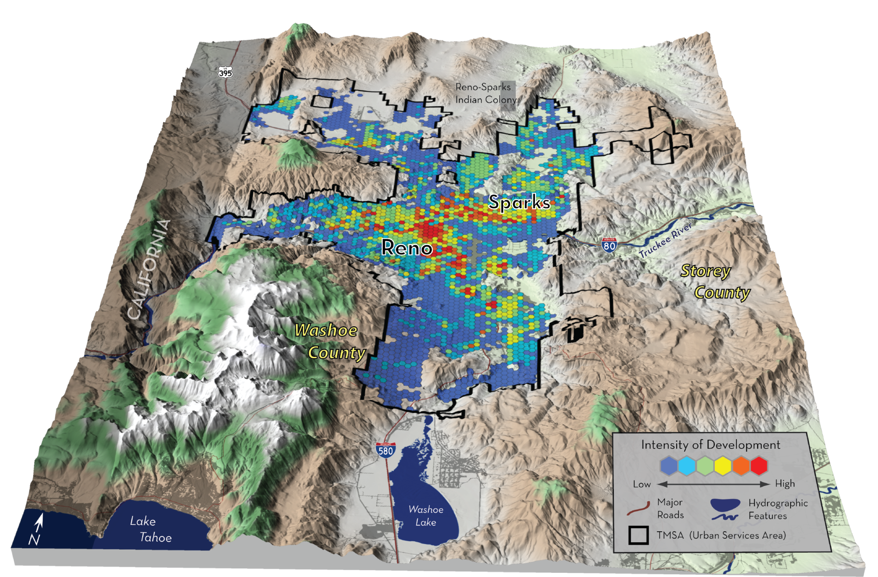
Agency Structure & Jurisdiction
People
  Regional Planning Governing Board (RPGB)
  Regional Planning Commission (RPC)
  Staff
Place
  All of Washoe County
  Exceptions:
    Tahoe Basin
    Tribal Lands
Notes:
Regional Planning’s authority is at the Master Plan level
Master Plan Amendment
Land Use
Text
Project of Regional Significance (PRS)
NRS 278.0278
PRS Guidelines

Slide 15
Mandate in State Law
Regional Planning in counties whose population is 100,000 or more but less than 700,000
NRS 278.0274 Contents of the Regional Plan
  Population growth
  Natural Resources
  Limit premature expansion
  Land use and transportation
  Public facilities and services
  Annexation
  Intergovernmental coordination

Slide 16
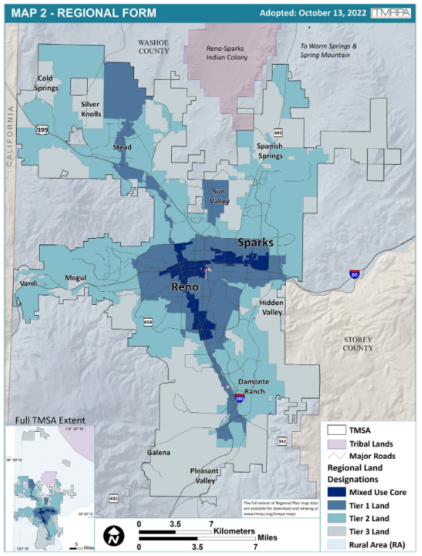
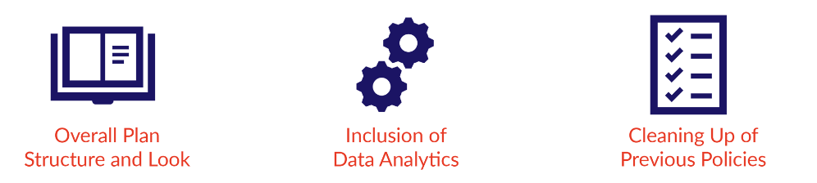
Adoption of the 2019 Regional Plan
Removed emphasis on jurisdiction boundaries and re-embed in state law
Regional land designations (RLDs or Tiers)
  Regional Form Map (Map 2)
  Targets density in the MU Core and Tier 1
  Criteria based approach to Tier changes and TMSA additions
Implementation of Facility and Service Standards
  Policy PF 1 and Table 3.2
Initial Review Memo (IRM)

Slide 17
Regulatory Function
Review of Conformance with the Regional Plan
  Jurisdiction master plans
  Affected entity facilities plans
Review of Conformance for “Projects of Regional Significance (PRS)”
  Defined in state law NRS 278.026
  Memorialized with specific additions in Regional Planning Commission resolution 23-02 (found as Appendix 2 of the Regional Plan)
Regional Plan Amendments
  Policy updates
  Spheres of Influence
  Mapping regional utilities
Programs of Annexation and De-annexations
  RPC functions as the annexation and de-annexation commission
Notes:
Recap of the 3 goals in the context of our stool sample
Goal 1…
Goal 2…
Goal 3…

Slide 18
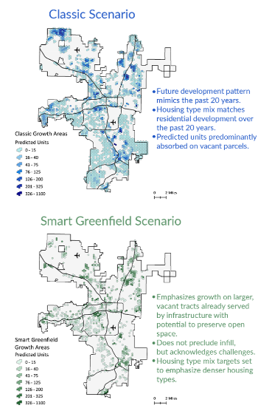
Data and Analytics
Truckee Meadows Annual Report (TMAR)
Natural Resource (NR) Plan Initiative
  Hosted NR data portal
  Targeted policy additions to the RP
Public Infrastructure Plan (PIP)
  Collect and combine information about past and planned capital improvements
Modeling population and job growth
  2024 Washoe County Consensus Forecast
  Assist with RTC Travel Demand Model
  Assist with Regional Water Management Plan
  Scenarios of future growth and differential impacts

Slide 19

Regional Coordination
Multi-jurisdiction board and commission
  Joint and cooperative planning
Regularly convene jurisdiction and affected entity staff for regional planning initiatives
  Example: Regional Plan Update Working Group
Intergovernmental coordination
  Economic development
  Neighboring counties/cities
  Tribal governments
Focus on data sharing and aligning understanding with facts
Community conversations and events

Slide 20
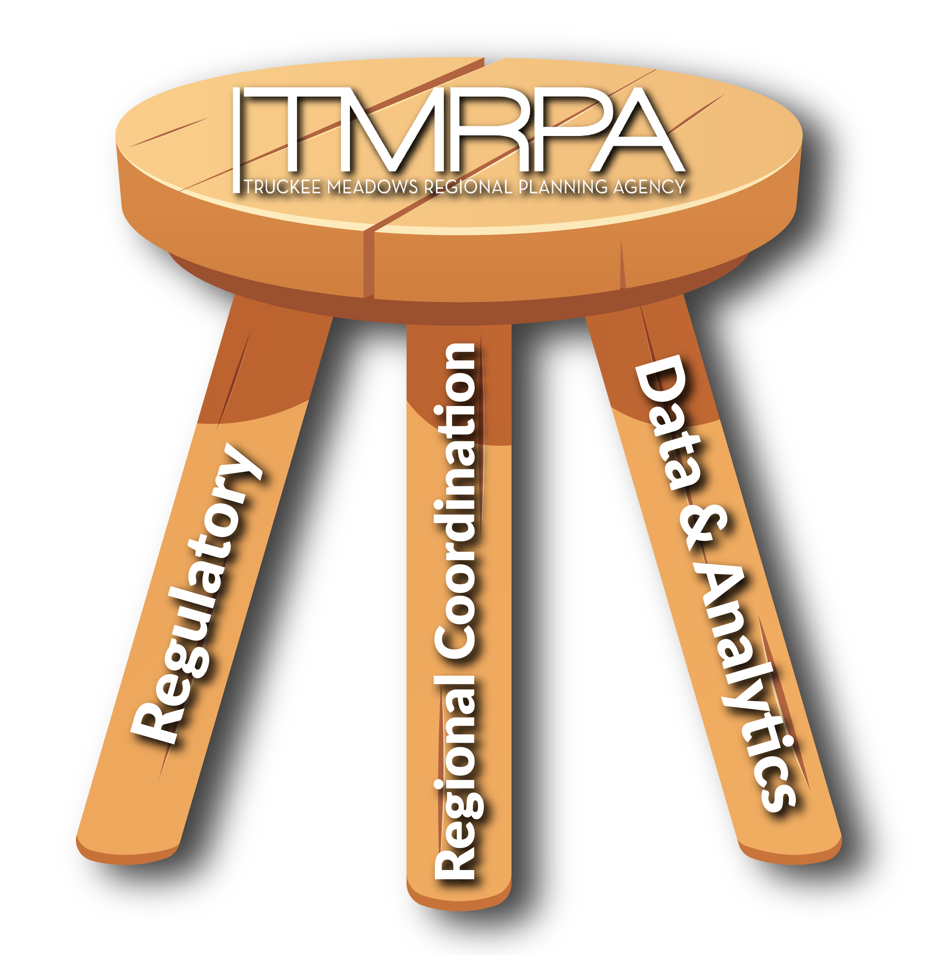
Summary
Regional Planning in Washoe County is required by state law
Regulatory function to ensure conformance with a shared regional vision for growth (aka the Regional Plan)
Data and analytics to support data driven decision making
Fosters coordination and collaboration among jurisdictions, entities and other organizations

Slide 21
Where to go to learn more
TMRPA website - https://tmrpa.org/
Regional Plan
  https://tmrpa.org/2019-truckee-meadows-regional-plan/
Truckee Meadows Annual Report (TMAR) website
  https://tmrpa.org/tmar/
TMRPA Maps and Data page
  https://tmrpa.org/maps-gis-data/
TMRPA Natural Resources (NR) Plan Effort and NR Data Portal
  https://tmrpa.org/nrplan/
Public Infrastructure Plan Effort
  https://tmrpa.org/public-infrastructure-plan/
2024 Regional Plan Update
  https://tmrpa.org/2024-rpu/
Contact Information:
input@tmrpa.org
Jeremy Smith
Director
jsmith@tmrpa.org
775-225-0285

Slide 22
Washoe County
Master Plan
Eric Young

Slide 23
October 2, 2024

Slide 24
Plans
Why does my job exist?
The State of Nevada requires all jurisdictions to adopt “Master Plans.” [NRS.278.160]
Washoe County’s Master Plan must include plans for
  Housing
  Intergovernmental Coordination
  Conservation of Historic and Natural Resources including Recreation & Open Space
  Land Use
  Transportation
  Public Facilities & Services

Slide 25
Plans
Washoe County’s newly adopted master plan includes each of these essential elements.
  Envision Washoe 2040 Elements
    Population and Housing Element
    Regional Form and Coordination Element
    Conservation of Natural and Cultural Resources Element
    Adaptation and Resiliency Element
    Land Use Element
    Transportation Element
    Public Facilities and Services Element

Slide 26
Plans
Intergovernmental Coordination is a new Element:
  Recognition of How our Region functions.
    Our region depends on the cooperation of a rich network of public service agencies. Each of these agencies is pursuing its own unique set of responsibilities. And each of them is guided by its own planning document.
      Washoe County itself includes my department, Community Services, but also Libraries, Senior Services, Parks and Recreation, Human Services, Sheriff, and Northern Nevada Public Health.
      Other agencies such as Reno and Sparks, the State of Nevada, the BLM and the Forest Service, the Regional Planning Agency, TMWA (and other water companies), multiple fire agencies, Regional Transportation Commission.
      Communication, Coordination, and Cooperation with other agencies are central elements of planning and development review.

Slide 27
Plans

Slide 28
Planning
Commission
Rob Pierce

Slide 29

Planning Commission
Rob Pierce, Planning Commission Chair
www.washoecounty.gov/csd

Slide 30
Purpose of Planning Commission
Created pursuant to NRS 278.030, performs all the duties and functions delegated by the terms of NRS 278.010 to 278.630. The Planning Commission has the responsibility for adoption of Washoe County’s Master Plan, recommending regulatory zone changes and development code amendments, recommending regional road impact fee (RRIF) changes and reviewing and approving development applications for unincorporated Washoe County.
7 Members
Unincorporated Washoe County
4 Year Terms
Appointed by the Board of County Commissioners
Meets monthly
Serve on other boards (i.e. Regional Planning Commission)

Slide 31
Planning Commission Responsibilities
Application Types (Discretionary Applications)
  Master Plan Amendments
  Regulatory Zone Amendments
  Abandonments
  Amendments of Conditions and extension of time requests (approved applications)
  Special Use Permits
    Projects of Regional Significance
    All other SUPs reviewed and approved by BOA
  Tentative Subdivision Maps

Slide 32
Washoe County Board of Adjustment
Created pursuant to NRS 278.270, performs all the duties and functions delegated by the terms of NRS 278.010 to 278.630. The Board of Adjustment has the responsibility for reviewing and approving development applications and certain appeals for unincorporated Washoe County.
    5 Members
    Unincorporated Washoe County
    4 Year Terms
    Appointed by the Board of County Commissioners
    Meets monthly

Slide 33
Board of Adjustment Responsibilities
Application Types
  Special Use Permits
  Variances
  Administrative Permits
  Appeals (of Staff Decisions)

Slide 34
Findings of Fact for Approval/Denial
Typical Findings:
Consistency - The proposed use is consistent with the goals and policies of the Master Plan.
Site Suitability – The site is physically suitable for the type of development and for the intensity of development.
Issuance not Detrimental – Issuance of the permit will not be significanly detrimental to the public health, safety or welfare or injurious to the property or improvements of neighboring properties.
Availability of Services – The development will provide for adequate public facilities and services.

Slide 35

Trevor Lloyd, Planner Manager
Washoe County CSD – Planning Division
tlloyd@washoecounty.gov
775-328-3617

Slide 36
Planning
Program
Trevor Lloyd

Slide 37
Washoe County Planning
Trevor Lloyd, Planning Manager
www.washoecounty.gov/csd

Slide 38
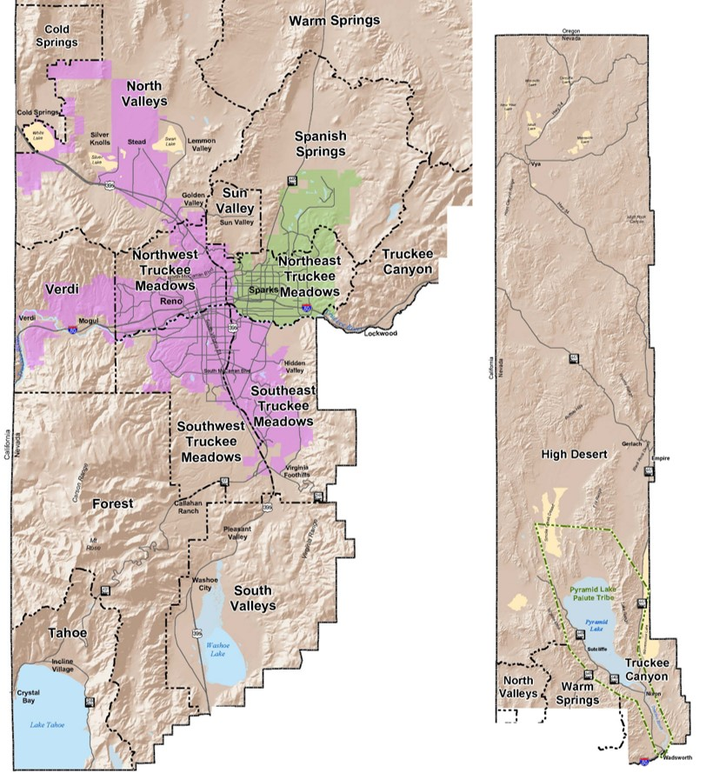
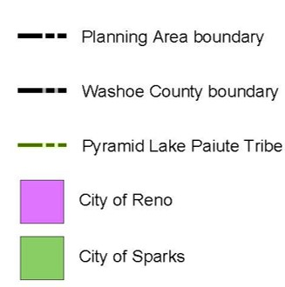
Washoe County
2 cities
6,542 sq. miles
502,937 population
(±115,000 Washoe)
2 regional planning agencies
Borders 12 counties

Slide 39
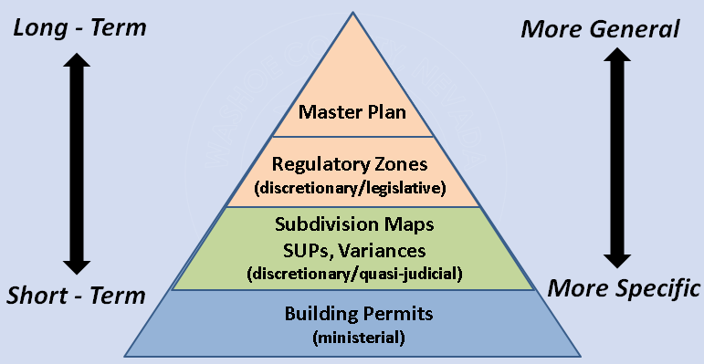
Planning Hierarchy
Washoe County: Planning Program
Master plans
Regulatory zones
Development Code
Planning applications
Building Permits

Slide 40
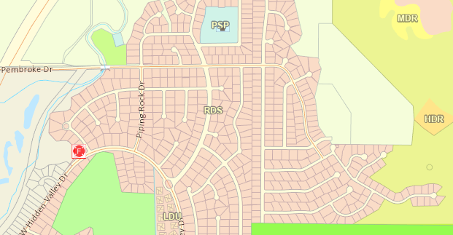
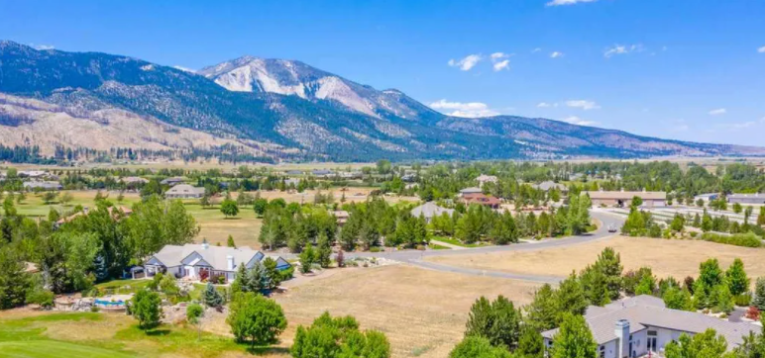
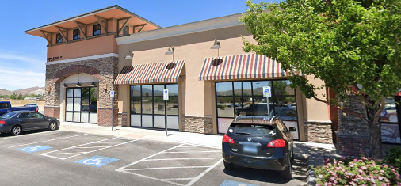
Key Responsibilities
Washoe County: Planning Program
Key Documents
Master planning and zoning
Development review
Boards and commissions
Code enforcement
Business license
Short Term Rental Program
Master Plan purpose: policy
Development Code
Zoning Maps

Slide 41
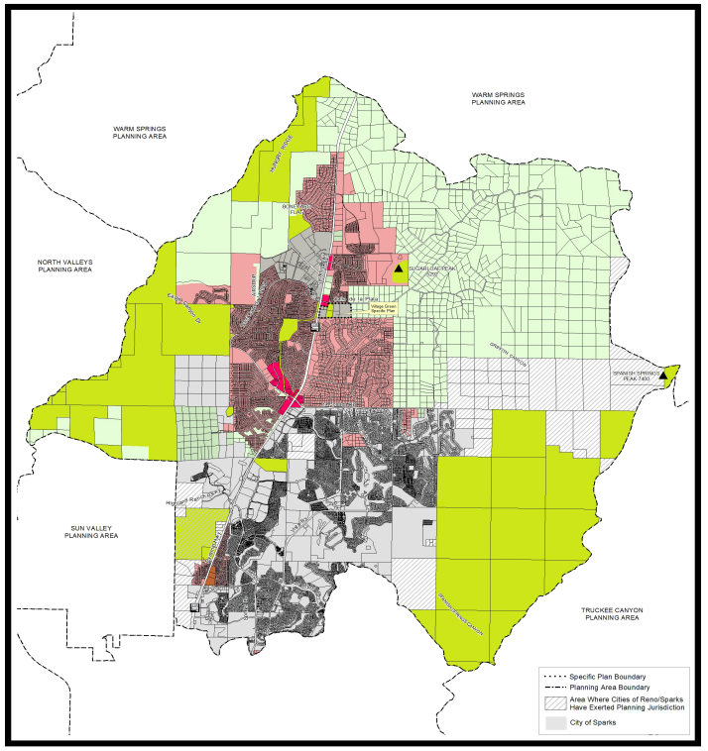
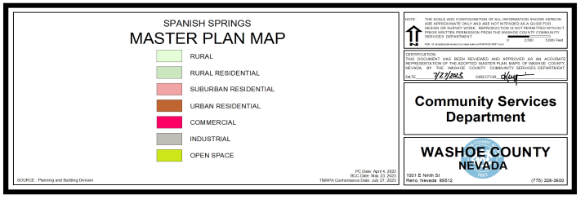
Master Plan Map
Spanish Springs Master Plan Map

Slide 42
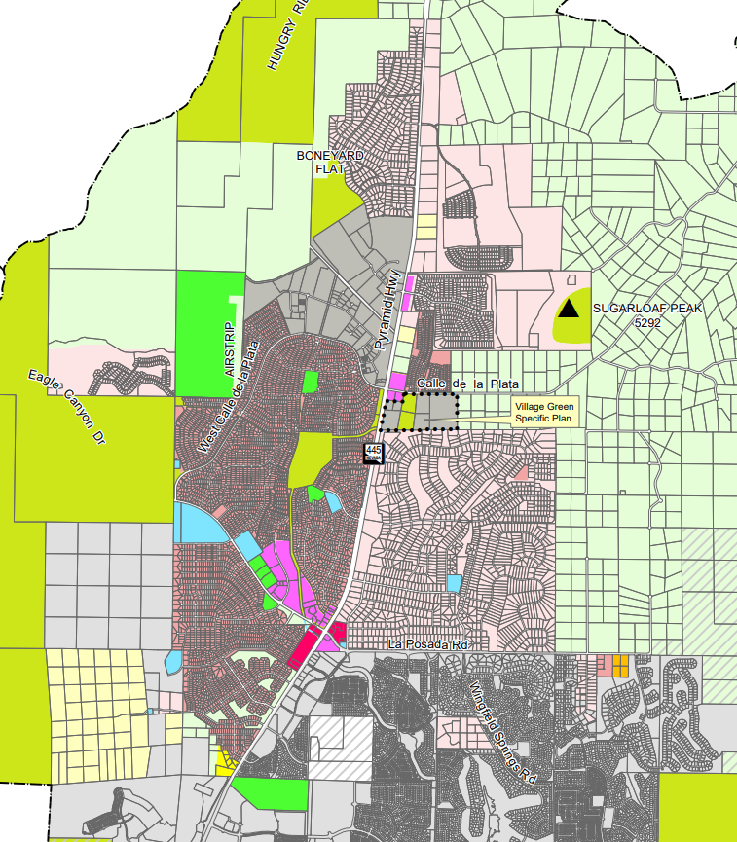
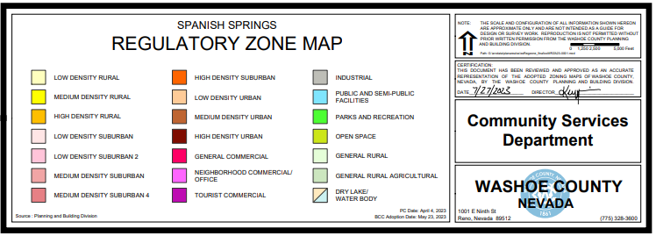
Zoning Map
Spanish Springs Regulatory Zone Map

Slide 43
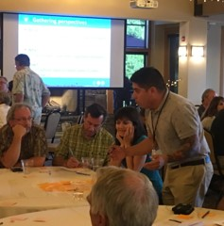
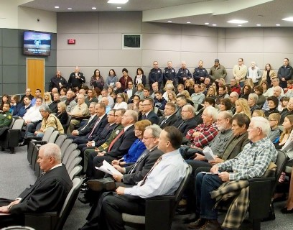
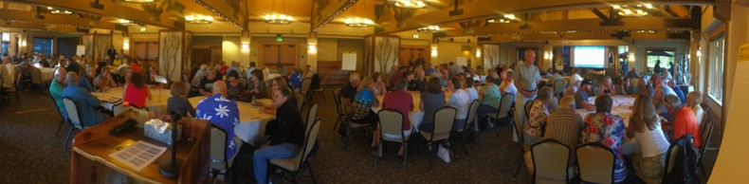
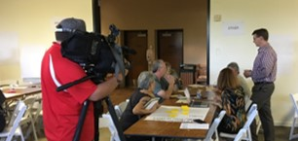
Washoe County: Planning Program
Public Outreach
• Public Noticing
• Neighborhood Meetings
• Surveys
• Public Hearings
• Community Workshops
• Social Media

Slide 44
Application Process
Pre-Application Or Pre-Development Meeting
Neighborhood Meeting
Application Submittal
Staff Analysis and Agency Reveiw
Noticing for Public Hearing
Public Hearing
Appeal Process
Final Plan or Building Permit Review (Administrative)

Slide 45
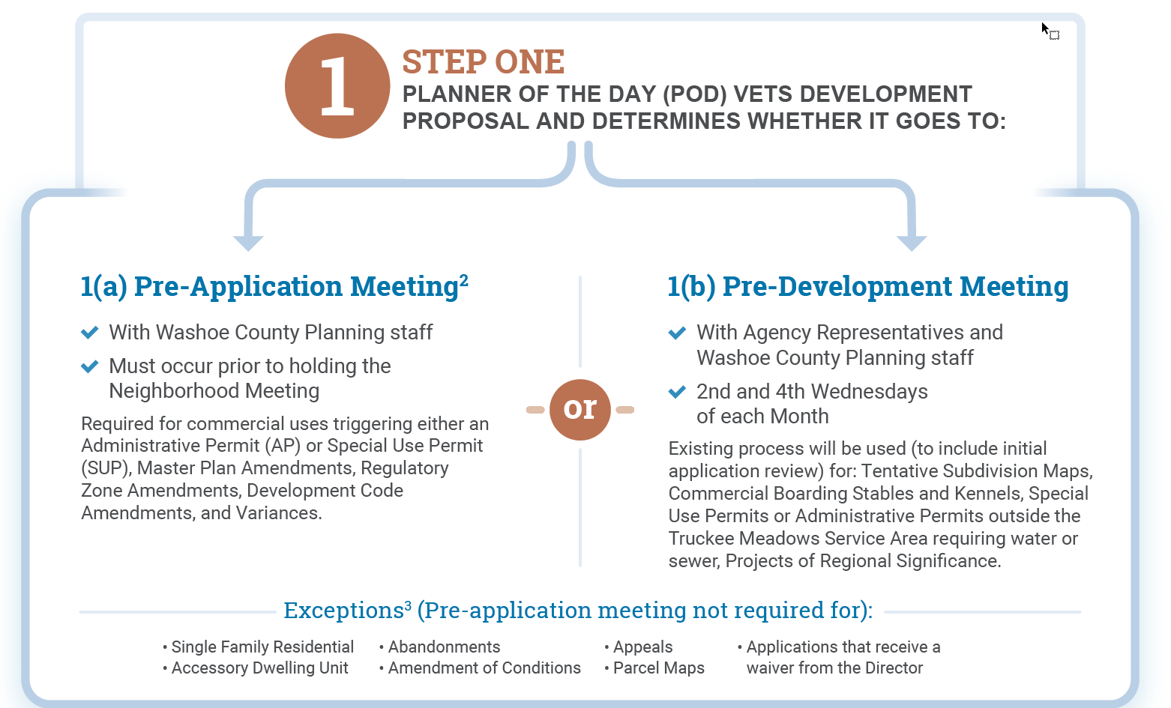
Pre-Application Process

Slide 46
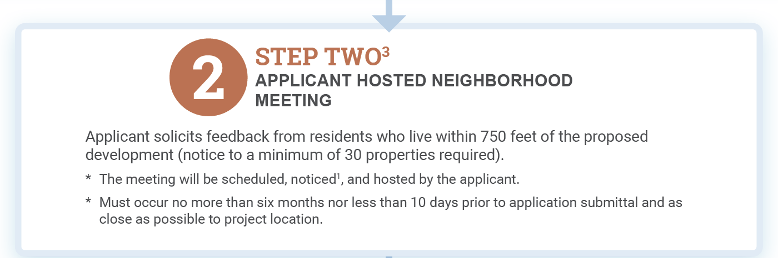
Pre-Application Process

Slide 47
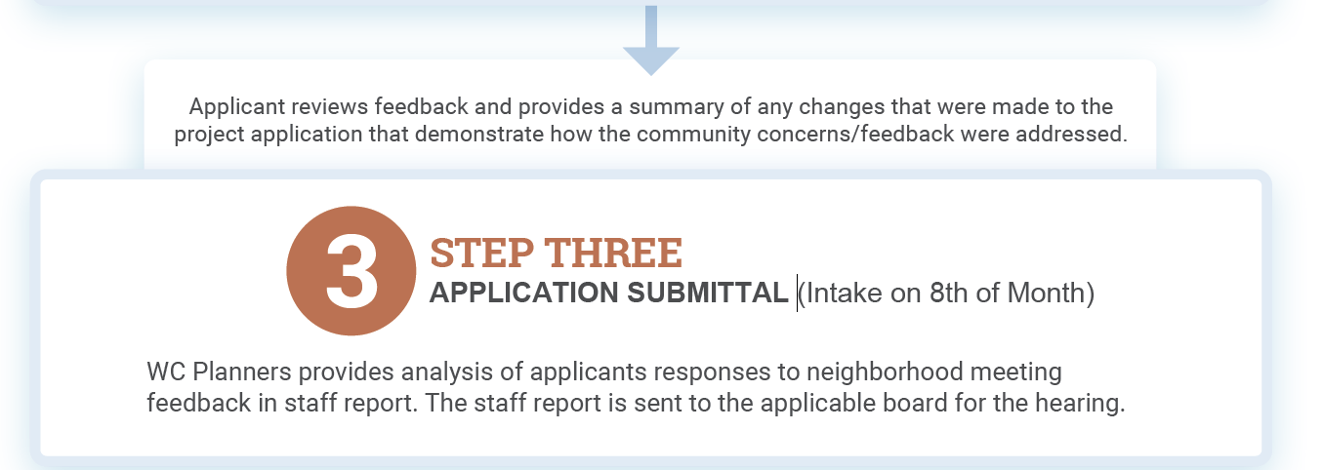
Pre-Application Process

Slide 48
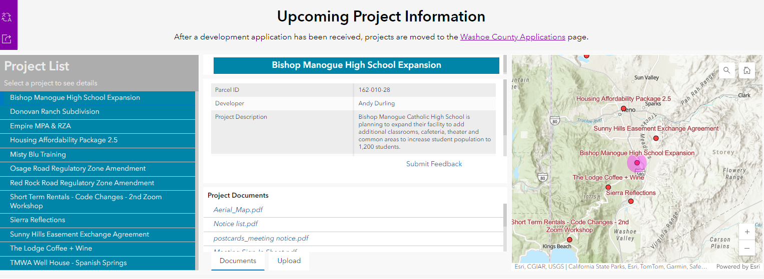
Neighborhood Meetings
https://neighborhood-washoe.hub.arcgis.com

Slide 49
Agency Review Process
Application (8th of each month)
Review of application for completeness (maximum of 3 days)
Case description written, public notice list created, given to administrative staff for Distribution to reviewing agencies. (approximately 4 days after submittal)
Comments received from reviewing agencies (approximately 3 weeks after submittal)
10-day appeal period following action by Planning Commission or Board of Adjustment

Slide 50
Important Contacts
Washoe County General Information
Washoe311@washoecounty.gov
Washoe County Planning
Planning@washoecounty.gov
775-328-6100
Trevor Lloyd, Planning Manager
tlloyd@washoecounty.gov
775-328-3817

Slide 52
Abbe Yacoben | Washoe County | Chief Financial Officer
Office: 775.325.8243 | ayacoben@washoecounty.gov
Michael Large | Washoe County | Deputy District Attorney (Civil Division)
Office: 775.337.5712 | mlarge@da.washoecounty.gov
Dr. Jeremy Smith | Truckee Meadows Regional Planning Agency | Director
Office: 775.321.8390 | jsmith@tmrpa.org
Dr. Eric Young | Washoe County Community Services Division | Senior Planner
Office: 328.3613 | eyoung@washoecounty.gov
Rob Pierce | Washoe County Planning Commission Chair & Board of Adjustment | Chair
Office: Contact Trevor Lloyd | rpierce@washoecounty.gov
Trevor Lloyd | Washoe County Community Services Division | Planning Manager
Office: 775-328-3617 | tlloyd@washoecounty.gov

