Slide 1
October 13, 2025
North Valley Citizen Advisory Board
Washoe County
Application Process

Slide 2
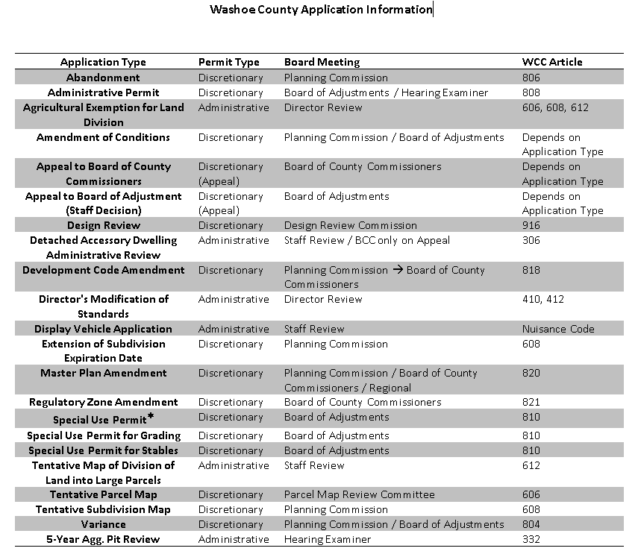


Application Matrix

Slide 3
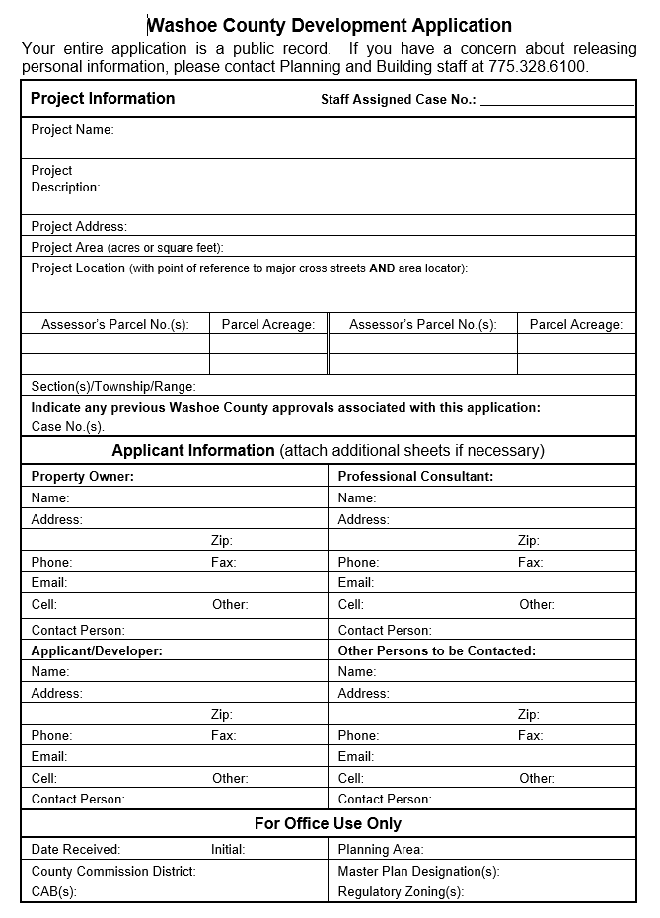
Application Form

Slide 4
Application Submittal Requirements
Fees
Development Application Form
Owner Affidavit
Proof of Property Tax Payment
Neighborhood Meeting
Application Materials
Proposed Site Plan Specifications
Grading Plans
Grading
Traffic Impact Report
Landscaping Plan
Signage Plan
Lighting Plan
Building Elevations

Slide 5
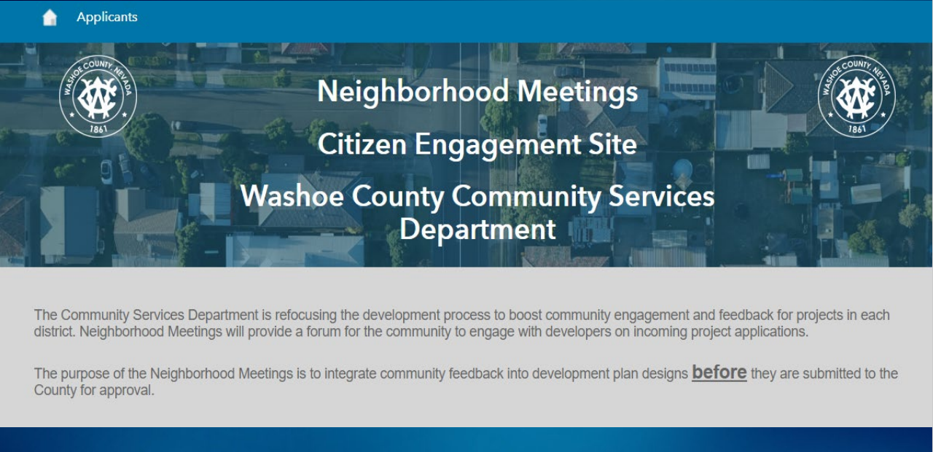
Neighborhood Meetings

Slide 6
Neighborhood Meeting HUB Website
https://neighborhood-washoe.hub.arcgis.com

Slide 7
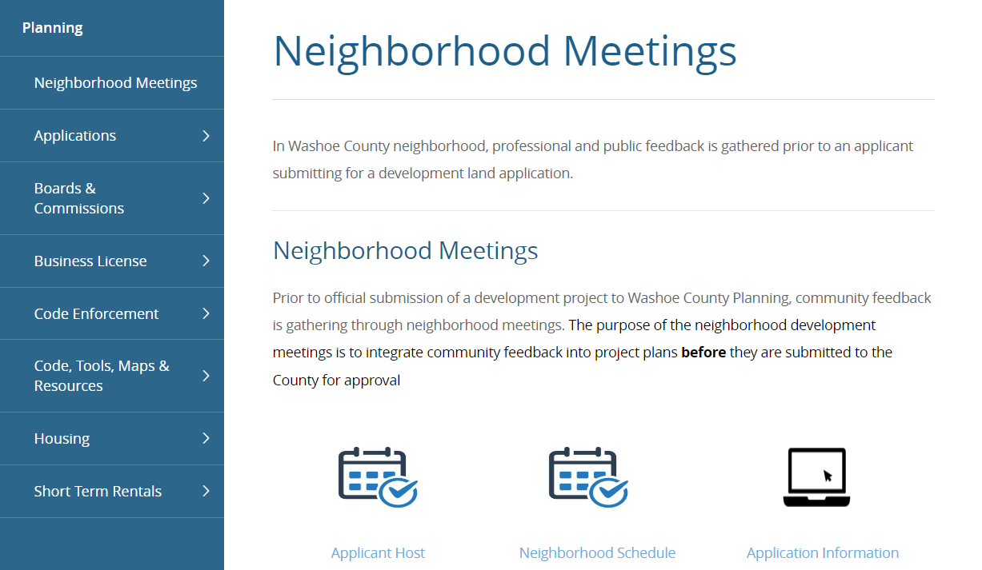
Neighborhood Meetings

Slide 8
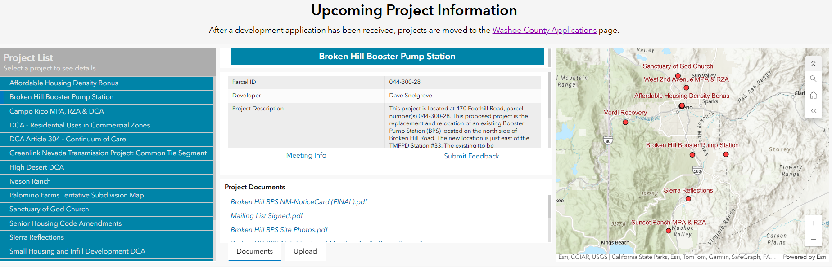
Neighborhood Meetings-1

Slide 9
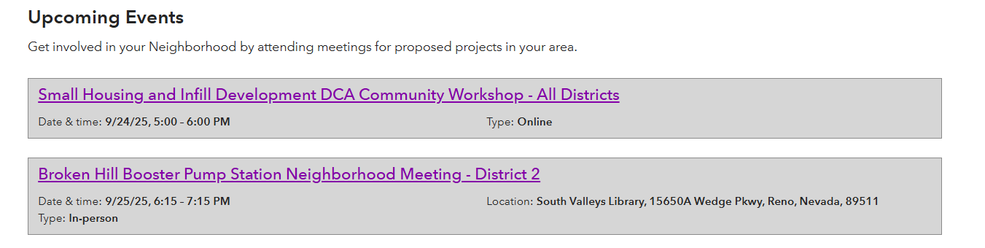
Neighborhood Meetings-2

Slide 10
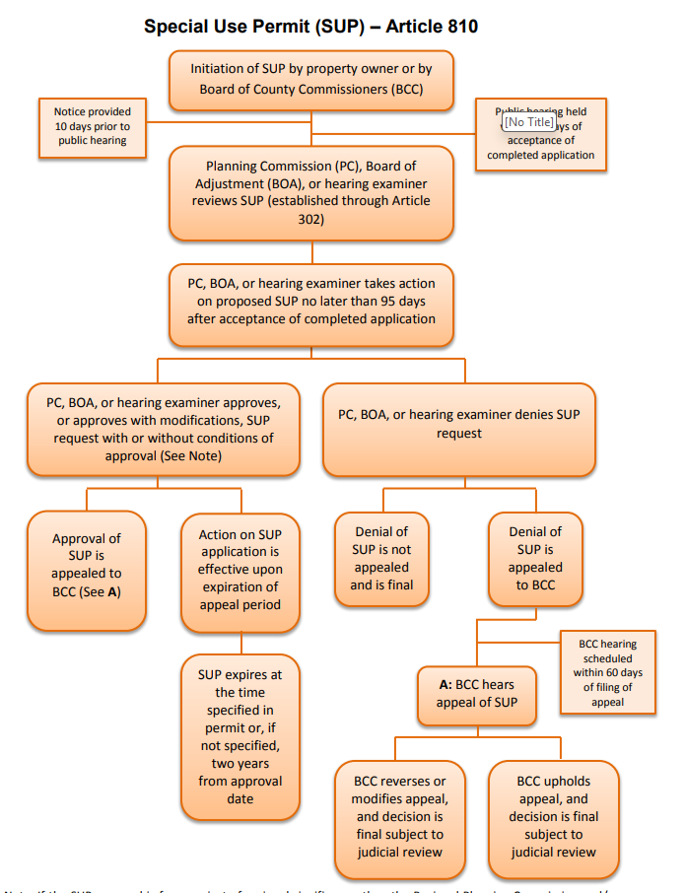
Application Process
Neighborhood Meeting
Application Submittal – 8th of Month
Notice to Neighbors
Staff Report Published Online
Public Hearing (Planning Commission or Board of
Adjustment
Appeal Period (10 Days)
Appeal to County Commission
Building Permit – Review and Issuance

Slide 11

Last slide

