Slide 1
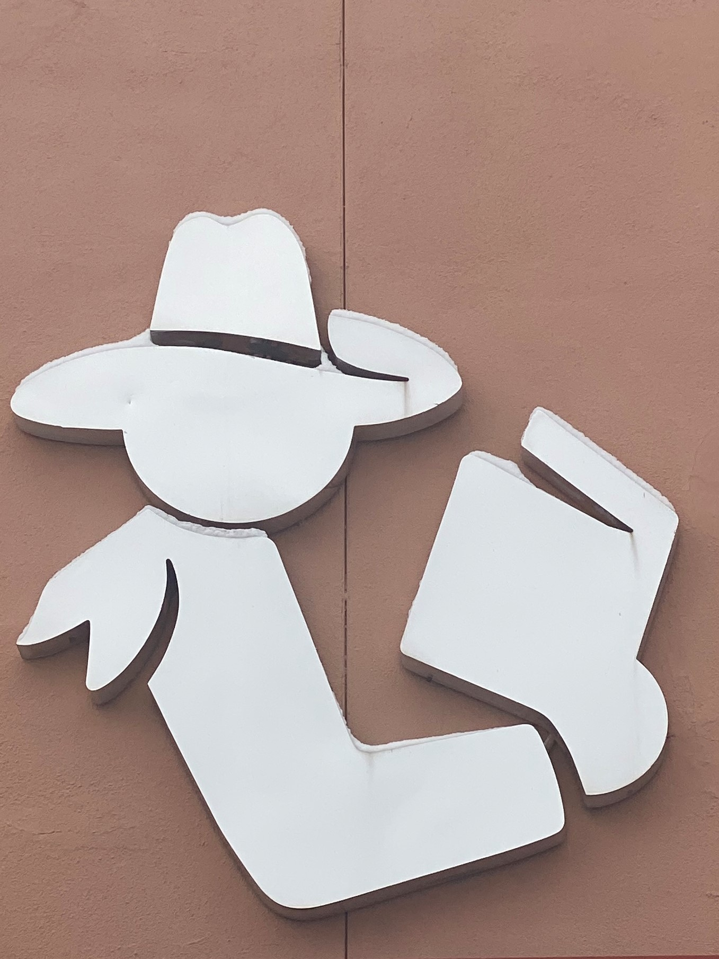
North Valleys Library, Washoe County Library System
Presented to Washoe County Citizen Advisory Board, District 5
January 9, 2023
By: Jonnica Bowen, North Valleys Library, Branch Manager

Slide 2
Who is the North Valleys Library?
#NV50 1973-2023

Slide 3
Washoe County Library System
Mission:
To connect people with information, ideas and experiences to support an enriched and engaged community, one person at a time.
Vision:
All Washoe County residents benefit from the Library’s support of literacy and self-education.
https://washoecountylibrary.us/about/about.php

Slide 4
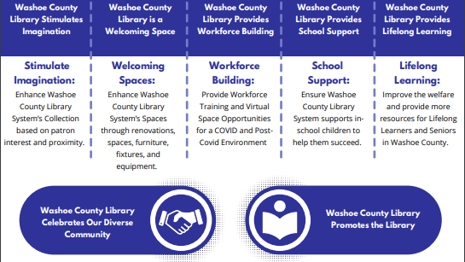
https://washoecountylibrary.us/_files/pdf/WCLS_StrategicPlan_2022-2025.pdf

Slide 5
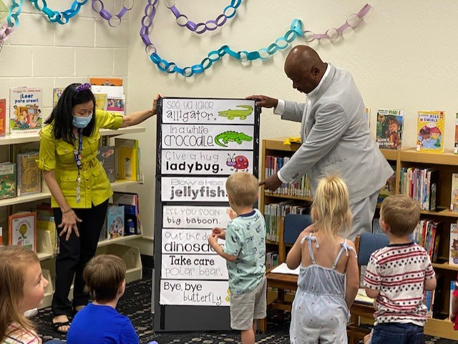
Stimulate Imagination:

Slide 6
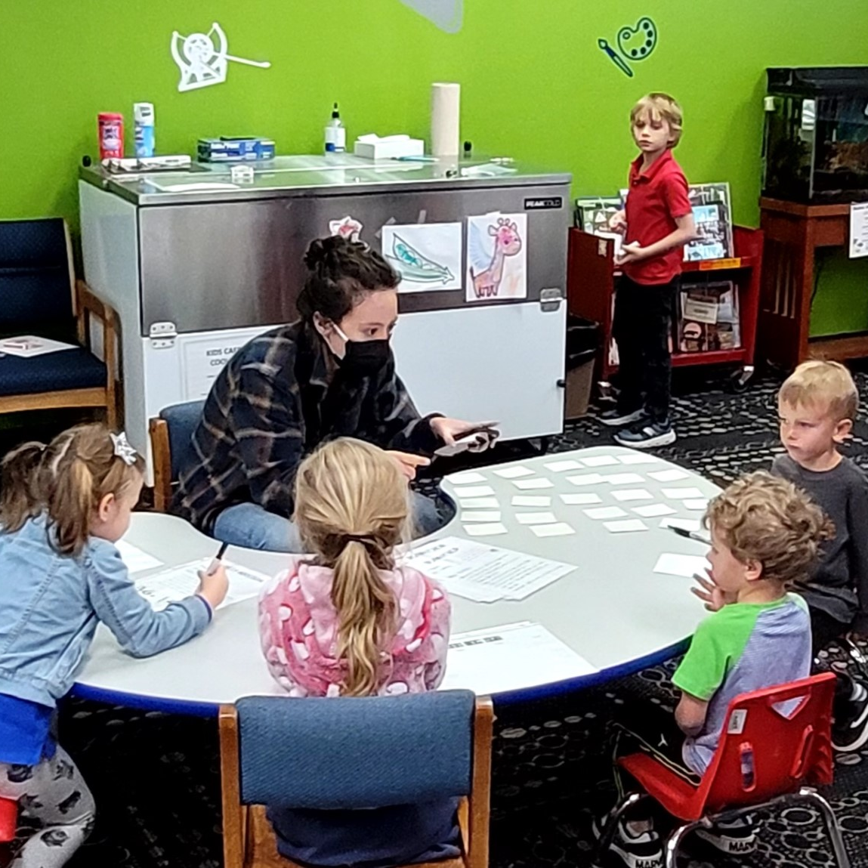
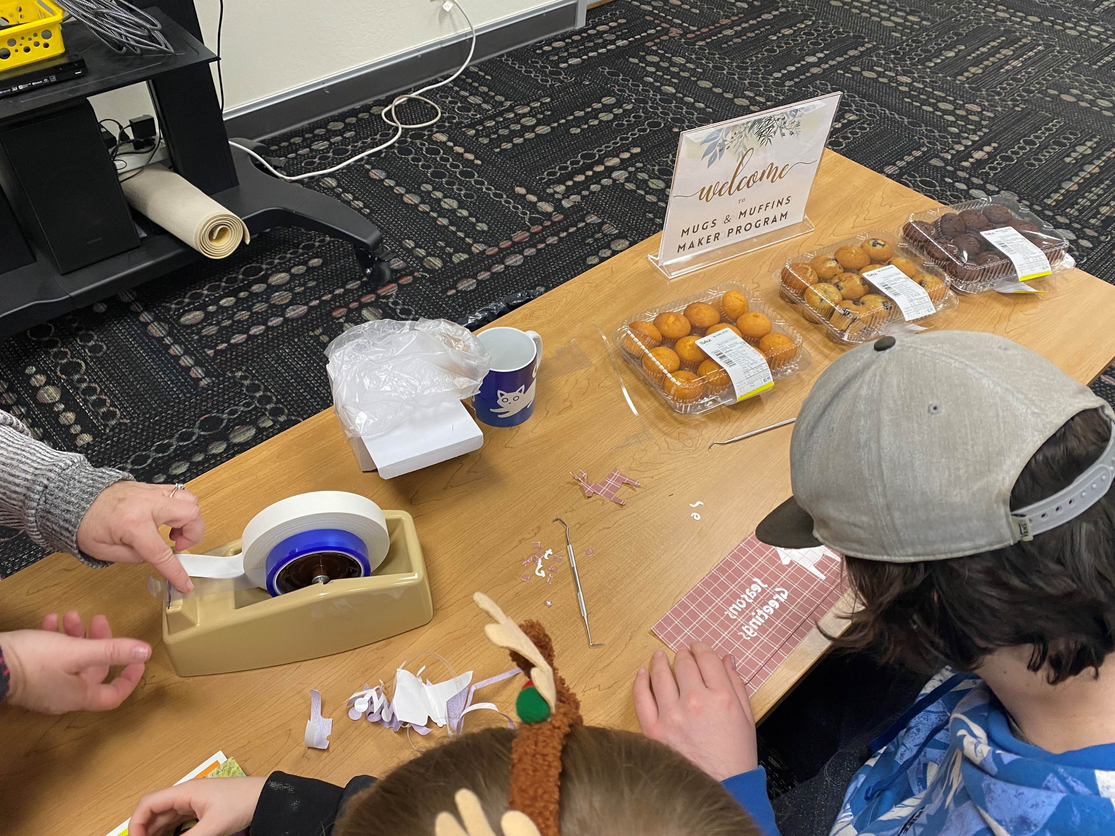
Stimulate Imagination

Slide 7
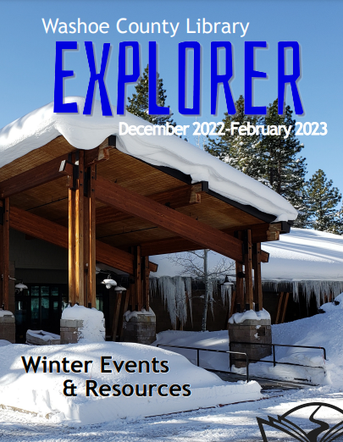
Stimulate Imagination
https://events.washoecountylibrary.us/
https://washoecountylibrary.us/events/explorer.php

Slide 8
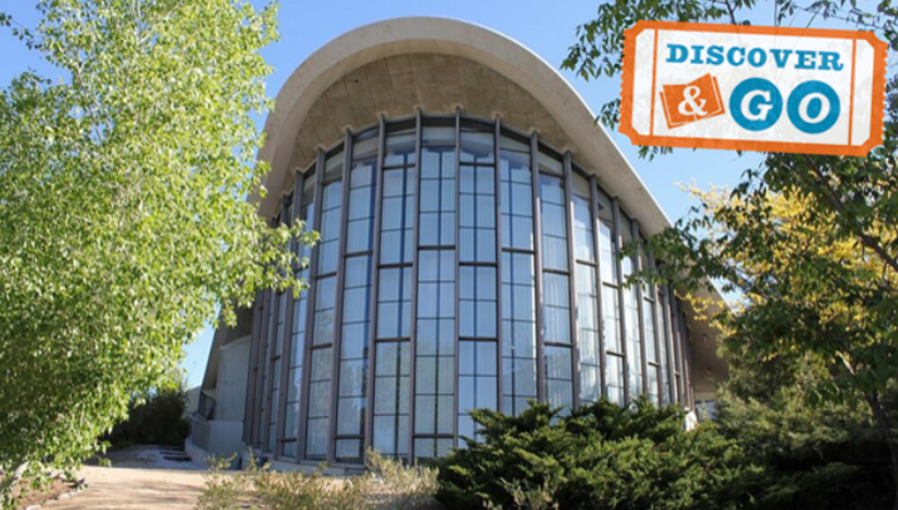
Stimulate Imagination
https://washoecountylibrary.us/downloads/discoverandgo.php

Slide 9
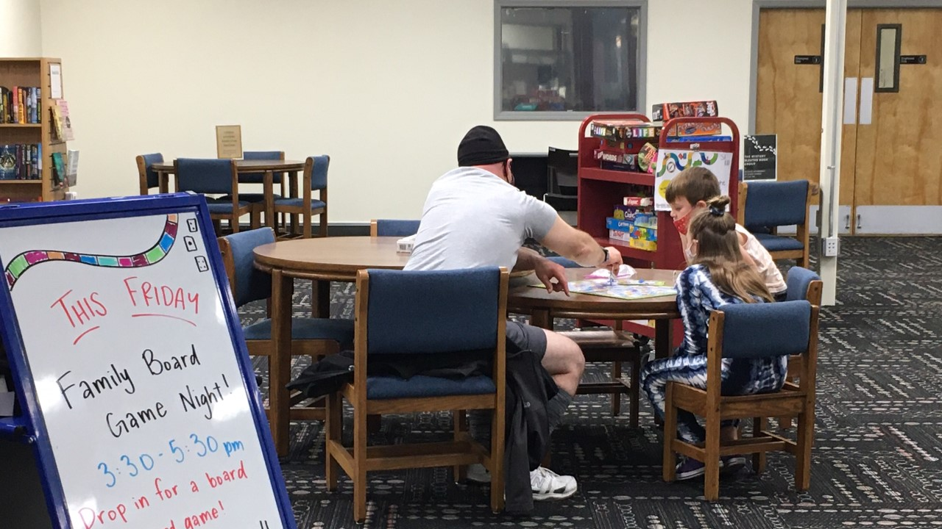
Welcoming Spaces

Slide 10
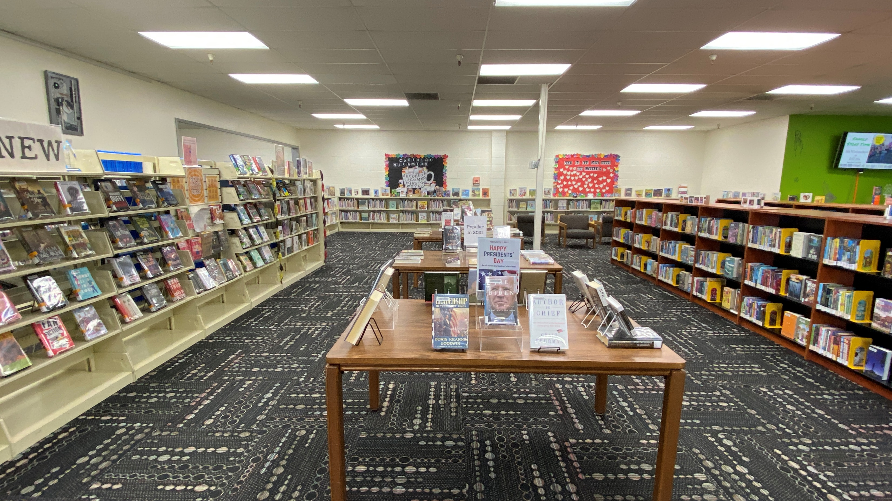
Welcoming Spaces

Slide 11
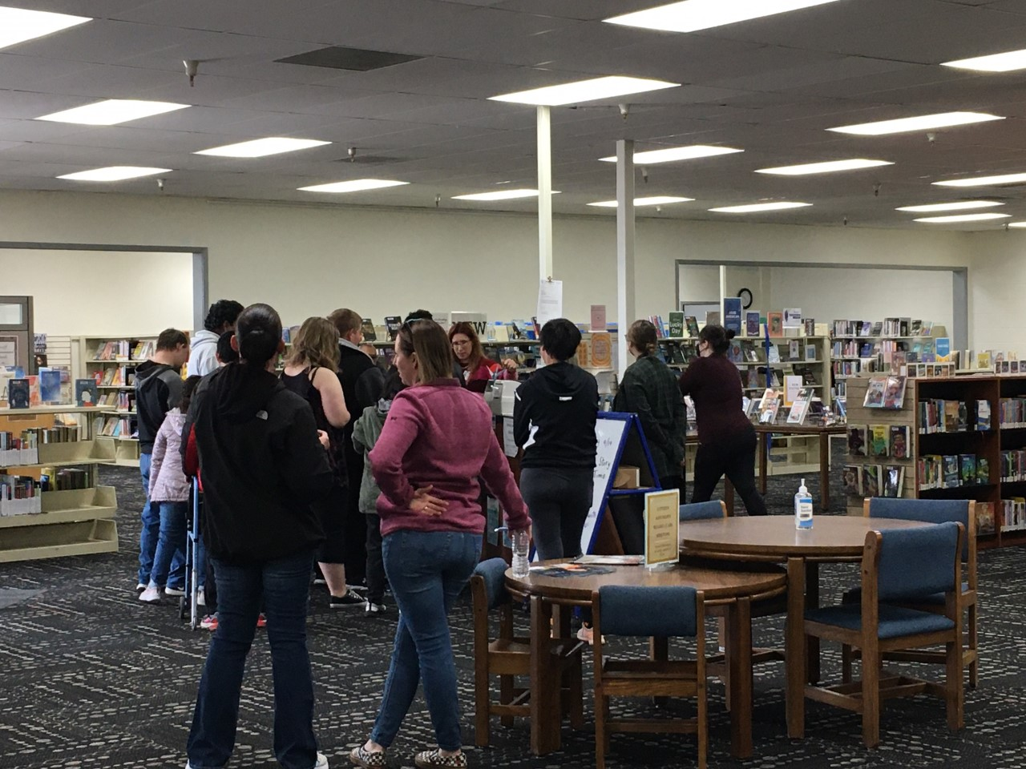
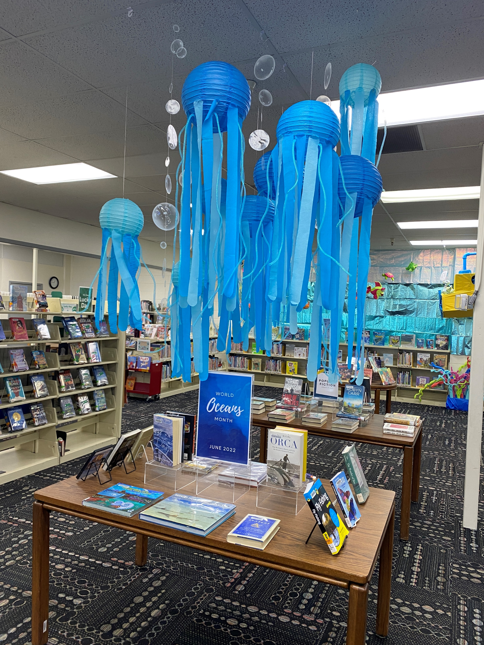
Welcoming Spaces

Slide 12
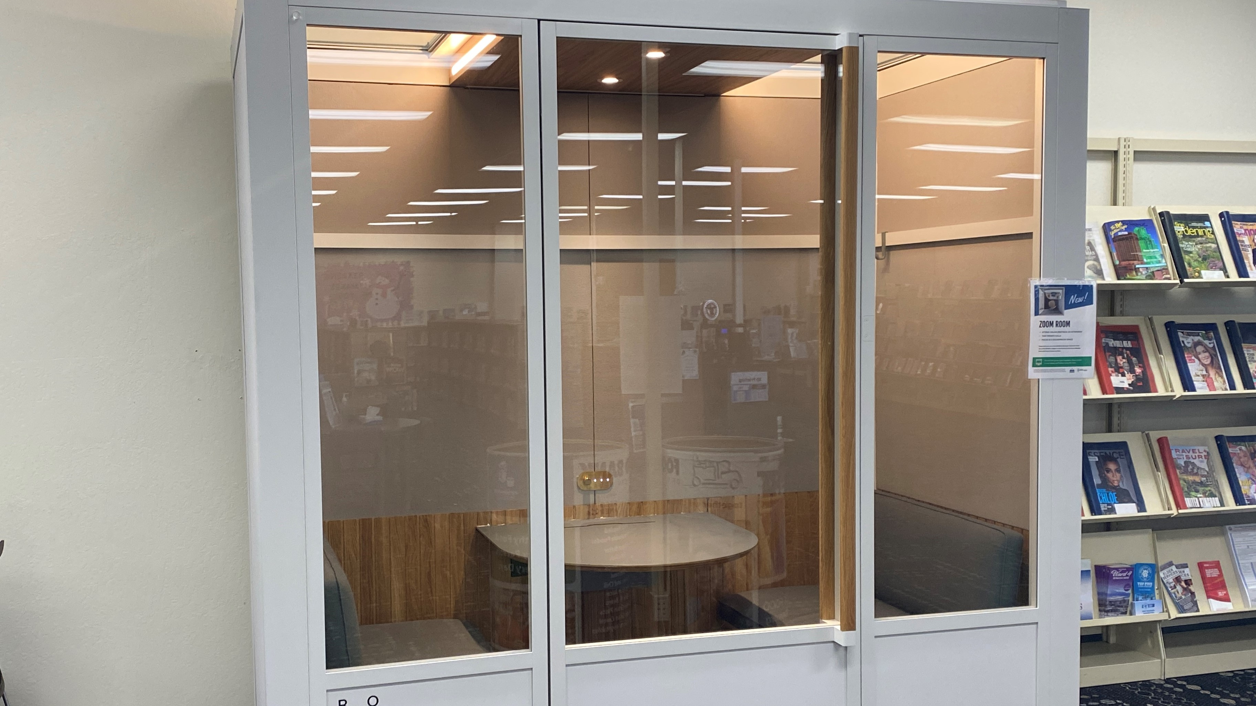
Workforce Building

Slide 13
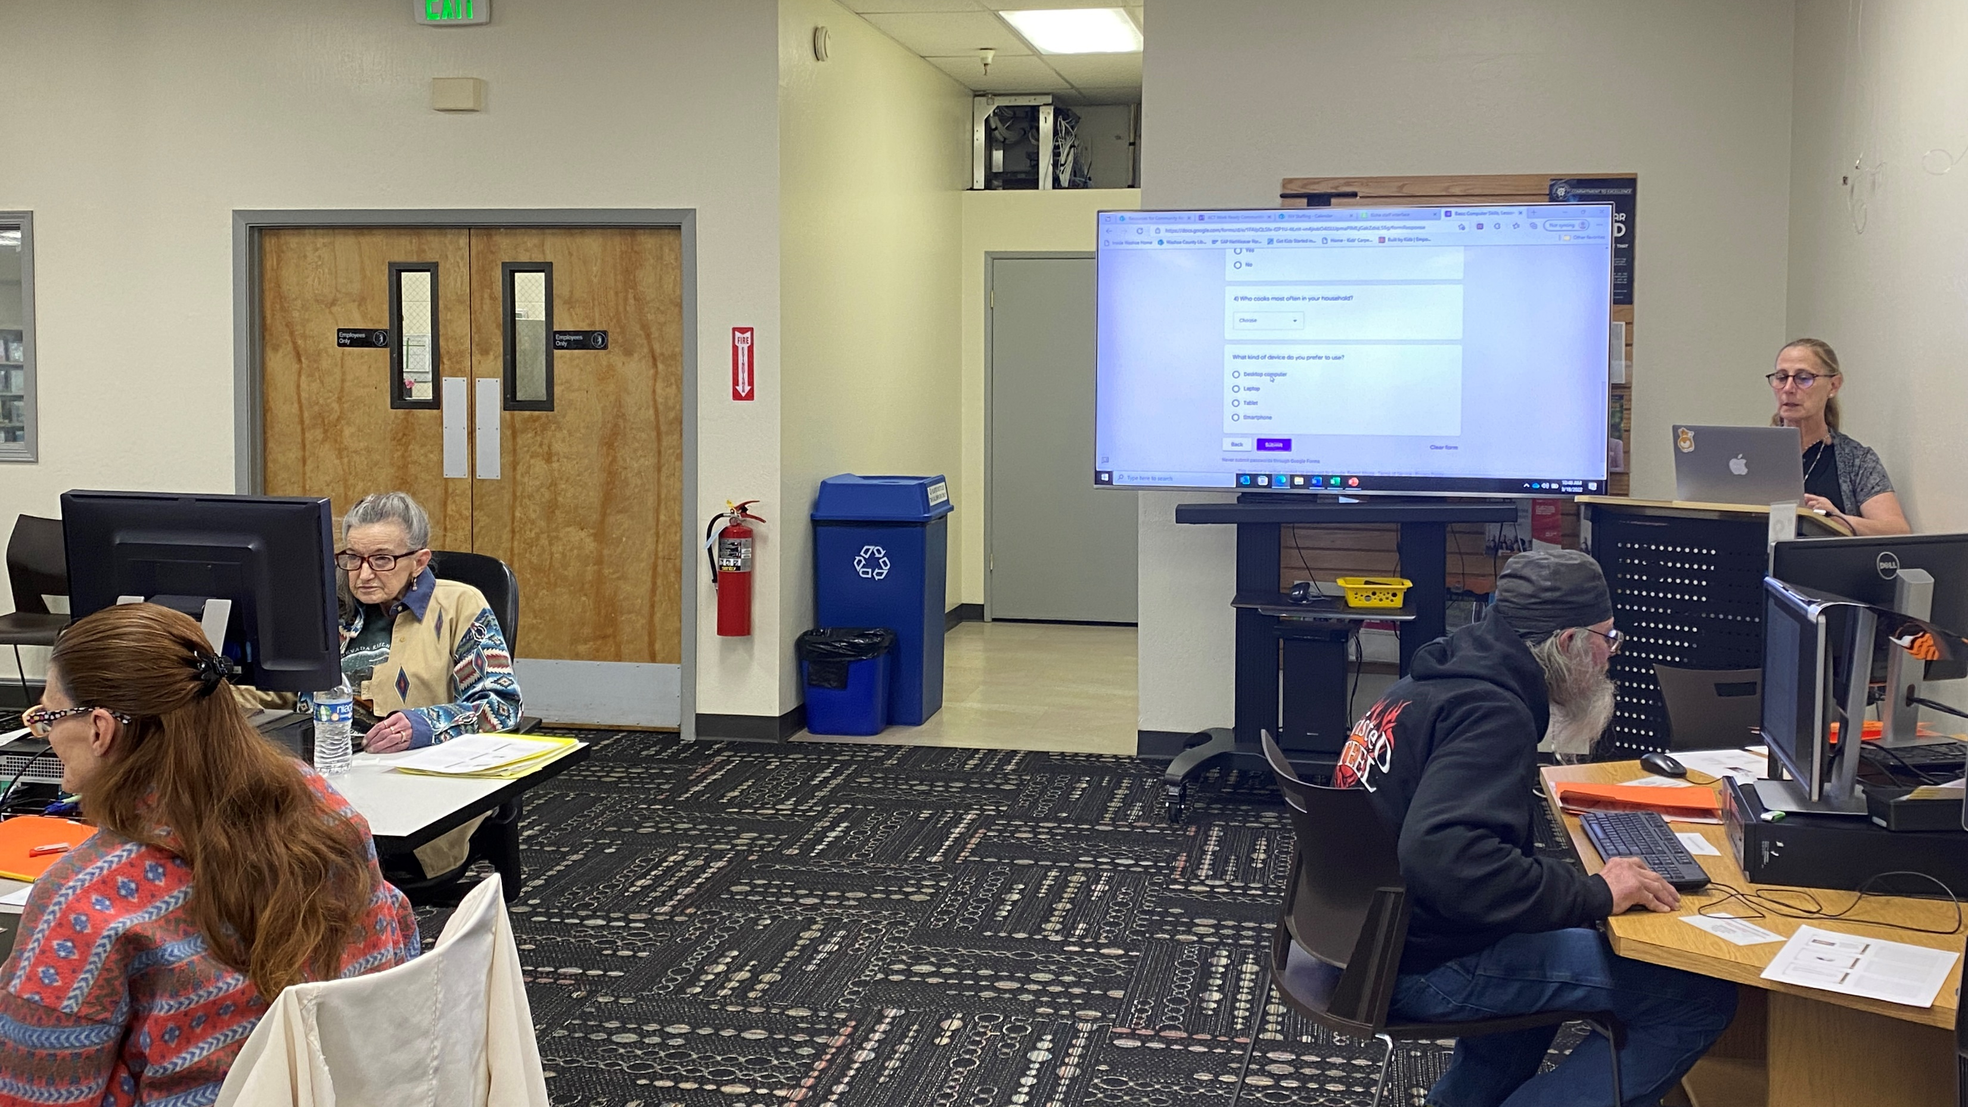
Workforce Building

Slide 14
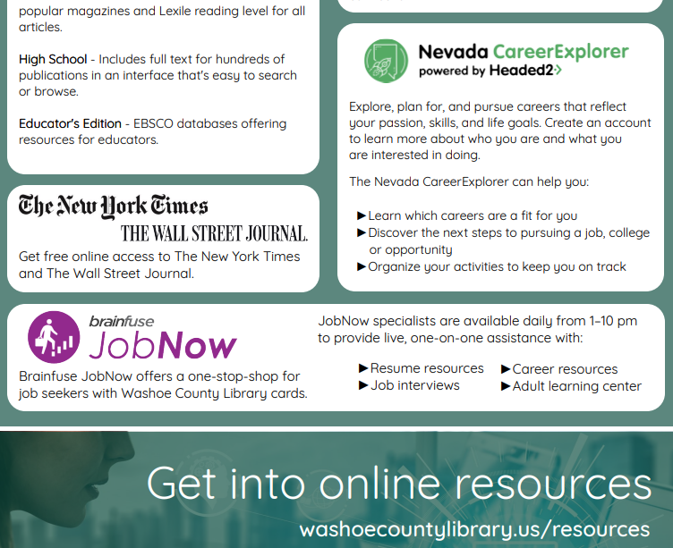
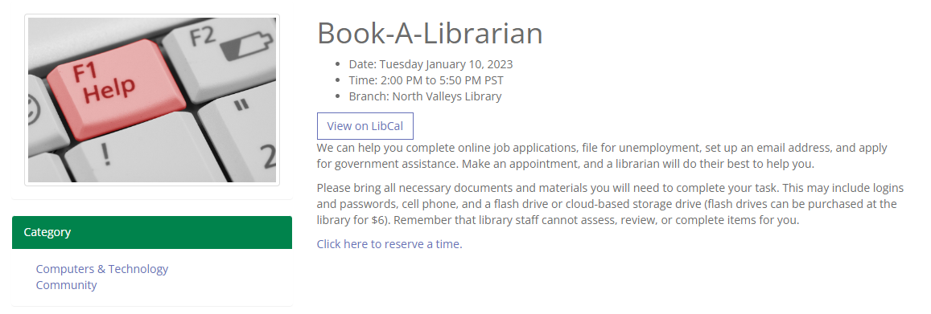
Workforce Building

Slide 15
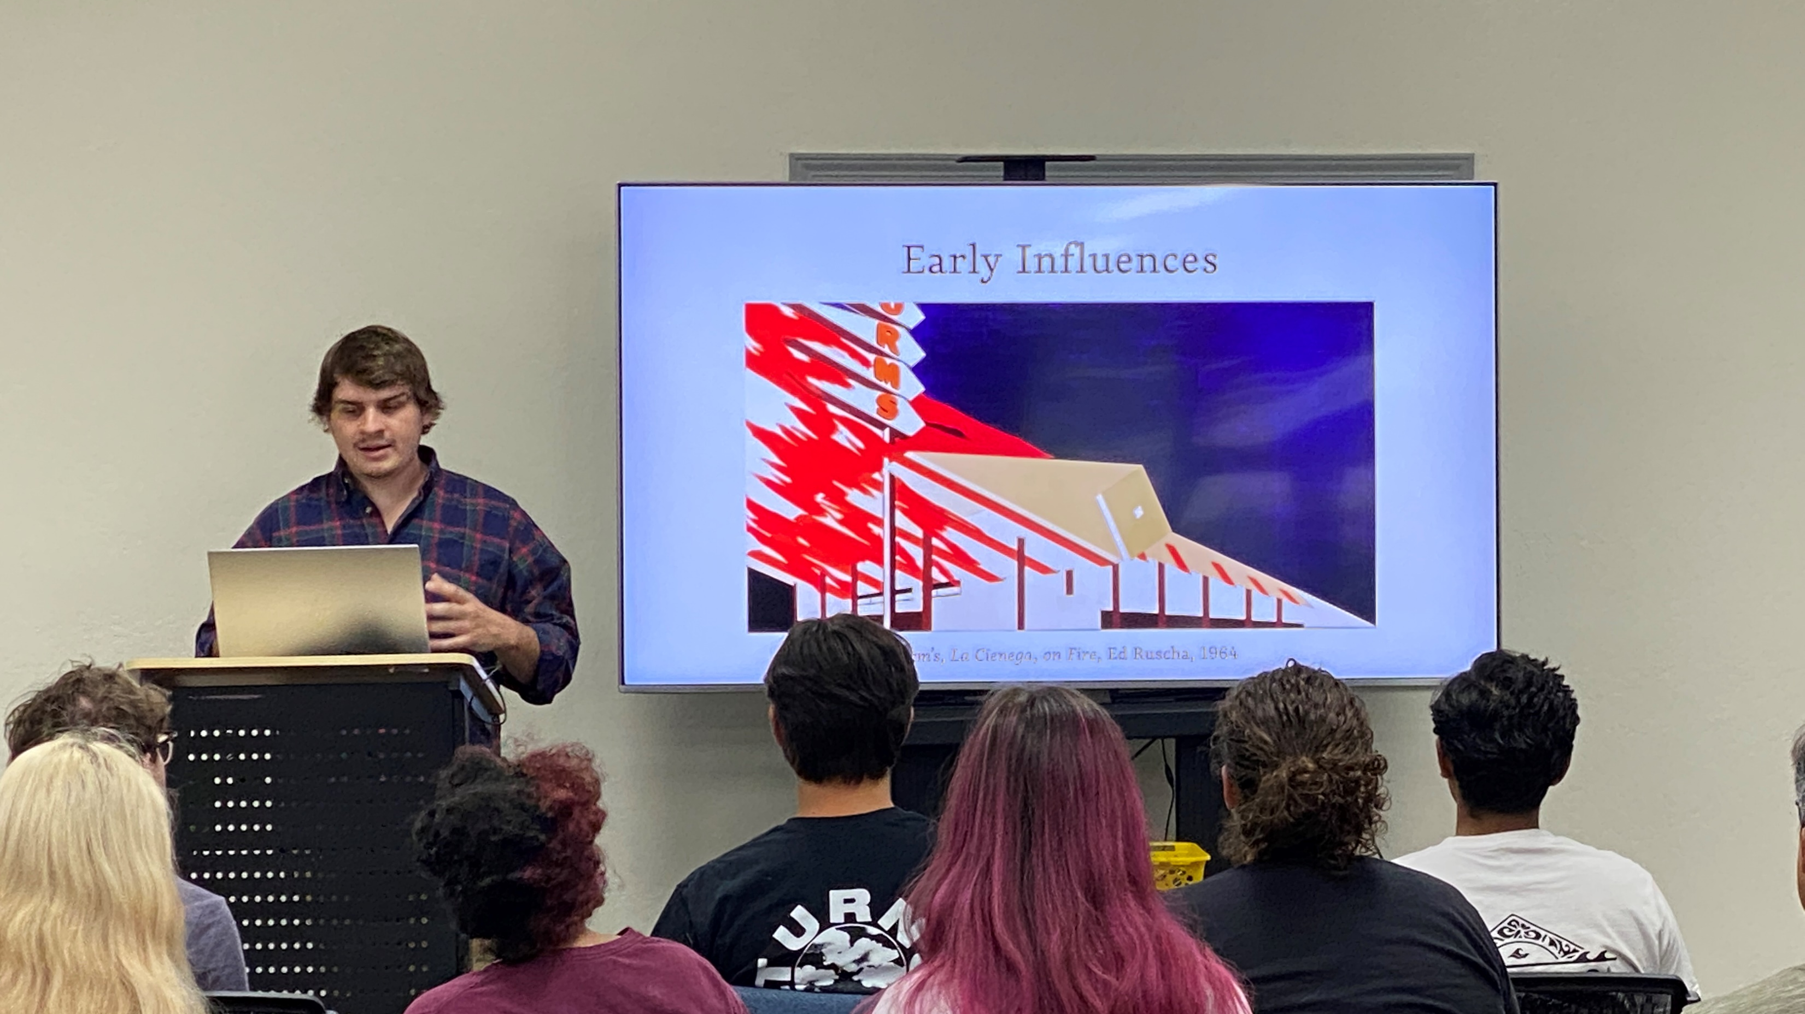
School Support

Slide 16
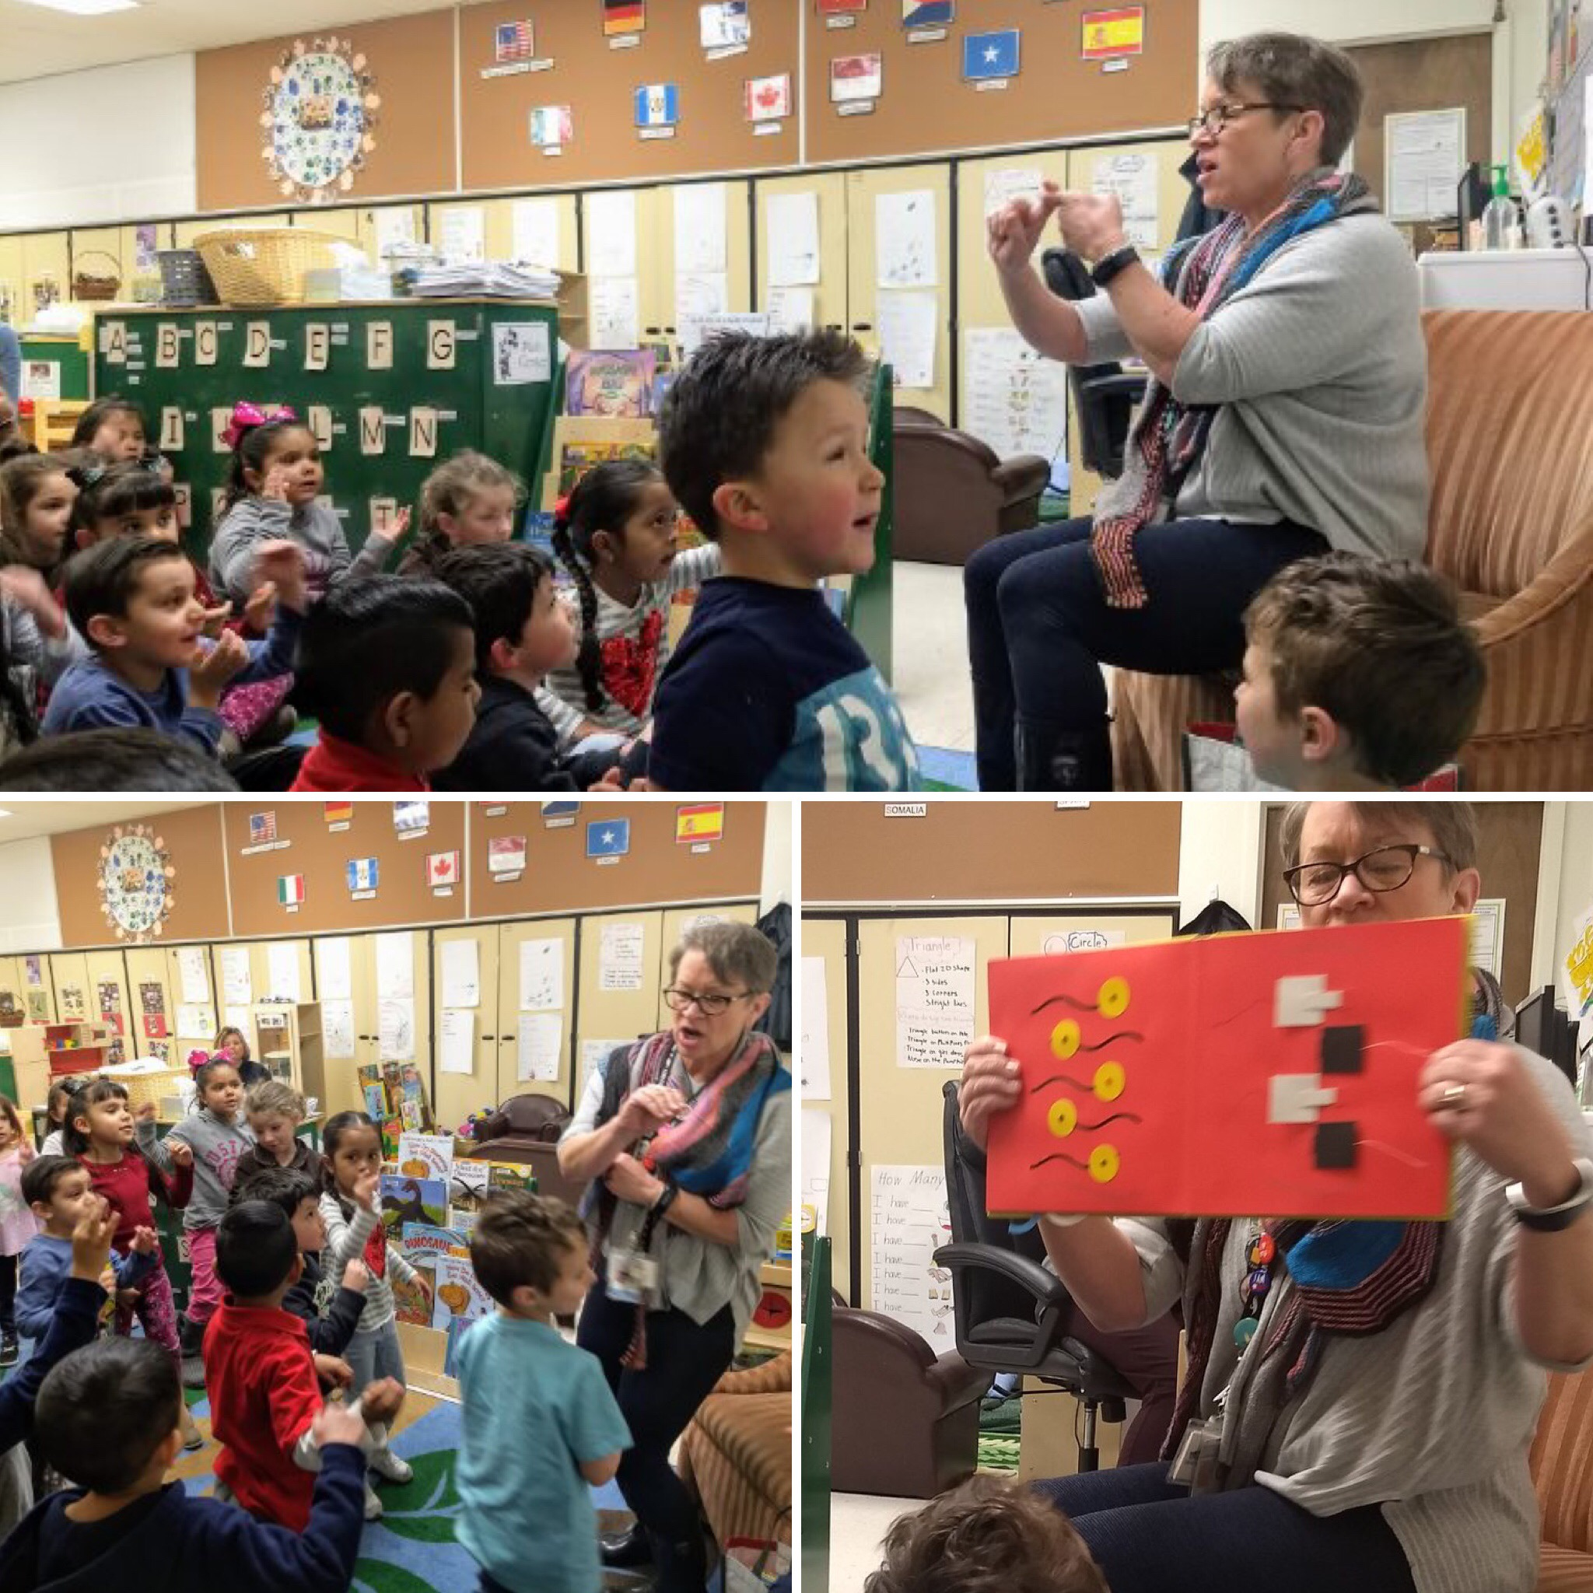
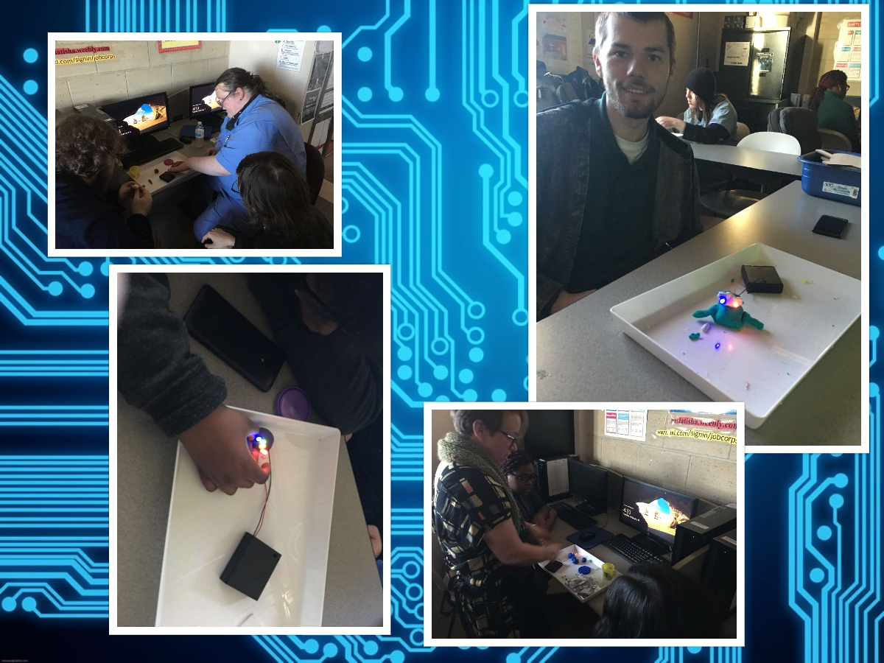
School Support

Slide 17
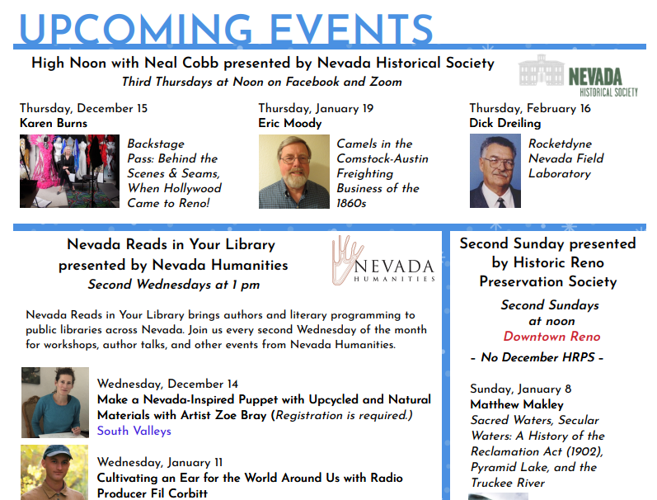
Lifelong Learning

Slide 18
Lifelong Learning
Homebound Services (washoecountylibrary.us)

Slide 19
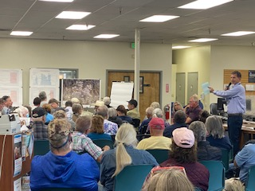
Lifelong Learning

Slide 20
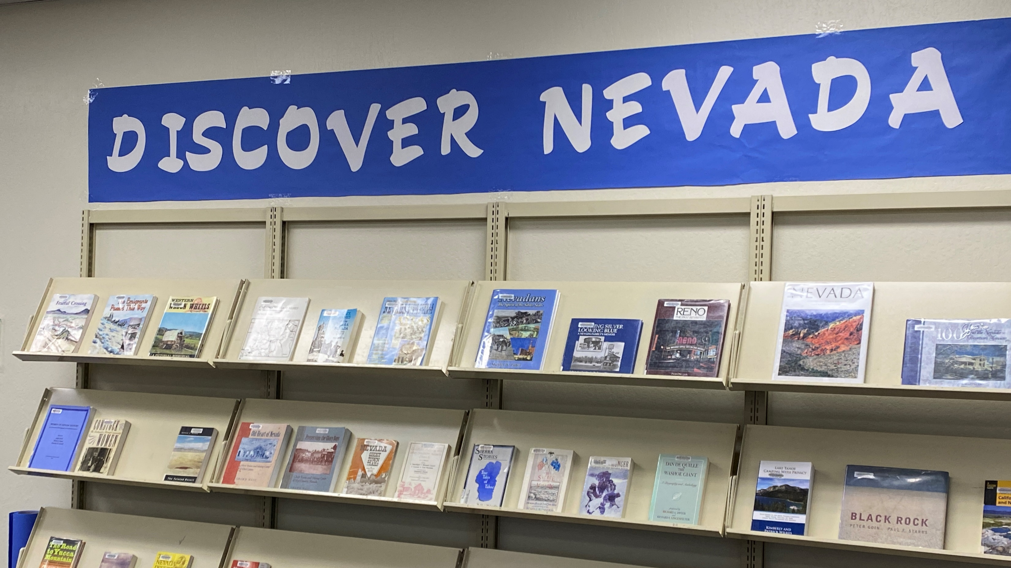
Lifelong learning

Slide 21
Lifelong Learning
https://libraryc.org/washoecountylibrary/21007

Slide 22
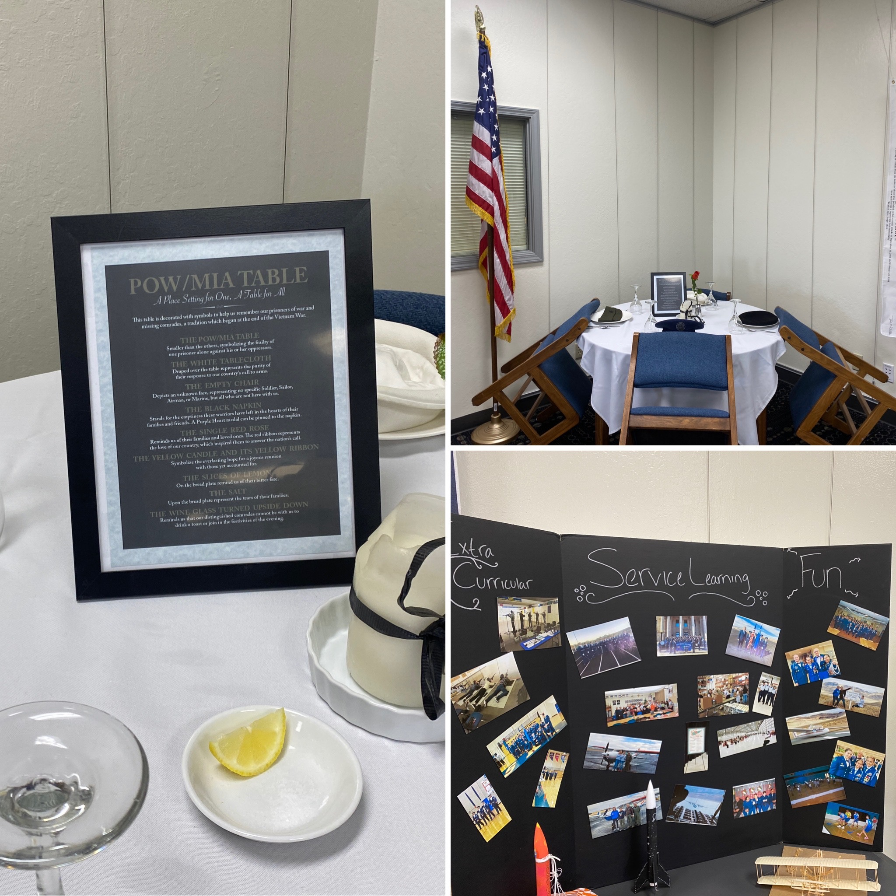
Celebrate Our Diverse Community

Slide 23
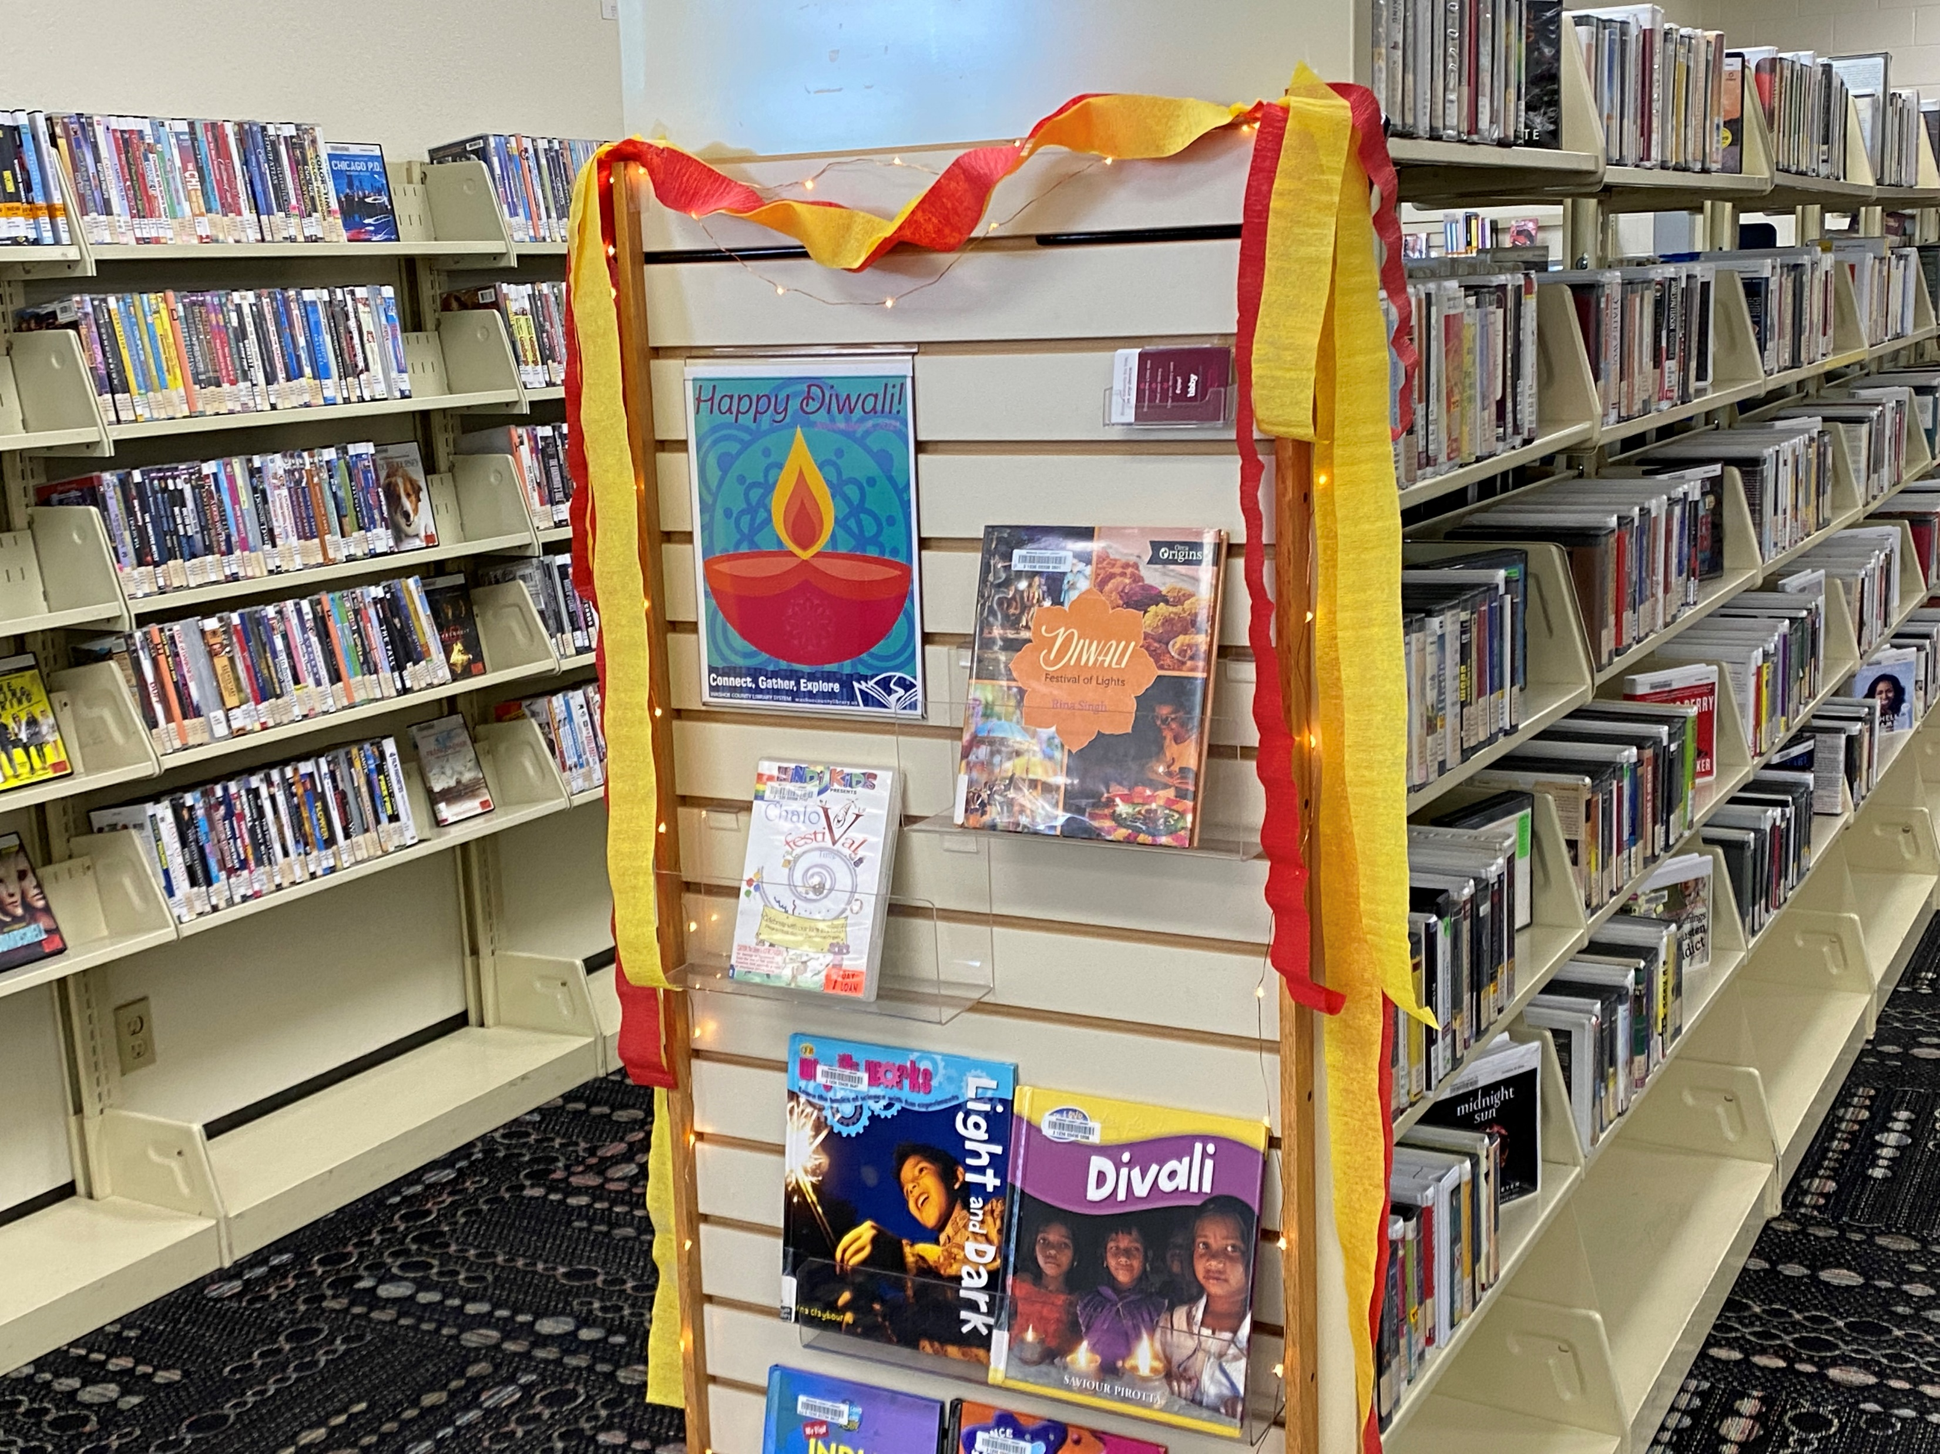
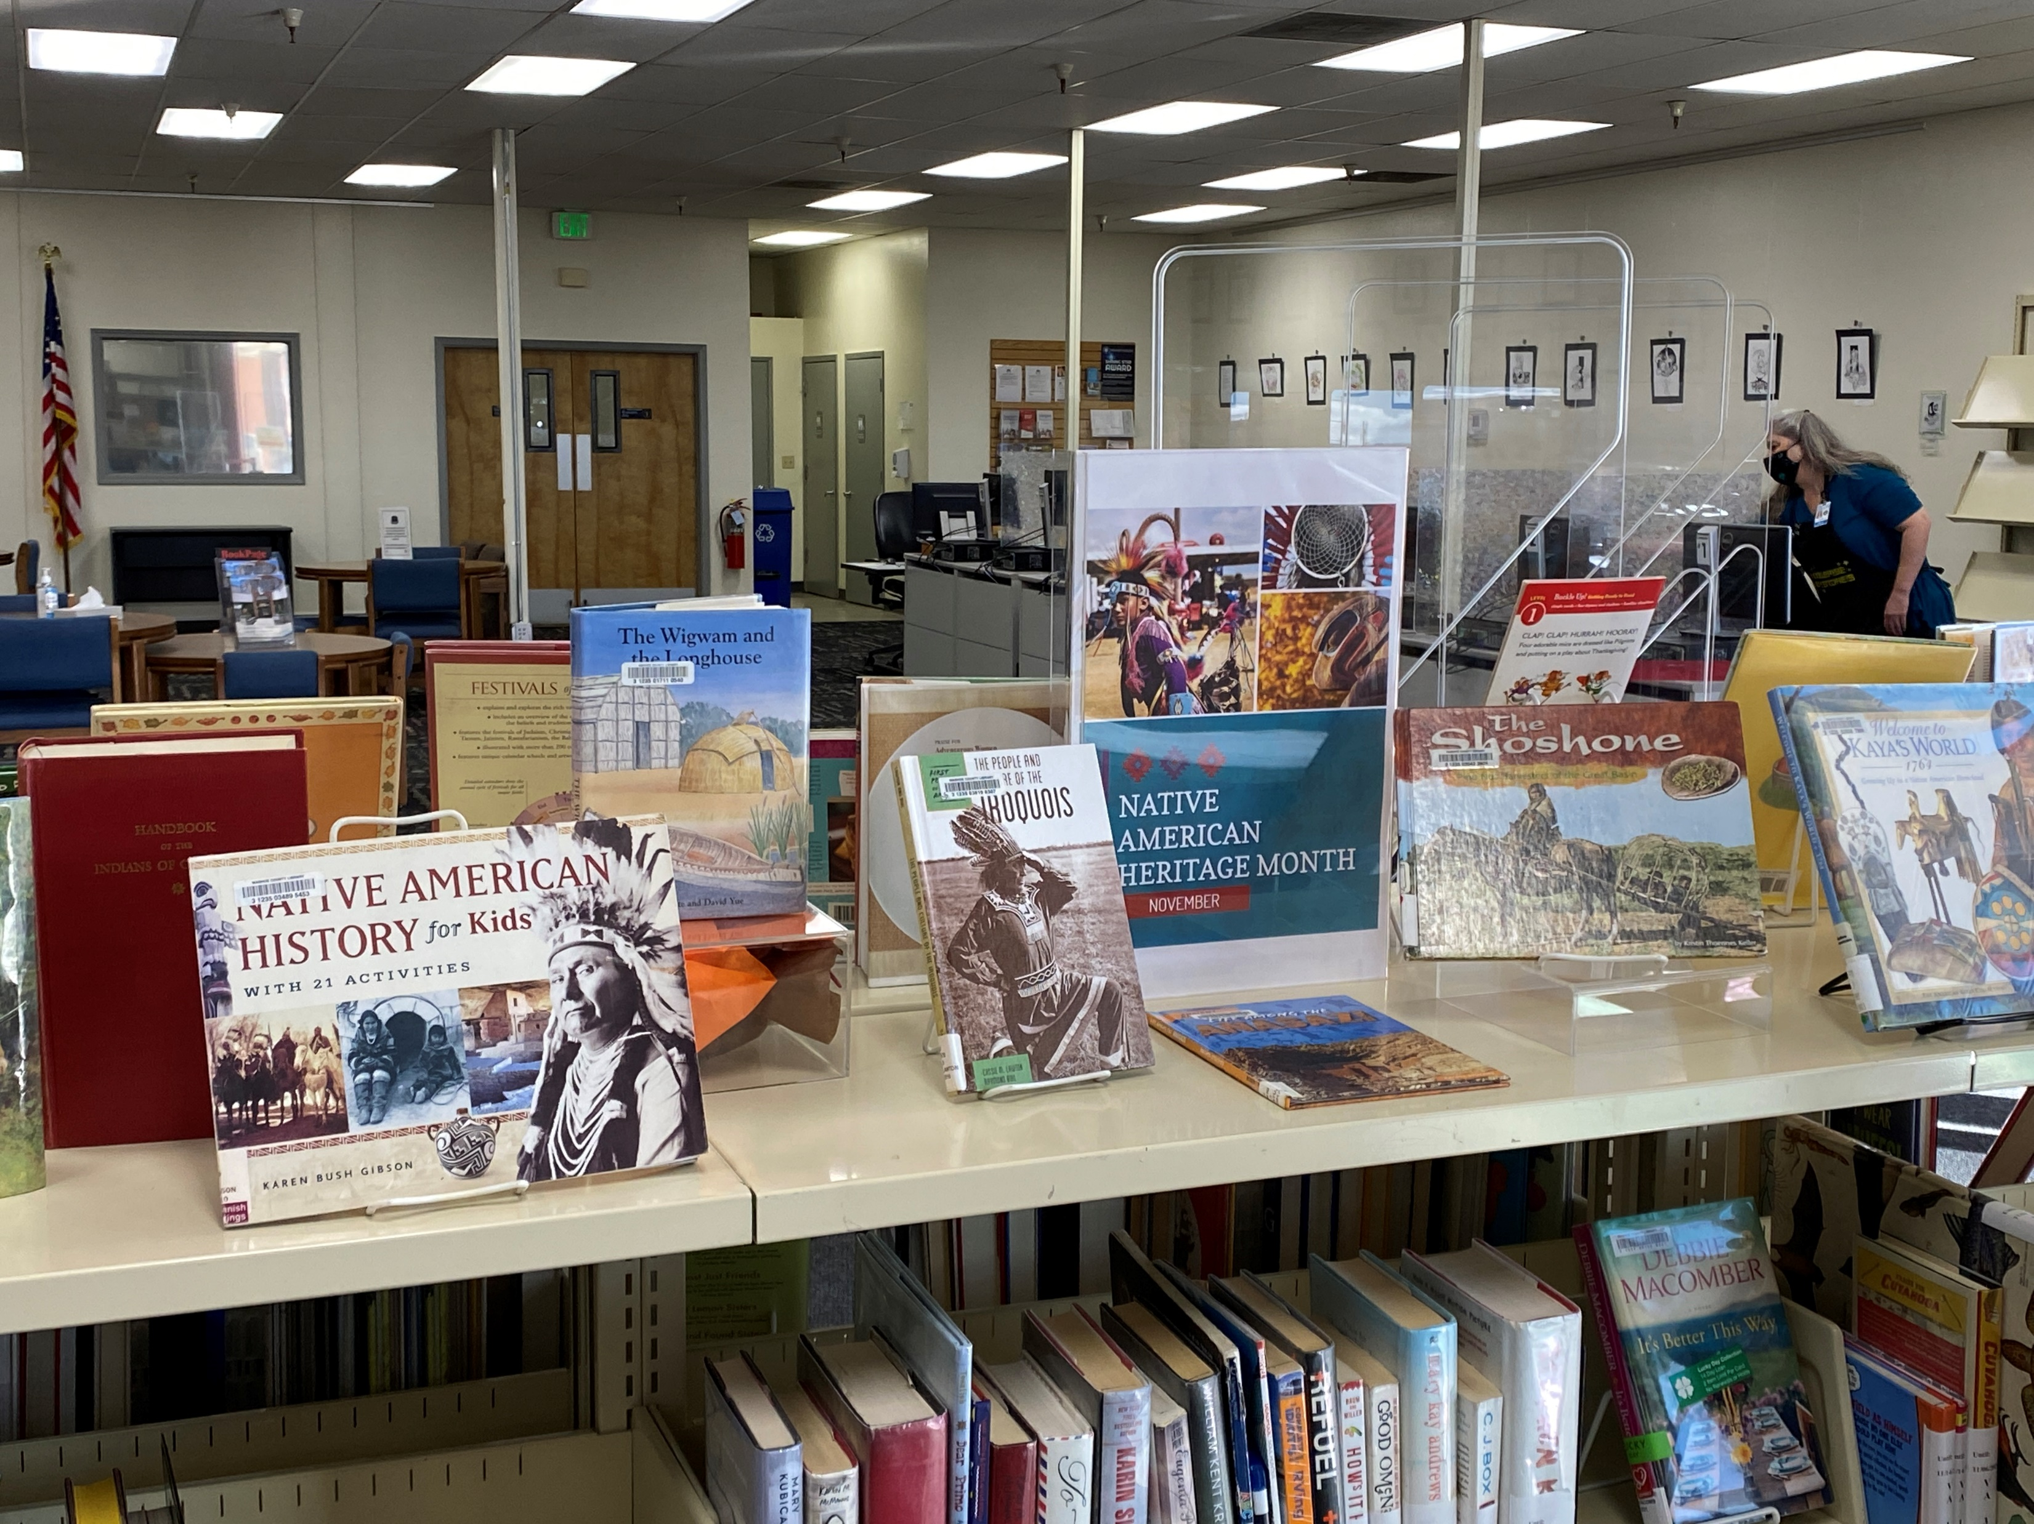
Celebrate Our Diverse Community

Slide 24
Celebrate Our Diverse Community

Slide 25
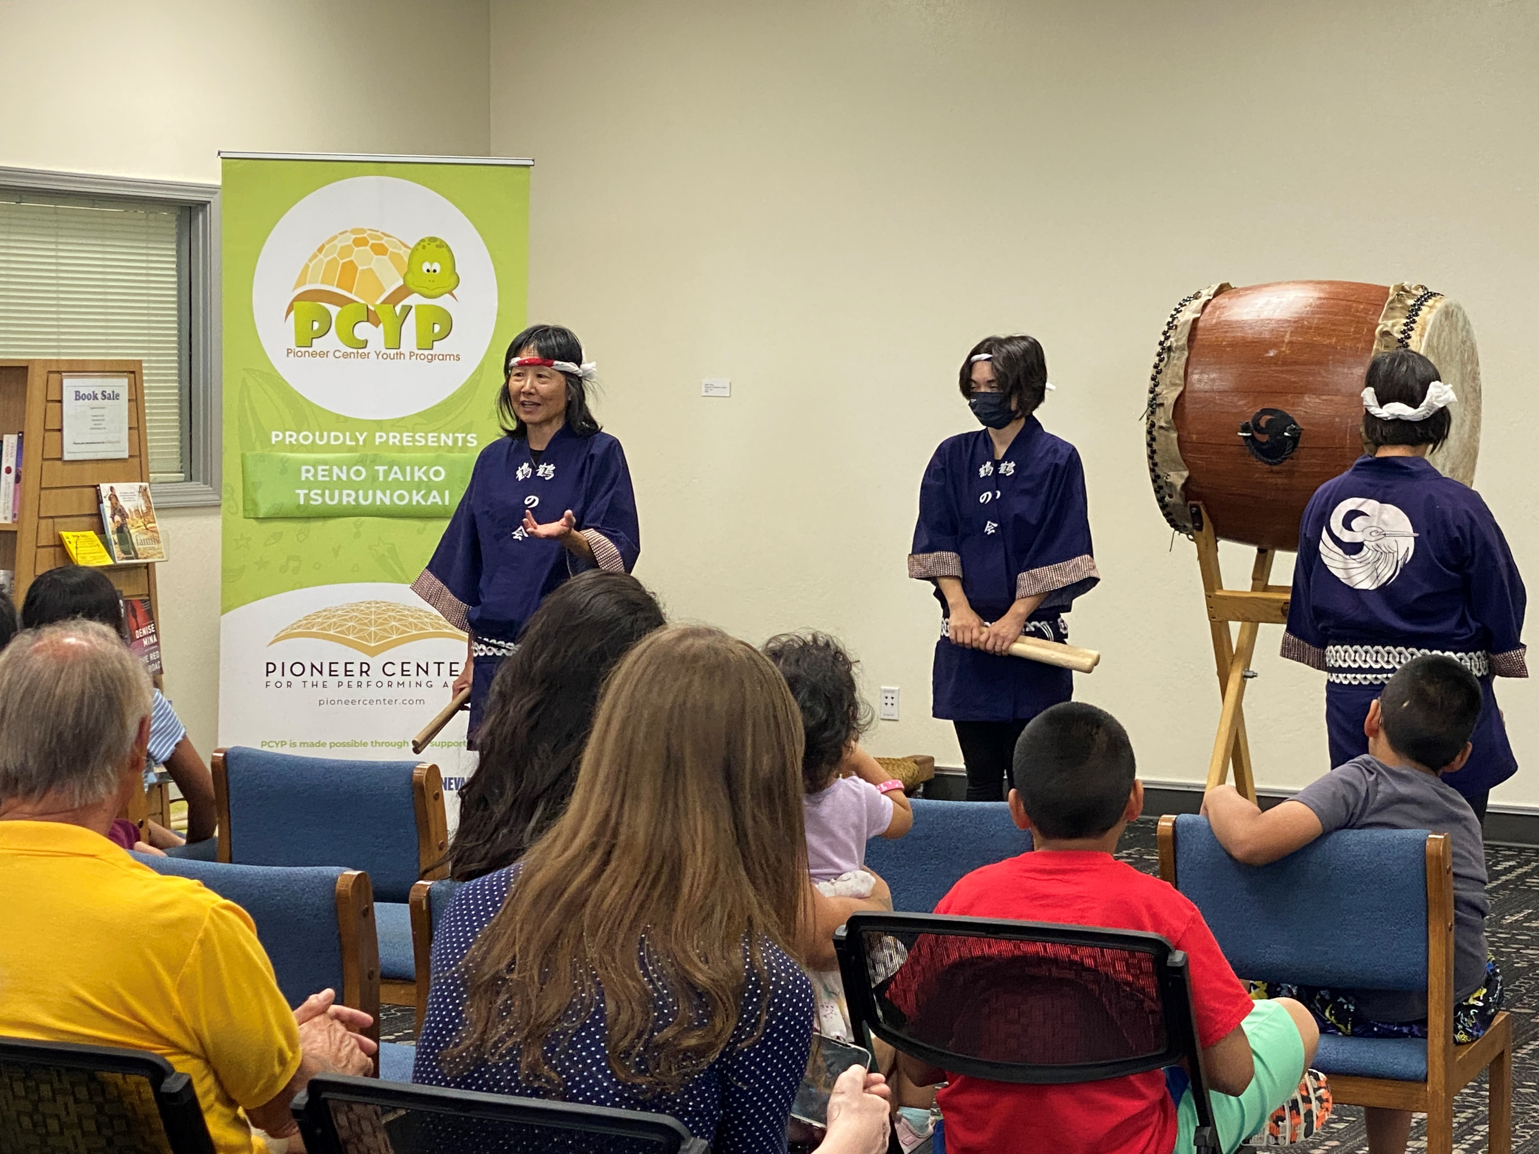
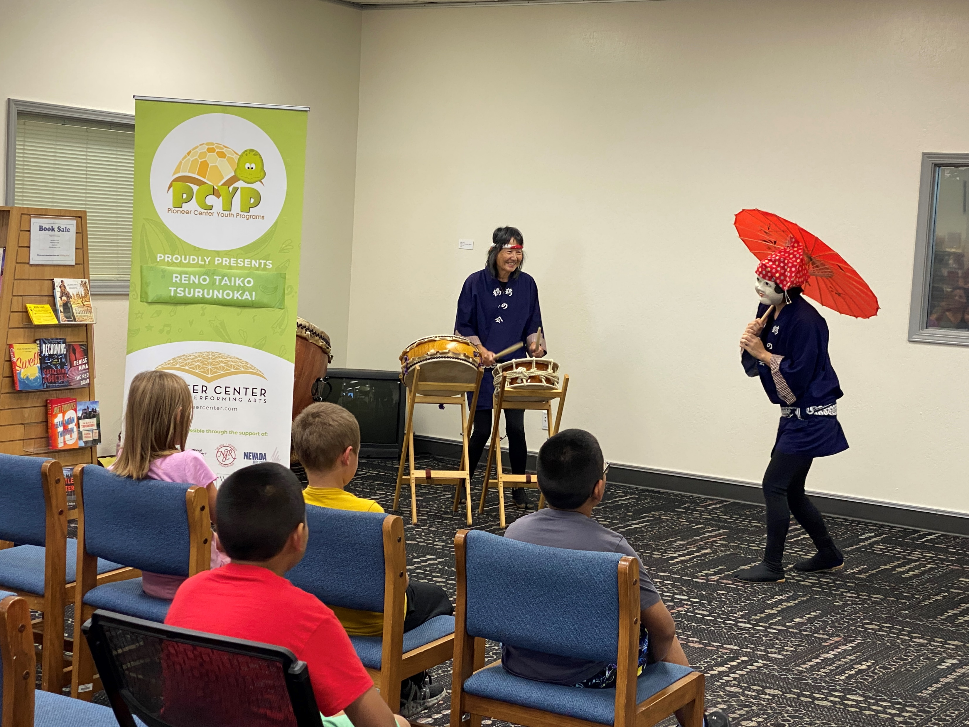
Celebrate Our Diverse Community

Slide 26
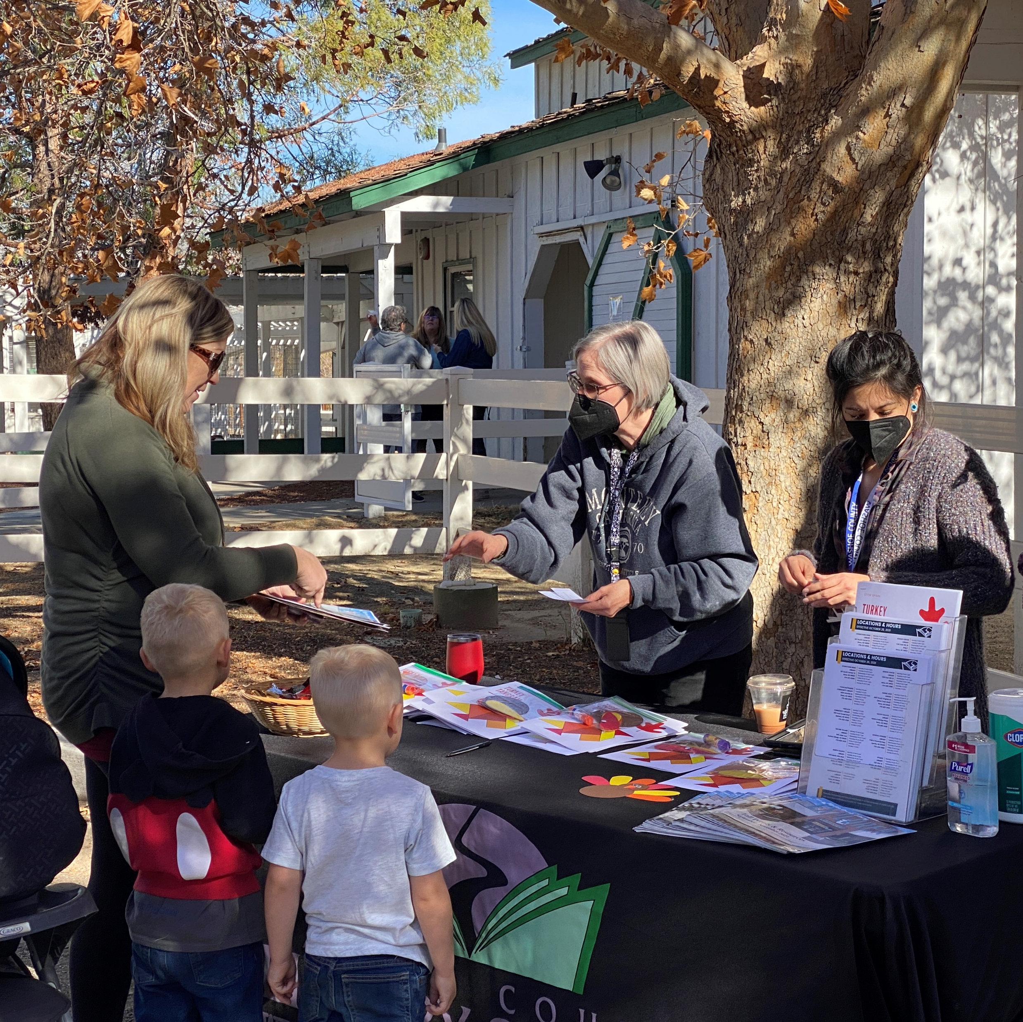
Promote the Library
https://washoecountylibrary.us/services/outreach.php

Slide 27
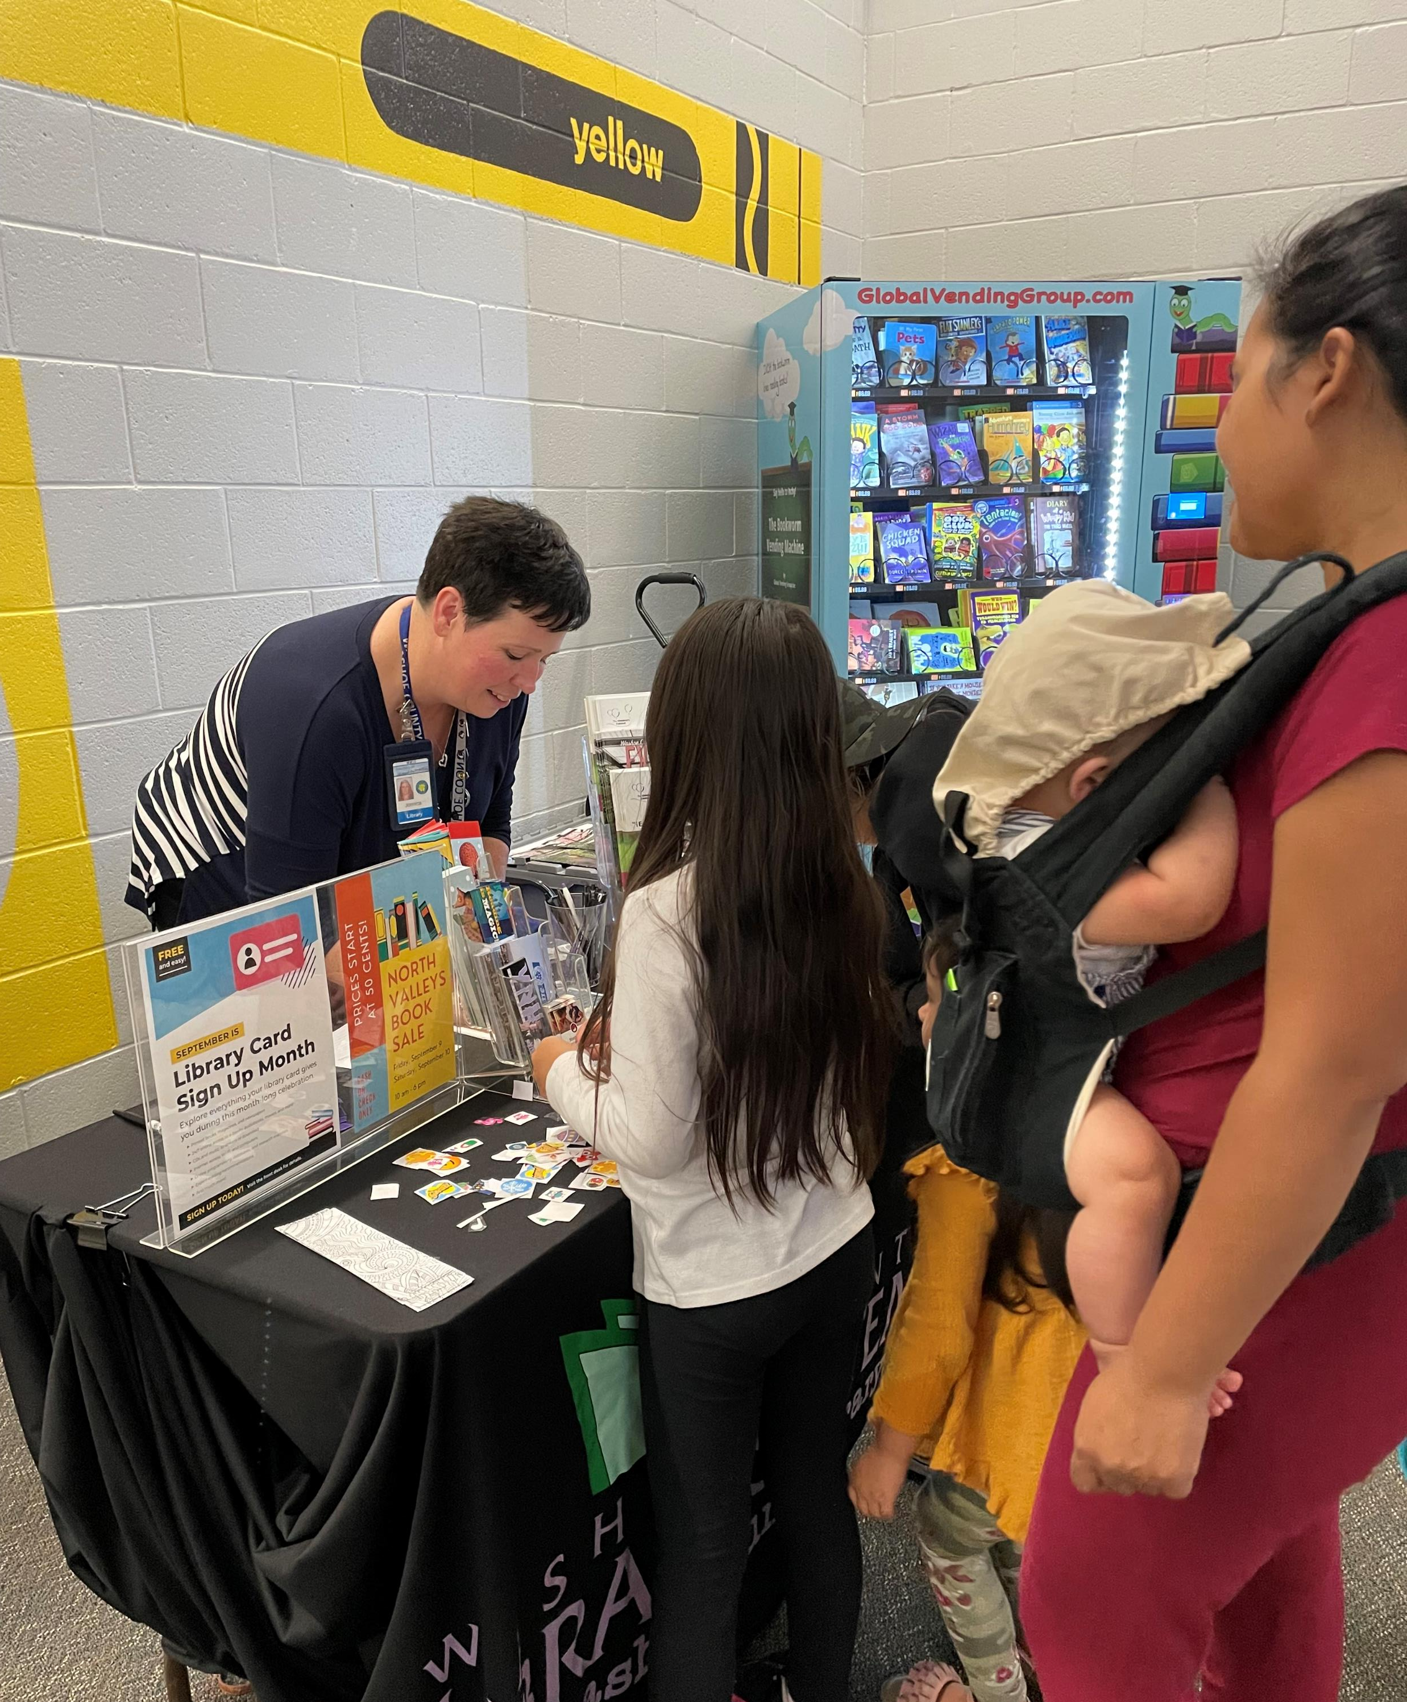
Promote the Library

Slide 28
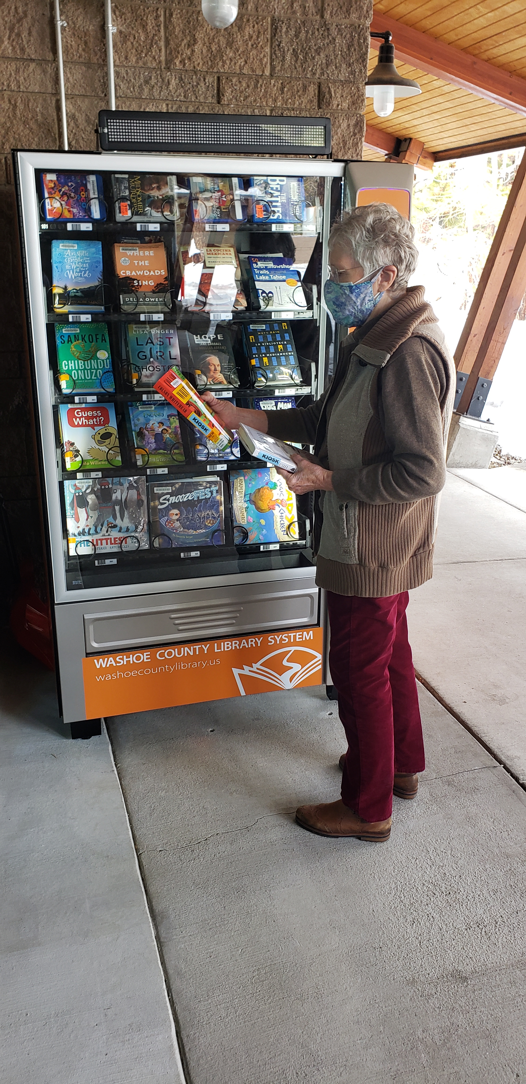
#NV50 2023 & Beyond!

Slide 29
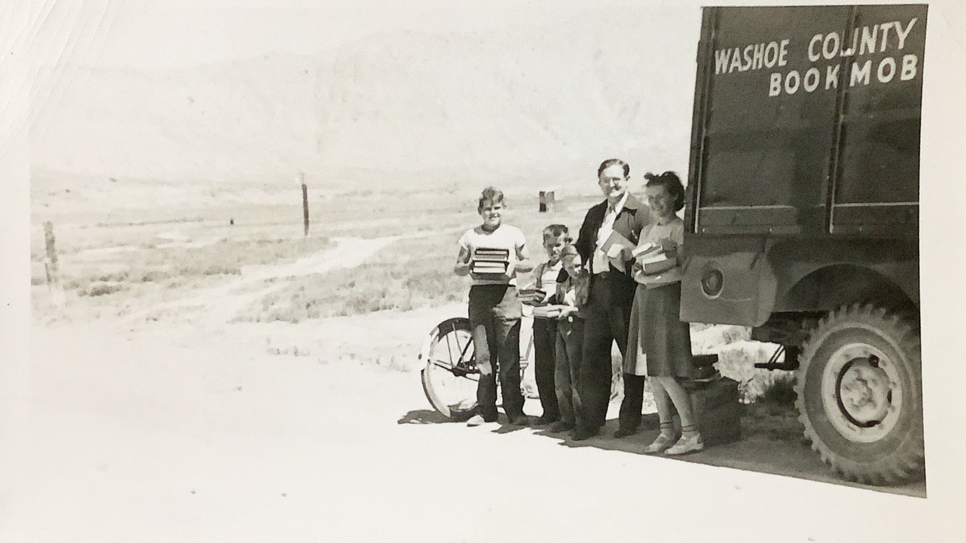
#NV50 2023 & Beyond!

