Slide 1
North Valleys Roundabout Public Art Project
August 14, 2023

Slide 2
North Valleys Roundabout Public Art
The City of Reno, in partnership with Washoe County and the Regional Transportation Commission (RTC) of Washoe County, will develop a large-scale public art project to be placed inside the roundabout at the intersection of Sky Vista Parkway and Silver Lake Road at the entrance to the North Valleys Regional Park, owned and operated by Washoe County.
This process will include community engagement and input that will inform the selection of an artist and design for the public artwork. This will be the first large-scale public art project that the City of Reno has undertaken in the North Valleys.

Slide 3
Artwork Location

Slide 4
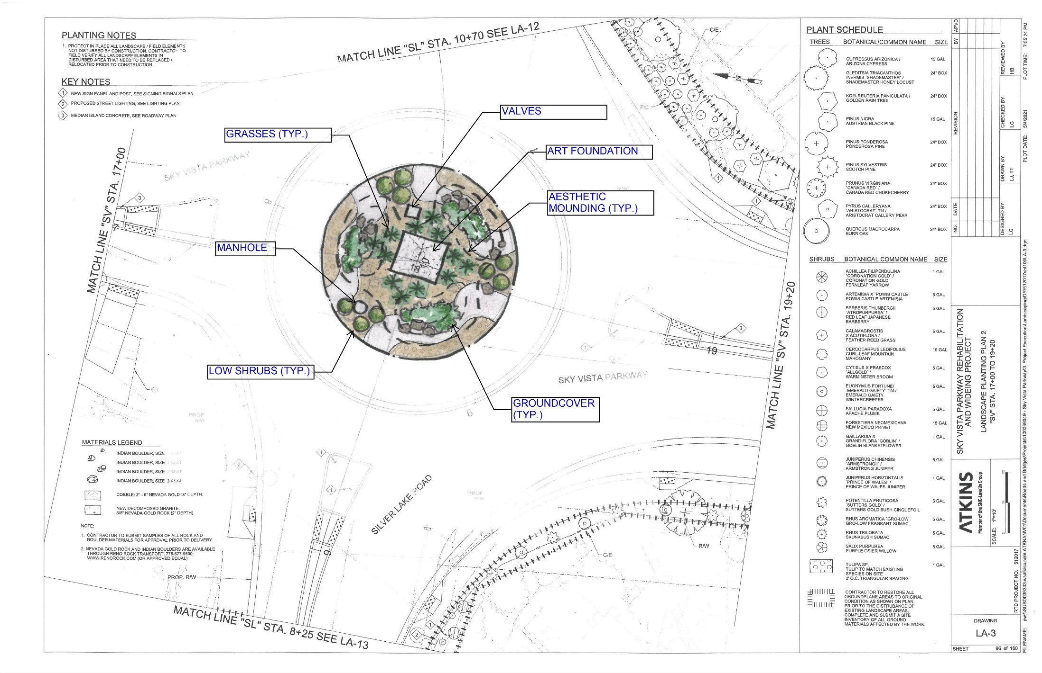

Slide 5
Process
Initial Community Input (Survey)
Call for Artists (RFQ)
Selection of 3 finalists
Community engagement sessions with finalist artist teams
Finalists present concept proposals for artwork
Selection of 1 artist team to develop artwork
Approval of final artwork
Artwork installation

Slide 6
Timeline
August 2023: Initial public outreach
October 2023: Call for artists (RFQ) opens
December 2023: 3 finalists selected
January/February 2024: Community engagement with finalists
April 2024: Finalists present proposals for artwork to public for input
May/June 2024: Finalist artist selected for project
May 2025: Artwork installed

Slide 7
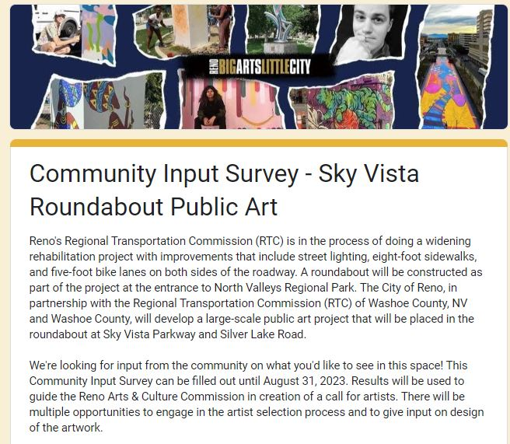
Community Input Survey

Slide 8
Questions?
City of Reno Arts & Culture
publicart@reno.gov
775-333-7750
www.RenoCulture.com

