Slide 1
UAS 101 Presentation
Washoe County, Nevada
February 2022

Slide 2
FAA Unmanned Aircraft Systems (UAS) Basics

Slide 3
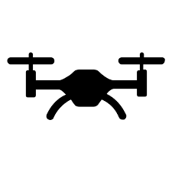
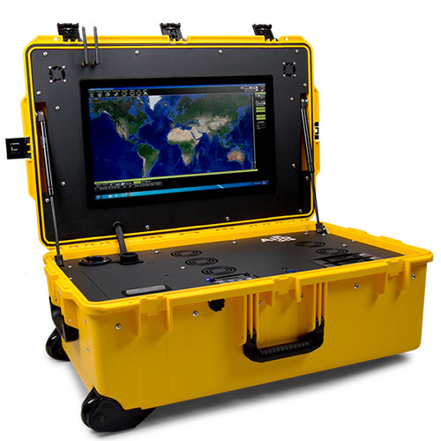
What Is a UAS?
Unmanned aircraft system (UAS)
Drones
Unmanned aerial vehicle (UAV)
Remotely piloted aircraft system (RPAS)
Radio-controlled model aircraft
A UAS is a system:
Unmanned Aircraft
Control Station
Command & Control Link(s)
Satellite
Unmanned Aircraft
Control Station

Slide 4
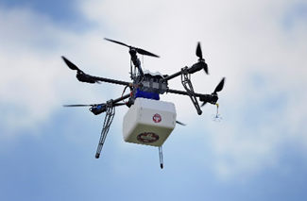
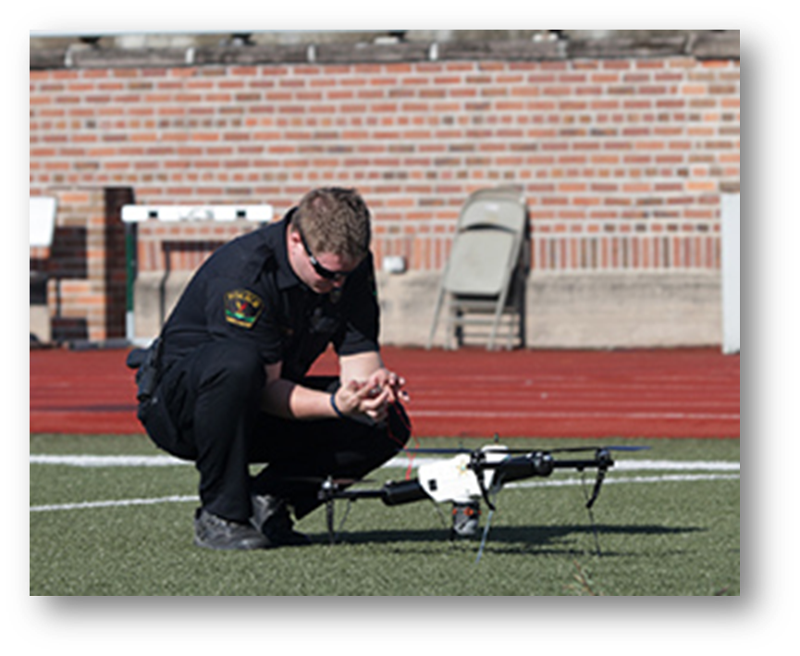
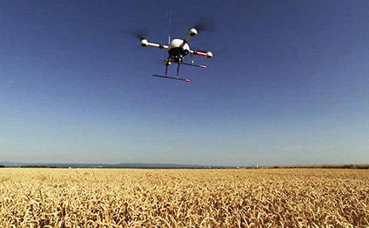
Why Fly UAS?

Slide 5
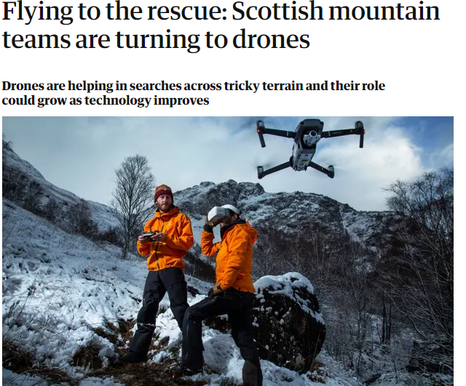
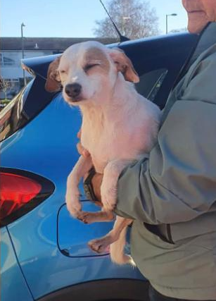
Stranded dog lured to safety by sausage dangling from a drone
By Sara Spary, CNN
Updated 1:09 PM ET, Sat January 22, 2022

Slide 6
What is the FAA’s Authority?
U.S. airspace is public space
49 U.S.C. §40103(a)(1)
UAS are aircraft subject to regulation
49 U.S.C. §40102(a)(6); 14 CFR 1.1; P.L. 112-95 §331
An aircraft is any device used, or intended to be used, for flight in the air
Small UAS allowed to operate without requirements for FAA certification or operating authority
P.L. 115-254 §349
UAS flown outdoors must comply with FAA regulations

Slide 7
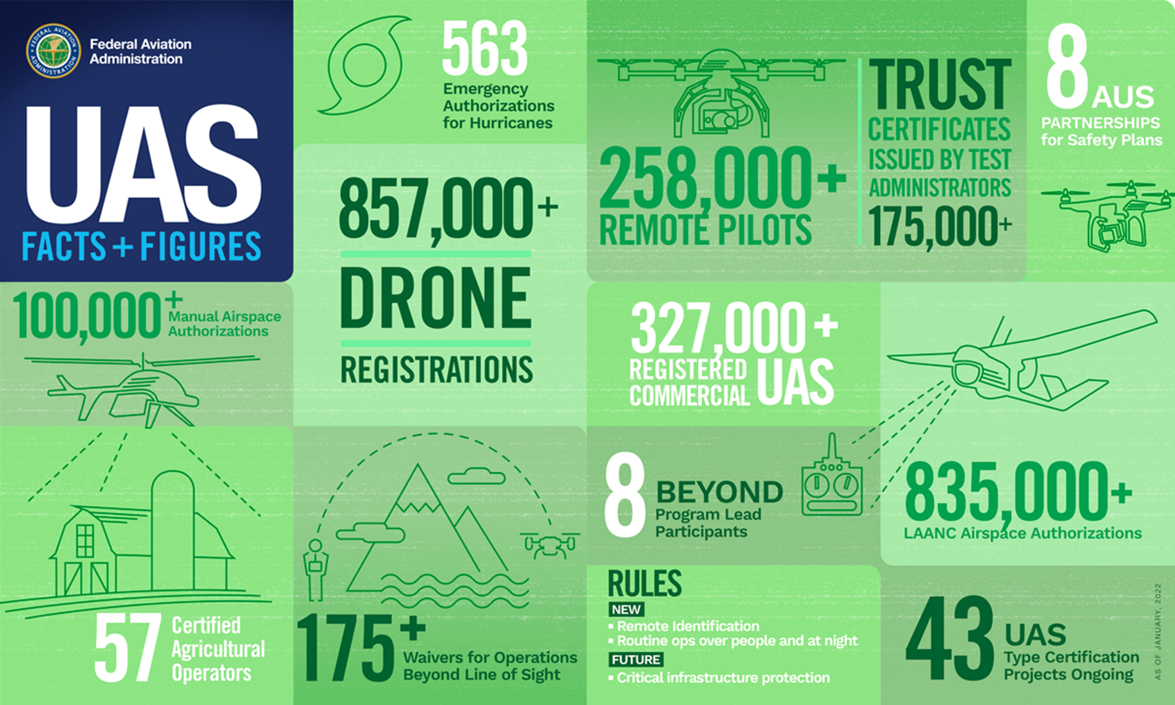

Slide 8
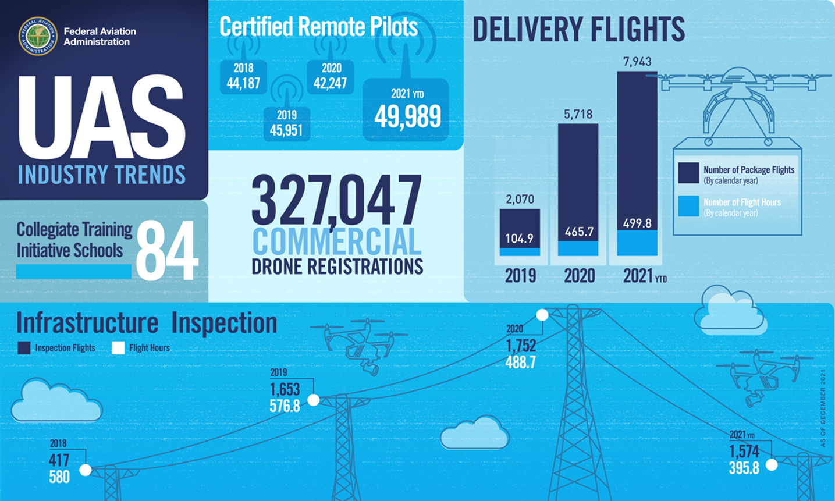
As of Nov, 23, 2020

Slide 9
What Do I Need to Know?

Slide 10
What are the Rules for Recreational Flyers?
1. Fly only for recreational purposes (enjoyment).
2. Follow the safety guidelines of an FAA-recognized Community Based Organization (CBO).
Note: We have not yet begun officially recognizing CBOs. Recreational flyers are directed to follow the safety guidelines of existing aeromodelling organizations or use the FAA provided safety guidelines per Advisory Circular 91-57B.
3. Keep your drone within the visual line of sight or use a visual observer who is co-located (physically next to) and in direct communication with you.

Slide 11
Rules for Recreational Flyers Cont.
4. Give way to and do not interfere with manned aircraft.
5. Fly at or below 400' in controlled airspace (Class B, C, D, and E) only with prior authorization by using LAANC or DroneZone.
6. Fly at or below 400 feet in Class G (uncontrolled) airspace.
Note: Flying drones in certain airspace is not allowed. Classes of airspace and flying restrictions can be found on our B4UFLY app or the UAS Facility Maps webpage.

Slide 12
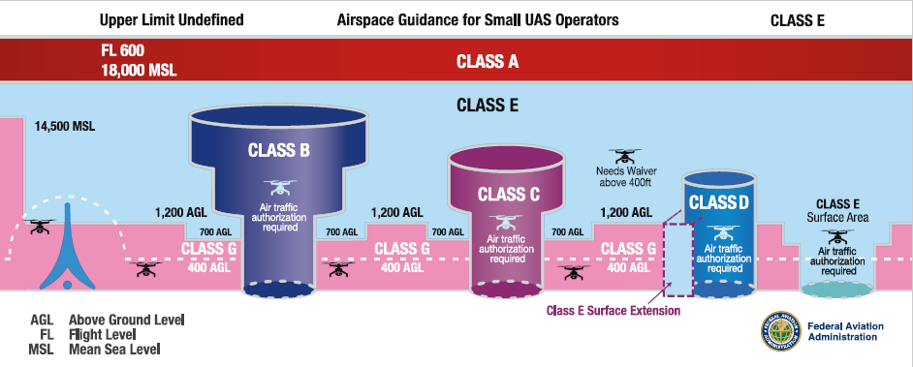
Airspace Requirements
Operations in Class G and Class E non-surface do not require ATC authorization
Operations in Class B, C, D & Class E surface areas require ATC authorization
Online portal available at the FAA DroneZone and through LAANC

Slide 13
Rules for Recreational Flyers Cont.
7. Take The Recreational UAS Safety Test (TRUST) and carry proof of test passage.
8. Have a current registration, mark (PDF) your drones on the outside with the registration number, and carry proof of registration with you.

Slide 14
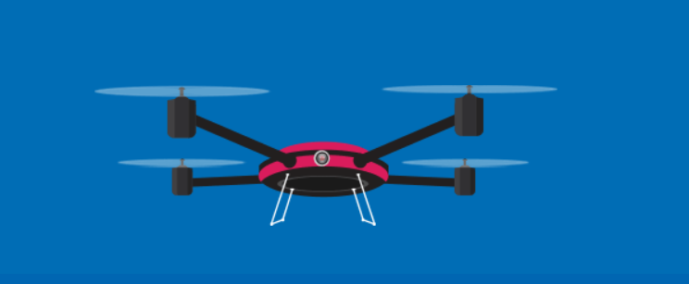
Online UAS Registration
Applies to all small UAS flown outside (in the National Airspace System):
Hobby: aircraft weighing less than 0.55 lbs do not need to be registered. UAS between 0.55 lbs and less-than-55 lbs can be registered online.*
Commercial: all aircraft
Owner must provide name, address, email
Non-recreational owners (includes Part 107 and Public COA) must provide make, model, and serial number (if available) of each sUAS
Register through FAA DroneZone
*(UAS 55 lbs and greater must be registered under Part 47.)

Slide 15
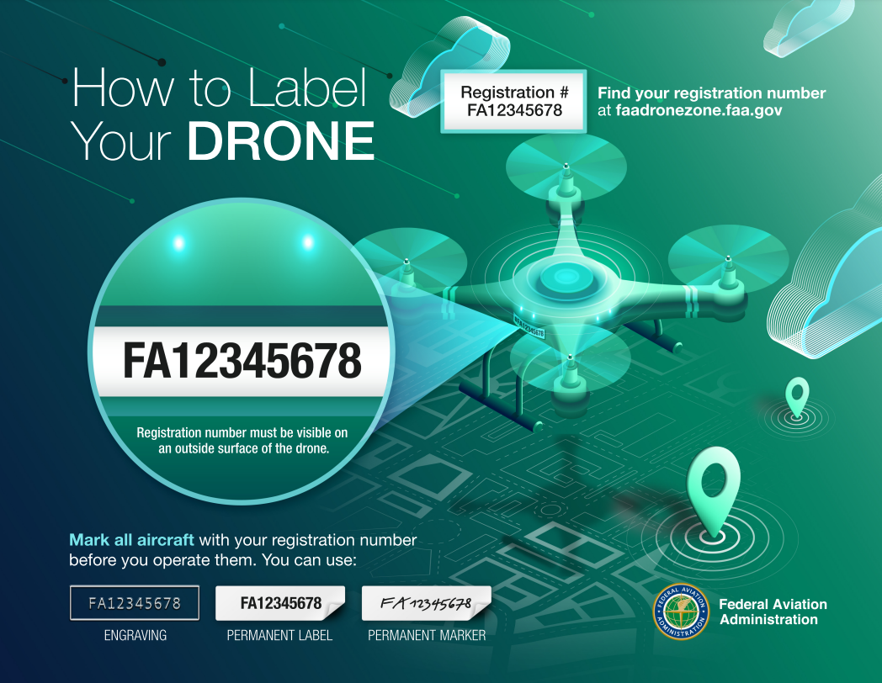

Slide 16
Rules for Recreational Flyers Cont.
9. Do not operate your drone in a dangerous manner. For example:
a. Do not interfere with emergency response or law enforcement activities. “i.e. Nevada NRS 493”
b. Do not fly under the influence of drugs or alcohol.
c. Individuals violating any of these rules, and/or operating in a dangerous manner, may be subject to FAA enforcement action.

Slide 17
The Recreational UAS Safety Test (TRUST)
TRUST is a free, on-line aeronautical knowledge and safety test developed by the FAA for recreational drone flyers.
All recreational flyers must take and past TRUST.
17

Slide 18
FAA-Approved Test Administrators https://www.faa.gov/uas/recreational_fliers/knowledge_test_updates/
Academy of Model Aeronautics (AMA)
Boy Scouts of America
Chippewa Valley Technical College
Community College of Allegheny County - West Hills Center
CrossFlight Sky Solutions LLC
Drone Launch Academy LLC
Drone Trust
Drone U
Embry-Riddle Aeronautical University (ERAU)
HSU Educational Foundation
Lake Area Technical College
New College Institute (NCI)
Pilot Institute
Proctorio Incorporated
Tactical Aviation
UAV Coach
University of Arizona Global Campus
Volatus Aerospace Corp

Slide 19
TRUST Details
The test is 23 questions and covers the topics below:
Understanding the requirements for recreational flyers;
Identifying airspace restrictions;
Requesting authorization for controlled airspace;
Conducting pre-flight assessments;
Following community based organization (CBO) safety guidelines;
Maintaining visual line-of-sight;
Getting to know your drone; and
Joining the community to keep learning.

Slide 20
B4UFLY App
B4UFLY helps recreational flyers know where they can and cannot fly with interactive maps
2016: B4UFLY launched (FAA’s first mobile app)
2019: FAA partnered with Kittyhawk to improve the B4UFLY user experience and launched the new app to the public
Over 15 million lookups and counting

Slide 21
Flying For Fun
Keep your drone within your visual line of sight or use a visual observer who is with you
Always give way to traditional aircraft
Fly at or below 400 feet
Understand local laws
Never operate in a dangerous manner
Follow the safety guidelines of a community based organization

Slide 22
Become a Certificated Remote Pilot
Requirements
Steps
At least 16 years old
Able to read, write, speak, and understand English
Be in a physical and mental condition to safely fly a UAS
Learn the rules (14 CFR part 107)
Pass a knowledge test
Register your drone with the FAA

Slide 23
Small UAS Rule (14 CFR Part 107)
First rule for small UAS
(<55 pounds)
Commercial, hobby, governmental operators can operate under Part 107
Became effective August 29, 2016
Recent part 107 amendment permits routine operations
over people
over moving vehicles
at night under certain conditions

Slide 24
LAANC (Low Altitude Authorization and Notification Capability)
Goals
Enable efficient notification and authorization services to small UAS operators
Provide the data exchange framework for UAS traffic management (UTM)

Slide 25
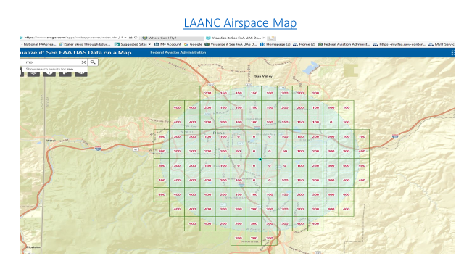

Slide 26
Reporting Unsafe Drone Activity
While flying or at the airport:
Report the sighting to Air Traffic Control
Note the location, altitude, and characteristics of the aircraft
Anywhere else:
Call local law enforcement
The FAA has published guidance for law enforcement to help them respond to unsafe UAS activity
Be as detailed & specific as possible
Location, altitude, direction, pictures, videos, etc.

Slide 27
Collaboration with Law Enforcement
FAA works with Law Enforcement Agents (LEAs) to educate and provide guidance on authority
FAA's Law Enforcement Assistance Program (LEAP)
Special agents from LEAP are your point of contact for federal, state, local, tribal, territorial and international law enforcement agencies.
Special agents can provide information on drone enforcement and registration matters.
Providing a LEAP special agent with reports of suspected unauthorized UAS incidents in a timely manner increases the FAA's ability to take enforcement action when appropriate.
Notes:
For questions about enforcements, contact LEAP at: LEAP@faa.gov.

Slide 28
Nevada Revised Statutes 493 NRS 493 TITLE 44 - AERONAUTICS CHAPTER 493 - GENERAL PROVISIONS UNIFORM LAW

Slide 29
NRS 493
NRS 493.100 Dangerous flying: Penalty.
NRS 493.103 Unmanned aerial vehicles: Action for trespass against owner or operator,
NRS 493.150 United States certificate, permit or license required for operation of civil aircraft within State.
NRS 493.140 Standards for determining whether operation is careless or reckless.
NRS 493.020 Definitions. 1. “Aircraft” includes unmanned aerial vehicle and any other vehicle used for navigation through the air.

Slide 30
Questions?

Slide 31
Thank You
Lee Oscar
Aviation Safety Inspector
Lee.A.Oscar@FAA.gov
FAASTeam Safety Program Manager AW
Reno Flight Standards District Office (FSDO)
775-276-8337c

