Slide 1
Explaining IV/CB Concerns
Incline Village Crystal Bay
Citizens Advisory Board
Diane Becker, chair
Prepared by Roxanna Dunn
roxanna_dunn@yahoo.com
October 2023

Slide 2
IV/CB is different from other areas of the county.
This section was reviewed and voted on at the November 6, 2023 CAB meeting.
Our roads
  In town – steep and winding roads
  In/out of town – IV/CB is limited to three egress roads
Attractions that draw large crowds
  Visitors around the lake, estimated at 25M vehicle trips annually
  Visitors from Reno and Carson
Summers
  Travel impeded due to road work on highways and other construction, plus much visitor traffic
  Inherent danger of forest fire, coupled with visitors ignorant of the risks
Winters
  Travel impeded by icy road conditions
  Difficulties getting a commute workforce into the basin

Slide 3
Numerous concerns are repeatedly raised at CAB meetings.
Issue | Repetitions
Workforce housing, STRs | 130
Distrust of county govt, TRPA, process | 86
Development, growth, overcrowding | 75
Evacuation | 74
Communication, lack of representation | 69
Safety, ebikes | 69
Zoning | 37
Transportation | 35
Traffic, parking | 27
Maintenance (roads, snow removal) | 24
Environment | 21
Tourism | 14
61% of comments expressed frustration with:
County or agency performance
Lack of local representation in planning
Having inputs ignored
Cataloged comments at CAB meetings:
April 2022 to July 2023
13 meetings total
466 comments –
56 different speakers

Slide 4
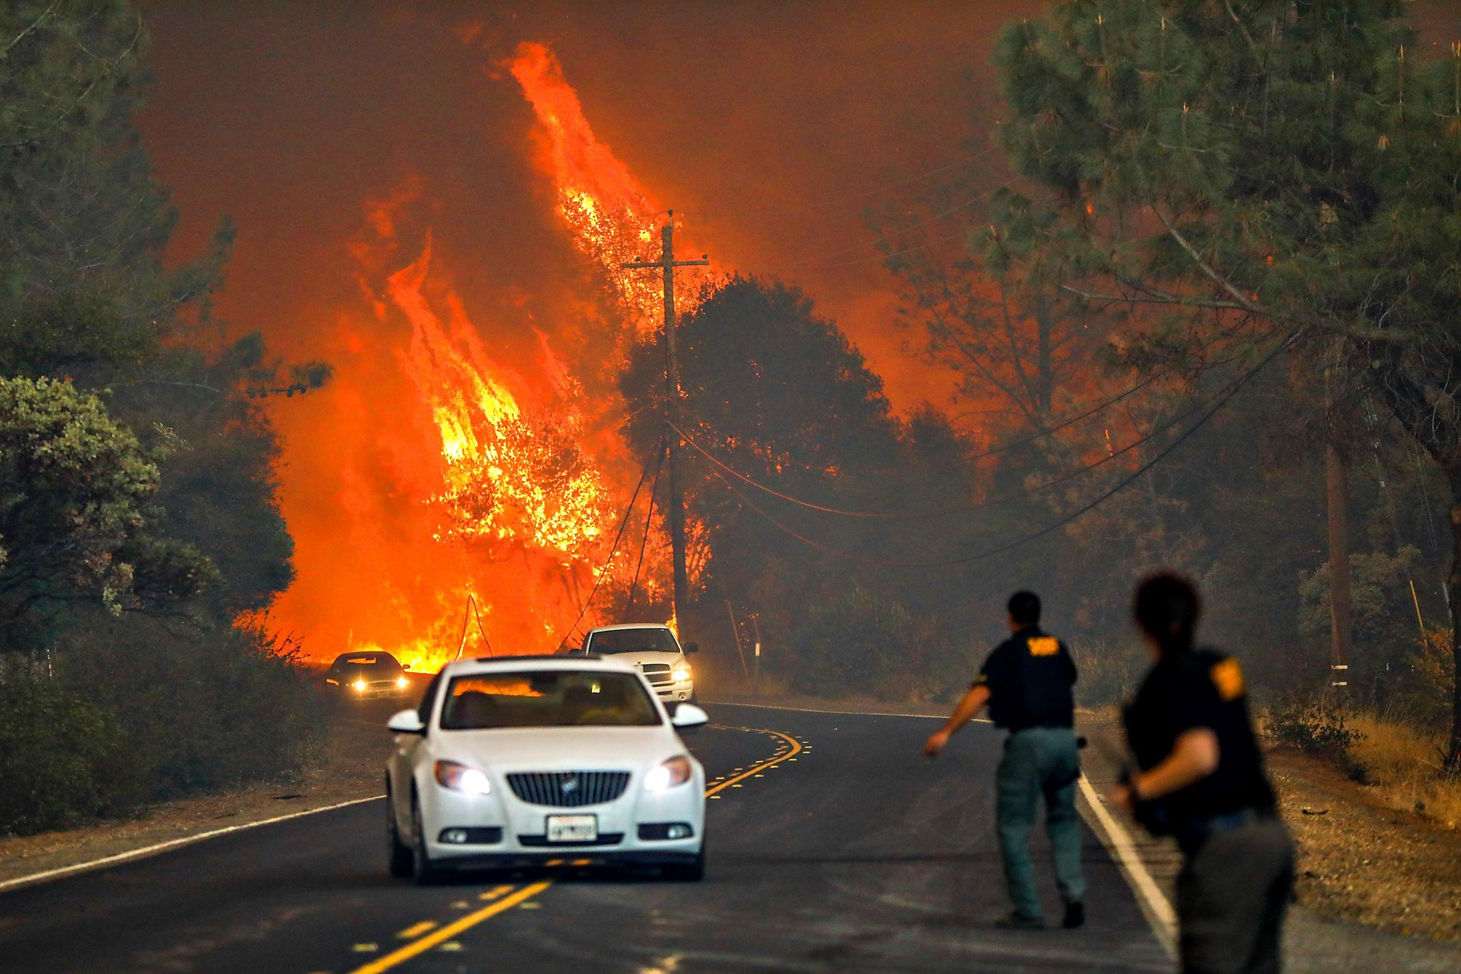
Evacuation
This section was reviewed and voted on at the November 6, 2023 CAB meeting.
Limited roads
Growing population
Also important:
Fuel reduction
Communication
Education

Slide 5

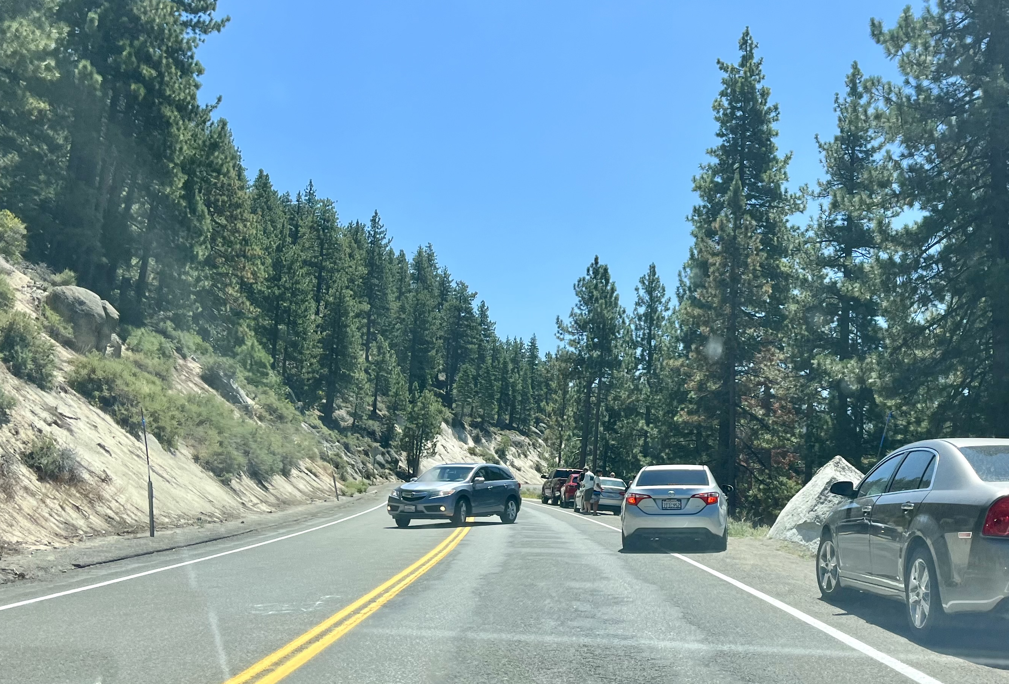
Evacuation: How much risk exists in an evacuation scenario?
Efficacy of egress routes ratio:
population
number of available lanes

Slide 6
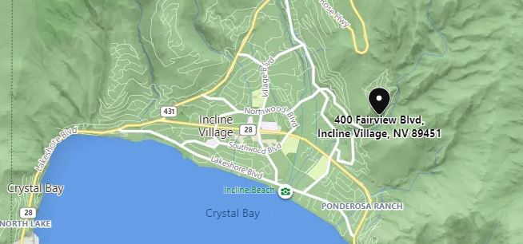
Evacuation: We have only three escape routes.
population
number of available lanes
268 homes
15 miles to Joy Lake Rd
Mileage indicates distance to the first junction that can disperse traffic.
5.5 miles to Hwy 267
12 miles to Hwy 50

Slide 7
Evacuation: Population estimates must include
1) transient population and 2) new development impact.
population
number of available lanes
Census pop (IV+CB) | 9,700
Second homes, STRs, UNR-LT, Hyatt | 4,900
Commute workers | 1,800
Day visitors | 3,500
 |  | 19,900
Kings Beach (70%) |  | 4,100
Current evac pop |  |  | 24,000
Nine47 |  | 90
Waldorf (2027-8) |  | 670
Cal-Neva |  | 600
Kings Beach Center |  | 530
 |  |  | 2,100
 |  |  |  | 26,100
Washoe County Evacuation Plan sets population at 8,669.
From here forward, this is what we mean when we say evac population.
All four on SR28
One mile stretch
P

Slide 8
Evacuation: How much risk exists in our evacuation scenario?
Efficacy of egress routes ratio:
population
number of available lanes
 | Paradise, CA | IV/CB+KB
Population (A) | 27,000 | 24,000
Number of escape routes | 5 2-lane roads 1 4-lane road | 3 2-lane roads
Number of escape lanes (B) | 14 | 6
Ratio – “evacuees” to escape lanes (A/B) | 1,928 | 4,000
P

Slide 9
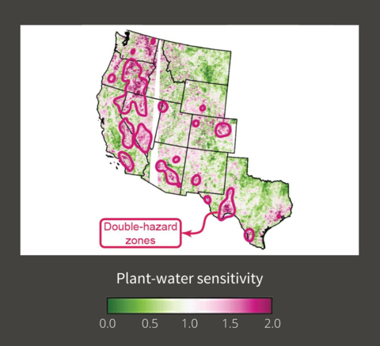
Washoe County lies in a double-hazard zone for wildfire.
new slide
Two factors that double the wildfire hazard:
  Tinder-dry plants
  Increase in atmospheric dryness
Plus, development in wildland-urban interface (WUI)
  Vast majority of wildland fires caused by people
Garthwaite, Josie. “Researchers identify ‘double-hazard’ zones for wildfire in the West,” Stanford Doerr School of Sustainability, February 7, 2022.

Slide 10
Evacuation: What can WC Commissioners do to reduce our risk?
Reduce
population
population
Increase
lanes out
number of lanes out

Slide 11

Evacuation: What can Washoe County Commissioners do to reduce out risk?
Develop a physical movement evacuation plan specific to Washoe Tahoe with IV/CB participants. Encourage and support infrastructure projects to alleviate the evacuation risk (wider shoulders, more turnouts, no parking on 28, convertible bike lane, burying power lines). Support a reservation system at Sand Harbor. Contribute to the Tahoe Douglas FD project to fund two lake-wide helicopters for rescue and fire fighting. Continue to support the Regional Preparedness Program to develop coordination across the north shore. Consider carefully adding more development, more attractions, and more people into the area until evacuation risks are understood.
>>STRs

Slide 12
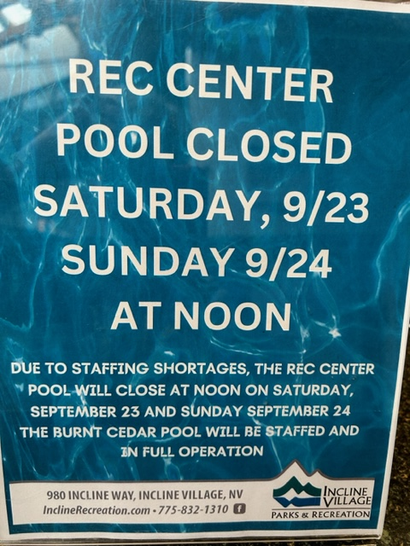
Workforce Housing
This section was reviewed and voted on at the xxxx CAB meeting.

Slide 13
Workforce Housing: Everybody suffers from the lack.
Commuting puts an extra burden on our WORKERS…
Difficult to hold a second job if commuting
Extra hours and expense ($6,160 per year)
And BUSINESSES suffer…
Difficulty hiring, high turnover, more overtime
Reduced days and hours and services
And then on RESIDENTS AND VISITORS who cannot get services…
And less tax revenue due to fewer tourists
And more pollution in the LAKE due to commuter miles.

Slide 14
Workforce Housing: Deed restrictions intended to encourage affordable housing allow developers to skew to high-end units.
TRPA Income Levels - Housing Affordability
Based on a 3-person household.
updated slide
Type of housing | Income (AMI) | Local job requirements
Affordable | <$71,200 (80%) | none
Moderate | <$106,800 (120%) | none
Achievable | no maximum | One occupant >=30 hours/week for a Tahoe-located or remote business requiring a local presence
 |  | Retired and has lived in Deed restricted unit > 7 years
These categories do not require Tahoe Basin employment.
This category has no income or assets cap, no limit on sales price, so the housing could be high-end condos.
Given these provisions, increasing height, density, and coverage might not result in hoped for workforce housing.

Slide 15
Workforce Housing: 10% inclusionary housing makes the workforce housing shortage worse.
updated notes
29% of the peak population are workers*.
Adding housing at a rate that increases population faster than it accommodates workers increases the shortage…
  At 10%, wf housing shortage is increased by 15 units for every 100 built
  At 29%, breakeven, shortage remains at current level
… and consumes land that makes future efforts to provide workforce housing more difficult or impossible.
math
* Peak population includes full-time residents, second home owners in town, STR renters, commute workers in town, and day visitors. This is the most all-encompassing estimate of population and therefore the largest denominator, and therefore the most conservative estimate of worker percentage. And number of workers is based on current 1.25 jobs per worker.
P

Slide 16
Workforce Housing: Where to build? Housing on public land is not enough.
The need is 1,205 units by 2026.*
awaiting updates
Location | Owner | Density: units per acre (A) | Acres (B) | Number units (A x B)
Southwood (OES) | TTD | 18.75 | 6.4 | 120
Country club | Washoe County | 15 | 1.3 | 19
Village, Donna | Washoe Schools | 15 | 3.5 | 52 | 191
Village at Harold | USFS | 15 | 13.23 | 198
Oriole Way | USFS | 15 | 0.22 | 3
Northwood | USFS | 15 | 0.58 | 8
Lark Court | USFS | 15 | 0.31 | 4 | 213
 |  |  |  |  | 404
*Washoe Tahoe Housing Needs Report, p.ES-3.
Table data from p.37 of Housing Roadmap, developed by Washoe Tahoe Housing Partnership

Slide 17
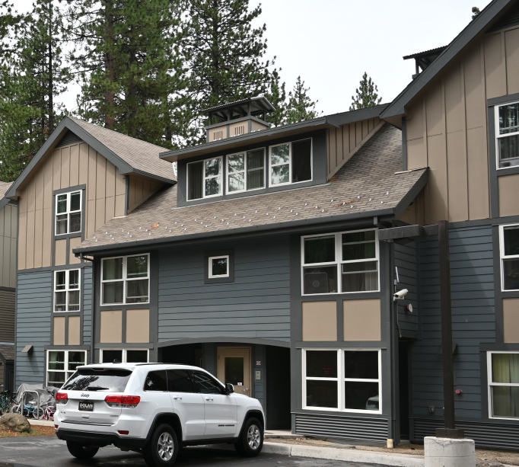
Workforce Housing: Without many public parcels available, private housing options must be pursued.
updated slide
Funding as outlined in Housing Roadmap
Private development with incentives – >30% workforce housing and funding
Employer provided housing
Placemate, rental assistance, down payment assistance – Roadmap, p.46
Redeeming some of the properties lost to STRs
Tighter deed-restrictions with better enforcement
updated slide

Slide 18
Workforce Housing: Washoe Tahoe is asking Washoe County Commissioners to…
Diane to rework the bullets on this slide.
Have county staff pursue the private housing options listed on the previous slide. Have the county hire consultants to review opportunities, including ROI analysis, for local government-funded workforce housing. When “Reno/Sparks” Housing Authority (funded by Washoe County) takes up workforce housing, expand its scope to include IV/CB solutions and add an IV/CB resident to the committee. Be cautious using inclusionary housing as a solution. Pilot Achievable housing restrictions to test the effect.
>>Conclusion

Slide 19
Workforce Housing Appendix: Here’s how 10% inclusionary housing makes the situation worse.
workers
peak population
5,735
19,900
= 29%
Here’s the math:
Assume adding a complex of 100 units, 10 of which are workforce housing.
100 units X 2.28 pphu = 228 people added to the population.
Divide by current IV/CB peak pop = 228/19,900 = 1.15% increase (0.0115)
This also means an increase in the need for service workers, and housing, so
5,735 workers* X 0.0115 = 57 additional employees needed
57/2.28 pphu = creates a need for 25 workforce units while adding 10. Net -15 wf units
Numbers in blue font are pulled from the Washoe Tahoe Housing Needs Report; pphu means people per household unit.
Population used here is the IV/CB peak population. 29% is therefore a very conservative estimate of ratio of workers to population.
back
P

Slide 20
Short Term Rentals
awaiting updates
This section was reviewed and voted on at the xxxx CAB meeting.
Commercial businesses are located in residential areas.

Slide 21
STRs: Online booking has changed the nature of short term rentals.
 | BEFORE ONLINE BOOKING | NOW
Decision to rent | Personal decision made by owner | Booking sites solicit owners to sign-up; investors, to sell
Advertising | Local newspapers or ski magazines, had to be renewed | International reach, 24/7, continuous, professional ads
Vetting renters | Phone call, references, credit check | Booking site verifies identify, xrefs against fraudulent accounts
Payment and taxes | Paid by check mailed to the owner or agent | Paid by credit card through the booking site; handles TOT
Damage, insurance | Deposit, optional extra policy | Booking site offers damage and liability insurance
Cleaning | Owner or agent schedules cleaning service | Booking site can schedule and manage cleaning service
 | More personal and hands-on Individual owners | Automated, handled for you Big business

Slide 22
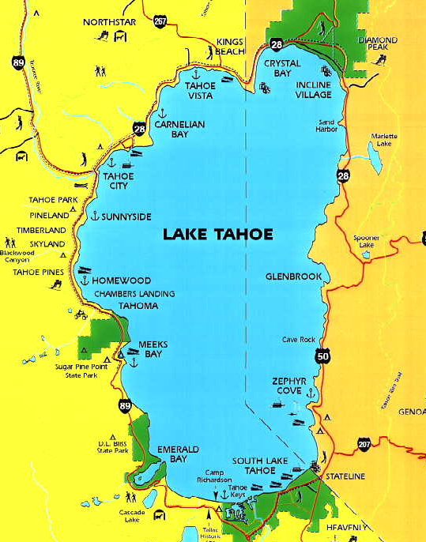
STRs: We are concerned about investors taking residents out of our residential areas.
awaiting updates
As of September 2023,
11% of STRs are owned by business entities.
9% of owners own 24% of STRs.
Several factors support investor purchases:
Housing prices continue to rise.
Online vacation rental business expands.
Long-time residents get fed up and leave (creates a vicious cycle).
Washoe Tahoe remains the only area in Tahoe without an STR cap.

Slide 23
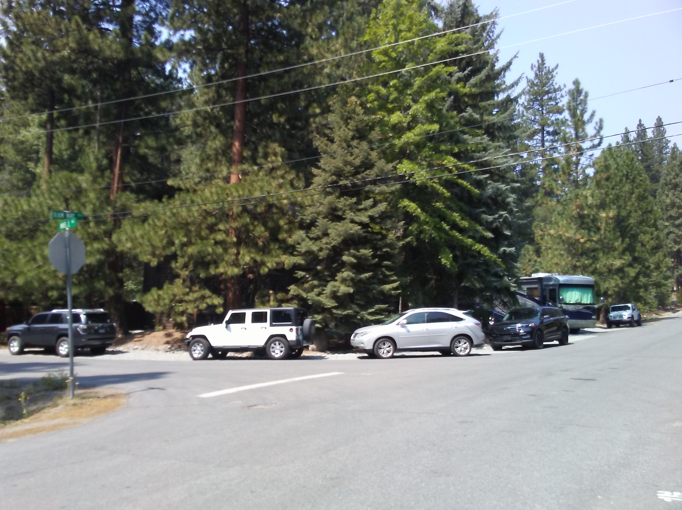
STRs: What about the property rights of neighbors?
updated slide
STR
Nuisance factor
  Unrelenting noise, disorderly conduct, trash, parking – unsupervised hotel
  Lack of enforcement – burden on neighbor to document and file complaint
  Neighbors receive no compensation.
Danger in an evacuation
  Less careful about fire danger
  Communication challenge, lost without GPS
  No incentive to shelter in place
Hollowing out the community
  Loss of neighborhood, loss of HOA control
  Loss of workforce housing
  Increases LTR rents around 5.35% per year
  Loss of young families and school-age children
Undermines efforts to promote mass transit by making tourists dependent on their cars.
HOA was an issue that the commissioners agreed to address, though I did not completely understand the history here. – seems centered in Tyrolia Village

Slide 24
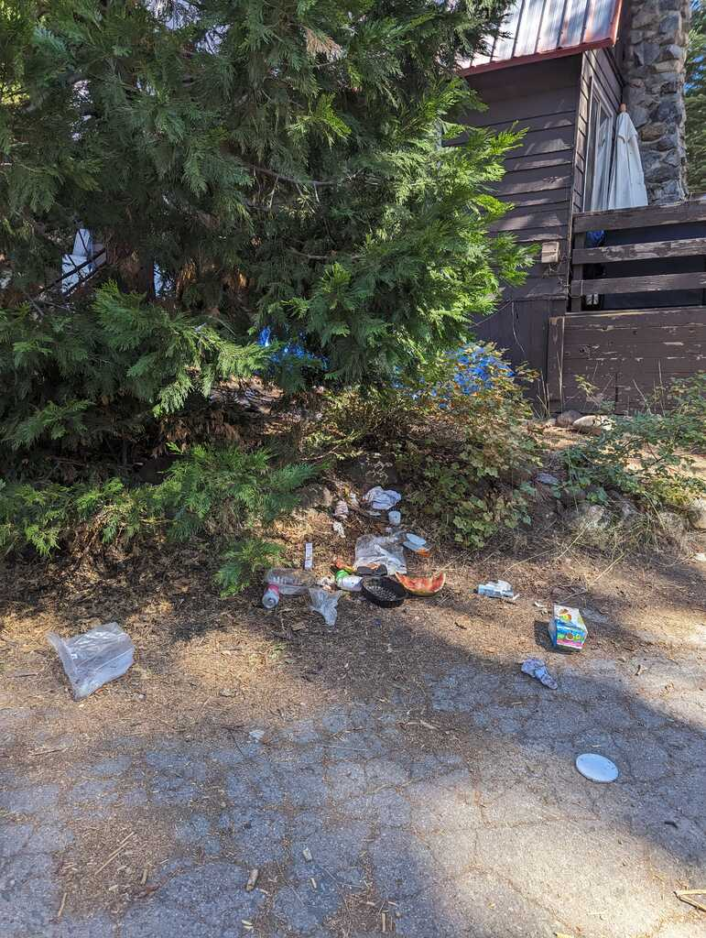
STRs: We are not anti-STR. We simply want the same protections that have been afforded most resort communities.
updated slide
Reduce STR impact: Cap the number of STRs. Limit density in residential neighborhoods. Reduce the allowed number of rental days. Ensure ADUs are not used as STRs. Reduce STR speculation: Require a one-year mandatory waiting period between purchase and applying for STR permit. Do not automatically rollover STR permits to new owners. Increase property tax on STRs without owner on site during rentals since they are businesses. Improve enforcement of rules: Clarify and educate on complaints versus violations, processes and consequences.
Highlighted items were approved with Dec 2023 STR Ordinance revision.
We ask you to consider the others as well.
morning after

Slide 25
Conclusion
This section was reviewed and voted on at the xxxx CAB meeting.

Slide 26
Please remember this.
Population growth and inadequate evacuation plans are major concerns given the increasing threat of a wildfire and the constraint of limited escape routes.
Our community needs a greater portion of our workforce living locally in order to:
  give businesses more stability
  meet the needs of residents and visitors
  be available during winter storms
  reduce pollution in the lake
Short-term-rentals are businesses, and they:
  decrease available housing
  diminish the livability of our homes
  invite investors to hollow out communities
Many resort communities face similar issues.
Can we take on the challenge of making Tahoe a model of how an area can preserve its natural environment, welcome tourists, and provide a good home for its residents?

Slide 27
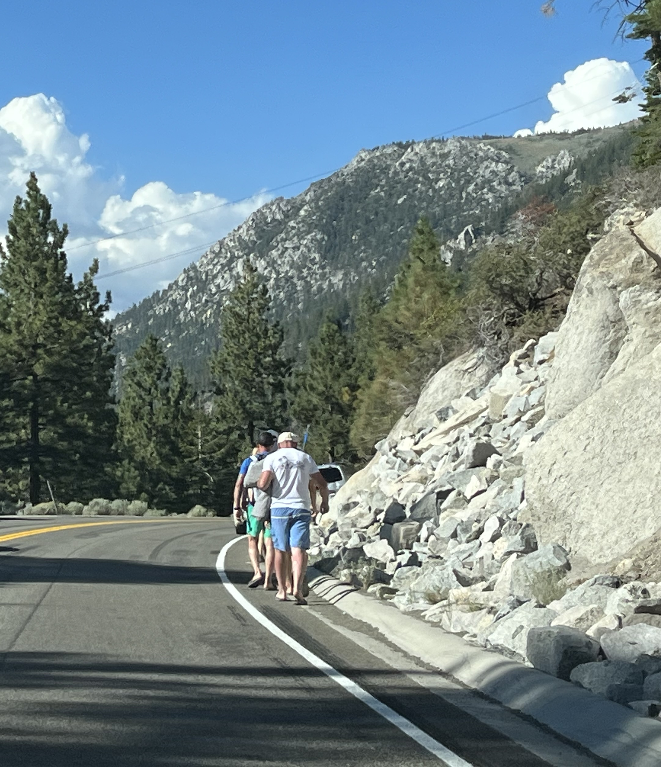

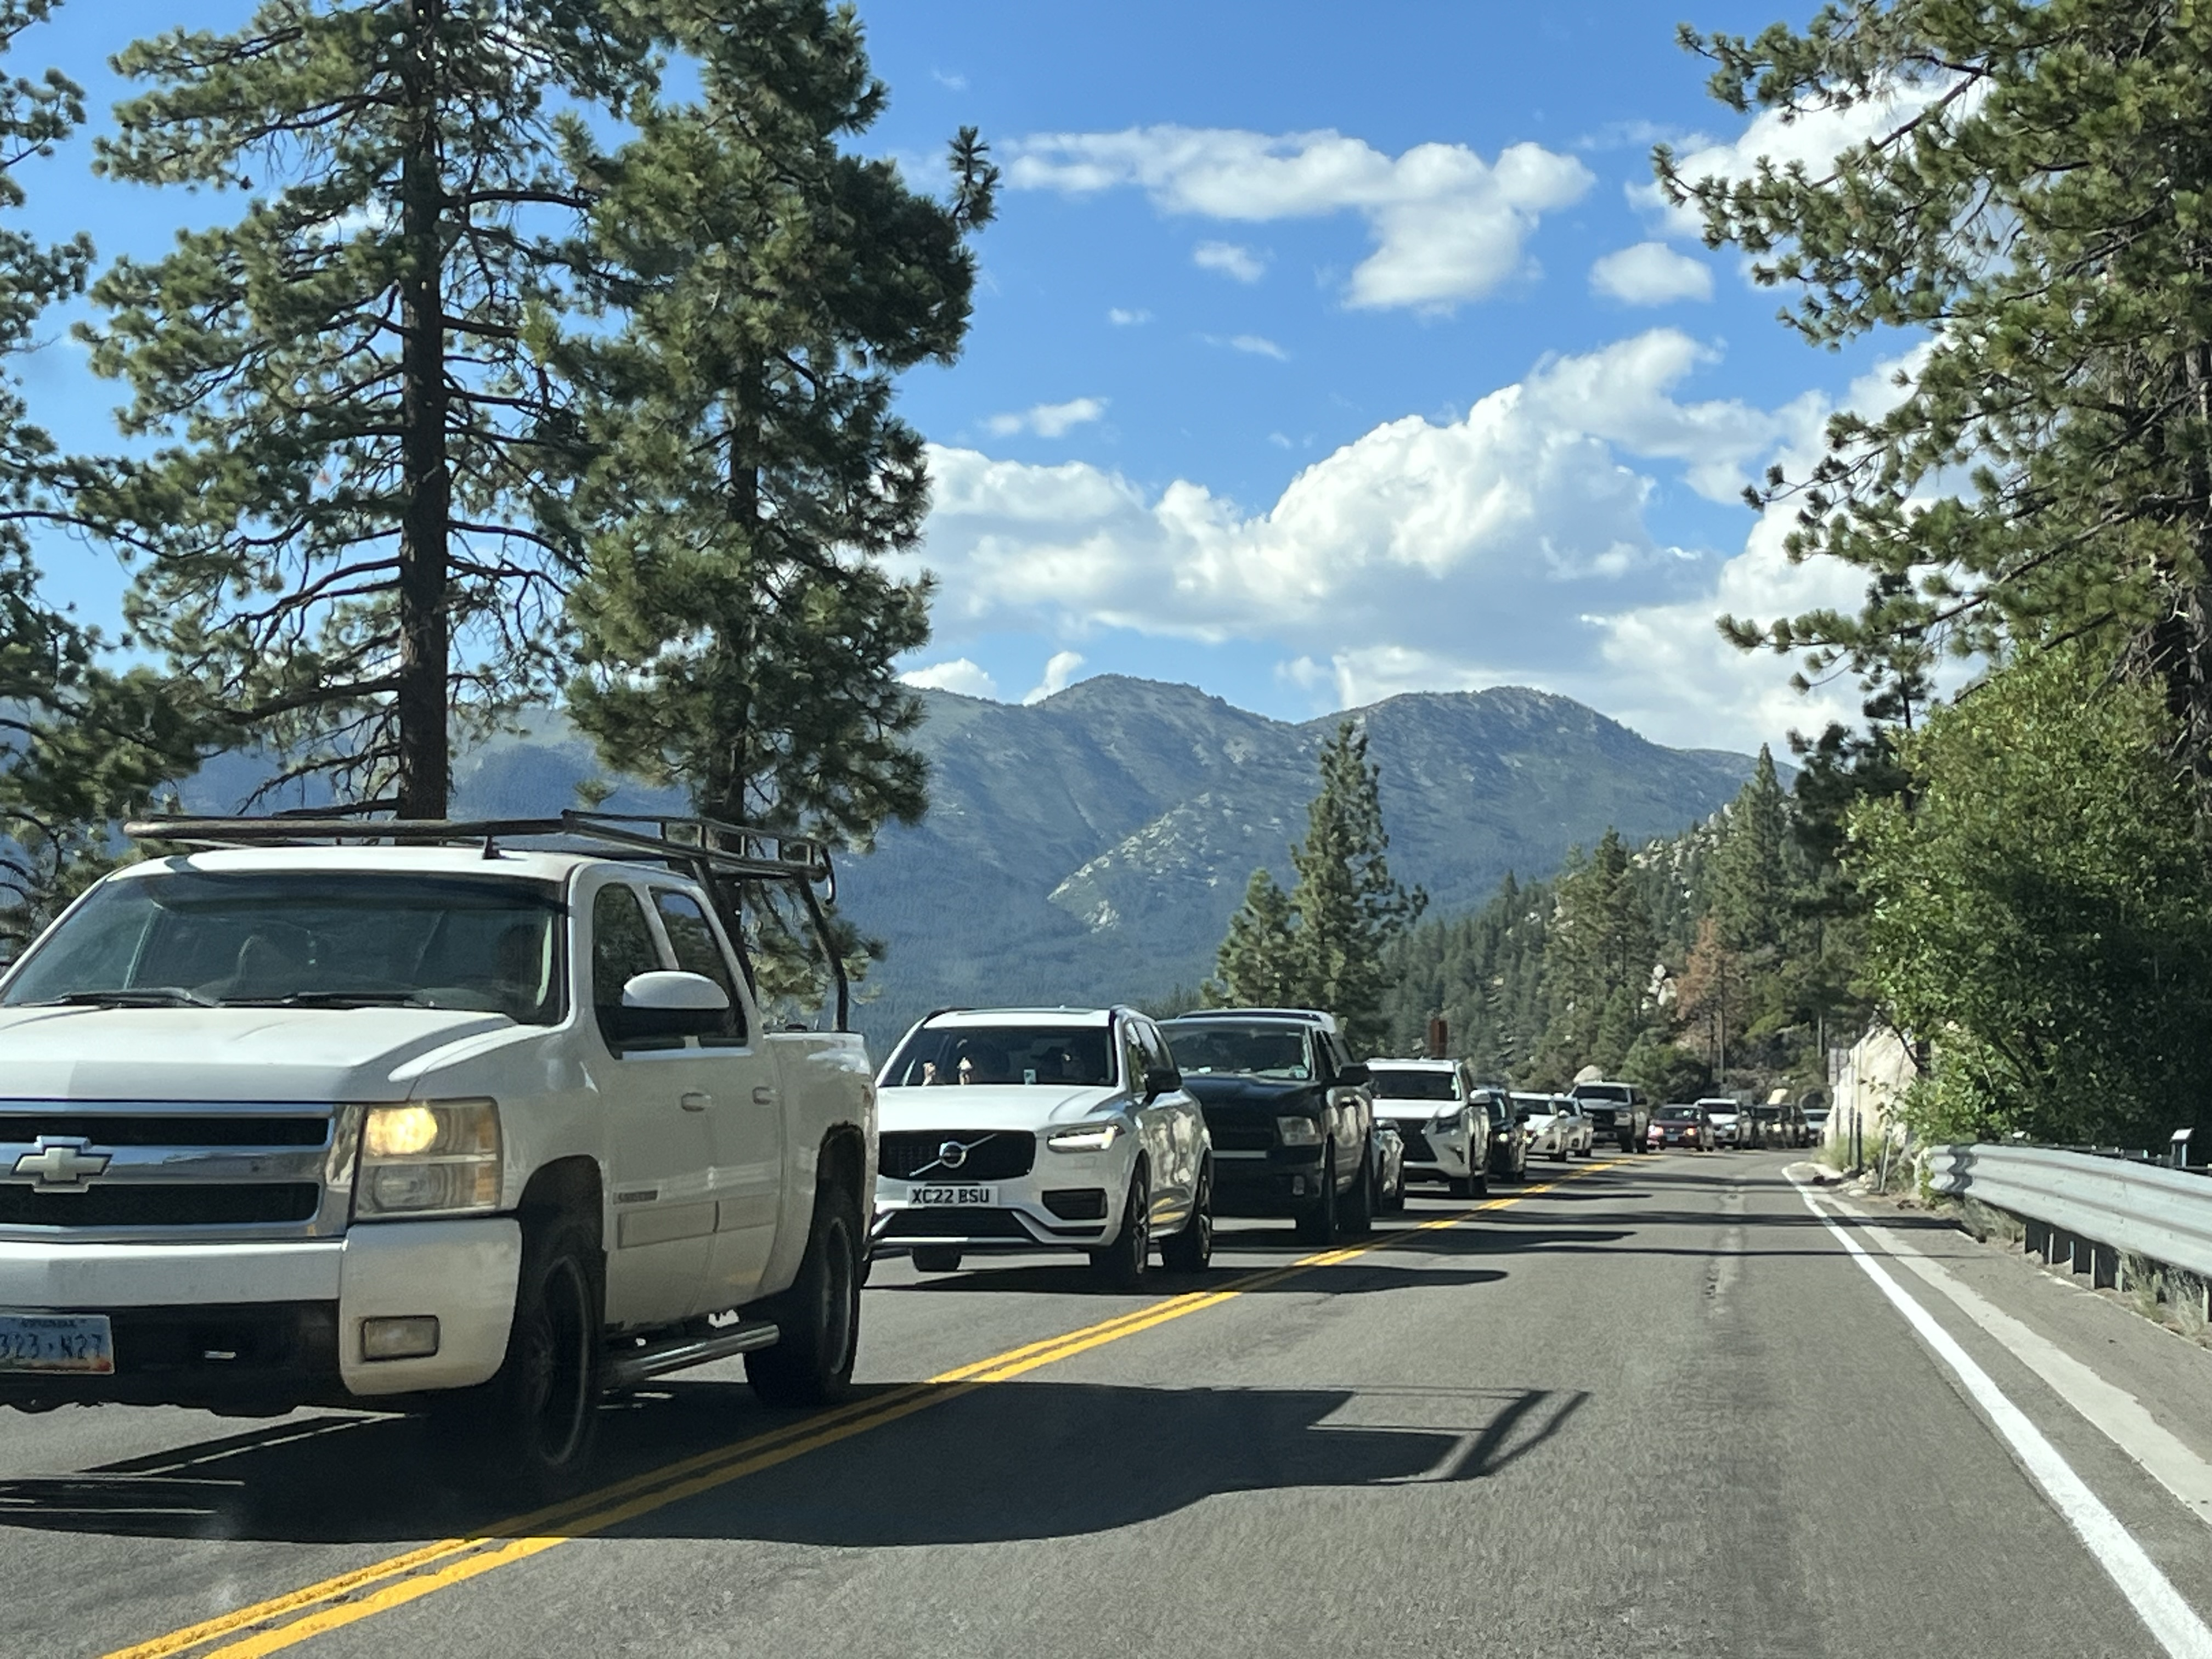

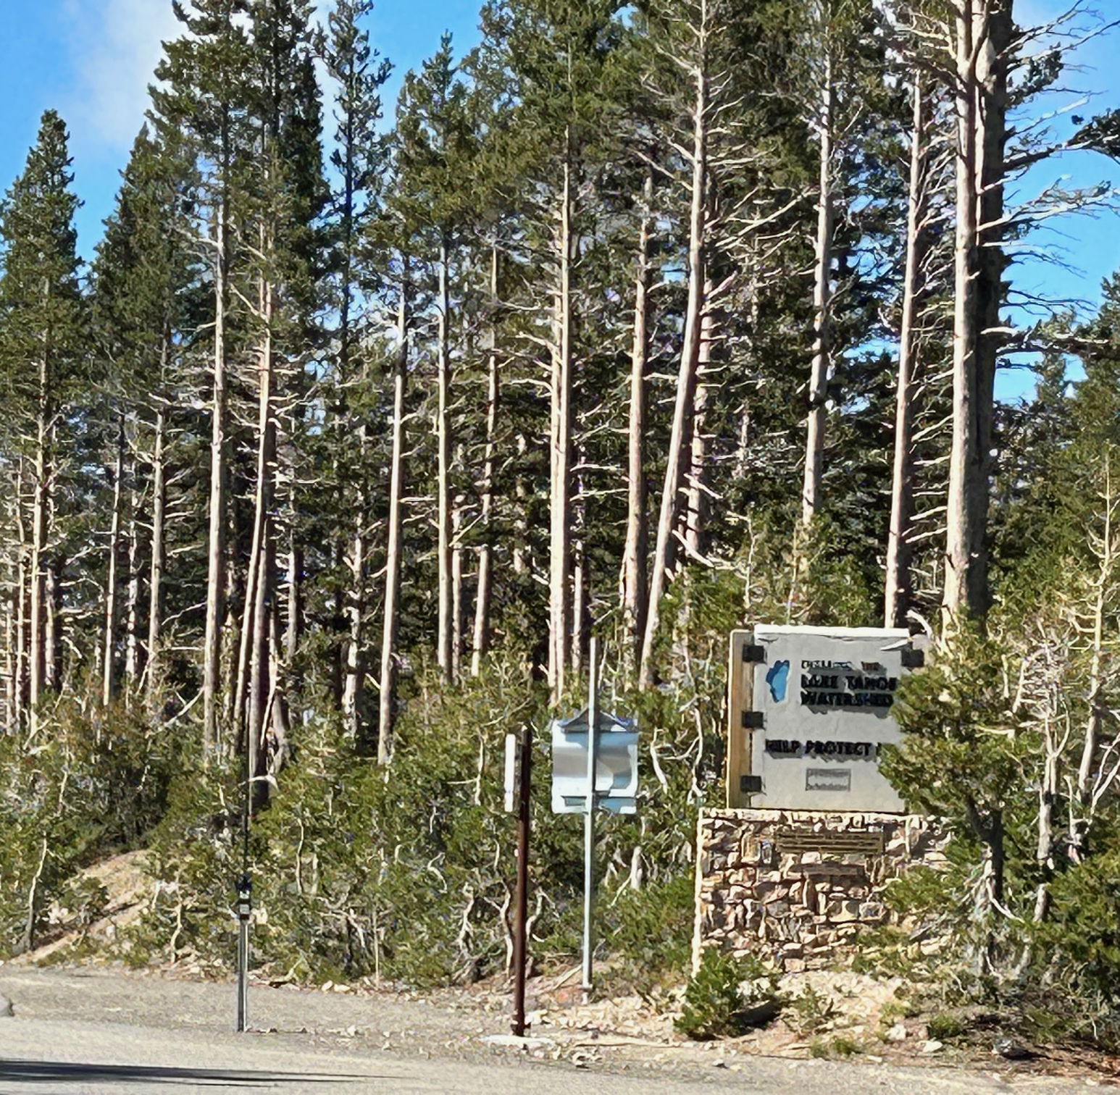
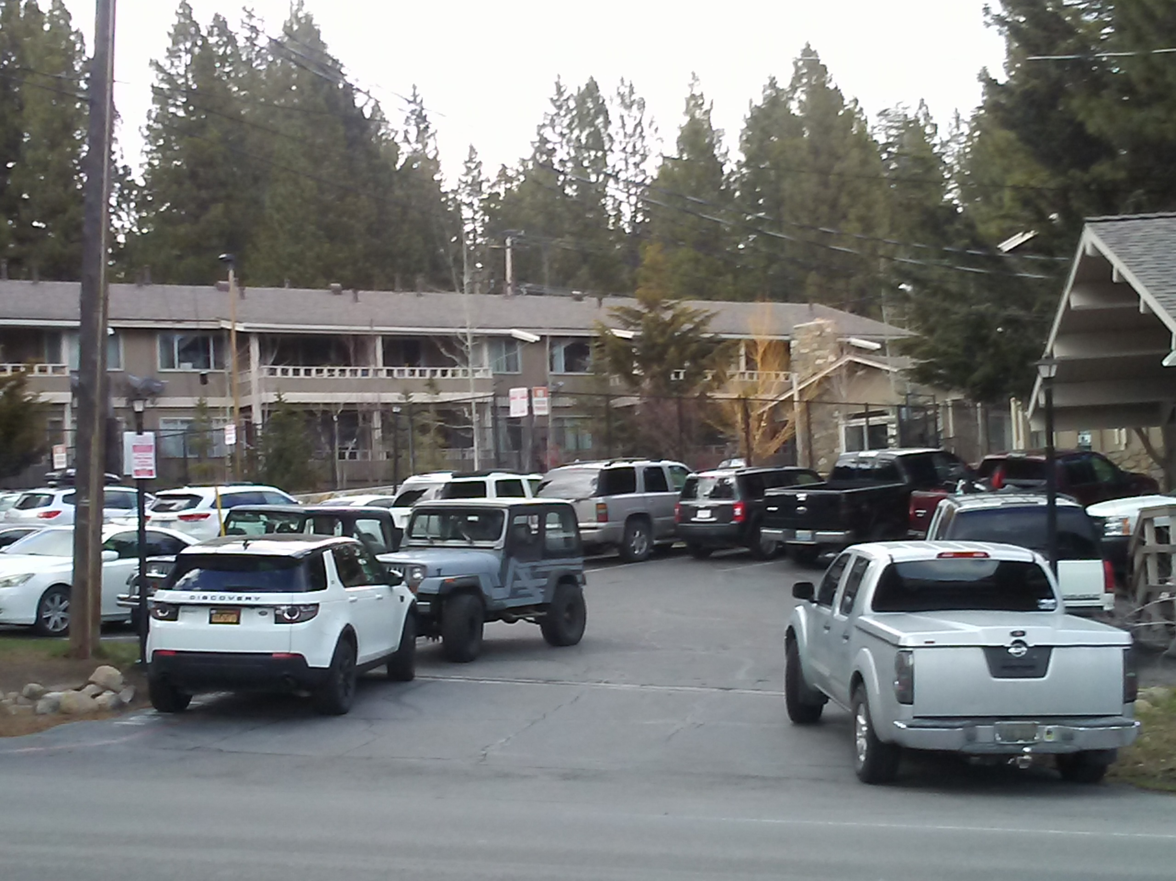
SAN FRANCISCO (KGO) -- Fodor's Travel Guide put Lake Tahoe on its list of "Ten Regions to Avoid in 2023,” saying the region has become overpopulated.
Thank you for your attention.
Questions?

