Slide 1
Managing Multi-Use Paths & Use Etiquette

Slide 2
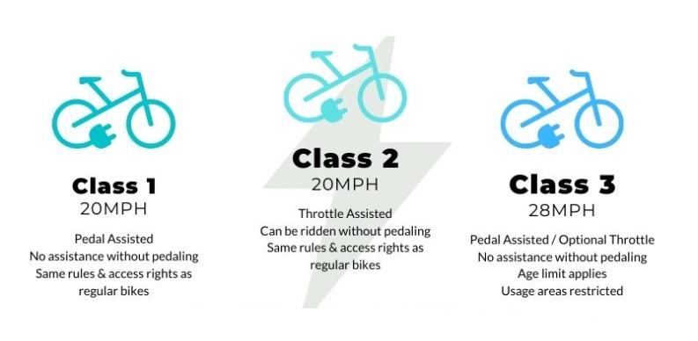
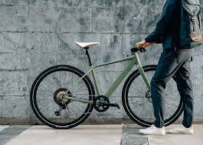
WHAT IS AN E-BIKE?WHAT IS THE DIFFERENCE?
Would you know if this is an E-bike?

Slide 3
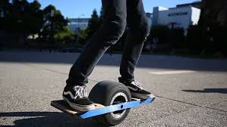
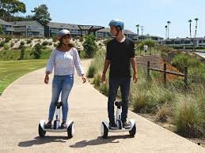
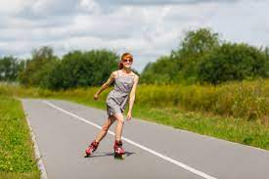
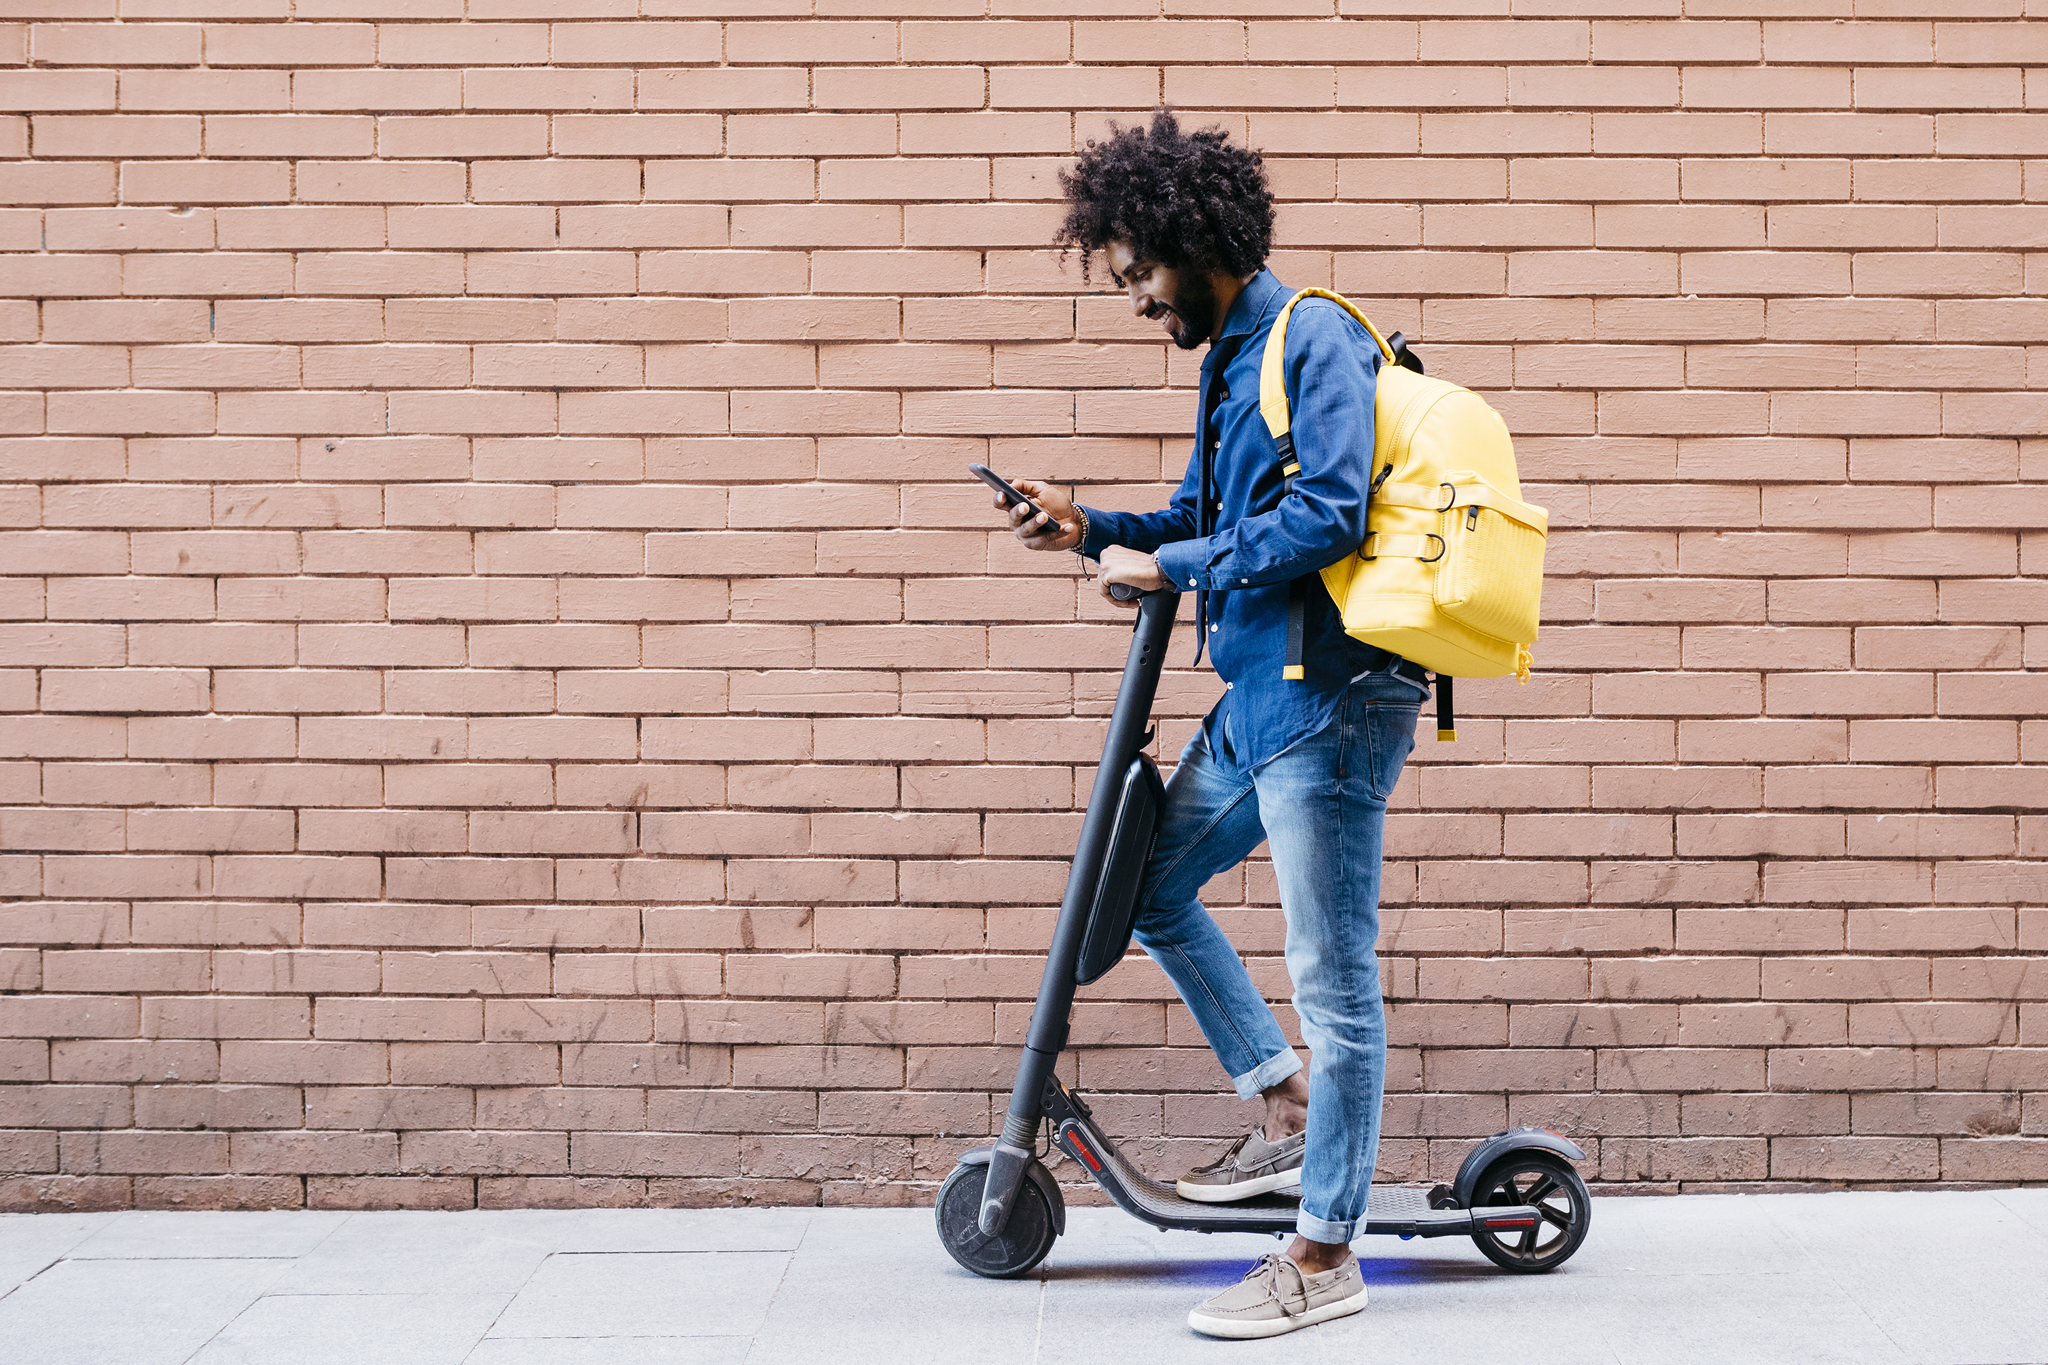
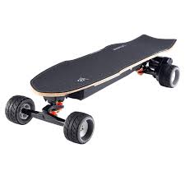
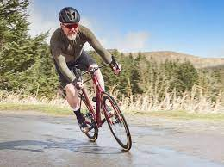
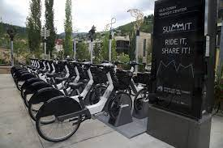
Additional Devices Using Pathways

Slide 4
Multi-Use Pathway Continuity
Plans to connect a paved, multi-use path around Lake Tahoe will require multi-jurisdictional coordination
Policy, management, etiquette, signage and messaging should attempt to be consistent throughout the trail system
Incline Village, Tahoe City, and South Lake Tahoe are hubs for trail data collection, informational centers, and etiquette messaging campaigns. Pilot programs may be necessary to gain insight into effective trail management strategies.

Slide 5
CHAPTER 95
SECTION 21. Non-Motorized Vehicles 95.200 Bicycles and Other Operator-Propelled Vehicles.
No person may operate or ride a bicycle, electric bicycle as defined in Chapter 484B of NRS, scooter, skateboard or other operator-propelled vehicle or device in any county park when the director has determined that conditions are unsafe or otherwise inappropriate for the operation of the vehicle or device and has issued an order prohibiting such activity.
All persons must restrict speed and manner of operation of a bicycle, electric bicycle as defined in Chapter 484B of NRS, scooter, skateboard or other operator-propelled vehicle or device to a reasonable and prudent manner relative to terrain, prevailing conditions, equipment, personal capabilities, personal safety and the safety of all other park users.

Slide 6
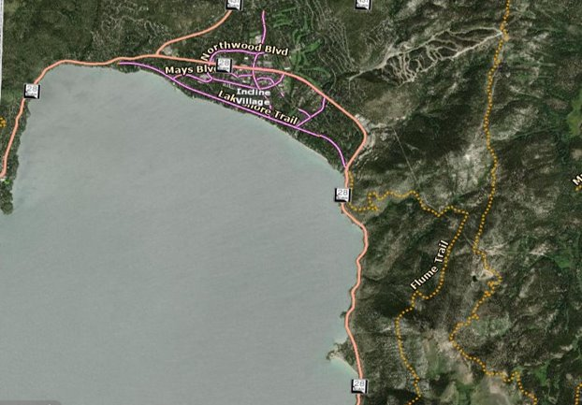
Incline Village Multi Use Paths
Include:​
Lakeshore Trail ​
Eastshore Blvd​
Northwood Blvd​
Mays Blvd​
Side Street Paved Paths
Multi Use Paths Permit:
Pedestrians
Bicycles
Skateboards
Roller Skates
Scooters
Dog Walkers

Slide 7
SR 28 CORRIDOR PROJECT
Path will connect Incline Village to Spooner Summit
Future connectivity will reach the existing paved paths through South Lake Tahoe

Slide 8
WHAT CAN BE DONE NOW? WHAT IS UNDERWAY?
Washoe County and regional Stakeholder groups are collaborating

Slide 9
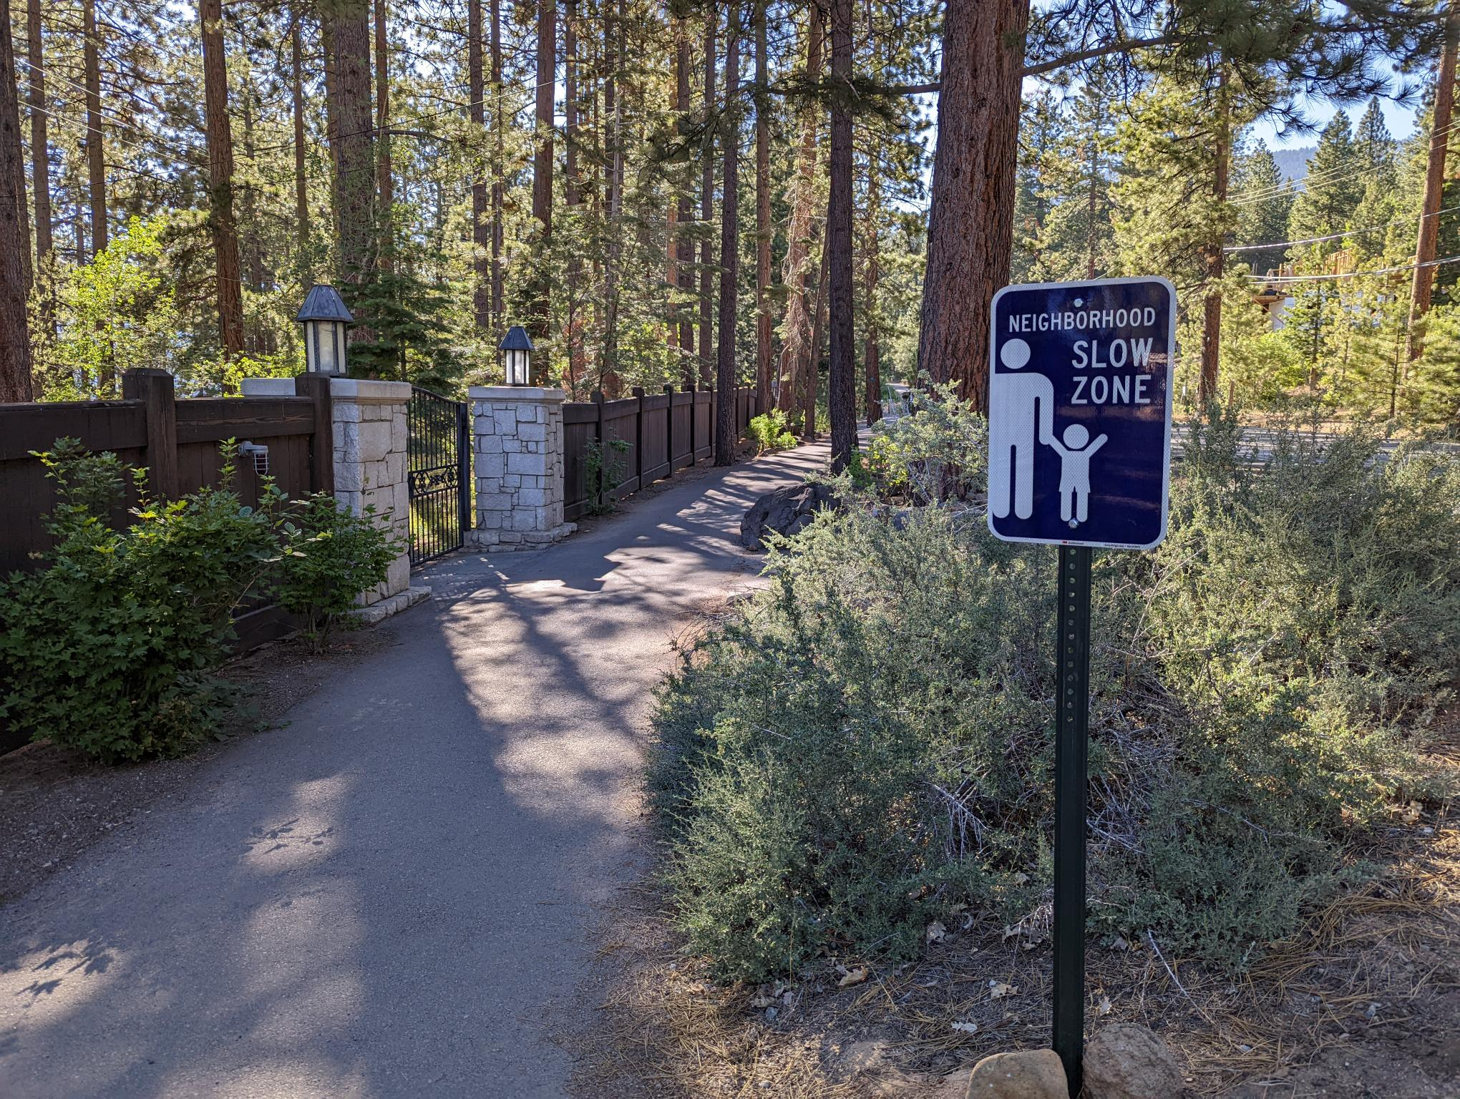
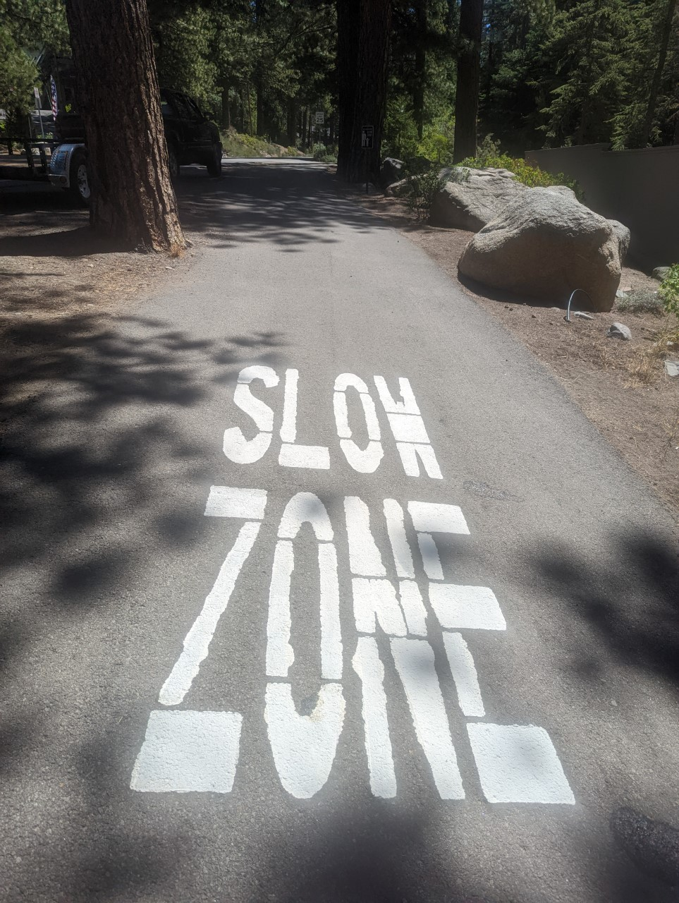
Take Care Tahoe Trail Etiquette Campaign, hosted by the Tahoe Fund.
Over 60 regional participating stakeholder groups or individuals are working to address trail etiquette, user conflicts, consistent sign messaging, and innovative solutions to address the concerns associated with multi use paths around Lake Tahoe and Truckee.

Slide 10
In Process
Data Collection
Utilize speed monitors, trail counters, and docents to better understand the actual vs. perceived occurrence of trail speeds
Installation of new messaging
Pathway stencils, sandwich boards, banners
Utilize QR codes for additional information – multi language opt.
Utilize iconography and large fonts

Slide 11
TAHOE FUND -
TAHOE/TRUCKEE MULTI USE PATHWAY PILOT PROGRAM

Slide 12
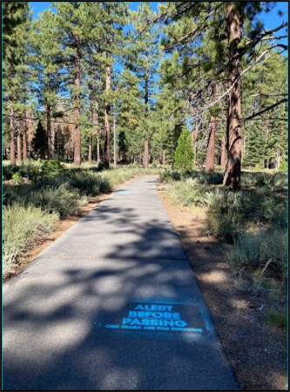
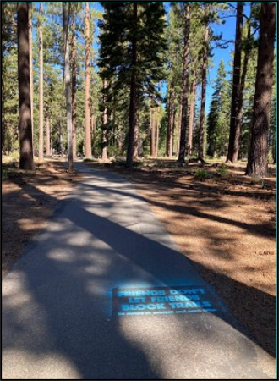
TAHOE FUND - TRUCKEE/TAHOE PILOT PROGRAM

Slide 13
SANDWICH BOARDS IN CONGESTED AREAS
Utilization of English & Spanish
QR Code directs users to trail etiquette information in multiple languages
Iconography helps to identify pathway as multi-use
Messaging targets ALL users – avoiding divisive campaigns

Slide 14
Managing Speed is Possible
Best Scenario
Trails are INITIALLY DESIGNED to mitigate speeds with curvilinear design and not straightaways. Speed bumps, pinch marks, bollards can effectively slow speeds. Some strategies are not suitable on trails that are plowed for snow removal and may be prohibitive for ADA access.
Education
Massive Education campaigns, signage, docents and pilot programs can help to educate users about the best practices for etiquette. Ideally this is a long-term plan that helps to create the local “vibe” and users tend to regulate themselves.

Slide 15
SPEED IS THE ISSUE – NOT THE MODE OF TRANSPORTATION
MANAGING MULTI-USE PATHS OVER PROHIBITION OF USE
Advancing Technology - all bicycles, skateboards, one-wheels, etc. have the capacity to exceed acceptable speed limits on pathways. What recreational or transportation device will come next?
E-bikes vs. Analog - Becoming more difficult to tell them apart. We should not prohibit all bicycle use from paths.
Multi-Use Path - We want to encourage bicycle use and alternative transportation. Our roads are congested, and parking is limited.
Safety - Sending children, families, tourists and commuters into our busy streets would require widened streets with improved bicycle lane options.
Regional Continuity - Long term planning looks to a multi-use path around Lake Tahoe/Truckee, incorporating bicycle lanes through future areas of development. Continuity of policy and etiquette messaging is necessary.

Slide 16
Thank you

