Slide 1
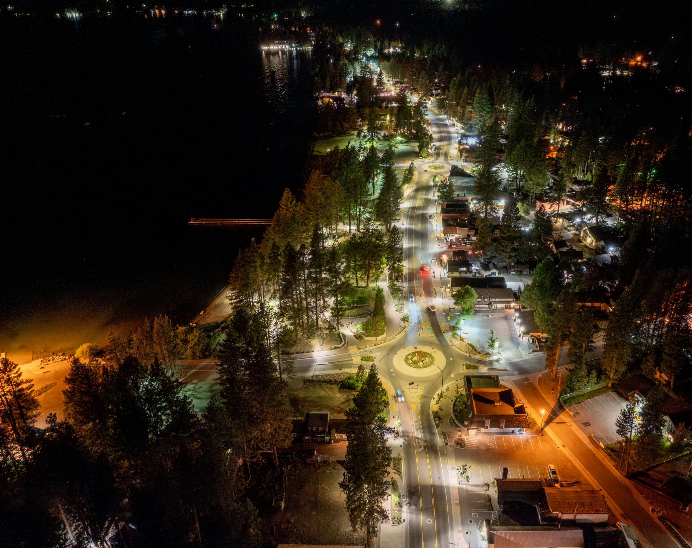
Connections 2050: Regional Transportation Plan/Sustainable Communities Strategy
NTBA EVC
September 9, 2024
Notes:
Regional Transportation Plan is updated every four years and it’s comprehensive transportation and funding plan that spans over the next 25 years. So we’re looking out to 2050 and envisioning what the transportation system could look like. And then we also have to develop financial projections and figure out how we could actually pay for all of these great projects, so it is rooted in reality and what’s actually feasible for the Basin in the next 25 years

Slide 2
Planning Approach: Transportation Goals
Notes:
These are our six primary goals, which are guiding this plan update. Every transportation project meets at least one of these goals:
Safety:
Increase safety and security for all users of Tahoe’s transportation system.
Environment:
Protect and enhance the environment, promote energy conservation, and reduce greenhouse gas (GHG) emissions.
Mobility:
Enhance and sustain the connectivity and accessibility of the Tahoe transportation system, across and between modes, communities, and neighboring regions, for people and goods.
Performance:
Provide a dynamic, reliable, and efficient transportation network through coordinated operations, system management, technology, and monitoring.
Prosperity:
Foster economic well-being, sustainability, and community vitality by optimizing the movement of goods and people and advancing equitable transportation solutions in town centers and throughout the region.
Resilience:
Provide for the preservation and sustainability of the existing transportation system by actively identifying and pursuing new transportation funding and by performing maintenance activities that support climate resiliency, water quality, and safety.

Slide 3
Planning Approach: Public Input
9,724 participants reached through presentations, workshops, meetings, webinars, and pop-up events
6,220 participants reached through surveys, including:
Tahoe Regional Trails Plan Survey
Transportation Equity Study Survey
SR89 Trail Feasibility Study Survey
Transportation Safety Survey
Destination Stewardship Survey
Transit Passengers and Unmet Transit Needs Surveys
Notes:
2021-present

Slide 4
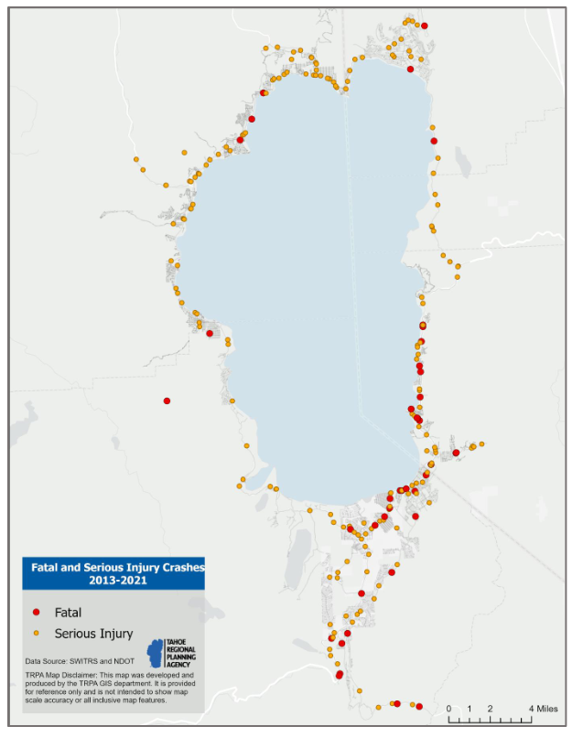
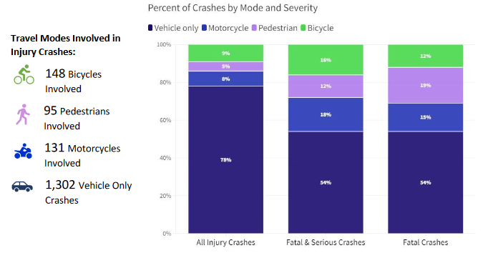
Planning Approach: Data Driven
Notes:
RTP strategies are tailored to specific trip types and travelers

Slide 5
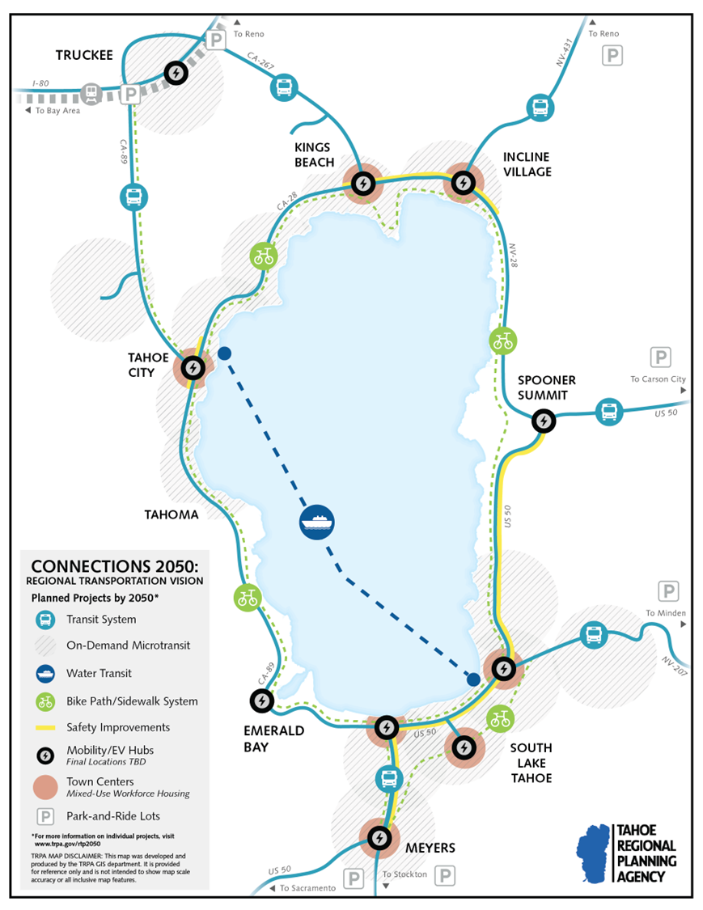
2050 Vision
Notes:
We thought it might be easier and more fun to show the 2050 transportation system through the eyes of one of it’s users
Introduce Billie. Billie will walk through 2050 vision for Tahoe transportation

Slide 6
Transit: The Vision
FREE!
Notes:
This is our friend Billie the Bear. The year is 2050 and today is Billie’s friend, Ezra the Eagle’s birthday, so she is traveling from Tahoe City to South Lake Tahoe to spend the day with him.
Billie takes TART Connect, a free microtransit service, from her den in the mountains down to the nearest Tahoe City bus stop. She looks up and sees that the next bus to South Lake Tahoe is coming in 10 minutes. It’s easy for her to know when the next bus is arriving and where it’s heading thanks to the electronic boards showing real-time estimated arrival times and destinations. It’s free to ride the bus, so when a sleek electric bus pulls up right on time, she boards alongside several other passengers.
Transit Vision: Free to the user, frequent, accessible, reliable. Connected around the Region, real-time info, electric buses, safe and accessible bus shelters

Slide 7
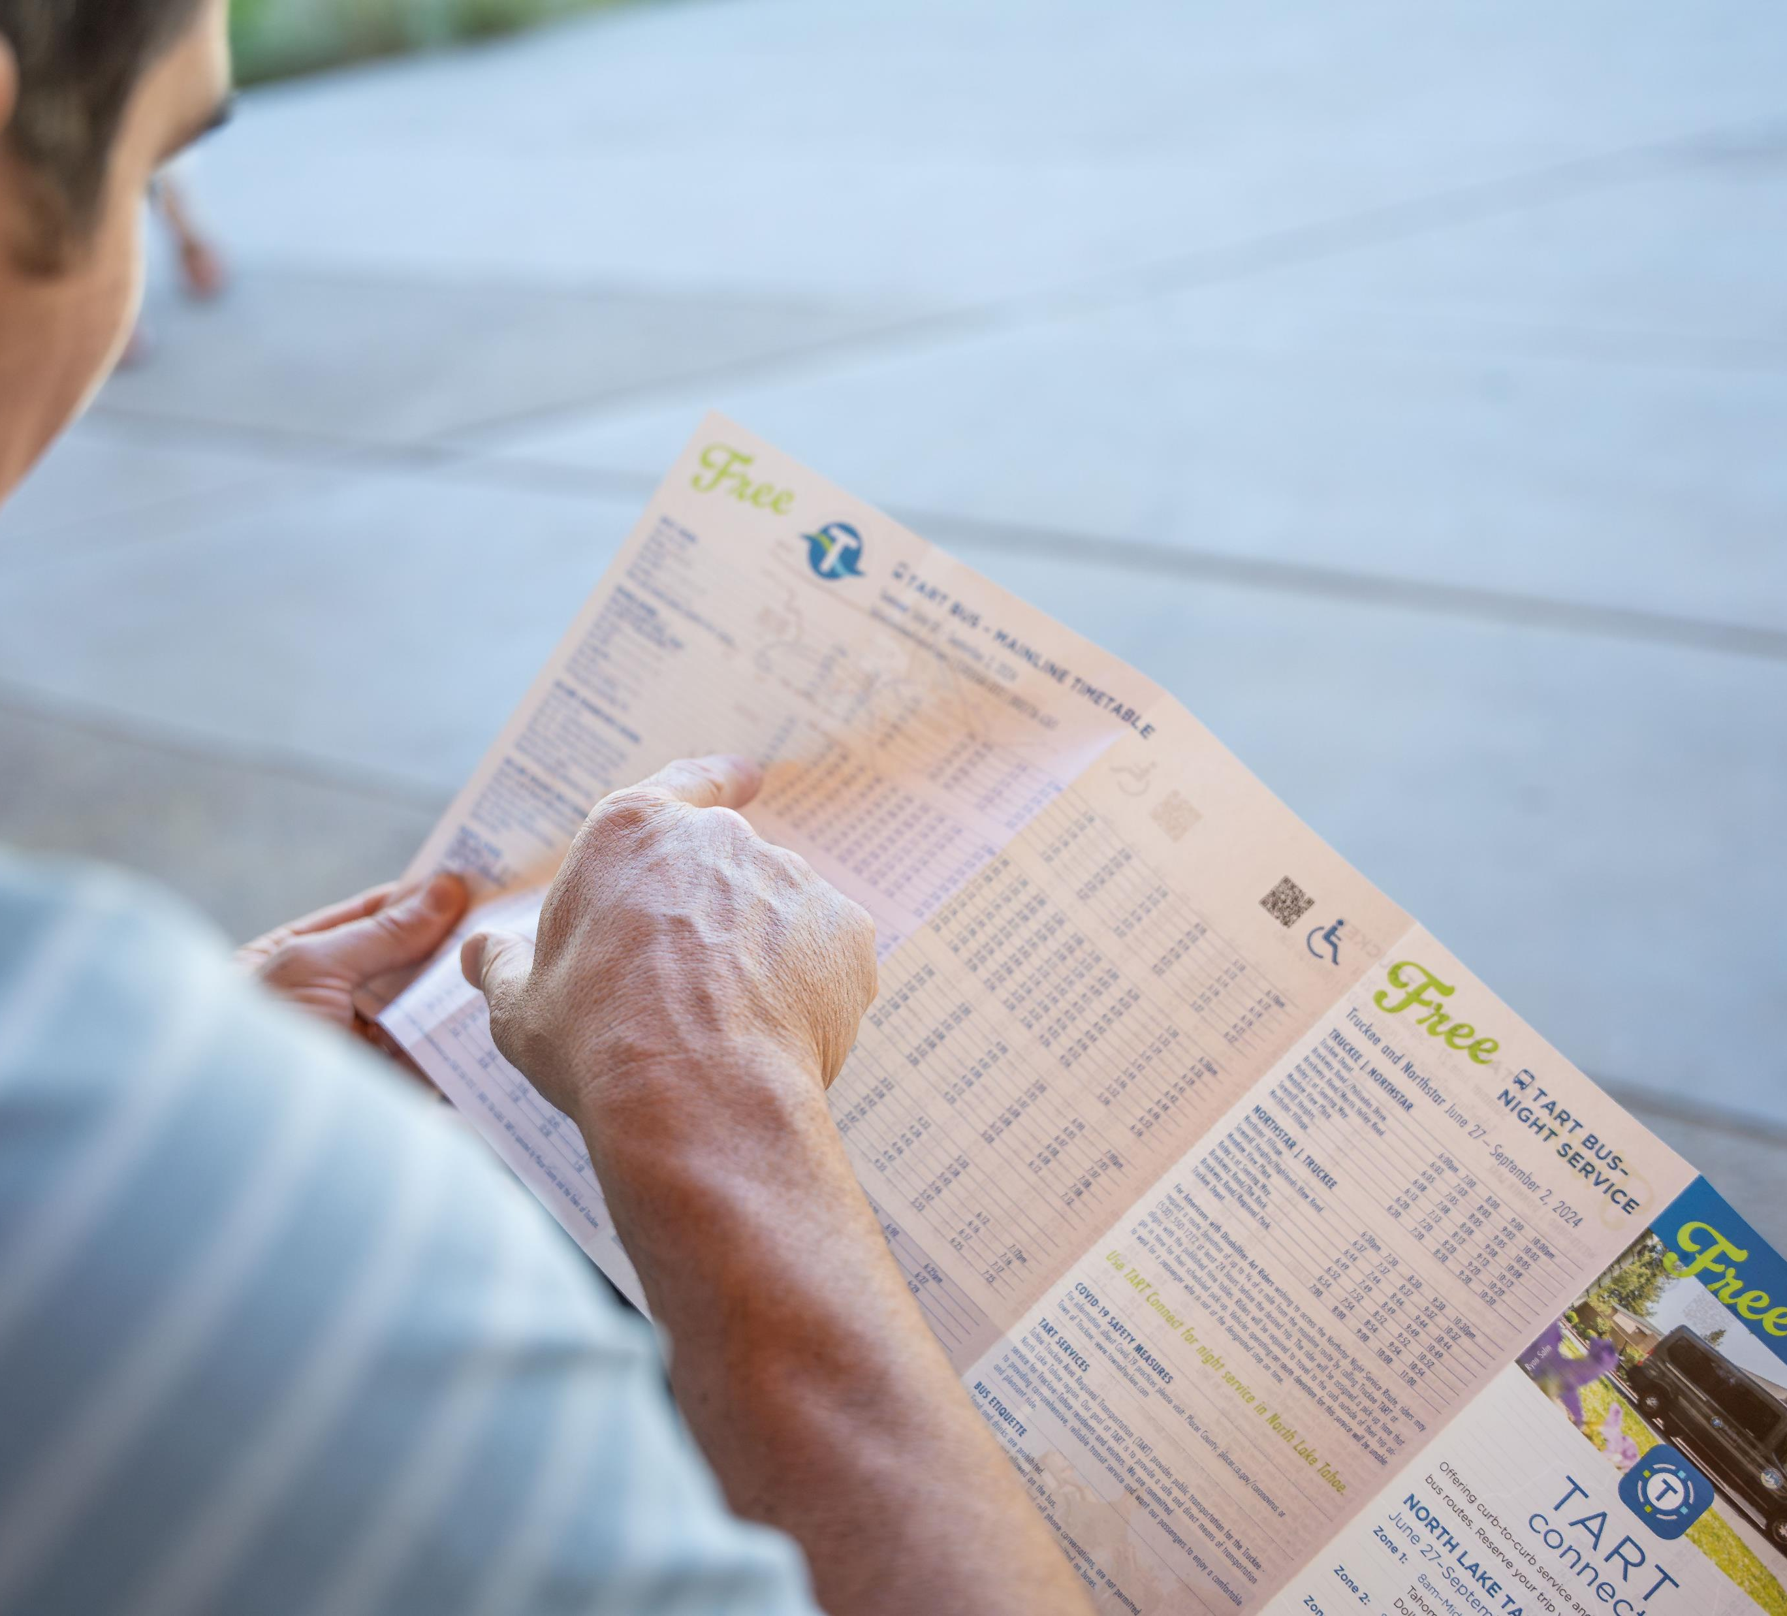
Transit: The Reality
Local transit is free
Microtransit is expanding
BUT….
No connections between North & South Shore
Routes are not frequent or reliable
We heard people want more frequent transit

Slide 8
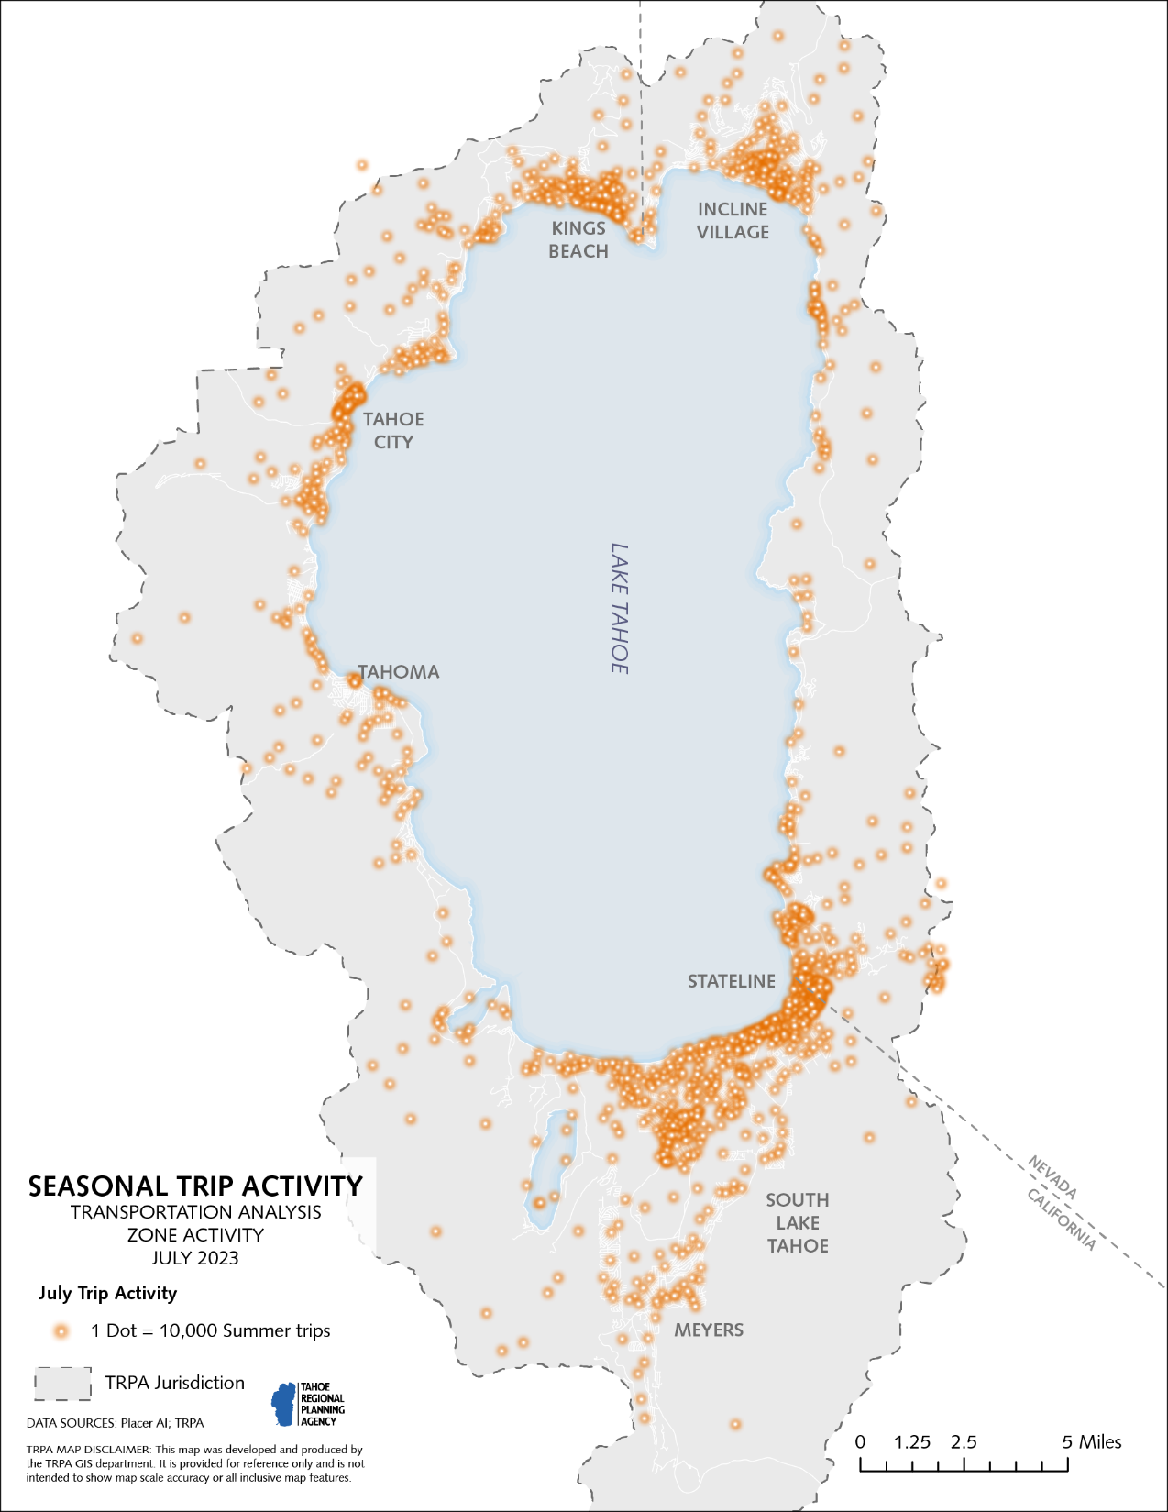
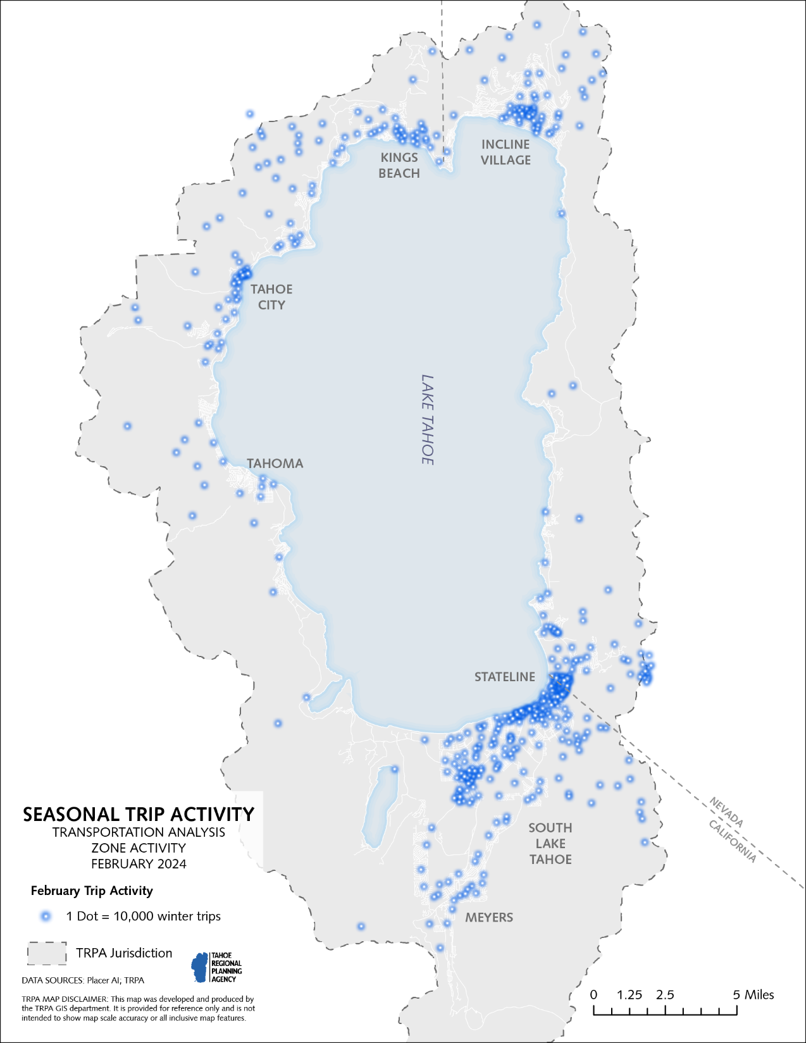
Notes:
Discuss different transit needs for different seasons – recreation-based transit will cater to different seasonal needs. Explain how this data informs RTP decision-making
Transit will be frequent year-round in town centers

Slide 9
Towns: The Vision
Notes:
Billie’s bus pulled into the transit center at the South Lake Tahoe Y, a vibrant town center. Ezra didn’t own a car, but it was an easy to walk to the restaurant from both his house and the transit center. Quaint shops, local markets, and charming cafes lined the streets, creating a bustling community where residents and visitors alike could walk around safely and visit local businesses. Thanks to TRPA’s policy changes, affordable housing like Ezra’s was prioritized in town centers so that he could get to grocery stores, restaurants, and medical care without a car.
Towns vision: Town centers are walkable, bikeable, and have mixed-use development with affordable/workforce housing

Slide 10
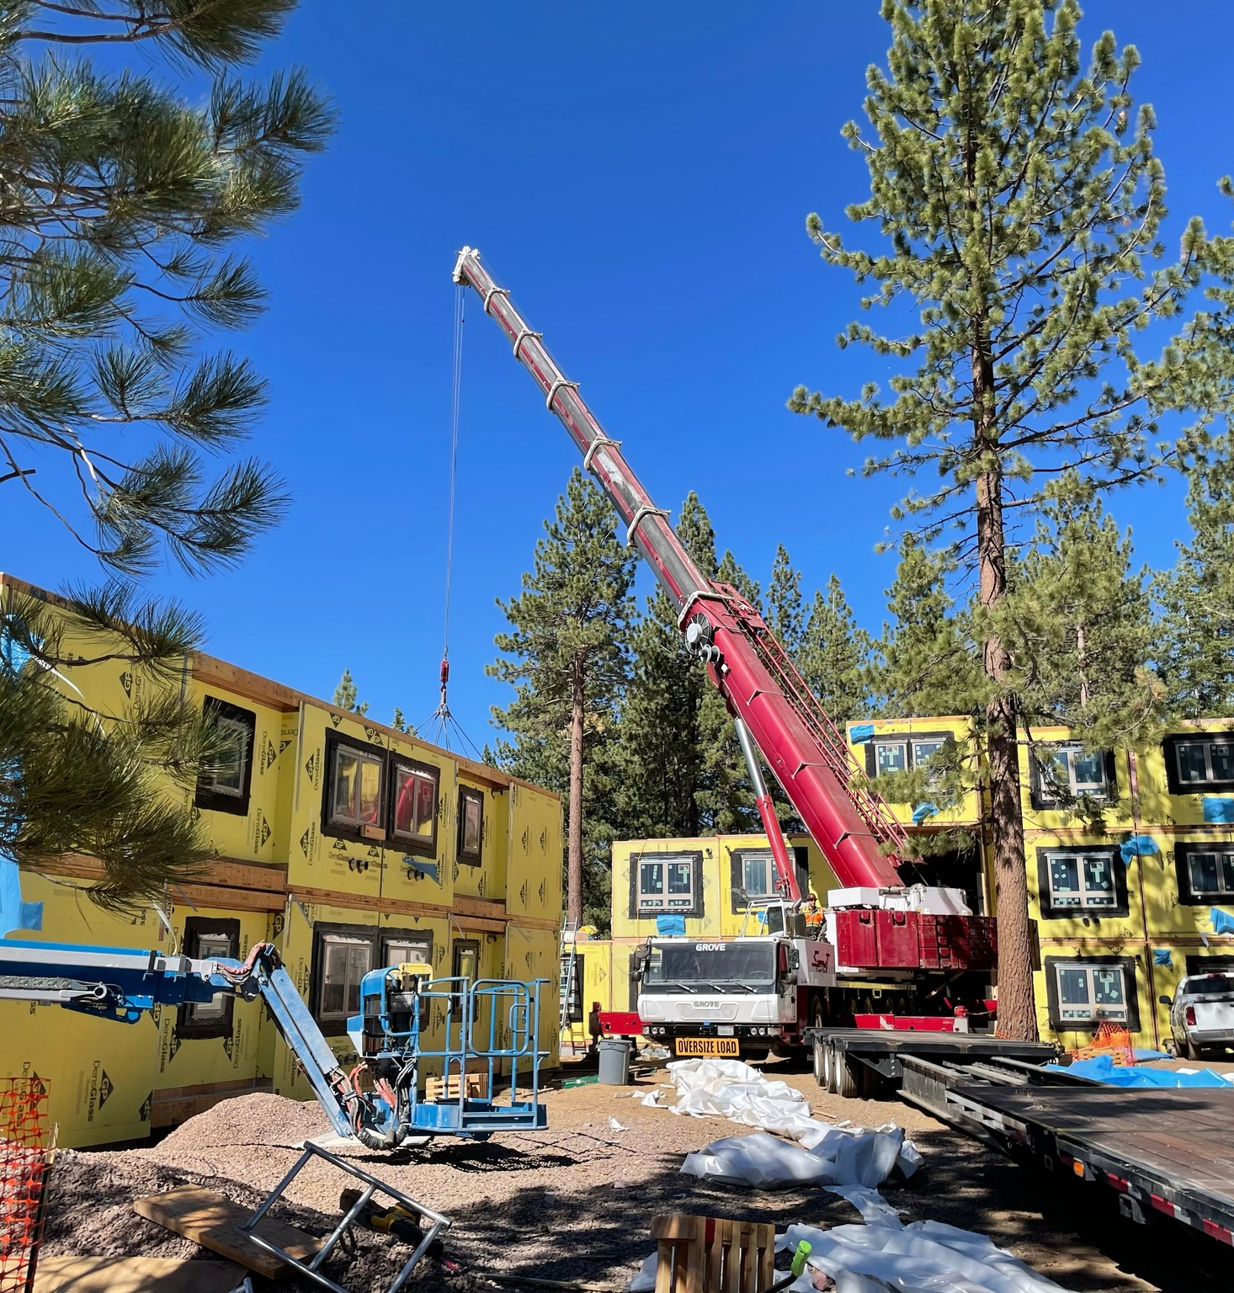
Towns: The Reality
We heard people want more affordable housing
Affordable housing is under construction
Mobility hubs are being planned/built
BUT….
Not all Tahoe workers can afford to live in the Basin
More mobility hubs are needed to truly connect the region

Slide 11
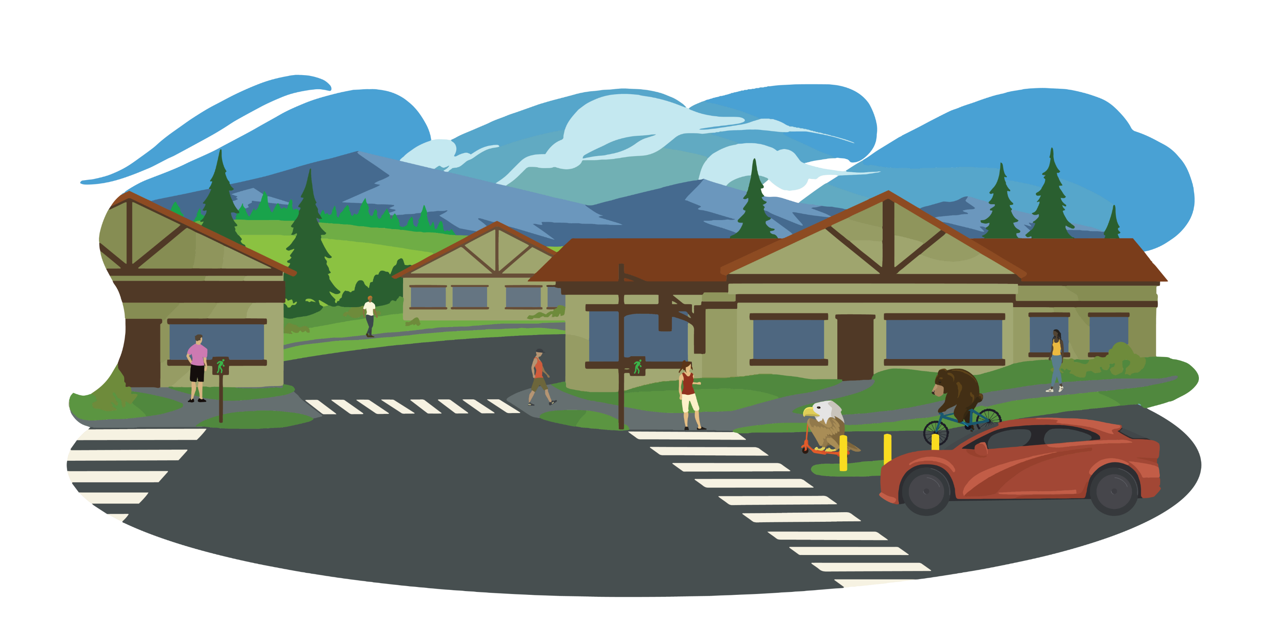
Safety: The Vision
Notes:
After lunch, Billie and Ezra decide to meet their friend Lola the Lahontan cutthroat trout at a nearby trailhead for a hike. Billie rents a bike from a nearby shop, and Ezra uses an app to unlock an e-scooter. Pedestrian-friendly crossings plus separated sidewalks and bike paths, and responsible speed limits make it safer for walkers, bikers, and drivers to safely get around. There has not been a serious injury or fatality on Tahoe’s roadways since 2045. Even in the winter, pedestrians and cyclists stays safely separated from vehicles thanks to regularly plowed sidewalks and paths. Thanks to this infrastructure, Billie and Ezra cruise through town worry-free.
Safety vision: pedestrian and bicycle facilities and crossings are built into streets and all users feel safe traveling by any mode. There are zero roadway fatalities

Slide 12
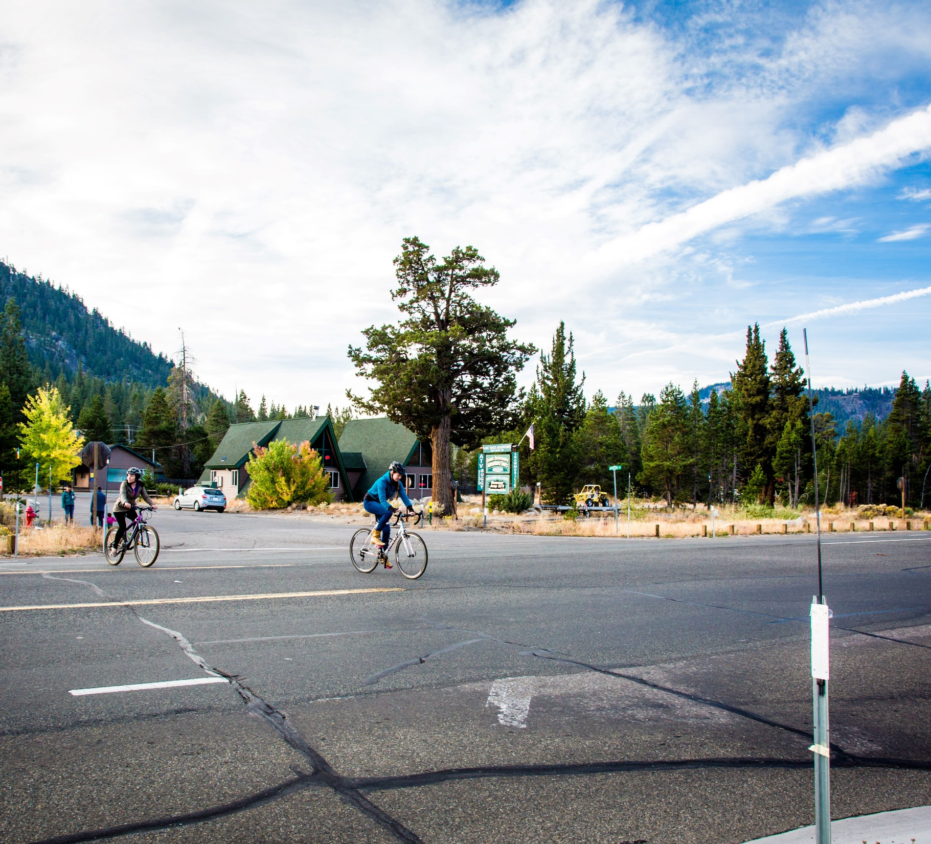
Safety: The Reality
Tahoe's fatality rate is lower than average
200 miles of bike and pedestrian facilities have been added/improved since 1997
BUT...
Tahoe roads average 5 fatalities and 20 serious injuries annually
105 miles of road are high stress for bicyclists
We heard people feel less safe walking, biking, or using shared mobility (e-scooters)

Slide 13
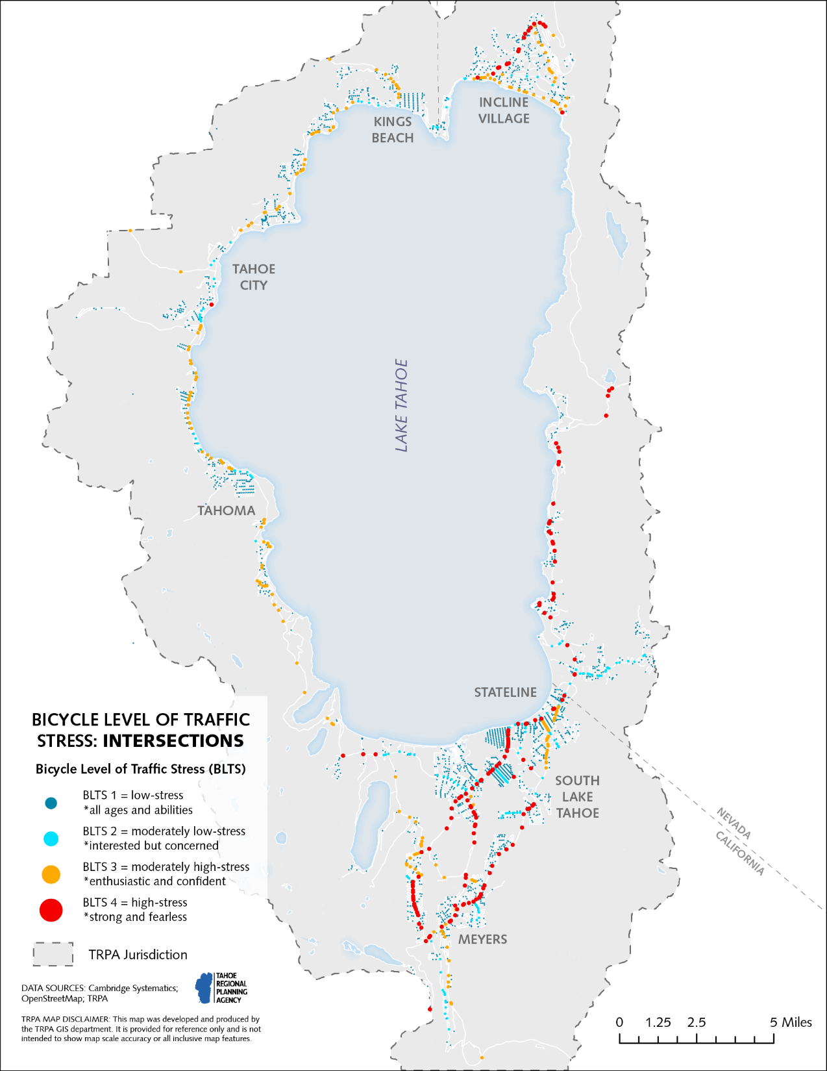
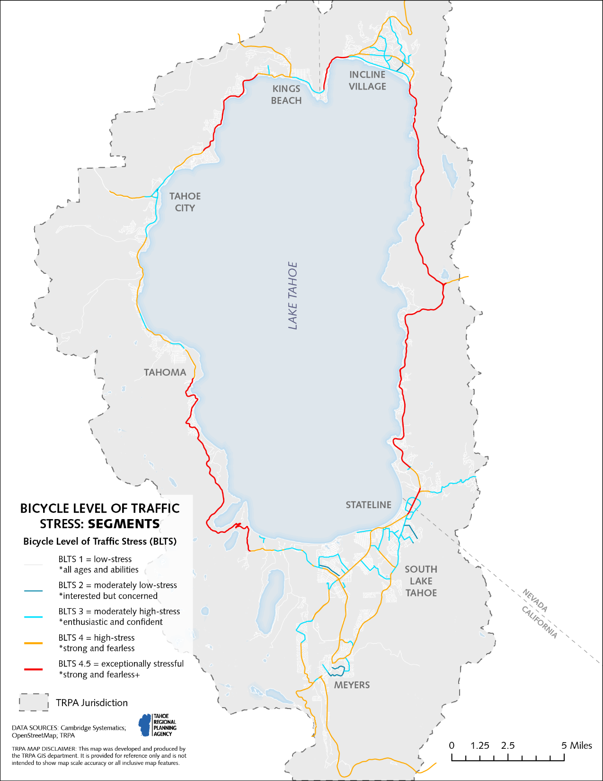
Notes:
Discuss how BLTS analysis informs RTP decision-making

Slide 14
Trails: The Vision
Notes:
Billie and Ezra ride their bike and e-scooter from the Y in SLT and meet Lola the Lahontan cutthroat trout at the trailhead to Tahoe Mountain, which features disabled parking, along with serviced trash cans and bathrooms. Lola, Billie and Ezra enjoy a lovely afternoon winding through towering pines to breathtaking views of Lake Tahoe and Desolation Wilderness.
Trails vision: connected bike path around the lake. Connections to trailheads and beaches with paths that connect to town centers so that people can safely bike or walk anywhere they need to go.

Slide 15
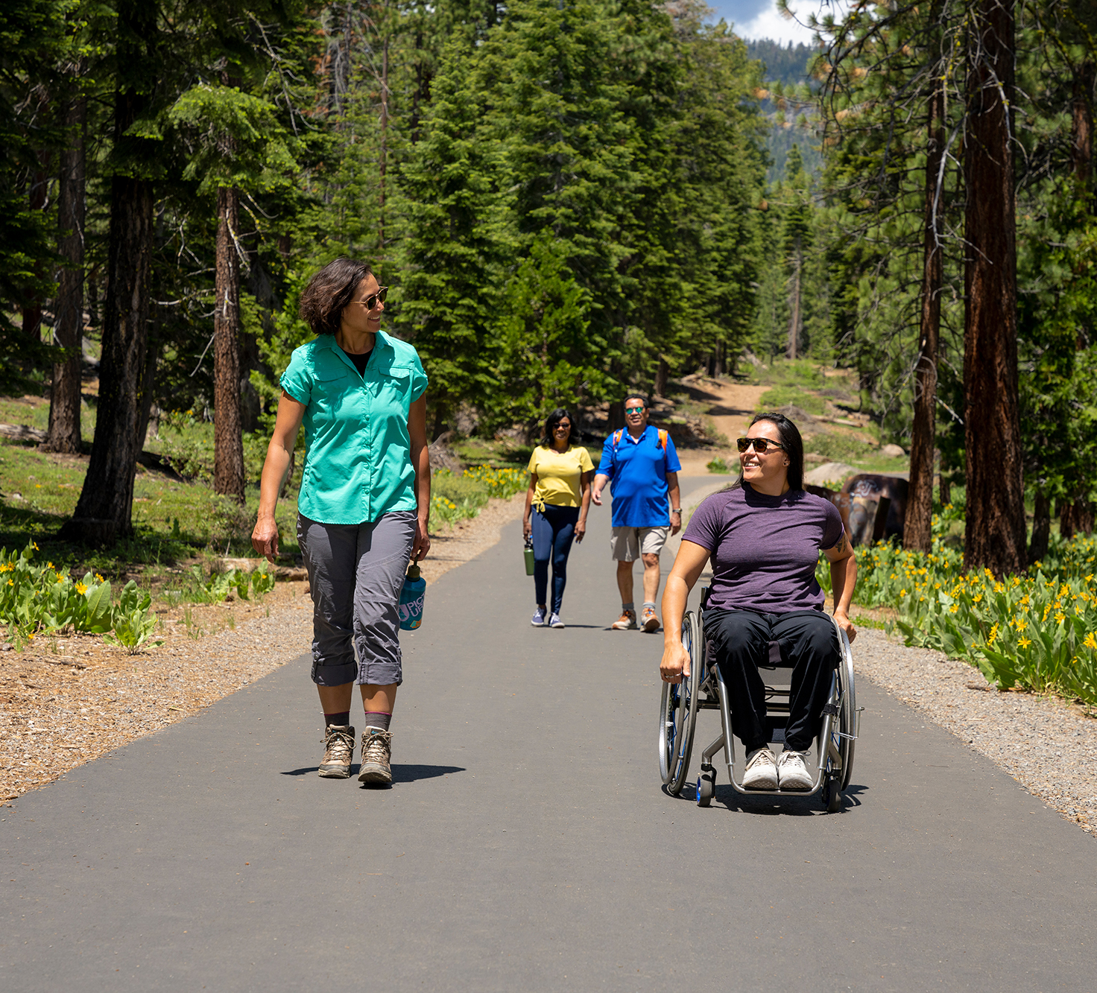
Trails: The Reality
61 miles of shared use paths
46 miles of bike lanes
29 miles of sidewalks
BUT….
0 miles of Class 2b (buffered) & 4 bikeways
55 miles of Class 1 paths and 27 miles of sidewalks and complete streets are planned, but design and construction are expensive and lengthy
We heard people want safer on-street facilities

Slide 16
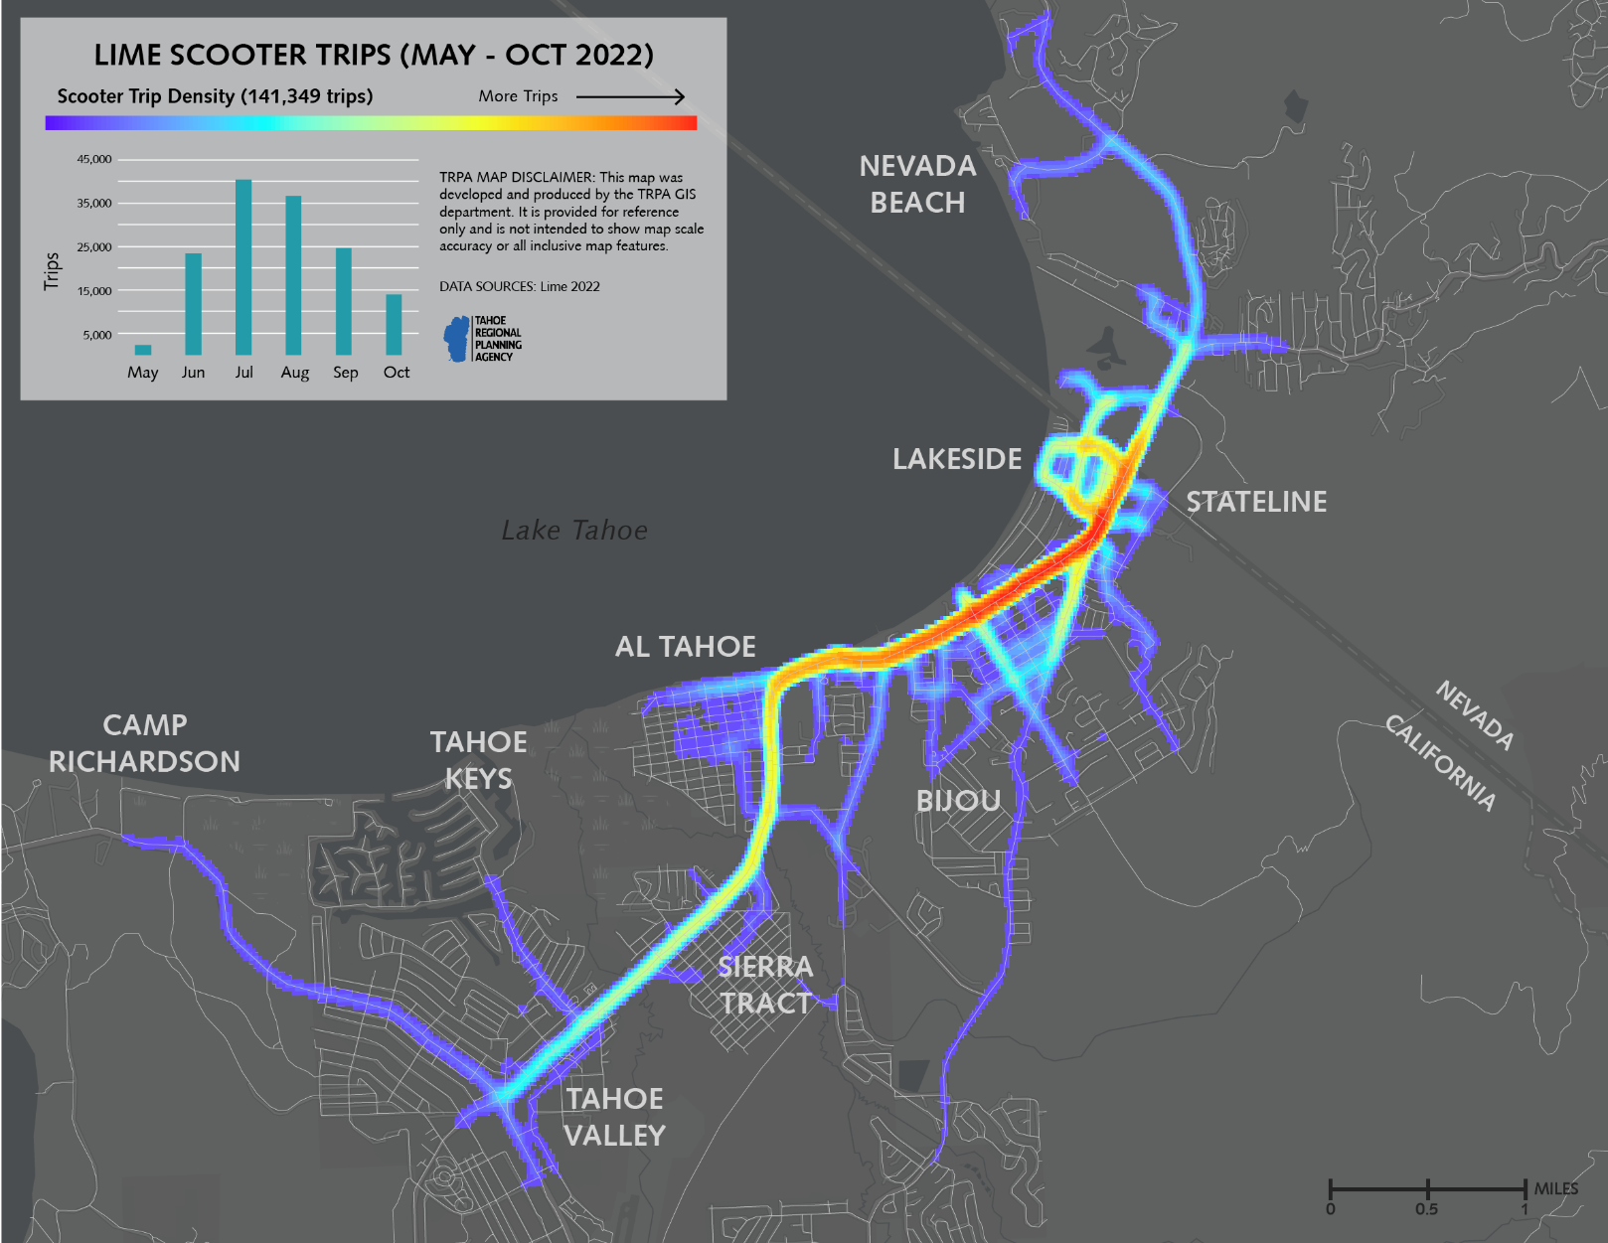
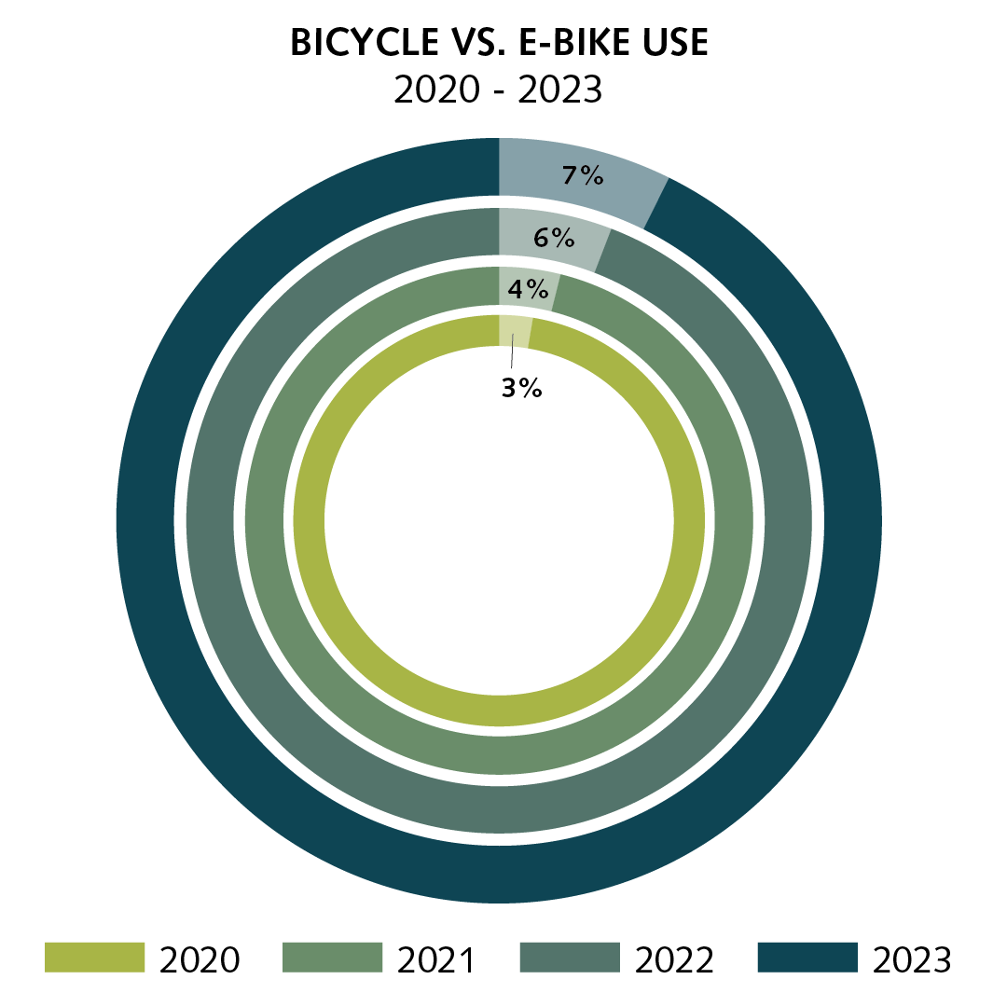
Notes:
Explain how this data helps inform RTP decision-making and how e-mobility can be accommodated in the future

Slide 17
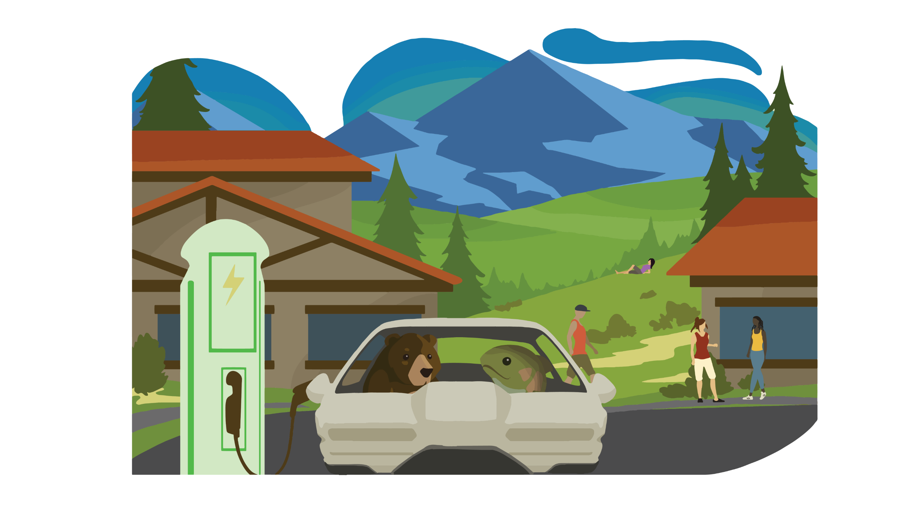
Technology: The Vision
Notes:
When they get back to the trailhead, it’s well into afternoon and Billie needs to get back to her den on the other side of the lake. Lola also lives near Tahoe City and offers her a ride in her electric vehicle. Billie checks Google Maps and sees it’s just as fast to take public transit as it is to take a private vehicle. Now that Tahoe has coordinated signals and bus-only lanes, it’s often cheaper, easier, and more convenient to take public transit. But she opts for extra time and company with Lola and decides to carpool back to the North Shore. Lola finds a nearby electric vehicle charging station, and once they’re charged up they cruise back to the North Shore.

Slide 18
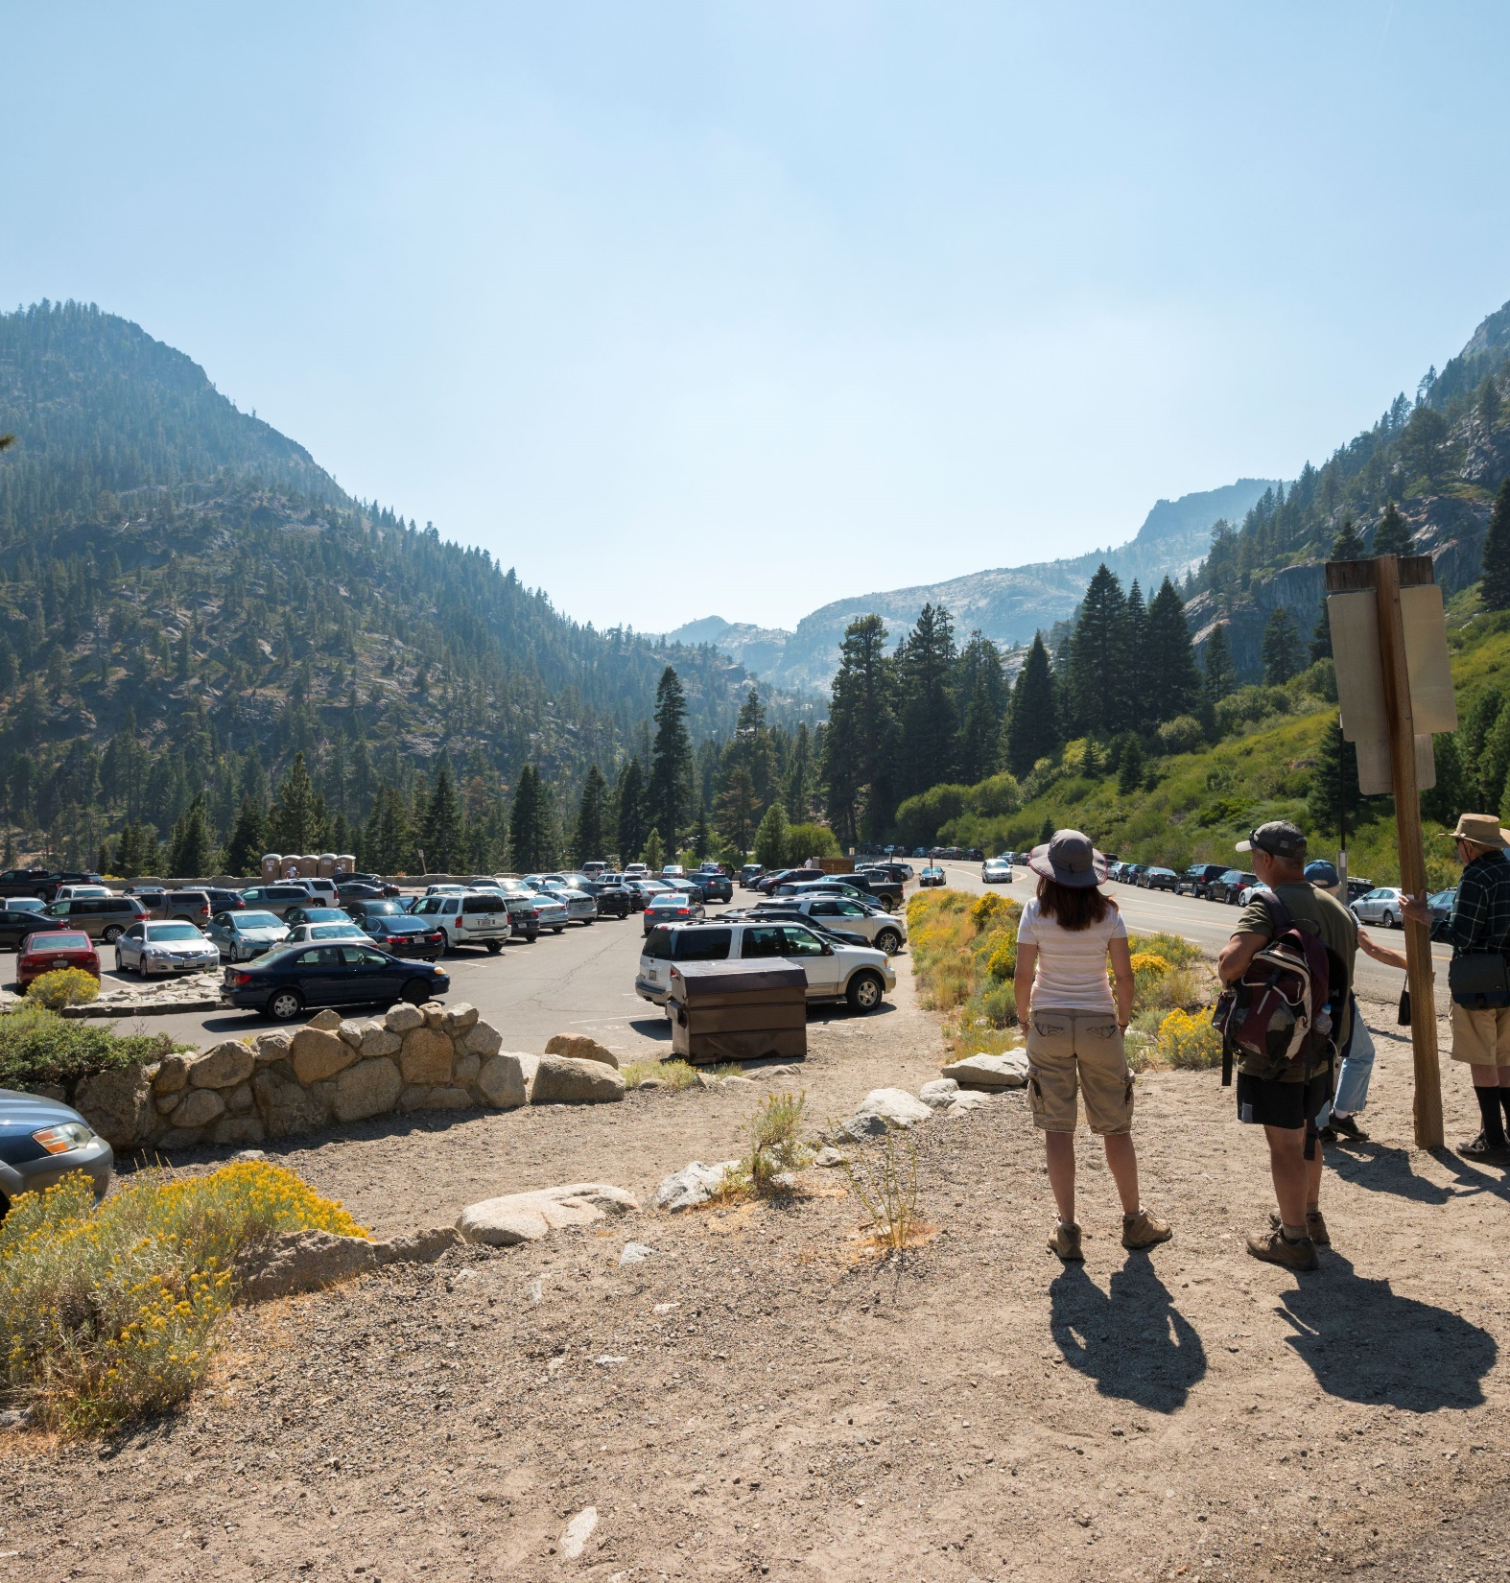
Technology: The Reality
We heard people want more broadband around the Lake
New parking reservation systems
EV charging is expanding
BUT….
Recreation-based parking is mostly a free-for-all
EV charging is still minimal
Gaps in cellular coverage
Notes:
Insert ev photo

Slide 19
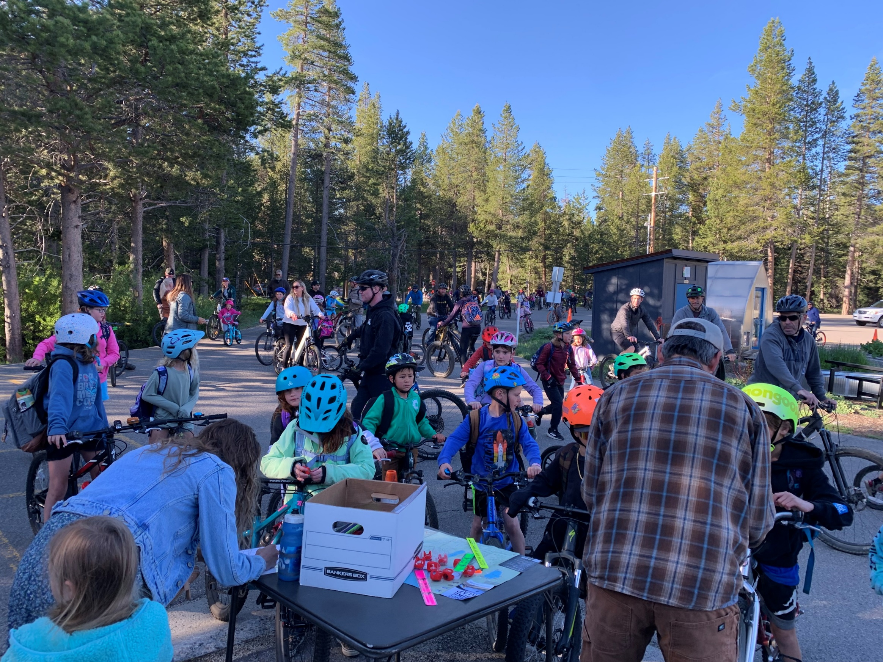
Next Steps
Timeline
Spring 2025 – more opportunity to comment!
Summer 2025 – TRPA Board consideration
Sign up for TRPA Transportation E-news
Funding outlook:
$2 billion+ over 25 years
~$100 million/year

Slide 20
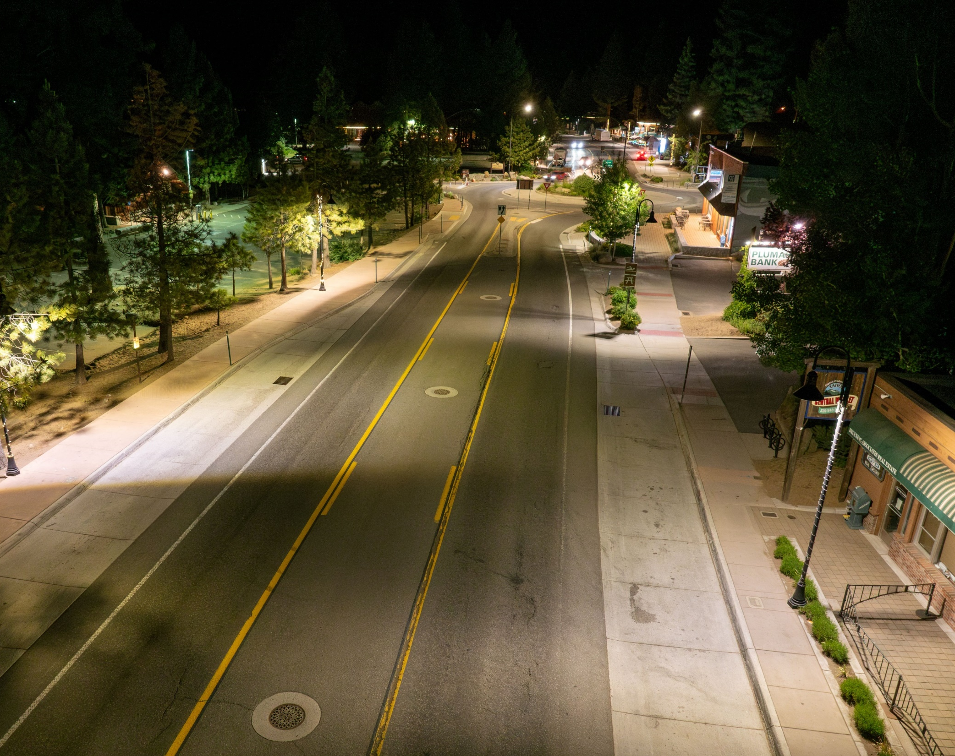
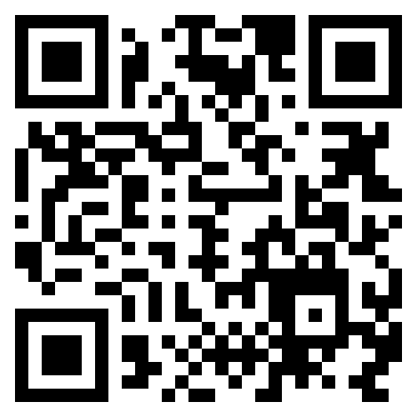
Questions?
We want your feedback!
Take our survey at trpa.gov/connections2050
Contact:
rtp@trpa.gov

