Slide 1
Climate Action Planning
Sustainability Department presentation to
Incline Village Citizen Advisory Board (CAB)
Monday, July 22, 2024

Slide 2
Meeting the needs of the present
without compromising the ability
of future generations
to meet their own needs

Slide 3
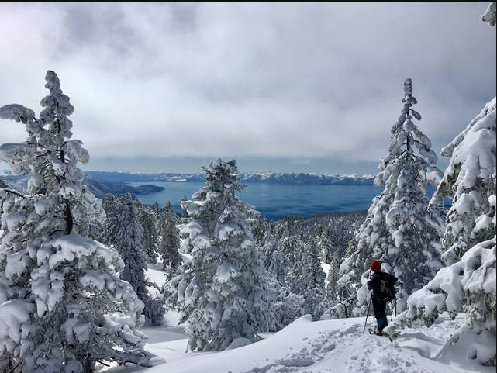
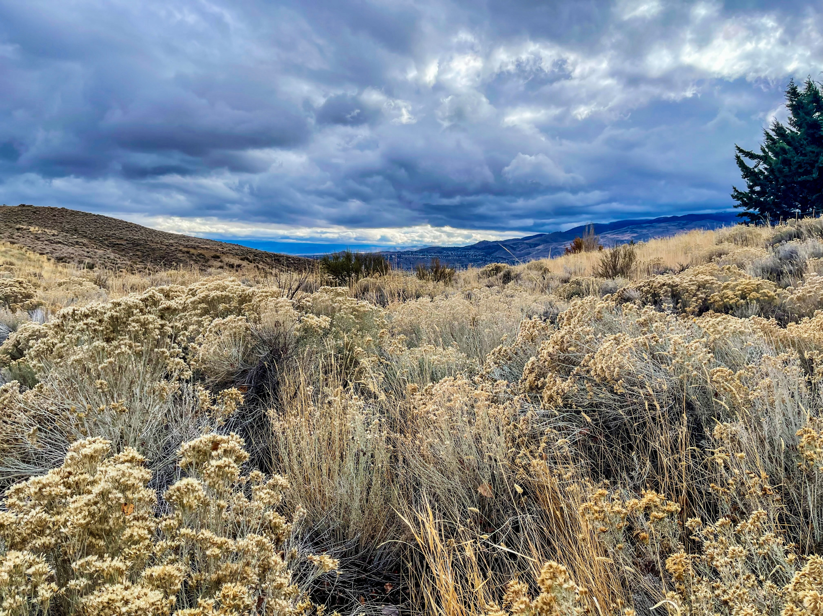
CLIMATE
ENVIRONMENT
RESILIENCE
Long-term (usually at least 30 years) regional or even global average of temperature, humidity, and rainfall patterns over seasons, years, or decades.
All the physical surroundings on Earth. The environment includes everything living and everything nonliving. Nonliving: atmosphere, hydrosphere (water), lithosphere (outer layer of Earth).
The capacity of a community, business, or natural environment to prevent, withstand, respond to, and recover from a disruption.

Slide 4
Net Zero
2050

Slide 5
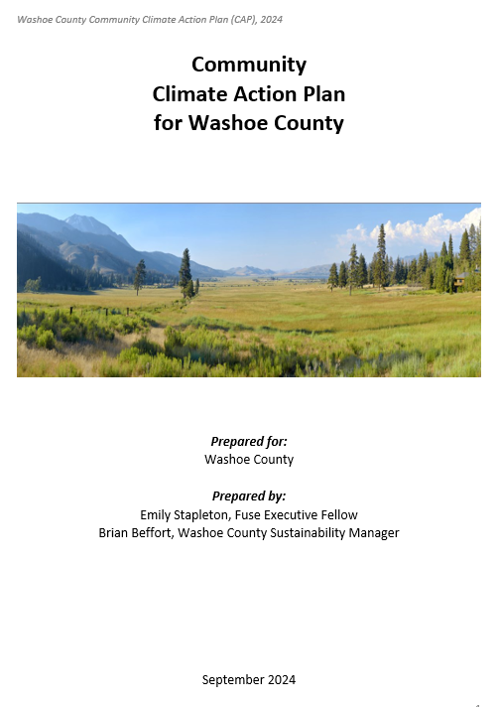
We’re creating a Climate Action Plan
a strategic document that outlines a collection of measures and policies to reduce greenhouse gas (GHG) emissions and actively address climate challenges.
It defines reduction goals based on local priorities and
develops a framework with tactical activities to help achieve those goals.”
A climate action plan also aims to address inequalities
in the way the effects of climate change are being distributed.”

Slide 6
Our health goals
Limit severe weather
Limit heat health risks
More stable growing seasons
Less acidic oceans
Wildlife conservation
Healthier average
Temperatures
Less risks for asthmatics
Less impact for those with allergies
Fewer adverse cardiovascular impacts
More opportunities to enjoy the outdoors
Improved
Air Quality

Slide 7
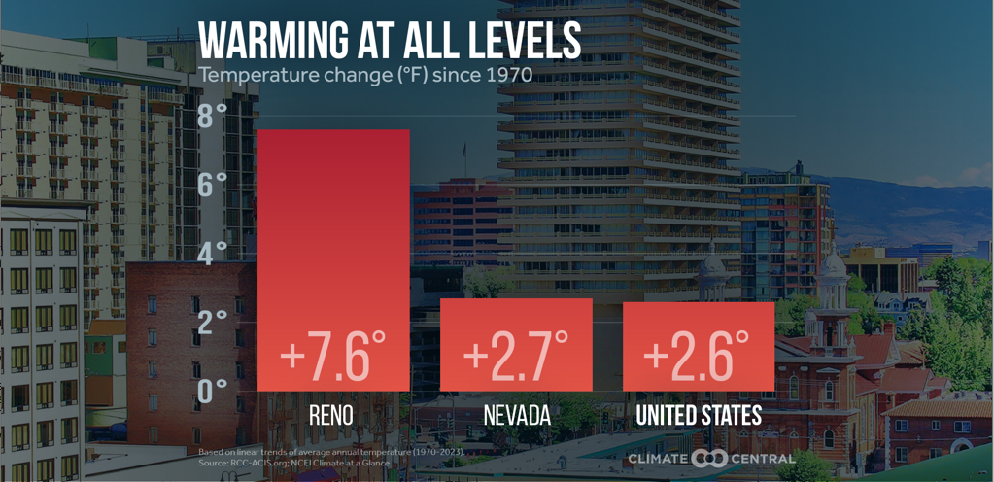
Reno is the country’s fastest warming metro

Slide 8
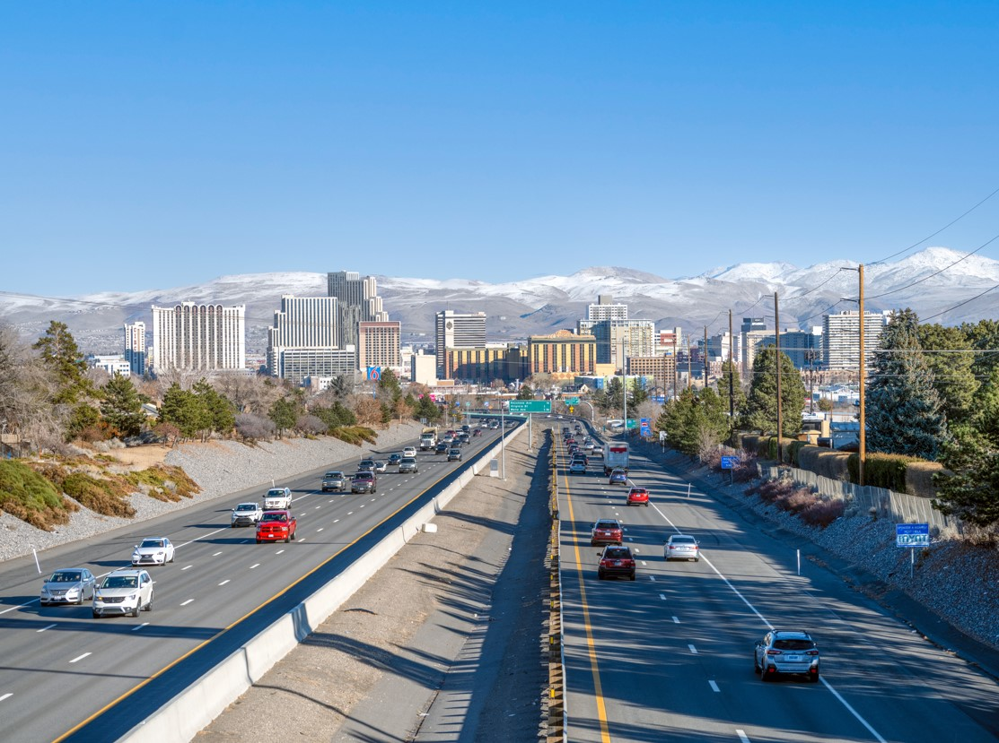
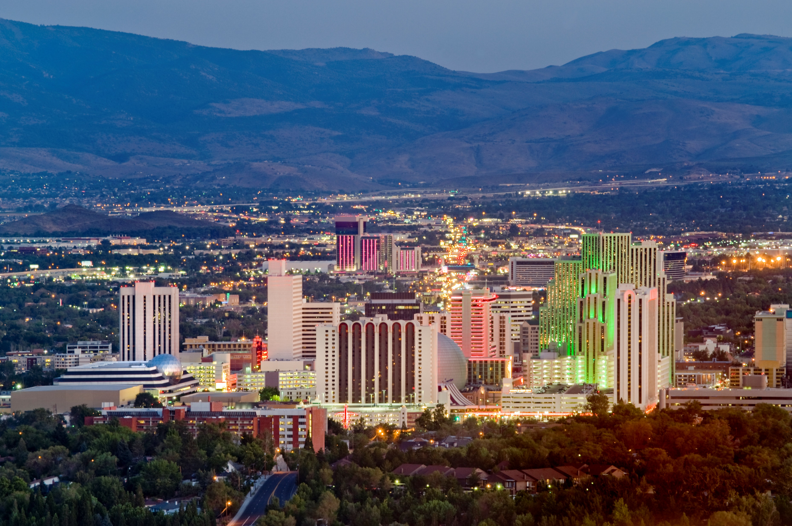
Everyday activities contribute to warming
Transportation
Solid Waste
Potable Water
Buildings
Wastewater
Agriculture, Forestry,
Other Land Use (AFOLU)

Slide 9
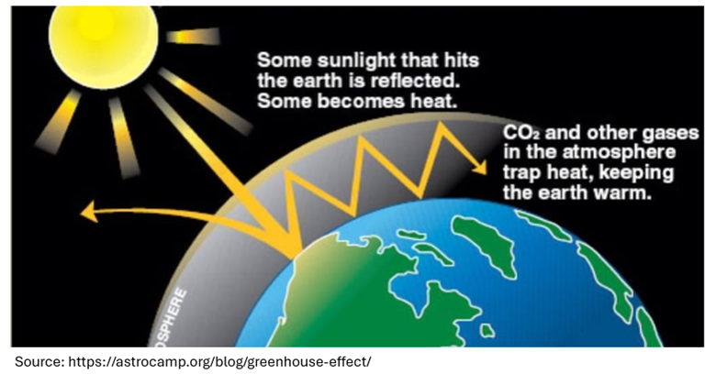
Trapped greenhouse gases (GHGs) cause warming

Slide 10
BUILDINGS
TRANSPORTATION
WATER & WASTE
~54%
~27%
~14%
Renewable energy
Electric appliances
Insulation
Development locations
Your ideas?
Walking
Biking
Transit
Carpools
Trains
Telecommuting
Land use & planning
Electric Vehicles
Your ideas?
Reuse of goods
Rent / borrow / gift
Compost
Conserve Water
Your ideas?
*Preliminary 2021 Washoe County Community GHG Emissions

Slide 11
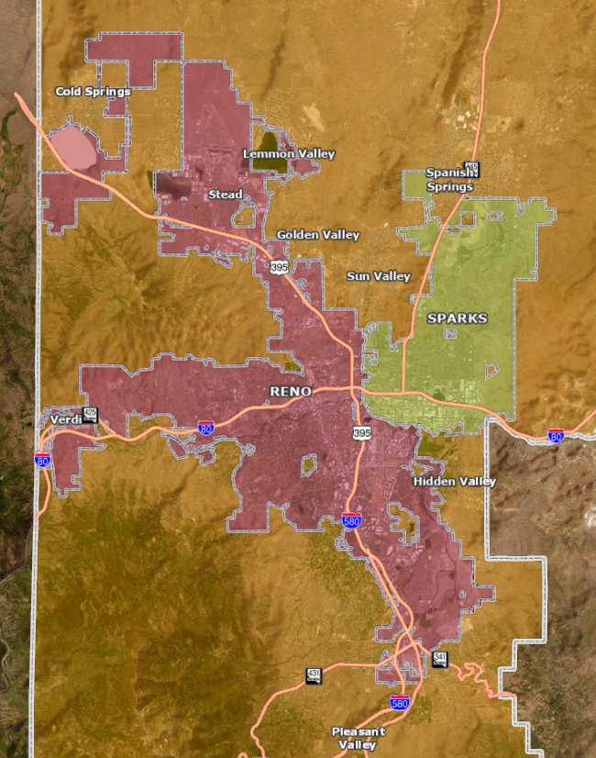
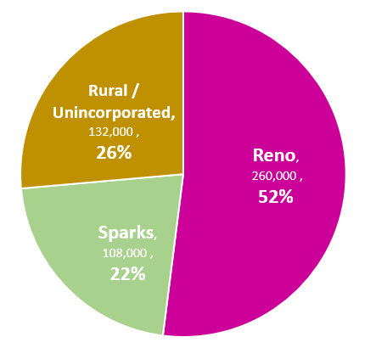
Washoe County, geography
26% live in Rural / Unincorporated
2021 uspopulation.org
6,600 square miles
Washoe Regional Mapping System (washoecounty.us)

Slide 12
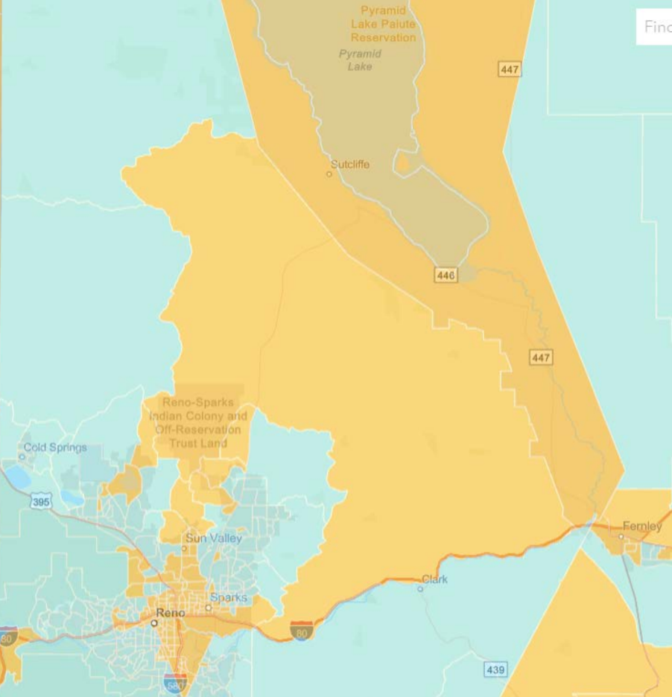
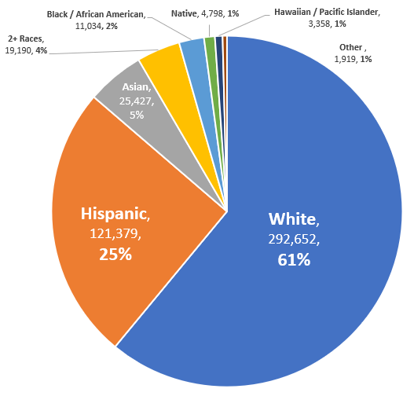
Washoe County, population (479k)
Areas around Reno, Sparks, and Pyramid Lake have high Environmental Justice concerns
25% Hispanic
Source: https://ejscreen.epa.gov/mapper/
2021 uspopulation.org
Notes:
Washoe County
Environmental Justice Map (EPA)
Reno, Sparks, Sun Valley,
Reno-Sparks Indian Colony,
Pyramid Lake Paiute Reservation
Particulate Matter 2.5
Ozone
Diesel Particulate Matter
Air Toxics Cancer Risk
Air Toxics Respiratory Hazard Index
Toxic Releases to Air
Traffic Proximity
Lead Paint
RMP Facility Proximity
Hazardous Waste Proximity
Superfund Proximity
Underground Storage Tanks
Wastewater Discharge
% Low Income
% Unemployed
% Limited English Speaking
% Less than High School Education
Low Life Expectancy

Slide 13
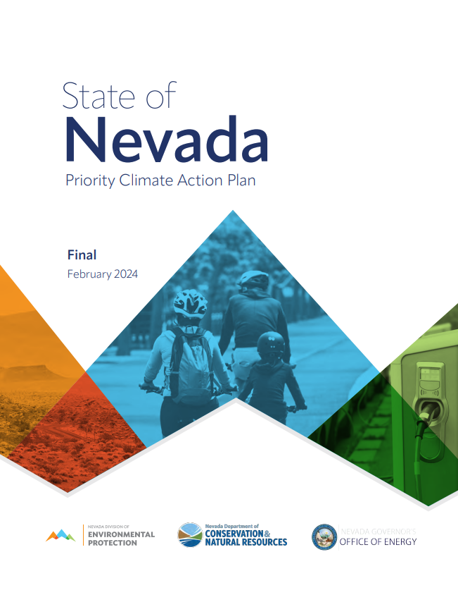
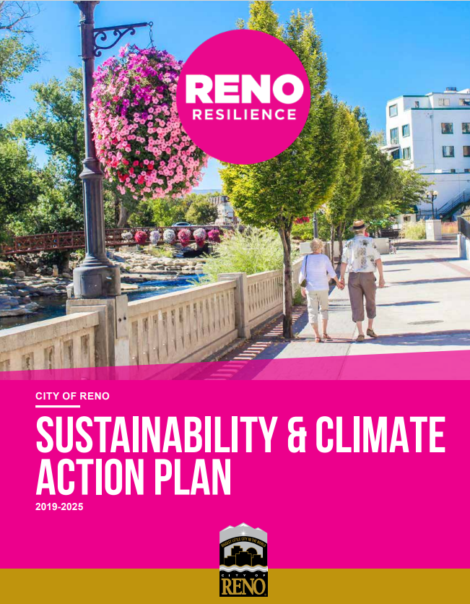
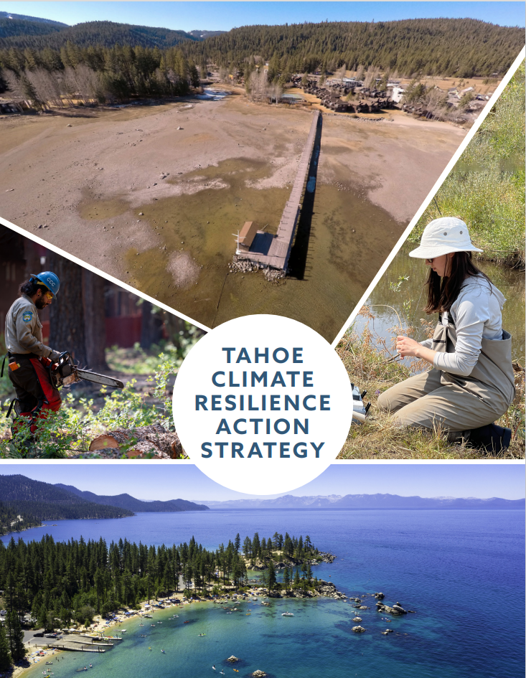
We work in community
Notes:
Tahoe Climate Resiliance Action Strategy 2022 (trpa.gov)
637050147692830000 (reno.gov)
23121 Nevada - Final PCAP-Design Lite (nv.gov)

Slide 14
We appreciate your feedback and participation
August 2024
July 2024
Take the
Clean Air survey
Review Washoe County’s
draft Climate Action Plan
Take the survey and sign up for Washoe County Sustainability emails at washoecounty.gov/sustainability

Slide 15
Thank you
Brian Beffort, Sustainability Manager
Emily Stapleton, Fuse Executive Fellow, Climate
washoecountysustainability@washoecounty.gov

