Slide 1
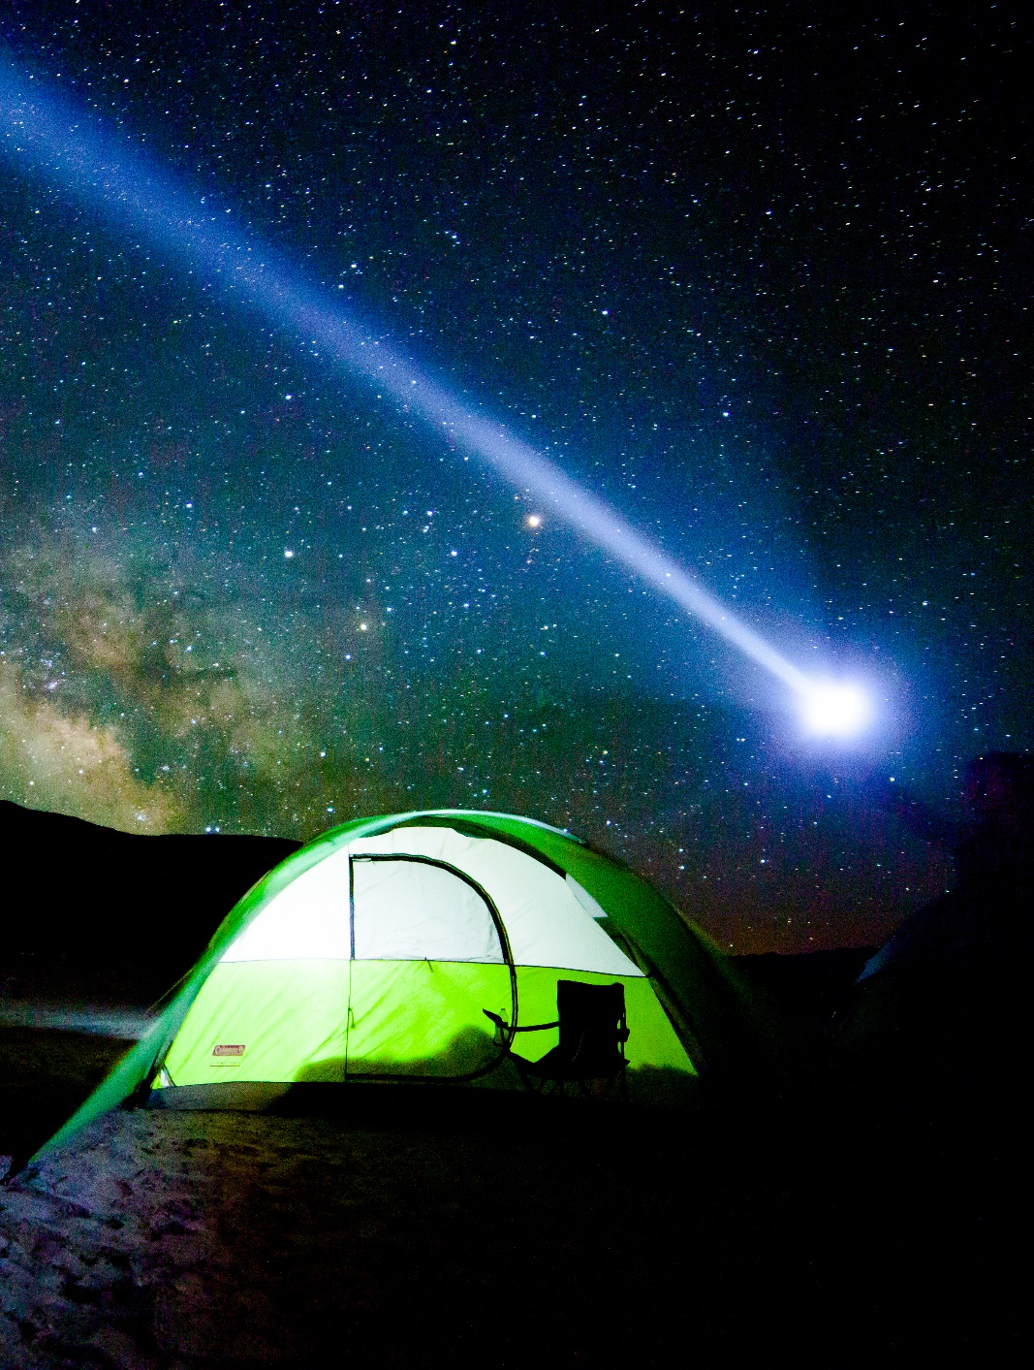



Nevada Division of Outdoor Recreation Nevada Starry Skies Certification
________
Presented by:
Chelsea Kincheloe
Program Lead- Nevada Starry Skies
Logo Owned by NDCNR.
ndor.nv.gov

Slide 2
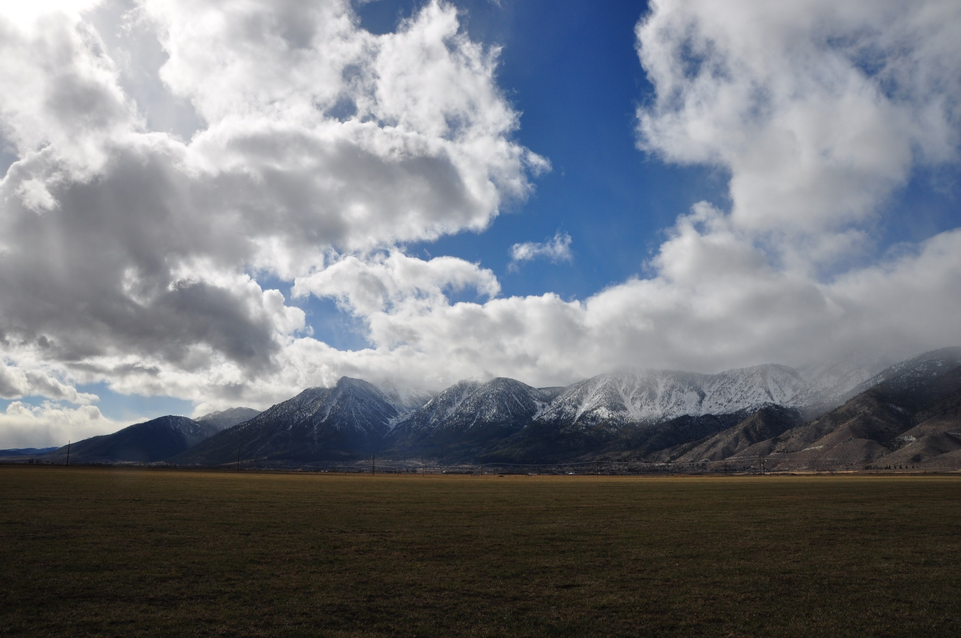


Division Overview
- - - - - - - - - - - - - - - - - - - - - - - - - - - - - - - - - - - - - - - - - - - - - - -
Mission: To advance and promote sustainable, world-class outdoor recreation opportunities throughout Nevada
Goals:
Support Nevada's outdoor recreation economy​
Establish Nevada as a home for world-class outdoor recreation​​
Affirm outdoor recreation's role in improving public health and community wellness​
Increase community capacity for outdoor recreation and stewardship​
NDOR is run as an effective and efficient agency
Notes:
Created by the legislature in 2019, staff of one for awhile, growing since 2022.
I’ll give an overview focused on our activities related to tourism

Slide 3
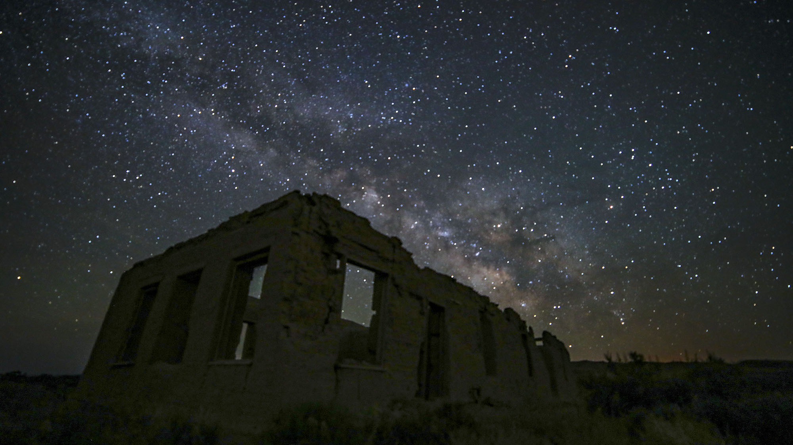

Nevada Starry Skies Destination Program
Photo courtesy of Travel Nevada
- - - - - - - - - - - - - - - - - - - - - - - - - - - - - - - - - - - - - - - - - - - - -
To become a Nevada Starry Skies Destination:
Implement a management plan and/or policy that protects dark skies
AND provide education about the importance of dark skies
Rolling application process.
3
Entire slide created by NDCNR, Photo owned by NDCNR
Notes:
IDA certification takes years, lots of money, hiring a consultant, etc. So, we changed the NAC to increase accessibility and help communities take first steps
We have a toolkit available and technical assistance available
Interested in working with schools, open spaces, parks, towns, cities, counties, HOAs, to implement simple changes to lighting infrastructure and provide education to improve dark skies around them and health and safety and wellbeing of the community

Slide 4
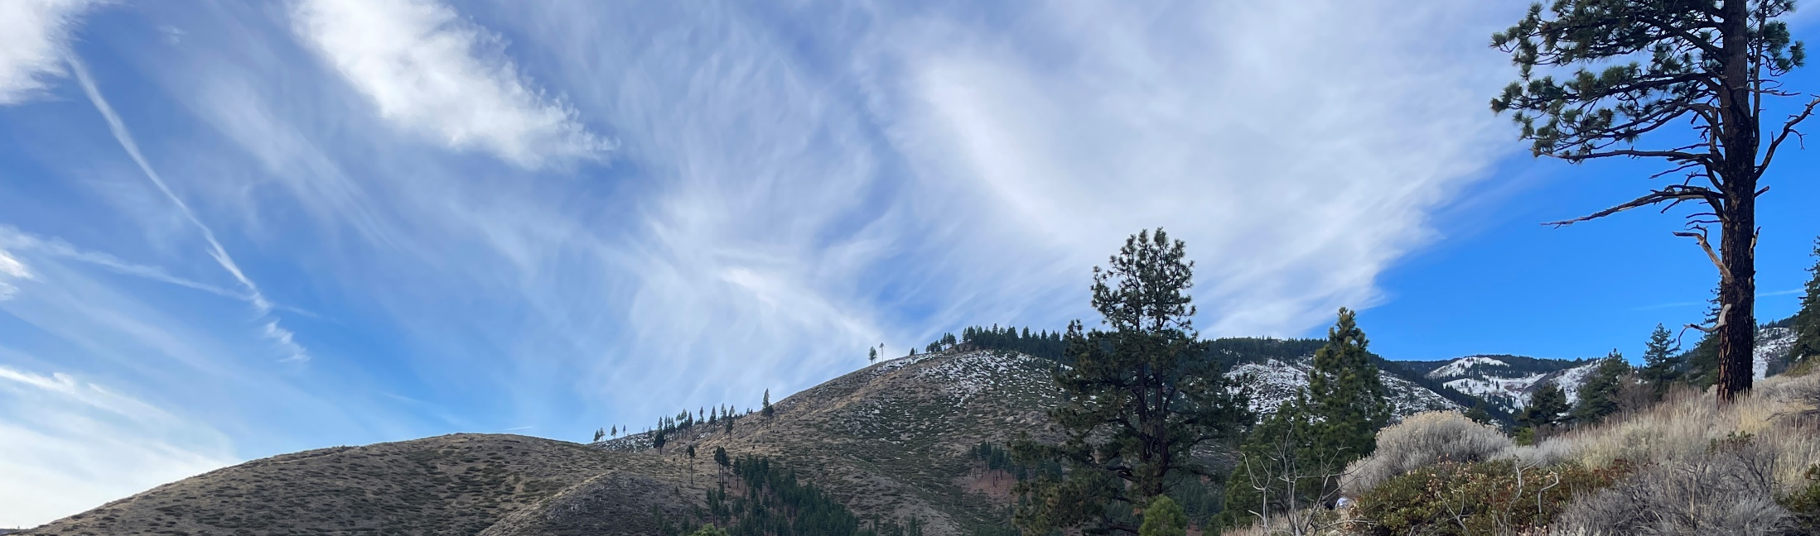
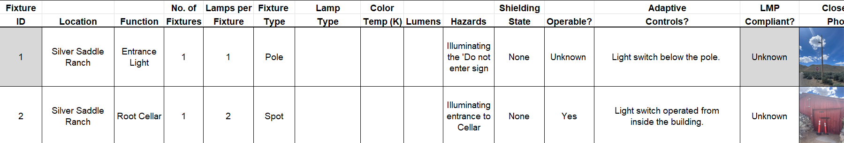
Next Steps
- - - - - - - - - - - - - - - - - - - - - - - - - - - - - - - - - - - - - - - - - - - - -
Complete a lighting inventory in Gerlach of public buildings and businesses.
Identify unnecessary lights and adhere to the Five Principals of Outdoor Lighting.
4
Entire slide created by NDCNR, Photo owned by NDCNR

Slide 5
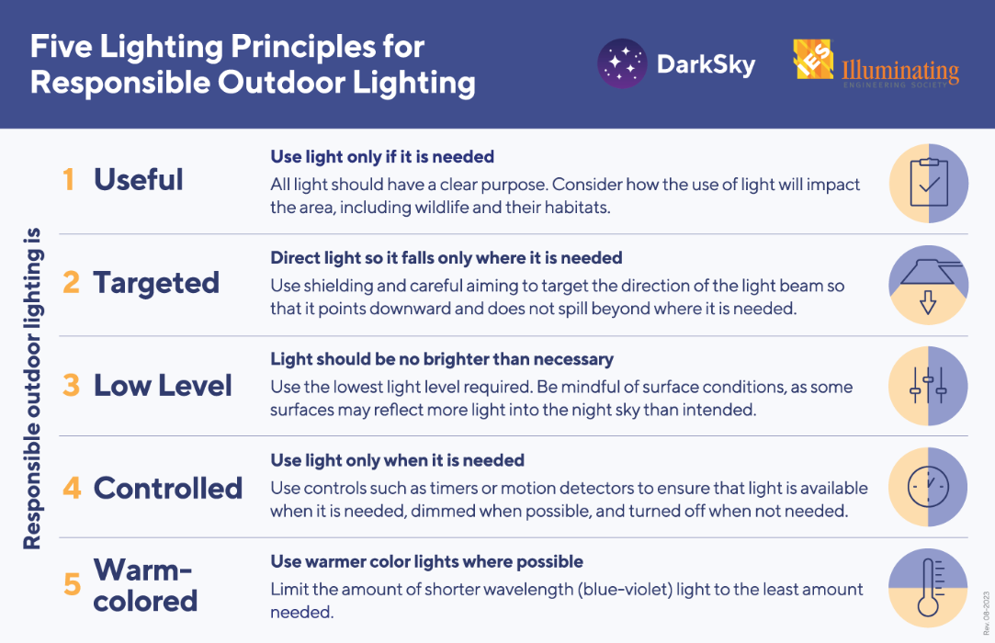
Five lighting principles for responsible outdoor lighting: Useful, Targeted, Low Level, Controlled.

Slide 6
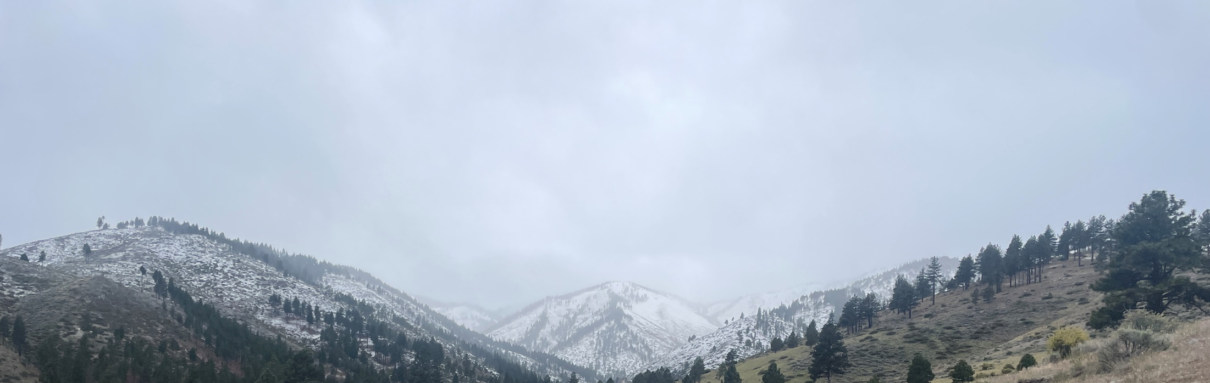
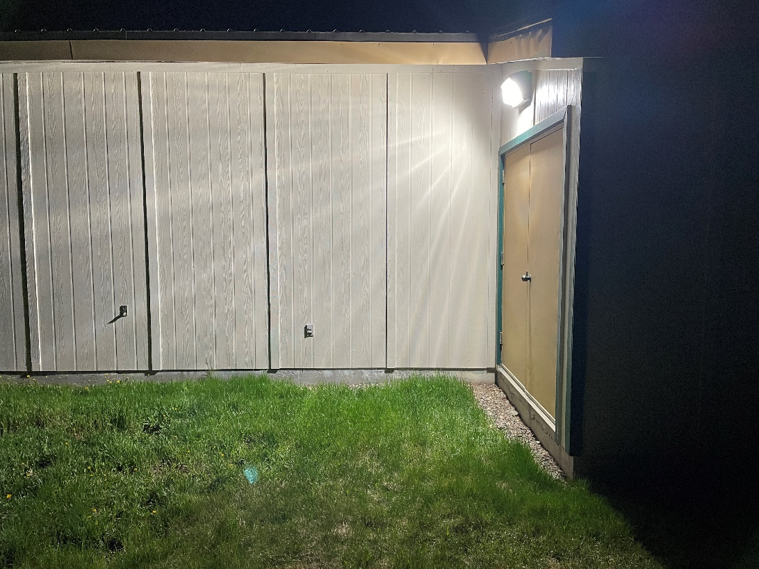
Final Steps
The community of Gerlach would need to collectively agree on a dark skies lighting policy to implement for public buildings.
Create a timeline to implement changes.

Slide 7
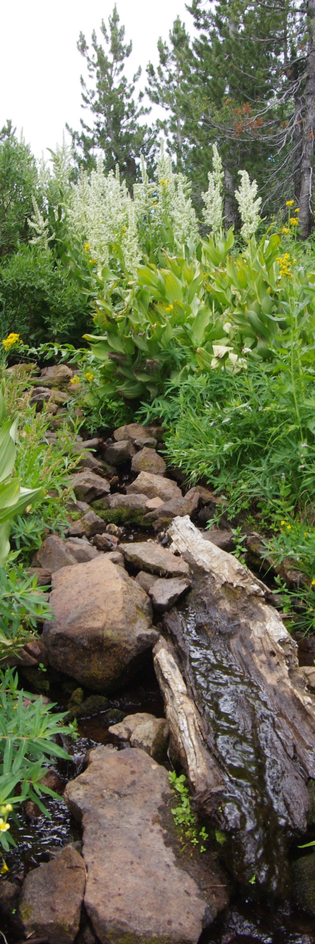
Questions?
Contact
Chelsea Kincheloe
Trails, Dark Skies & Communication
Nevada Division of Outdoor Recreation
Phone: 775-684-2701
Email: c.kincheloe@ndor.nv.gov
Photo owned by NDCNR, permission granted to NDOR

